Slide 1

COMPUTATIONAL INTELLIGENCE FOR OPTIMIZATION
Girl with a Pearl Earring
Image reconstruction with 100 semi-transparent triangles
a staged Genetic Algorithm study
1000-D
RMSE 72 → 20.3
30 seeds
integer search
best reconstruction
every claim validated
CIFO 2025
VERMEER, c. 1665

Slide 2
THE CHALLENGE
The problem, and how we attacked it
THE PIPELINE
Approximate Vermeer's portrait with 100 colored triangles, minimising pixel-wise RMSE.
1
Representation & fitness
5
Structural operators
Each triangle is drawn in fixed z-order with alpha blending. Any gene change affects every layer above. The search space has no independent sub-problems and resists greedy methods.
2
Baseline + diversity diagnostic
6
GA vs SA (Challenge 2)
3
OAT 9 parameter sweeps
7
Multi-seed validation
→ A population-based GA, tuned and validated empirically.
4
Optuna joint tuning
8
Run to convergence
GA; Girl with a Pearl Earring
2

Slide 3
FOUNDATIONS
Representation & fitness
100 triangles × 10 genes = 1000-D integer genome
6
vertex coords x,y ∈ [0,300]×[0,400]
3
RGB color each [0,255]
1
alpha [20,180] at init
Fitness = pixel-wise RMSE (lower is better). Random start ≈ 72.
The thread for everything that follows:
alpha-blending makes the landscape epistatic, a triangle's contribution depends on every layer above it, so the schema theorem only partially holds.
Target; 400×300 RGB; Porter-Duff Over compositing; z-order baked in (triangle 0 bottom → 99 top)
GA; Girl with a Pearl Earring
3

Slide 4
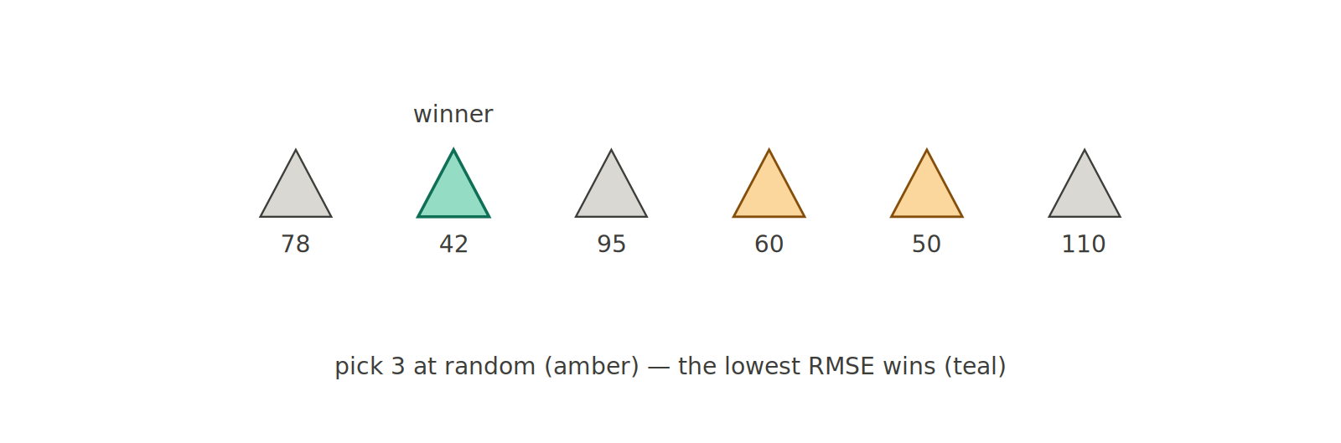
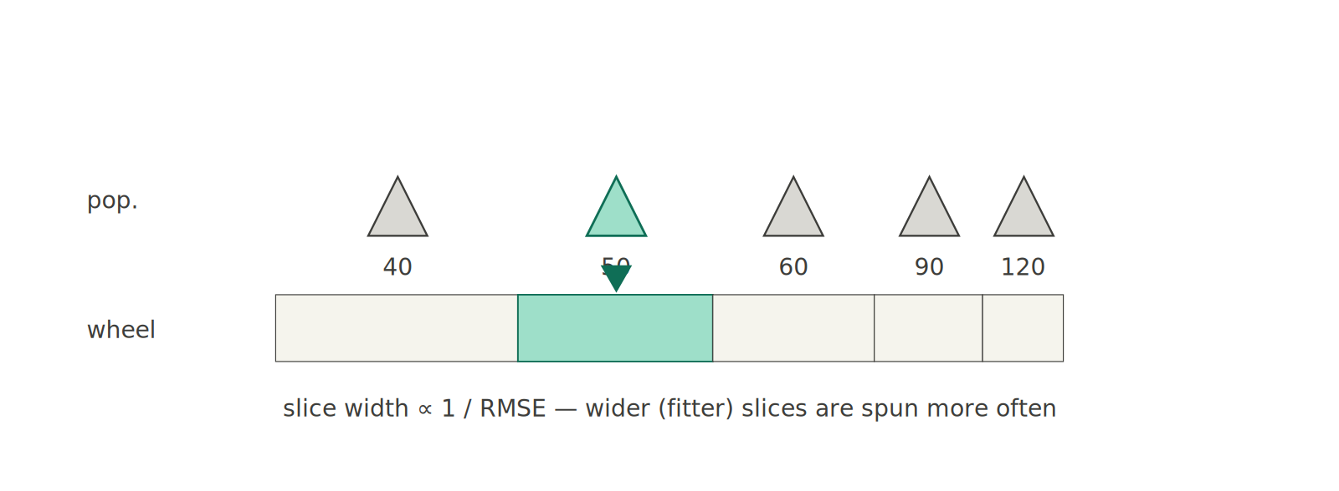
OPERATORS; 1 / 5
Selection
Tournament selection, used throughout:
Tournament (used)
Pick k individuals at random (the lowest RMSE wins).
k is the selection-pressure knob (larger k favours the current best).
OAT later prefers k = 6 (the dynamic schedule anneals it 2 → 5).
Fitness-proportionate roulette (alternative)
GA; Girl with a Pearl Earring
4

Slide 5
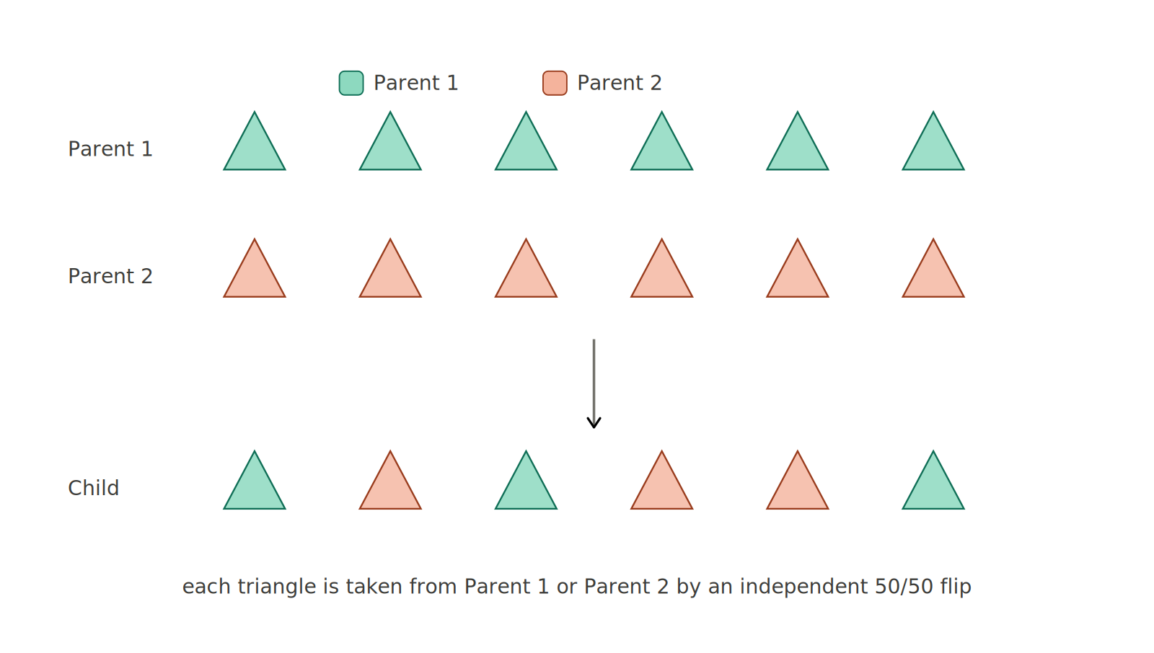
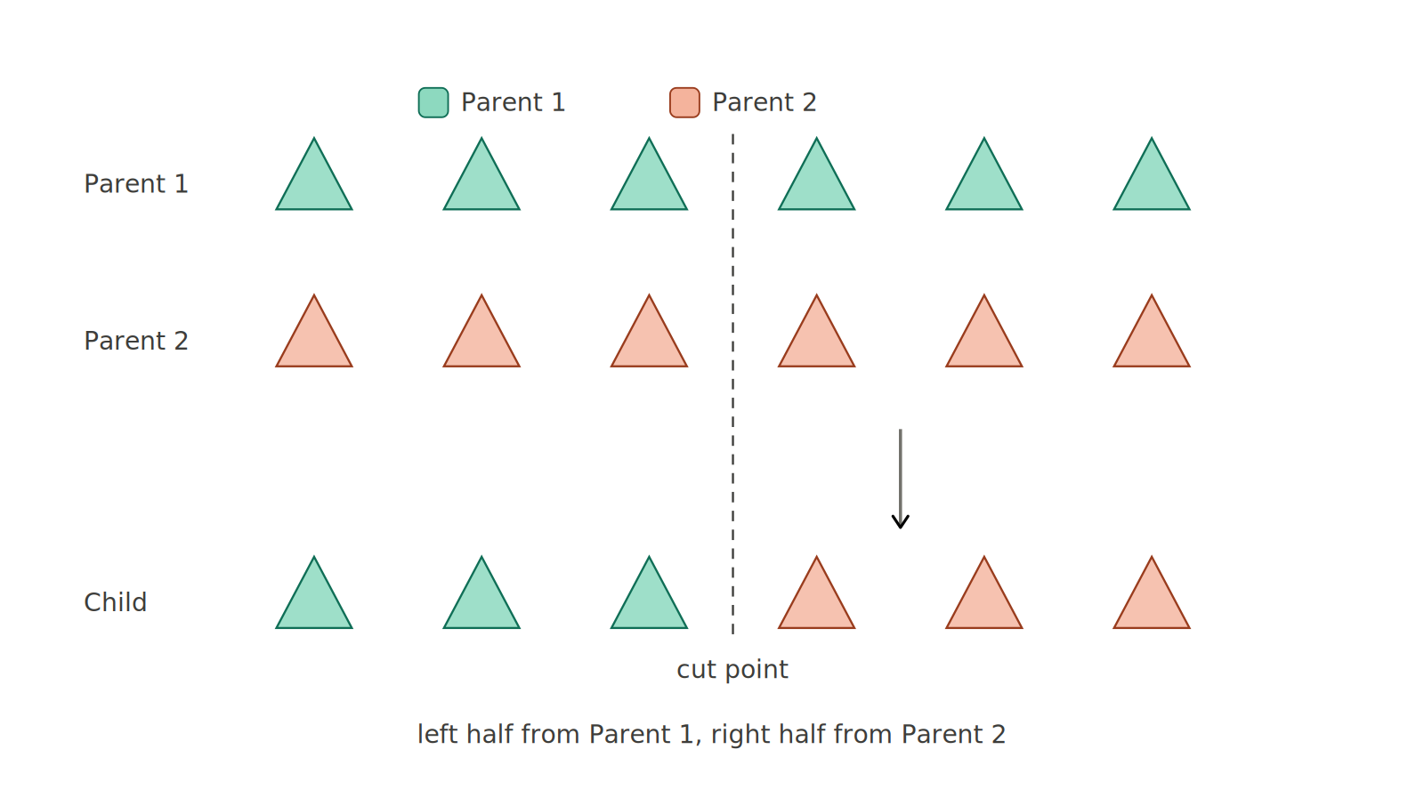
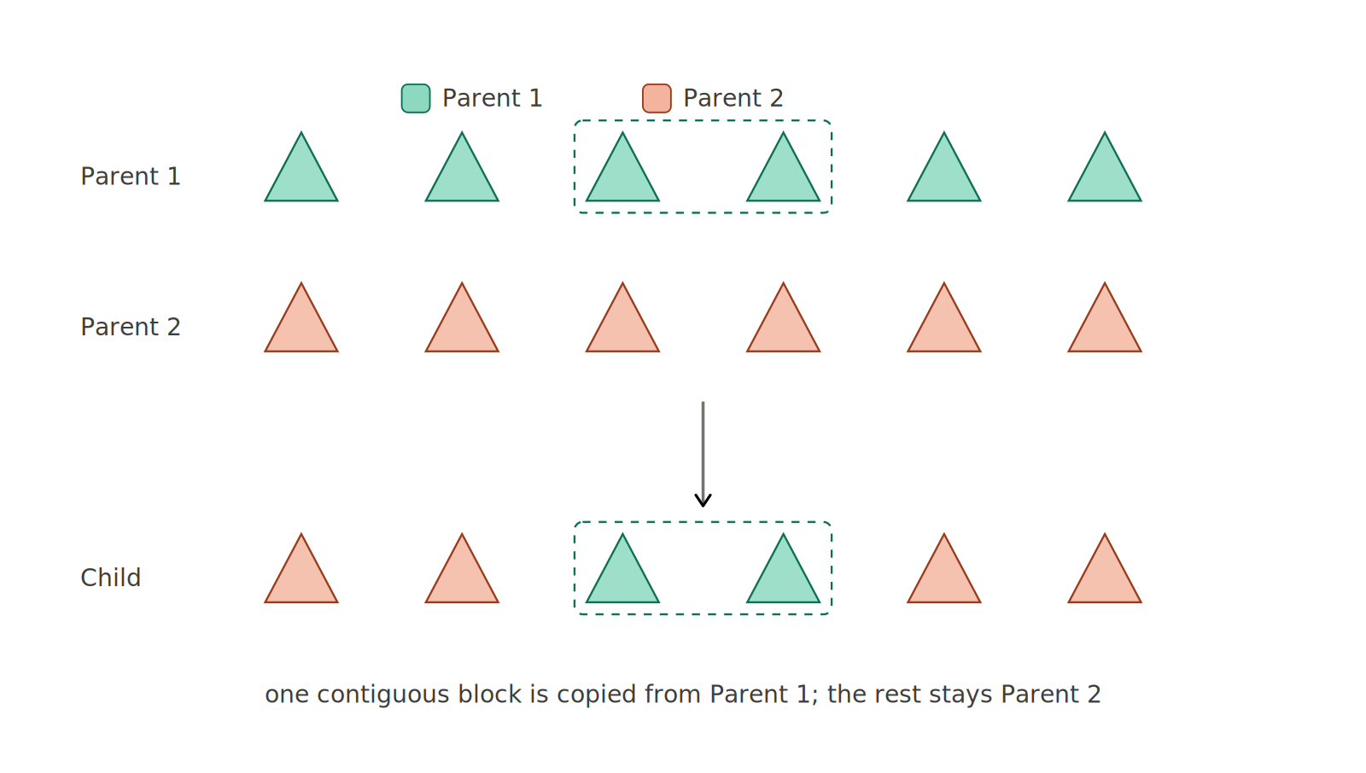
OPERATORS; 2 / 5
Crossover - always at triangle level
all cut on 10-gene boundaries, so a triangle's shape + colour + alpha are never split
Uniform
Single-point
Block
each slot from either parent (50/50)
left half P1, right half P2
one contiguous block from P1
Why it matters: uniform crossover beat single-point by 3.35 RMSE (p < 0.05) in OAT; maximal mixing helps most on this short, collapse-prone budget.
GA; Girl with a Pearl Earring
5

Slide 6
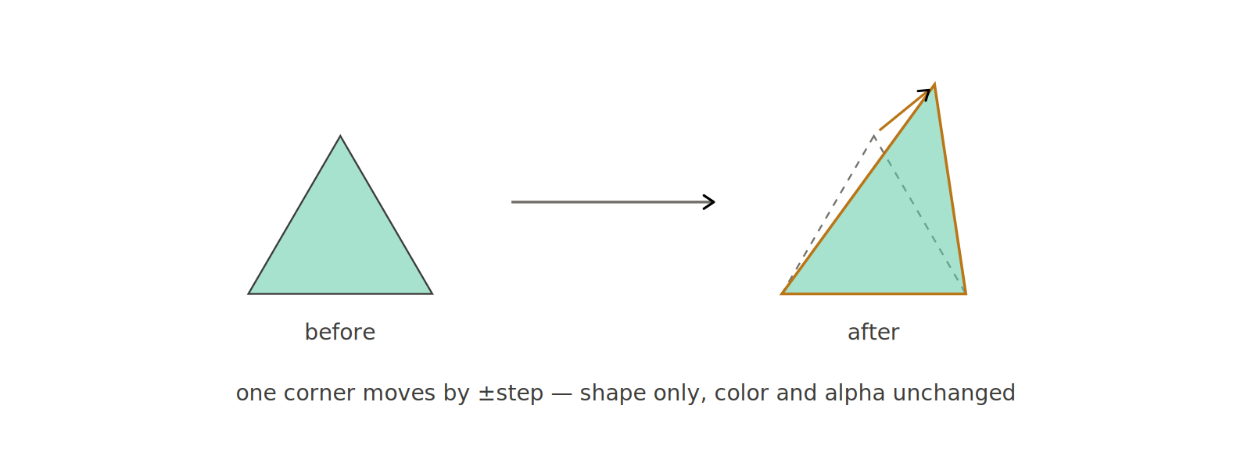
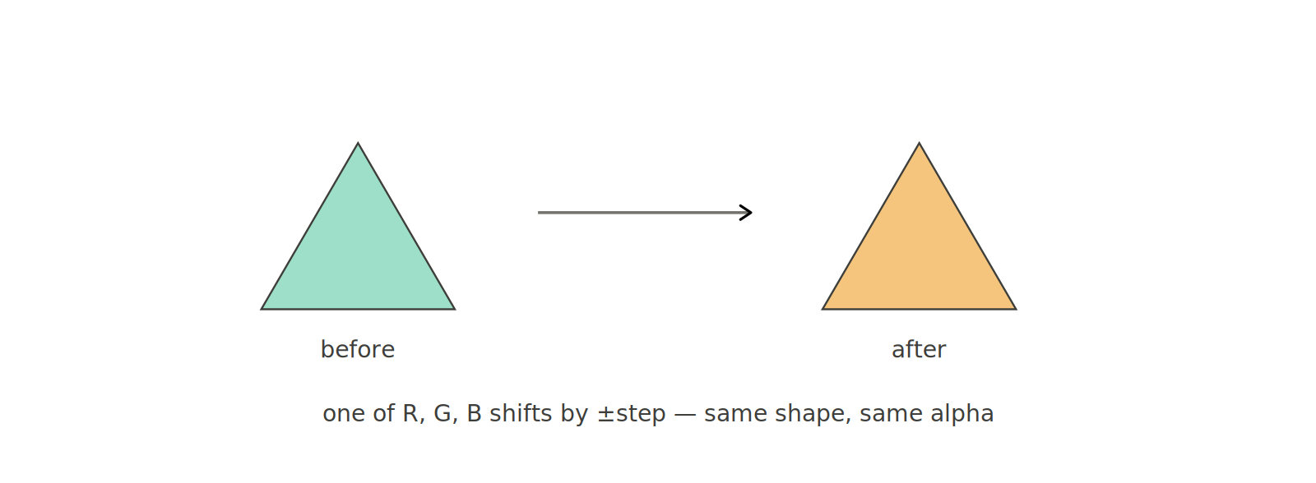
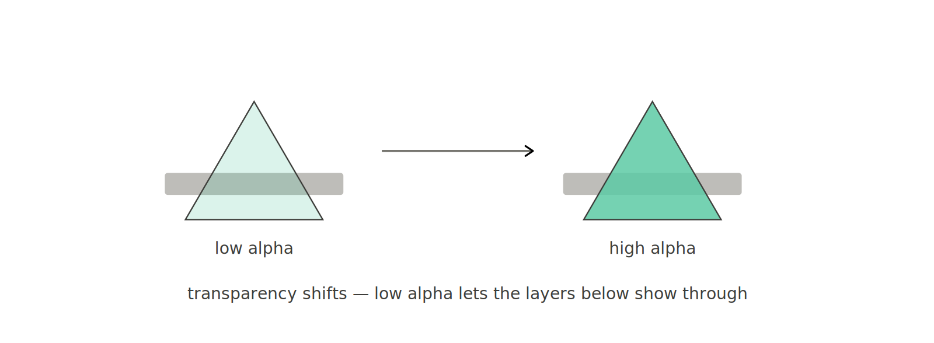
OPERATORS; 3 / 5
Fine mutations
nudge a single gene a little (for local refinement)
Vertex shift
Colour shift
Alpha shift
one corner moves ± step
one of R/G/B shifts ± step
transparency changes ± step
Mutation rate matters far more than which fine operator is used (see OAT, Experiments C & E).
GA; Girl with a Pearl Earring
6

Slide 7
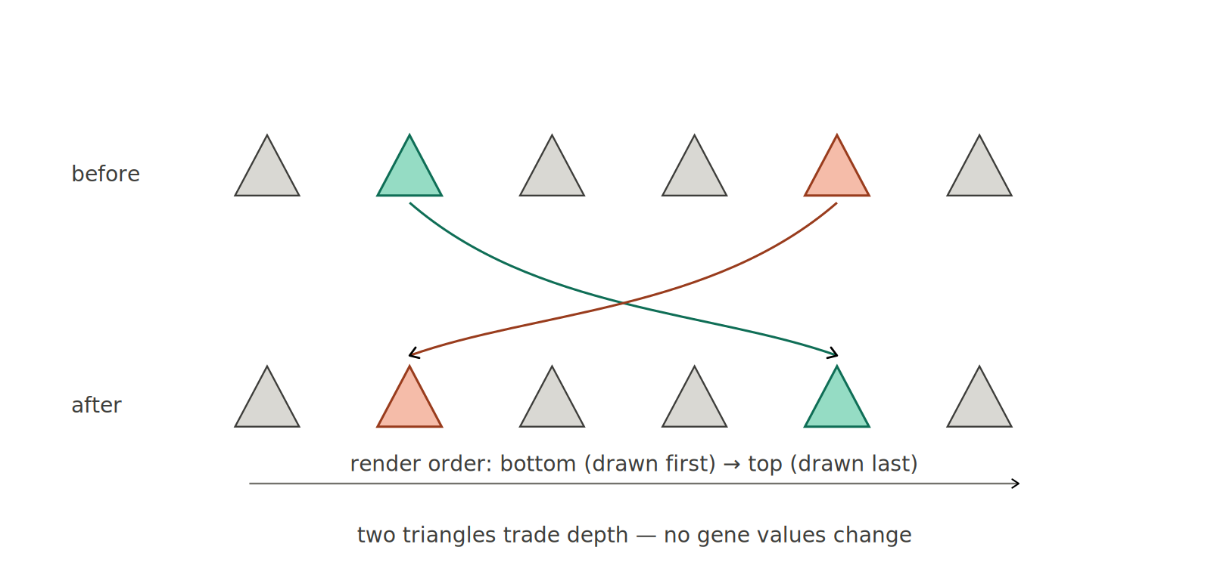
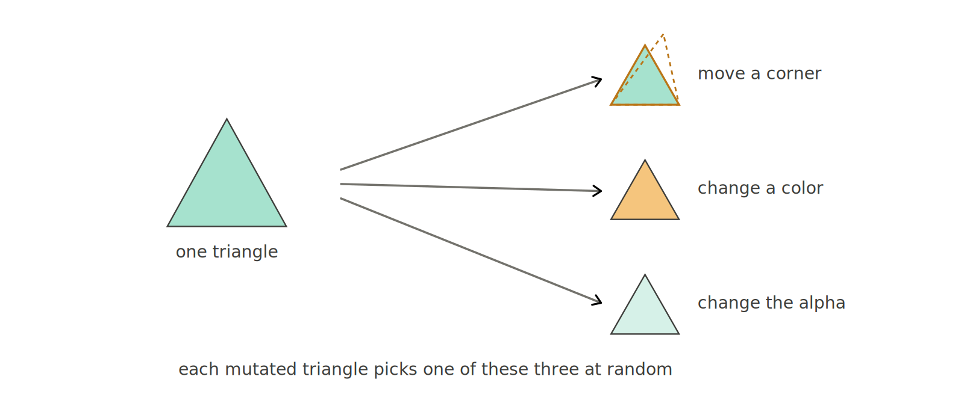
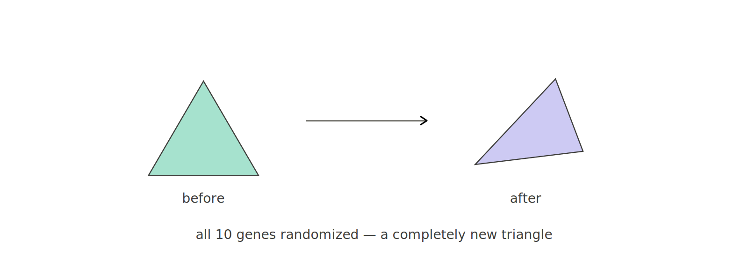
OPERATORS; 4 / 5
Disruptive & meta mutations
larger, structural moves (explored more in the Section 8 ablation)
Triangle replace
Z-order swap
Random (meta)
all 10 genes randomised; a whole new triangle
two triangles trade depth; no gene values change
each triangle picks one fine shift at random
Z-order swap is the operator analogue of the inversion operator (it reorders without touching genes).
GA; Girl with a Pearl Earring
7

Slide 8
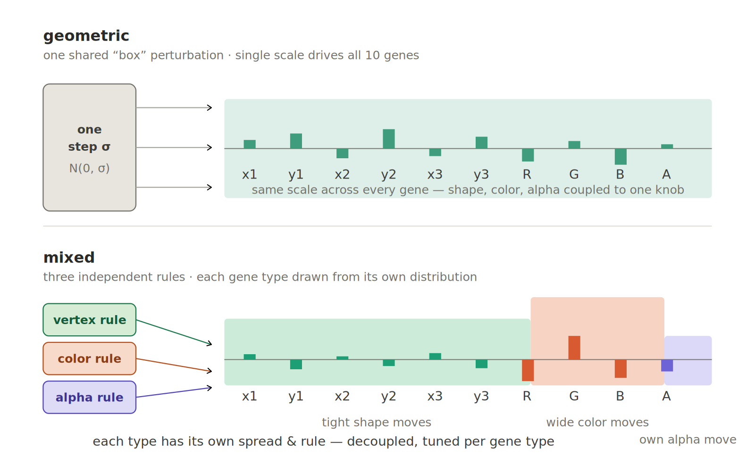
OPERATORS; 5 / 5
Geometric vs mixed mutation
Geometric one shared “box” σ perturbs all 10 genes together. Shape, colour and alpha coupled to one knob.
Mixed three independent per-gene-type rules, each with its own spread.
We test geometric in Section 8; but box mutation assumes a unimodal landscape, which alpha-blend epistasis violates.
GA; Girl with a Pearl Earring
8

Slide 9
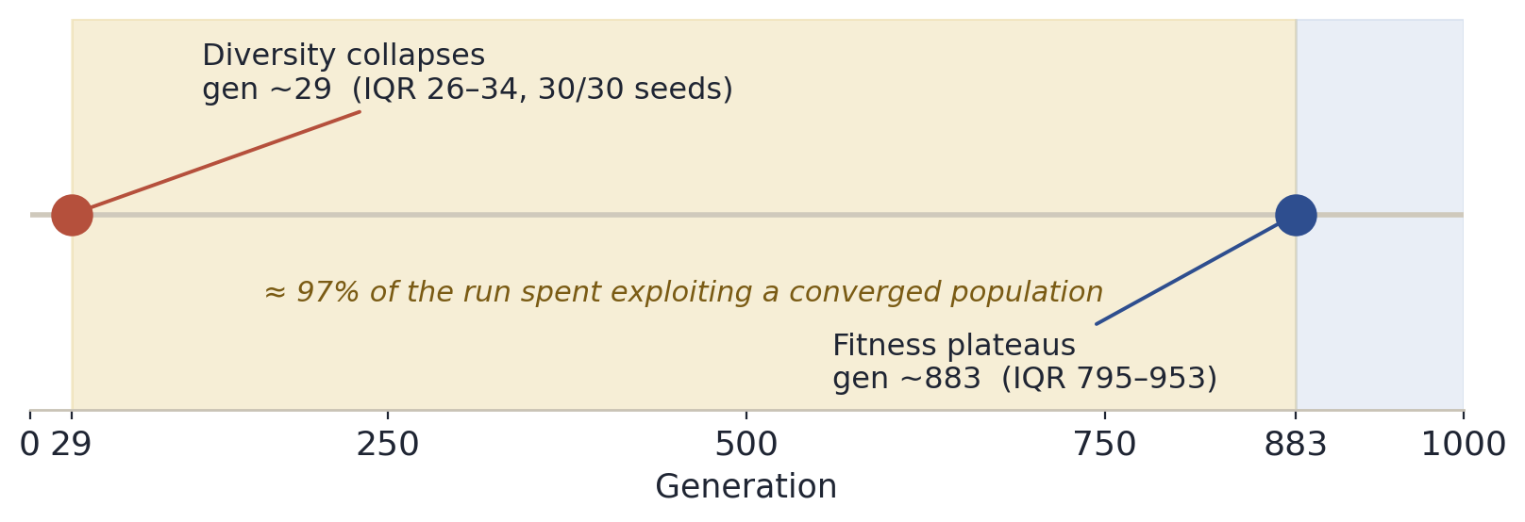
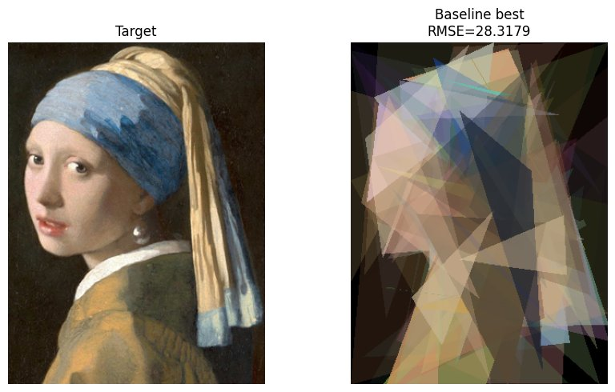
METHODOLOGY; BASELINE
Baseline & the diversity problem
28.40 ± 0.72
baseline RMSE; 30 seeds × 1000 gens
gen ~29
diversity collapses; in every single seed
≈ 97%
of the run spent exploiting a converged population
GA; Girl with a Pearl Earring
This collapse-then-exploit pattern drives every later design choice.
9

Slide 10
METHODOLOGY; STATISTICS
How every comparison is judged
WHAT WE MEASURE
HOW WE TEST
Average best fitness
Paired Wilcoxon
mean final RMSE across seeds
matched seeds (same init for both)
Median best fitness
Mann-Whitney U
robust central tendency
independent samples
Success rate
Holm correction
% runs below a fixed threshold
controls multiple-comparison error
Pre-registered & non-parametric. 30 fixed seeds per configuration. The success threshold;25.56 (90% of baseline) and every promotion rule were fixed before seeing results. Values not significantly worse than the best form an equivalence group and are kept.
GA; Girl with a Pearl Earring
10

Slide 11
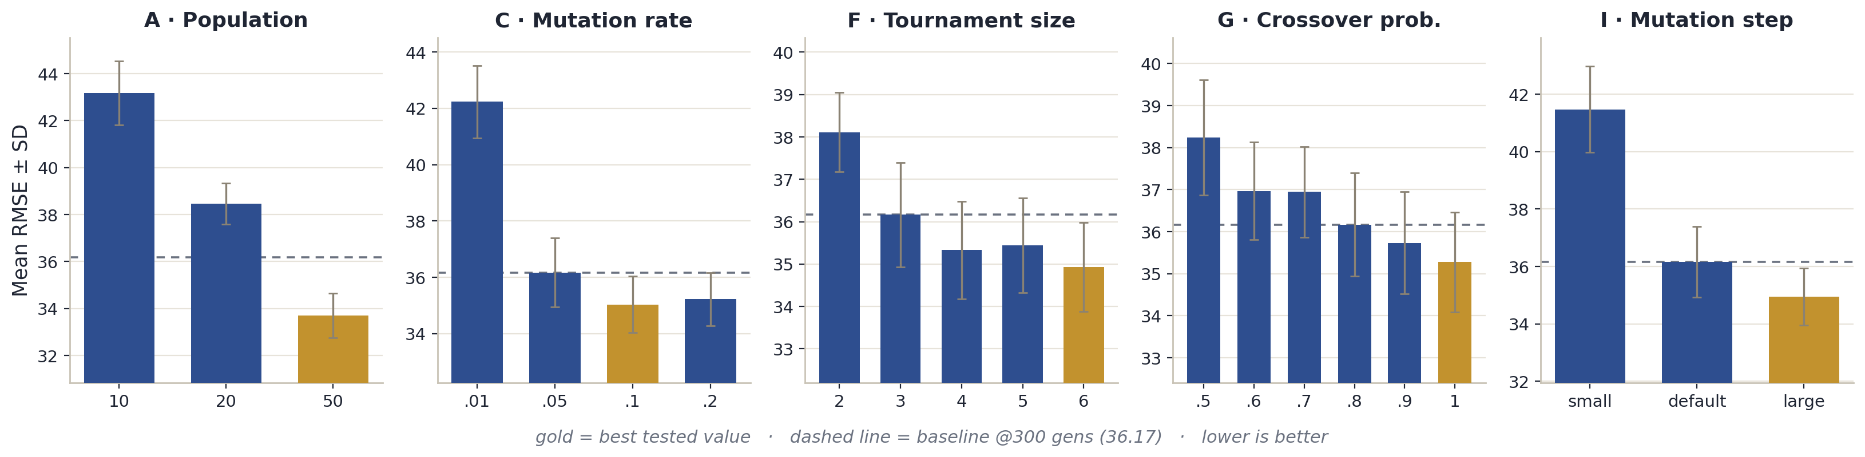
SECTION 6; OAT (1 / 3)
What moved the needle
vary one parameter; 30 seeds × 300 gens; compared against baseline at 300
Why these help: After the gen-29 collapse the GA lives in exploitation; so stronger selection (tournament ↑), always-recombine (xo-prob → 1), larger steps and a higher mutation rate inject the variation that still pays off. All five significantly beat baseline. Population and budget are confounded but point the same way.
Winners → pop 50; tournament 6; xo-prob 1.0; steps 50/80/50; mut-rate 0.1
GA; Girl with a Pearl Earring
11

Slide 12
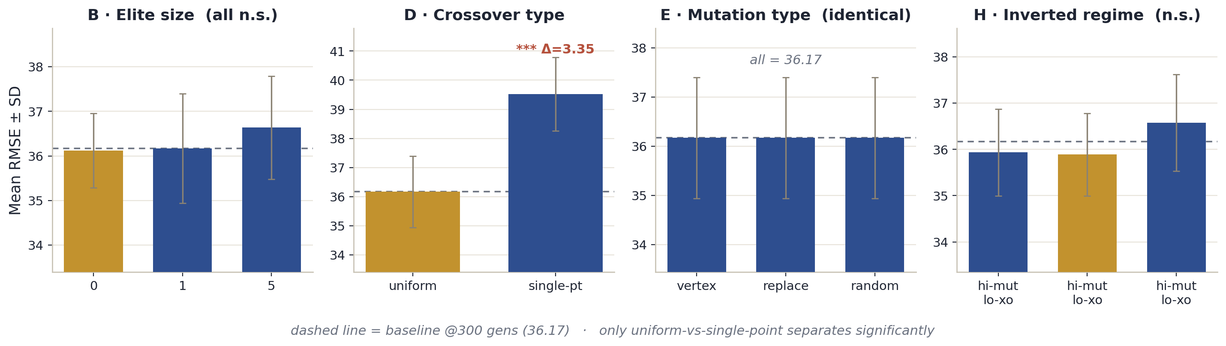
SECTION 6; OAT (2 / 3)
What didn't separate and why
Elite size, mutation type, and the inverted regime are statistically indistinguishable once the population collapses, these barely matter. The lesson is the rate/type split: mutation rate matters a lot, mutation type not at all (all three identical). Only uniform-vs-single-point crossover separates.
GA; Girl with a Pearl Earring
12

Slide 13
SECTION 6; OAT (3 / 3)
From 9 sweeps to one search box
OPTUNA SEARCH SPACE; 10 PARAMETERS
3 PATTERNS CARRIED FORWARD
population_size
[50, 65]
1
Upper-edge optima
tournament_size
[4, 8]
population, tournament, xo-prob and steps peaked at the tested edge → ranges extended outward.
mut_prob
[0.10, 0.20]
xo_prob
[0.90, 1.30]
elite_size
[1, 5]
2
Rate ≫ type
crossover_type
{uniform, single-pt}
mutation rate is decisive; mutation type is a near-random categorical.
mutation_type
{vertex, replace, random}
vertex_step
[50, 65]
3
Inverted regime inconclusive
color_step
[80, 104]
high-mut / low-xo neither helps nor hurts; no evidence-based target.
alpha_step
[50, 65]
GA; Girl with a Pearl Earring
13

Slide 14
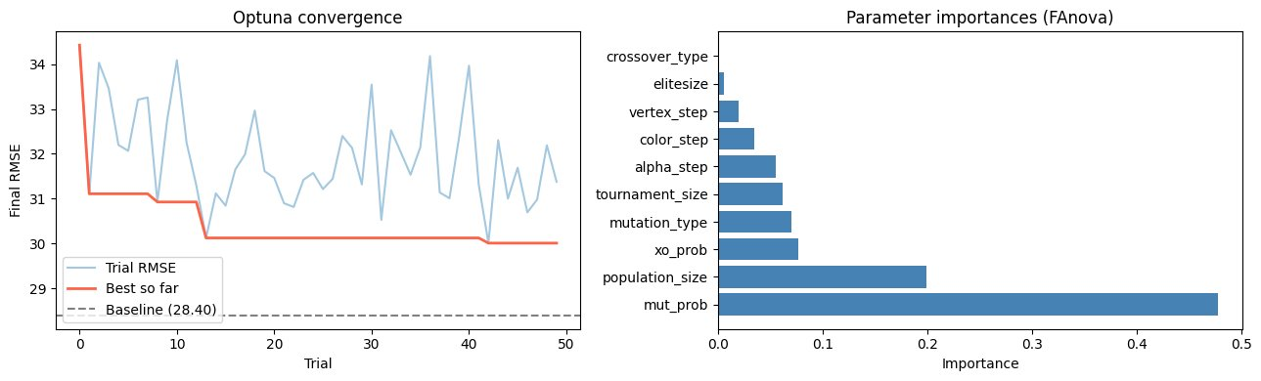
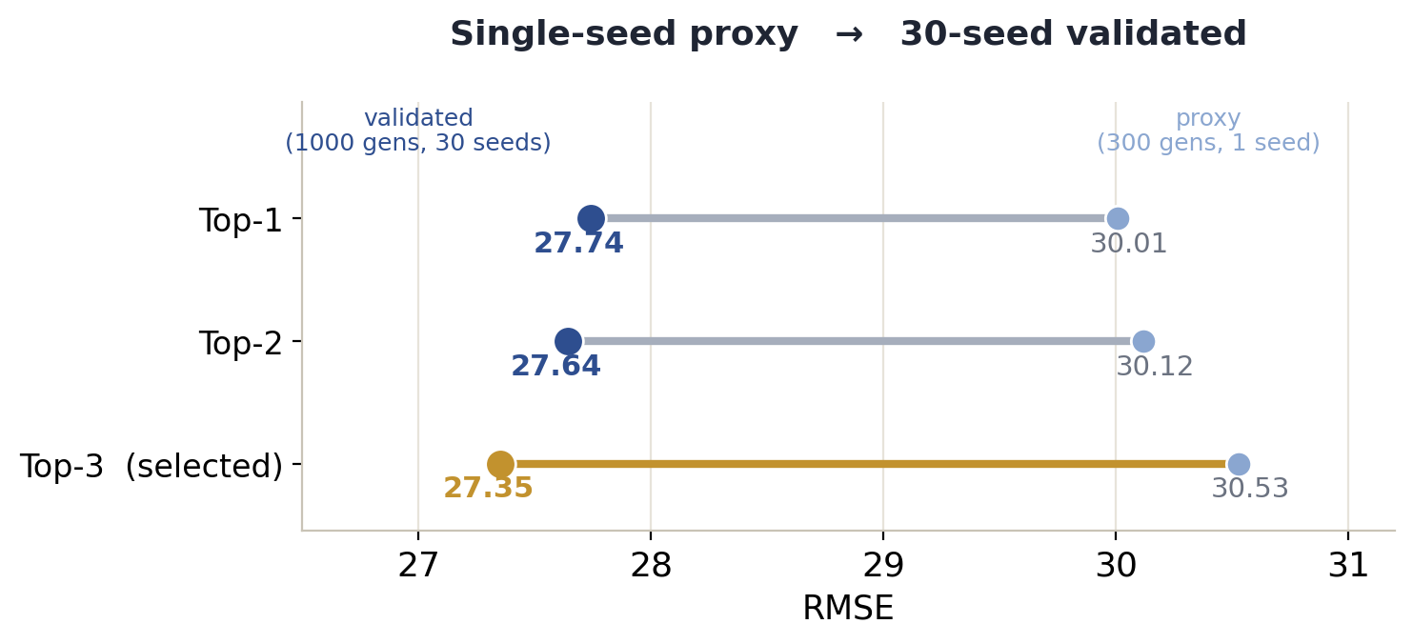
SECTION 7
Optuna: joint Bayesian tuning
50 trials × 300 gens (1 seed); top-3 revalidated at 30 seeds × 1000 gens
27.35 ± 0.57 gain 1.05 RMSE (3.7%) over baseline and a tighter SD.
The 30-seed winner had the worst single-seed proxy
why single-seed selection is unsafe. Boundary hits (tournament 7 > 6, xo-prob clamped at 1.0); diversity still collapses → Section 8.
GA; Girl with a Pearl Earring
14

Slide 15
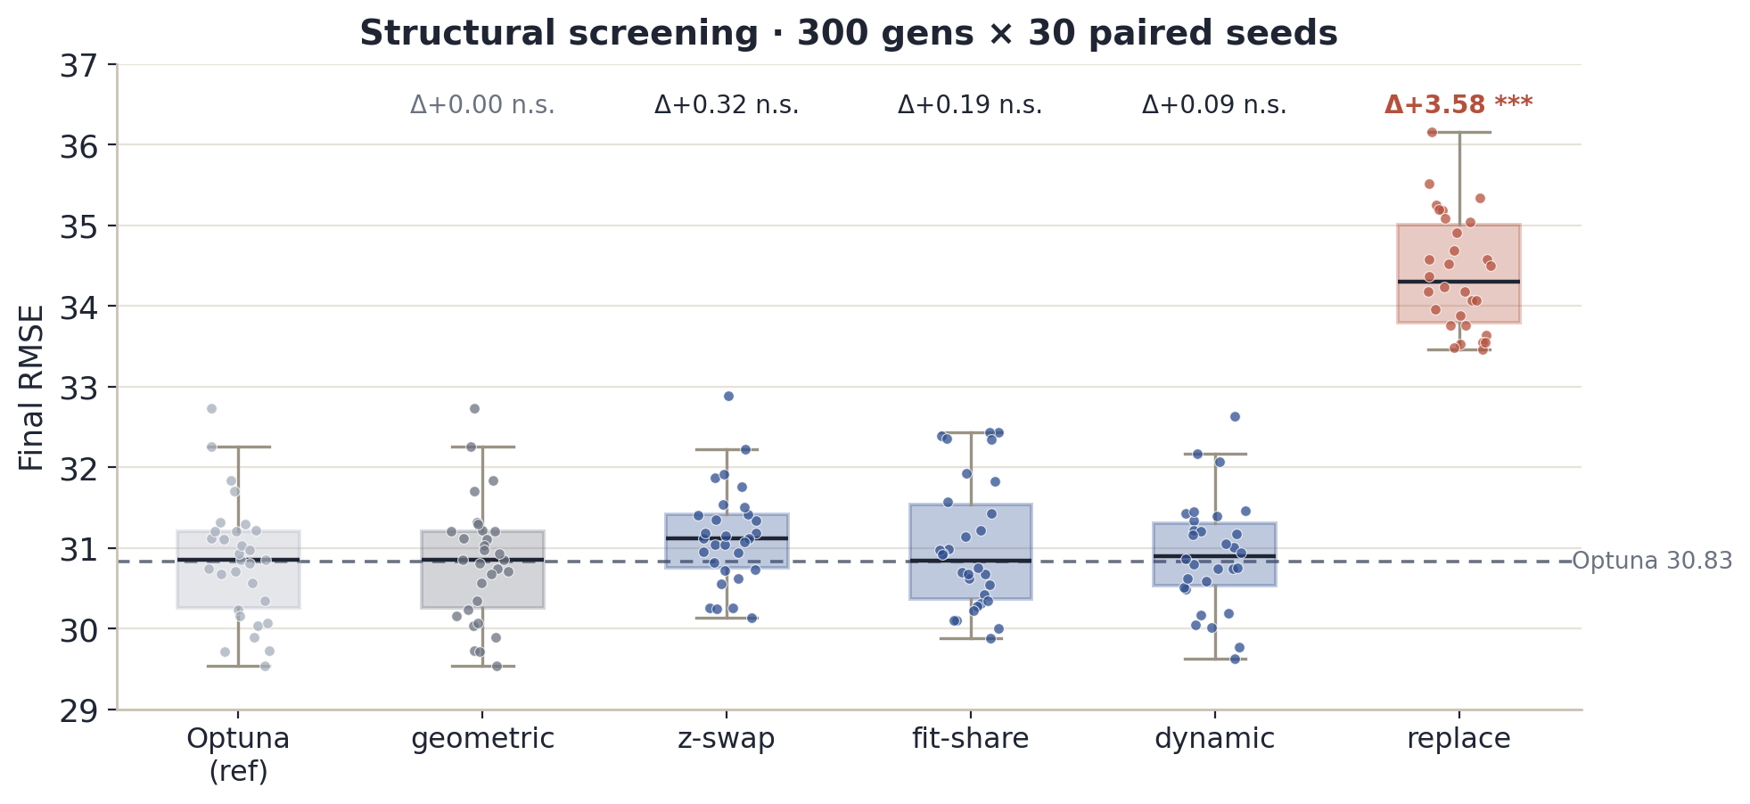
SECTION 8; STRUCTURAL (1 / 3)
Five structural ideas, screened at 300 gens
geometric
Tie. Override no-op. Theory predicts no gain on an epistatic landscape
replace
✗ +3.58. Order-10 mutation destroys schemata. Diversity pinned > 1100
z-swap
Tie. Inversion analogue: reorders layers, no gene change
fit-sharing
Tie. Penalty fires uniformly on a collapsed population
dynamic
Tie. Exploration phase eats the short 300-gen budget
Nothing beats Optuna at 300 gens, but a tie is not a failure.
GA; Girl with a Pearl Earring
15

Slide 16
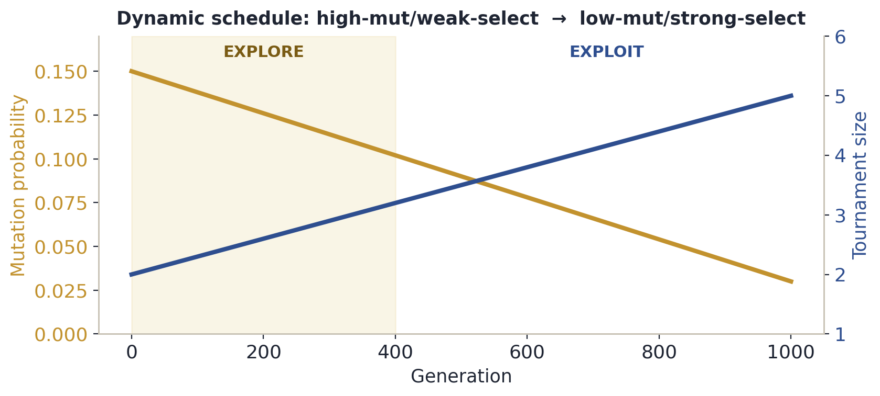
SECTION 8; STRUCTURAL (2 / 3)
Two promoted; and why that's defensible
Why it's a good pick
Both are diversity-preservers. The explore→exploit argument predicts they look like ties at a short budget and only separate at a long one, so a 1000-gen re-test is exactly the right discriminator.
The mechanics (briefly)
Fitness sharing: rescales f → f / Σ over normalised pairwise distances within σ_share (niching).
Dynamic schedule: anneals mutation 0.15 → 0.03 and tournament 2 → 5 over the run.
Pre-registered promotion rule: significant negative Δ, or a 95% CI lower-bound below 0. Three qualify (swap, fit-sharing, dynamic); the top two by mean: dynamic and fitness sharing go to full budget.
GA; Girl with a Pearl Earring
16

Slide 17
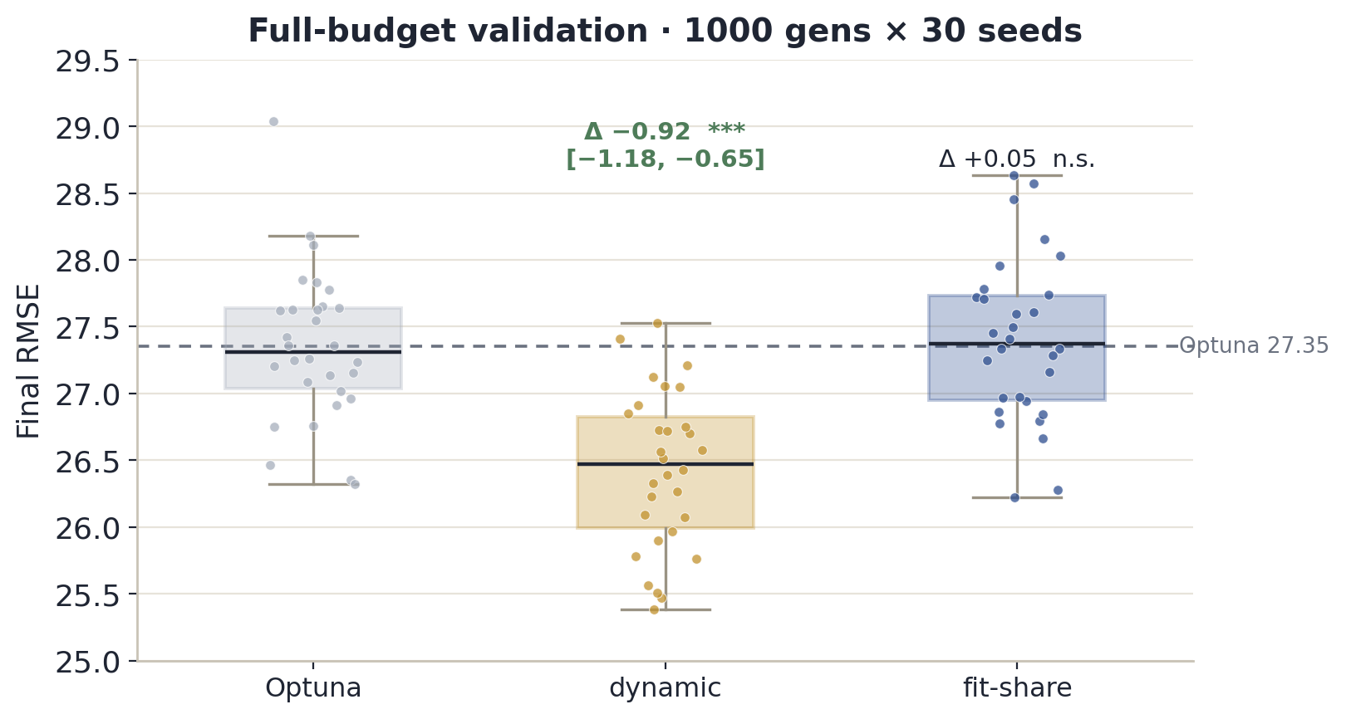
SECTION 8; STRUCTURAL (3 / 3)
Full-budget verdict → FINAL BEST
At 1000 gens the picture flips. Dynamic wins −0.92 [−1.18, −0.65], p < 0.0001 → 26.43 ± 0.59. Fitness sharing ties (+0.05, p = 0.72).
The insight: invisible at 300 gens, decisive at 1000. Diversity-preserving methods sacrifice early fitness and only pay off once the budget is long enough to exploit it.
FINAL BEST
Optuna configuration + dynamic schedule
GA; Girl with a Pearl Earring
17

Slide 18
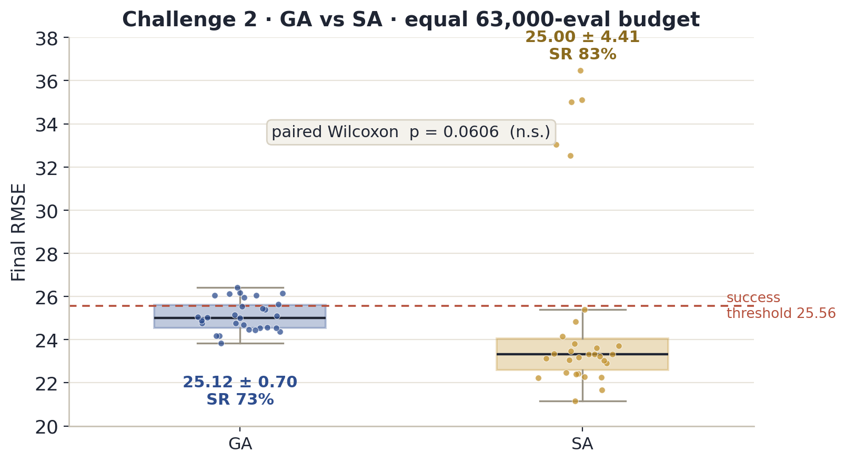
SECTION 9; CHALLENGE 2
GA vs Simulated Annealing
equal 63,000-evaluation budget; 30 seeds
GA 25.12 ± 0.70 (SR 73%)
SA 25.00 ± 4.41 (SR 83%)
paired Wilcoxon p = 0.0606 → no significant mean difference.
The story is variance: SA is bimodal and five seeds stalled at RMSE 32-36 while the rest landed low. GA never has a catastrophic run.
Verdict: SA can win when it works; GA is the reliable choice for a single run.
GA; Girl with a Pearl Earring
18

Slide 19
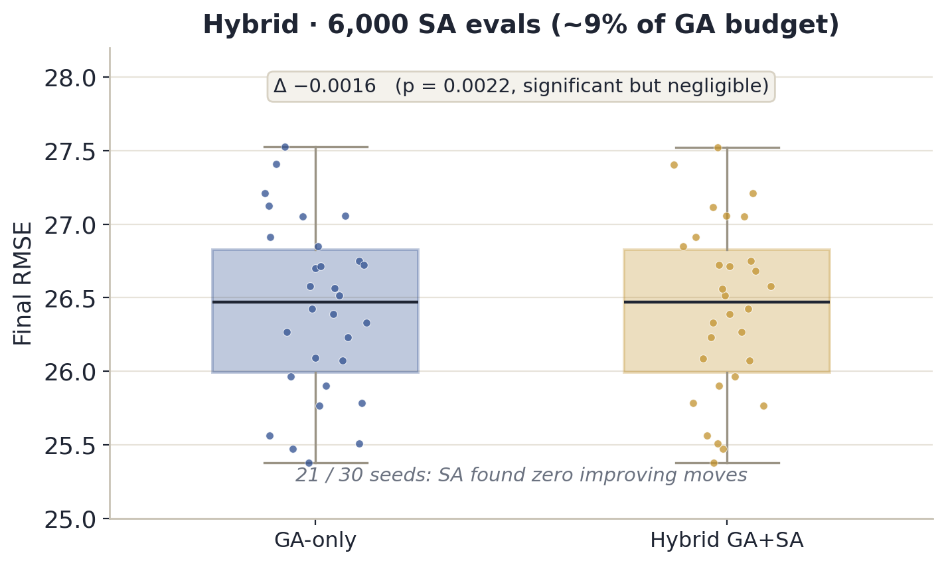
SECTION 10
Hybrid . Can SA polish the GA endpoint?
6,000 SA evals (~9% of the GA budget) on each converged GA solution. 26.4262 vs 26.4278; Δ −0.0016, p = 0.0022: significant but negligible.
21 / 30 seeds: zero improving moves.
The GA endpoint is already a local optimum with respect to single-gene moves (there is nothing left for local search to find).
GA; Girl with a Pearl Earring
19

Slide 20
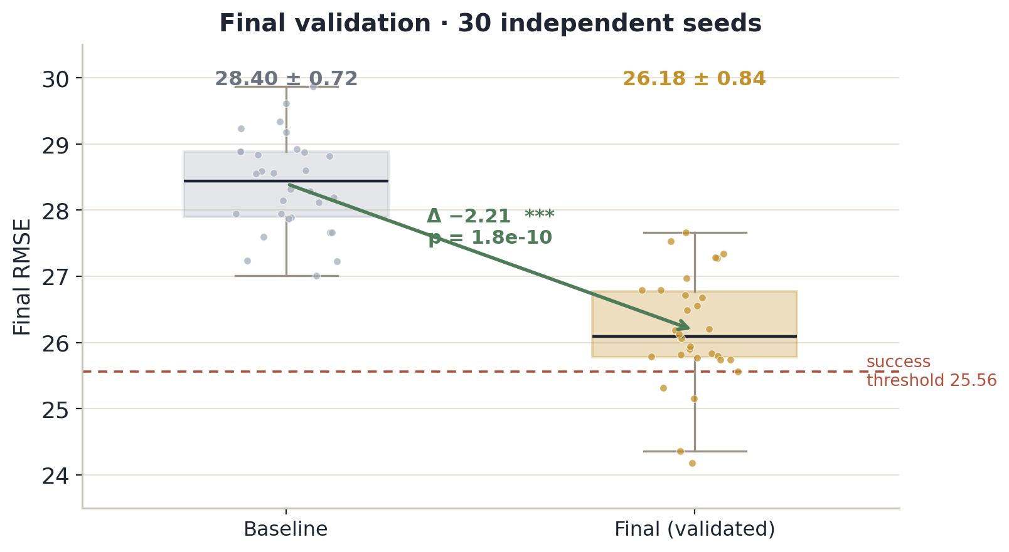
SECTION 11; THE ANSWER WE DEFEND
Final version (30 independent seeds)
26.18 ± 0.84
On 30 fresh seeds (100-129) consistent with the 26.43 from Section 8.6.
Vs baseline: Δ −2.21 [1.83, 2.60], p = 1.8 × 10⁻¹⁰ (≈ 7.8%). Every seed beats the baseline. Best 24.18.
This is the number we defend
GA; Girl with a Pearl Earring
20

Slide 21
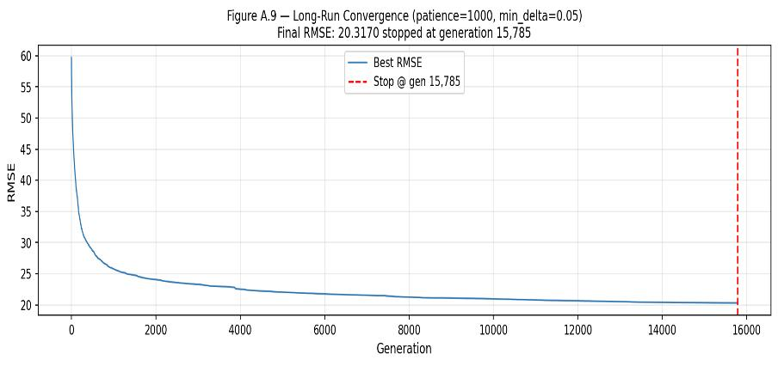

SECTION 12
Run to convergence
Ceiling 20,000 gens with early-stop (patience 1000, Δ < 0.05) fires at gen 15,785 → RMSE 20.32. A single unreplicated observation. The representation has real headroom beyond 1000 gens (the 1000-gen best was 24.47).
RMSE 20.32; gen 15,785
GA; Girl with a Pearl Earring
21

Slide 22
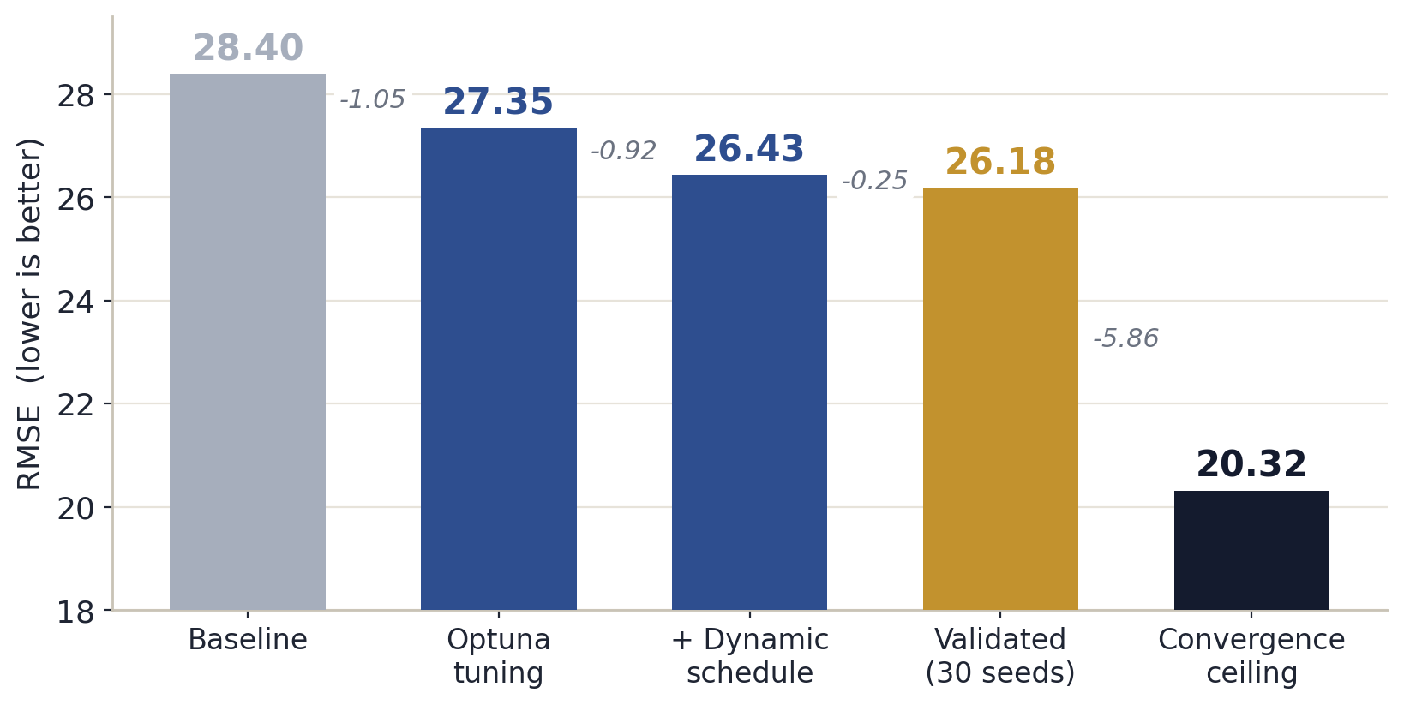
CONCLUSIONS
What we learned
Tuning + schedule did the work
Joint Optuna tuning was the biggest controllable gain, the dynamic schedule was decisive, invisible at 300 gens, worth ~1 RMSE at 1000.
The surprise
Fitness sharing did nothing (uniform penalty on a collapsed population). Triangle-replace won a tie with no independent justification.
GA vs SA
Consistency vs occasional brilliance - no significant mean difference (p = 0.0606). GA is the reliable pick
28.40 → 26.18 validated → 20.32 ceiling
GA; Girl with a Pearl Earring
22

Slide 23
Thank you
Questions?
Limitations: compute-bound (each 30-seed run takes hours); RMSE underweights fine detail like the pearl.

