Slide 1
Arrays and Strings

Slide 2
Arrays
Arrays are used to store multiple values in a single variable, instead of declaring separate variables for each value.
Two types
Single
Multi
dataType[] arr; (or)
dataType []arr; (or)
dataType arr[];
arrayRefVar=new datatype[size];

Slide 3
class Testarray{
public static void main(String args[]){
int a[]=new int[5];//declaration and instantiation
a[0]=10;//initialization
a[1]=20;
a[2]=70;
a[3]=40;
a[4]=50;
//traversing array
for(int i=0;i<a.length;i++)//length of array
System.out.println(a[i]);
}}
10
20
70
40
50

Slide 4
class Testarray1{
public static void main(String args[]){
int arr[]={33,3,4,5};
//printing array using for-each loop
for(int i:arr)
System.out.println(i);
}}
33
3
4
5

Slide 5
The Java Virtual Machine (JVM) throws an ArrayIndexOutOfBoundsException if length of the array in negative, equal to the array size or greater than the array size while traversing the array.
public class TestArrayException{
public static void main(String args[]){
int arr[]={50,60,70,80};
for(int i=0;i<=arr.length;i++){
System.out.println(arr[i]);
}
}}
Exception in thread "main" java.lang.ArrayIndexOutOfBoundsException: 4
At TestArrayException.main(TestArrayException.java:5)
50
60
70
80

Slide 6
Passing Array to a Method in Java
class Testarray2{
static void min(int arr[]){
int min=arr[0];
for(int i=1;i<arr.length;i++)
if(min>arr[i])
min=arr[i];
System.out.println(min);
}
public static void main(String args[]){
int a[]={33,3,4,5};
min(a);//passing array to method
}}

Slide 7
//Java Program to return an array from the method
class TestReturnArray{
//creating method which returns an array
static int[] get(){
return new int[]{10,30,50,90,60};
}
public static void main(String args[]){
//calling method which returns an array
int arr[]=get();
//printing the values of an array
for(int i=0;i<arr.length;i++)
System.out.println(arr[i]);
}}

Slide 8
Multidimensional Array in Java
dataType[][] arrayRefVar; (or)
dataType [][]arrayRefVar; (or)
dataType arrayRefVar[][]; (or)
dataType []arrayRefVar[];
int[][] arr=new int[3][3];//3 row and 3 column

Slide 9
Example to initialize Multidimensional Array in Java
arr[0][0]=1;
arr[0][1]=2;
arr[0][2]=3;
arr[1][0]=4;
arr[1][1]=5;
arr[1][2]=6;
arr[2][0]=7;
arr[2][1]=8;
arr[2][2]=9;

Slide 10
class Testarray3{
public static void main(String args[]){
//declaring and initializing 2D array
int arr[][]={{1,2,3},{2,4,5},{4,4,5}};
//printing 2D array
for(int i=0;i<3;i++){
for(int j=0;j<3;j++){
System.out.print(arr[i][j]+" ");
}
System.out.println();
}
}}

Slide 11
import java.util.Scanner;
public class ArrayInputExample1 {
public static void main(String[] args) {
int n;
Scanner sc=new Scanner(System.in);
System.out.print("Enter the number of elements you want to store: ");
//reading the number of elements from the that we want to enter
n=sc.nextInt();
//creates an array in the memory of length 10
int[] array = new int[10];
System.out.println("Enter the elements of the array: ");
for(int i=0; i<n; i++) {
//reading array elements from the user
array[i]=sc.nextInt();
}
System.out.println("Array elements are: ");
// accessing array elements using the for loop
for (int i=0; i<n; i++) {
System.out.println(array[i]);
}
}
}

Slide 12
Jagged Array in Java
If we are creating odd number of columns in a 2D array, it is known as a jagged array. In other words, it is an array of arrays with different number of columns.
int arr[][] = new int[3][];
arr[0] = new int[3];
arr[1] = new int[4];
arr[2] = new int[2];

Slide 13
class TestJaggedArray{
public static void main(String[] args){
int arr[][] = new int[3][];
arr[0] = new int[3];
arr[1] = new int[4];
arr[2] = new int[2];
int count = 0;
for (int i=0; i<arr.length; i++)
for(int j=0; j<arr[i].length; j++)
arr[i][j] = count++;
for (int i=0; i<arr.length; i++){
for (int j=0; j<arr[i].length; j++){
System.out.print(arr[i][j]+" ");
}
System.out.println();//new line
} } }
0 1 2
3 4 5 6
7 8

Slide 14
Copying a Java Array
We can copy an array to another by the arraycopy() method of System class.
Syntax of arraycopy method:
public static void arraycopy(
Object src, int srcPos,Object dest, int destPos, int length
)

Slide 15
class TestArrayCopyDemo {
public static void main(String[] args) {
//declaring a source array
char[] copyFrom = { 'd', 'e', 'c', 'a', 'f', 'f', 'e',
'i', 'n', 'a', 't', 'e', 'd' };
//declaring a destination array
char[] copyTo = new char[7];
//copying array using System.arraycopy() method
System.arraycopy(copyFrom, 2, copyTo, 0, 7);
//printing the destination array
System.out.println(String.valueOf(copyTo));
}
}
caffein

Slide 16
Cloning an Array in Java
Java array implements the Cloneable interface, so we can create the clone of the Java array.
single-dimensional array
it creates the deep copy of the Java array
It means, it will copy the actual value.
multidimensional array
creates the shallow copy of the Java array
which means it copies the references

Slide 17
//Java Program to clone the array
class Testarray1{
public static void main(String args[]){
int arr[]={33,3,4,5};
System.out.println("Printing original array:");
for(int i:arr)
System.out.println(i);
System.out.println("Printing clone of the array:");
int carr[]=arr.clone();
for(int i:carr)
System.out.println(i);
System.out.println("Are both equal?");
System.out.println(arr==carr);
}}
Printing original array:
33
3
4
5
Printing clone of the array:
33
3
4
5
Are both equal?
false

Slide 18
Strings
string is basically an object that represents sequence of char values.
An array of characters works same as Java string.
char[] ch={'j','a','v','a','t','p','o','i','n','t'};
String s=new String(ch);
String s="javatpoint";

Slide 19
public class StringExample{
public static void main(String args[]){
String s1="java";//creating string by Java string literal
char ch[]={'s','t','r','i','n','g','s'};
String s2=new String(ch);//converting char array to string
String s3=new String("example");//creating Java string by new keyword
System.out.println(s1);
System.out.println(s2);
System.out.println(s3);
}}

Slide 20
String[] cars;
String[] cars = {"Volvo", "BMW", "Ford", "Mazda"};
int[] myNum = {10, 20, 30, 40};
String[] cars = {"Volvo", "BMW", "Ford", "Mazda"}; System.out.println(cars[0]); // Outputs Volvo

Slide 21
cars[0] = "Opel";
String[] cars = {"Volvo", "BMW", "Ford", "Mazda"}; cars[0] = "Opel"; System.out.println(cars[0]); // Now outputs Opel instead of Volvo

Slide 22
String[] cars = {"Volvo", "BMW", "Ford", "Mazda"}; System.out.println(cars.length); // Outputs 4

Slide 23
String[] cars = {"Volvo", "BMW", "Ford", "Mazda"};
for (int i = 0; i < cars.length; i++) {
System.out.println(cars[i]);
}
String[] cars = {"Volvo", "BMW", "Ford", "Mazda"};
for (String i : cars) {
System.out.println(i);
}

Slide 24
Java String Methods
String charAt()
String compareTo()
String concat()
String contains()
String endsWith()
String equals()
equalsIgnoreCase()
String format()
String getBytes()
String getChars()
String indexOf()
String intern()
String isEmpty()
String join()
String lastIndexOf()
String length()
String replace()
String replaceAll()
String split()
String startsWith()
String substring()
String toCharArray()
String toLowerCase()
String toUpperCase()
String trim()
String valueOf()

Slide 25
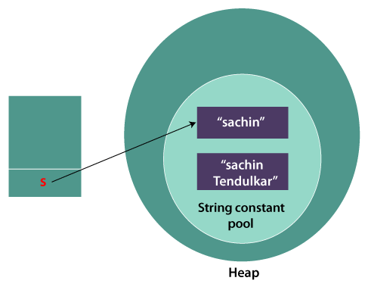
String objects are immutable. Immutable simply means unmodifiable or unchangeable.
class Testimmutablestring{
public static void main(String args[]){
String s="Sachin";
s.concat(" Tendulkar");//concat() method appends the string at the end
System.out.println(s);//will print Sachin because strings are immutable objects
}
}
Sachin

Slide 26
class Testimmutablestring1{
public static void main(String args[]){
String s="Sachin";
s=s.concat(" Tendulkar");
System.out.println(s);
}
}
Sachin Tendulkar

Slide 27
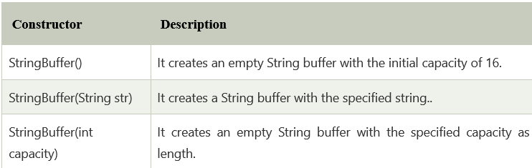
Java StringBuffer class
Java StringBuffer class is used to create mutable (modifiable) String objects.
The StringBuffer class in Java is the same as String class except it is mutable i.e. it can be changed.

Slide 28
Methods
append(String s)
insert(int offset, String s)
replace(int startIndex, int endIndex, String str)
delete(int startIndex, int endIndex)
reverse()
capacity()
ensureCapacity(int minimumCapacity)
charAt(int index)
length()
substring(int beginIndex)
substring(int beginIndex, int endIndex)

Slide 29
class StringBufferExample{
public static void main(String args[]){
StringBuffer sb=new StringBuffer("Hello ");
sb.append("Java");//now original string is changed
System.out.println(sb);//prints Hello Java
}
}
……………………………….
class StringBufferExample2{
public static void main(String args[]){
StringBuffer sb=new StringBuffer("Hello ");
sb.insert(1,"Java");//now original string is changed
System.out.println(sb);//prints HJavaello
} }

Slide 30
class StringBufferExample3{
public static void main(String args[]){
StringBuffer sb=new StringBuffer("Hello");
sb.replace(1,3,"Java");
System.out.println(sb);//prints HJavalo
}
}

Slide 31
Java StringBuilder class
Java StringBuilder class is used to create mutable (modifiable) String.
The Java StringBuilder class is same as StringBuffer class except that it is non-synchronized.

Slide 32
Java toString() Method
If you want to represent any object as a string, toString() method comes into existence.
The toString() method returns the String representation of the object.
Advantage of Java toString() method
By overriding the toString() method of the Object class, we can return values of the object, so we don't need to write much code.

Slide 33
class Student{
int rollno;
String name;
String city;
Student(int rollno, String name, String city){
this.rollno=rollno;
this.name=name;
this.city=city;
}
public static void main(String args[]){
Student s1=new Student(101,"Raj","lucknow");
Student s2=new Student(102,"Vijay","ghaziabad");
System.out.println(s1);//compiler writes here s1.toString()
System.out.println(s2);//compiler writes here s2.toString()
}
}
Student@1fee6fc
Student@1eed786

Slide 34
class Student{
int rollno;
String name;
String city;
Student(int rollno, String name, String city){
this.rollno=rollno;
this.name=name;
this.city=city;
}
public String toString(){//overriding the toString() method
return rollno+" "+name+" "+city;
}
public static void main(String args[]){
Student s1=new Student(101,"Raj","lucknow");
Student s2=new Student(102,"Vijay","ghaziabad");
System.out.println(s1);//compiler writes here s1.toString()
System.out.println(s2);//compiler writes here s2.toString()
}
}
101 Raj lucknow
102 Vijay ghaziabad

Slide 35
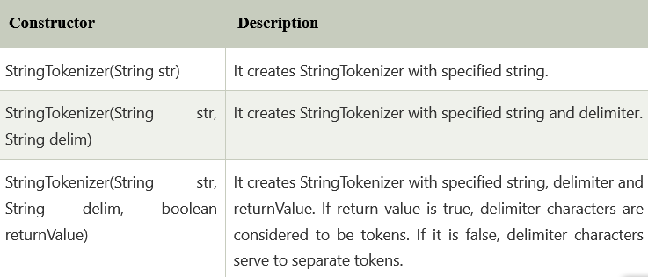
StringTokenizer in Java
The java.util.StringTokenizer class allows you to break a String into tokens.
It is simple way to break a String.

Slide 36
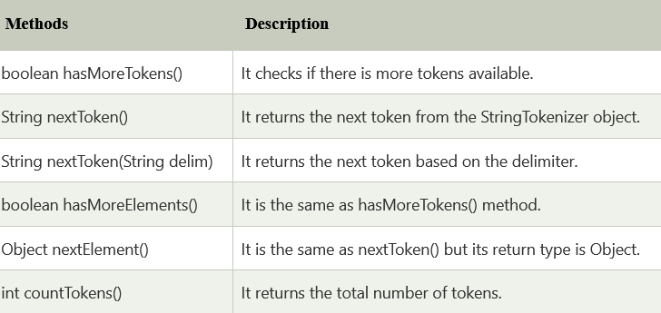

Slide 37
import java.util.StringTokenizer;
public class Simple{
public static void main(String args[]){
StringTokenizer st = new StringTokenizer("my name is khan"," ");
while (st.hasMoreTokens()) {
System.out.println(st.nextToken());
}
}
}
my
name
is
khan

Slide 38
import java.util.StringTokenizer;
public class StringTokenizer1
{
/* Driver Code */
public static void main(String args[])
{
/* StringTokenizer object */
StringTokenizer st = new StringTokenizer("Demonstrating methods from StringTokenizer class"," ");
/* Checks if the String has any more tokens */
while (st.hasMoreTokens())
{
System.out.println(st.nextToken());
}
}
}
Demonstrating
methods
from
StringTokenizer
class

