Slide 1
JAVA
Basic and Operators

Slide 2
Variables
A variable is a container which holds the value while the Java program is executed. A variable is assigned with a data type.
Variable is a name of memory location. There are three types of variables in java: local, instance and static.
There are two types of data types in java:
primitive
non-primitive.

Slide 3
Variable Declaration and Initialization
data_type var_name;
// type of data that can be stored in this variable
data_type var_name=value;
Eg:
int age=20;

Slide 4
Types of variables
Local Variables
Instance Variables
Static Variables
public class A
{
static int m=100;//static variable
void method()
{
int n=90;// instance variable
}
public static void main(String args[])
{
int data=50;//local variable
}
}//end of class

Slide 5
Local Variables
A variable defined within a block or method or constructor is called a local variable.
The life span/Scope of the variable is within the block
We can access these variables only within that block.
Initialization of the local variable is mandatory before using it in the defined scope.

Slide 6
Instance Variables
Instance variables are non-static variables and are declared in a class outside any method, constructor, or block.
Variables are created when an object of the class is created and destroyed when the object is destroyed.
Unlike local variables, we may use access specifier for instance variables.
Initialization of Instance Variable is not Mandatory. Its default value as 0.
Can be accessed only by creating objects.

Slide 7
Static Variables
Static variables are also known as Class variables.
These variables are declared similarly as instance variables.
Declared using the static keyword.
Static variables are created at the start of program execution and destroyed automatically when execution ends.
Initialization of Static Variable is not Mandatory. Its default value is 0
If we access the static variable like the Instance variable (through an object), the compiler will show the warning message, which won’t halt the program. The compiler will replace the object name with the class name automatically.
If we access the static variable without the class name, the compiler will automatically append the class name.

Slide 8
public class TestScope
{
static int x = 11;
private int y = 33;
public void method1(int x)
{
TestScope t = new TestScope();
this.x = 22;
y = 44;
System.out.println("Test.x: " + TestScope.x);
System.out.println("t.x: " + t.x);
System.out.println("t.y: " + t.y);
System.out.println("y: " + y);
}
public static void main(String args[])
{
TestScope t = new TestScope();
t.method1(5);
}
}
C:\AnuJava>java TestScope
Test.x: 22
t.x: 22
t.y: 33
y: 44

Slide 9
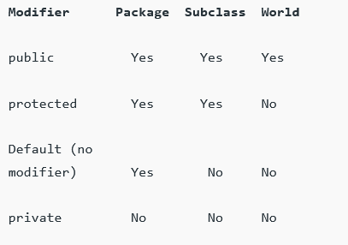
Scope of a variable

Slide 10
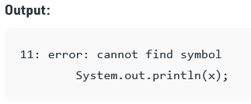
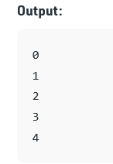
Eg: Scope
class Test
{
public static void main(String args[])
{
for (int x = 0; x < 4; x++)
{
System.out.println(x);
}
// Will produce error
System.out.println(x);
}
}

Slide 11
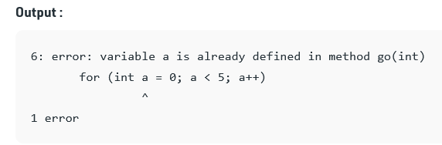
Eg.
class Test
{
public static void main(String args[])
{
int a = 5;
for (int a = 0; a < 5; a++)
{
System.out.println(a);
}
}
}

Slide 12
Output?
class Test
{
public static void main(String args[])
{
{
int x = 5;
{
int x = 10;
System.out.println(x);
}
}
}
}

Slide 13
Output?
class Test {
public static void main(String args[])
{
for (int i = 1; i <= 10; i++) {
System.out.println(i);
}
int i = 20;
System.out.println(i);
}
}

Slide 14
Data Types
Two types of languages
Statically typed languages
Each variable and expression type is already known at compile time.
Once a variable is declared it cannot hold values of other data type.
Eg. C, C++, JAVA
Dynamically types languages
These languages can receive different data types over time.
Eg. Ruby, Python

Slide 15
Java has two categories of data:
Primitive Data Type: such as boolean, char, int, short, byte, long, float, and double
Non-Primitive Data Type or Object Data type: such as String, Array, etc.
Primitive data are only single values and have no special capabilities.
Non-Primitive Data Type or Reference Data Types
The Reference Data Types will contain a memory address of variable values because the reference types won’t store the variable value directly in memory. They are strings, objects, arrays, etc.
Reference;
https://www.geeksforgeeks.org/data-types-in-java/?ref=lbp

Slide 16
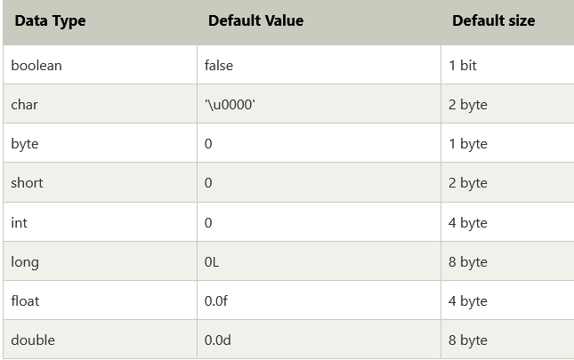

Slide 17
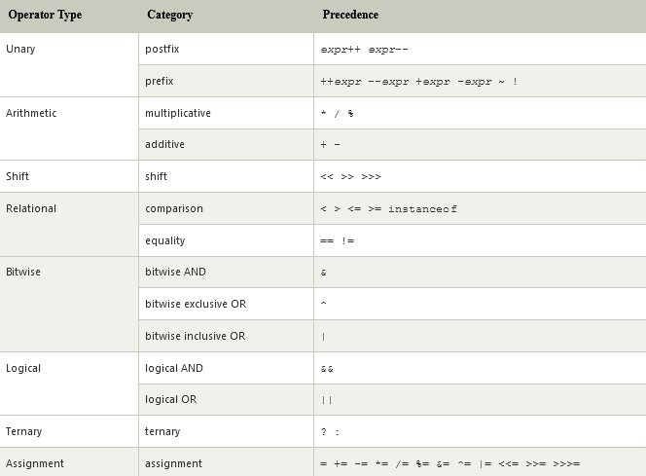
Operators in JAVA

Slide 18
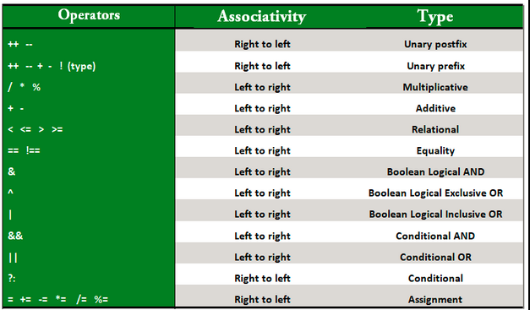
Operator Precedence

Slide 19
Example.
public class OperatorExample{
public static void main(String args[]){
int x=10;
System.out.println(x++);//10 (11)
System.out.println(++x);//12
System.out.println(x--);//12 (11)
System.out.println(--x);//10
}}

Slide 20
Output?
public class OperatorExample{
public static void main(String args[]){
int a=10;
int b=10;
System.out.println(a++ + ++a);
System.out.println(b++ + b++);
}}
C:\AnuJava>java OperatorExample
22
21

Slide 21
Output?
public class OperatorExample{
public static void main(String args[])
{
System.out.println(10*10/5+3-1*4/2);
}
}
21

Slide 22
class OperatorPrecedence
{
public static void main (String[] args)
{
int result = 0;
result = 5 + 2 * 3 - 1;
System.out.println("5 + 2 * 3 - 1 = " +result);
result = 5 + 4 / 2 + 6;
System.out.println("5 + 4 / 2 + 6 = " +result);
result = 3 + 6 / 2 * 3 - 1 + 2;
System.out.println("3 + 6 / 2 * 3 - 1 + 2 = " +result);
result = 6 / 2 * 3 * 2 / 3;
System.out.println("6 / 2 * 3 * 2 / 3 = " +result);
}
}

Slide 23
public class TemperatureConversion
{
public static void main(String arg[])
{
System.out.println("Evaluating the Temperature Conversion");
double fahrenheit = 98.4;
double celsius = ( 5.0 * (fahrenheit - 32.0) ) / 9.0; // clear expression because of the Parenthesis
System.out.println(fahrenheit + " F is same as " + celsius + " C.");
}
}

Slide 24
class OperatorExample{
public static void main(String args[]){
int a=10;
int b=-10;
boolean c=true;
boolean d=false;
System.out.println(~a);//-11 (minus of total positive value which starts from 0)
System.out.println(~b);//9 (positive of total minus, positive starts from 0)
System.out.println(!c);//false (opposite of boolean value)
System.out.println(!d);//true
}
}
O/P : -11 9 false true

Slide 25
Output?
import java.io.*;
class Logical {
public static void main(String[] args)
{
int a = 10, b = 20, c = 20, d = 0;
System.out.println("Var1 = " + a);
System.out.println("Var2 = " + b);
System.out.println("Var3 = " + c);
if ((a < b) && (b == c)) {
d = a + b + c;
System.out.println("The sum is: " + d);
}
else
System.out.println("False conditions");
}
}

