Slide 1
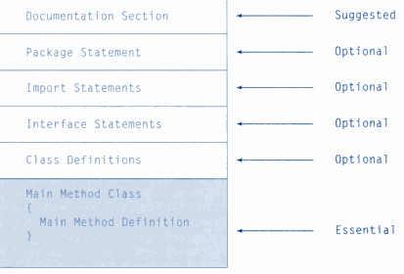
Structure of Java Program

Slide 2
Java Environment/
Life Cycle of Java Code
Compile-time Environment
Runtime Environment
Class Loader
Bytecode
Verifier
Java Class
Libraries
Java
Source
(.java)
Java
Interpreter
Just in Time
Compiler
Java
Bytecodes
move locally
or through
network
Java
Virtual
machine
Java
Compiler
Runtime System
Java
Bytecode
(.class )
Operating System
Hardware

Slide 3
JVM architecture
Java Bytecode
Interpreter
JIT
Native Code
JVM
CPU

Slide 4
Java Tokens
  Java Character set
  Keywords
  Identifiers
  Literals
  Operators

Slide 5
Java Character set
  -Letters
  -(A to Z & a to z)
  -Digits
  -(0 to 9)
  -Punctuation Marks.

Slide 6
Keywords
abstract | continue | for | new | switch
assert | default | goto | package | synchronized
boolean | do | if | private | this
break | double | implements | protected | throw
byte | else | import | public | throws
case | enum | instanceof | return | transient
catch | extends | int | short | try
char | final | interface | static | void
class | finally | long | strictfp | volatile
const | float | native | super | while

Slide 7
Identifiers
Names given to variables, objects, methods
Must not be a Java keyword
Must begin with a letter.
Followed by any number of characters, digits, or _ (note, no blanks)
Identifiers should be well chosen
  use complete words (even phrases)
  this helps program documentation

Slide 8
Literals – Examples
Integers
  4, 19, -5, 0, 1000
Doubles
  3.14, 0.0, -16.123
Strings
  “Hi Mom” “Enter the number : “
Character
  'A' 'X' '9' '$' '\n'
Boolean
  true, false

Slide 9
Operators in Java
Arithmetic Operations in Java
  Addition, subtraction, multiplication, division, modulus: (+, -, *, /, %)
Equality and Relational Operators
  Equality, not equals, greater than, greater than or equal, less than, less than or equal: (==, !=, >, >=, <, <=)
Logical Operators
  Binary operators
    logical AND: && (two boolean operands w/ short circuit)
    logical AND: & (two boolean operands no short circuit)
    bitwise AND: & (two integer operands)
    logical OR: || (two boolean operands w/ short circuit)
    logical OR: | (two boolean operands no short circuit)

Slide 10
Operators(contd…)
    bitwise OR: | (two integer operands)
    logical exclusive OR: ^ (two boolean operands)
    bitwise exclusive OR: ^ (two integer operands)
Unary operator
    logical NOT: ! (single boolean operand)
    bitwise NOT: ~ (single integer operand)
    ++(increment operator) a++ b--
    --(decrement operator)

Slide 11
Assignment Operators
+= | c += 7 | c = c + 7
-= | d -=4 | d = d – 4
*= | e *= 5 | e = e * 5
/= | f /= 3 | f = f / 3
%= | g %= 9 | g = g % 9

Slide 12
Increment & Decrement operators
++ | preincrement | ++a | Increment a by 1 then use the new value
++ | postincrement | a++ | Use the current value of a then increment by 1
-- | predecrement | --b | Decrement b by 1 then use the new value
-- | postdecrement | b-- | Use the current value of b then decrement by 1

