Slide 1
Electrical distribution at Computer Centre
V. Srinivas Rao

Slide 2
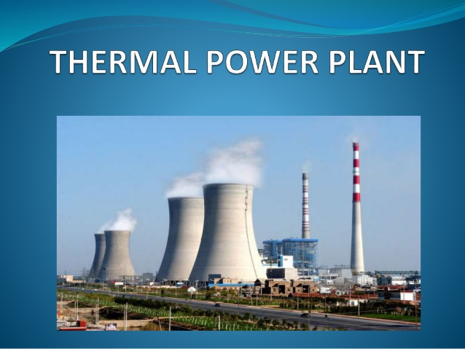

Slide 3
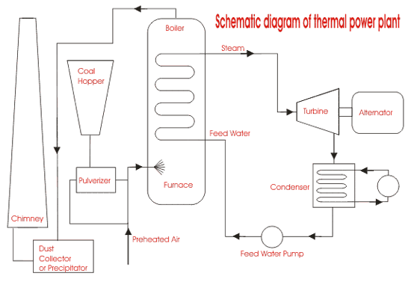

Slide 4
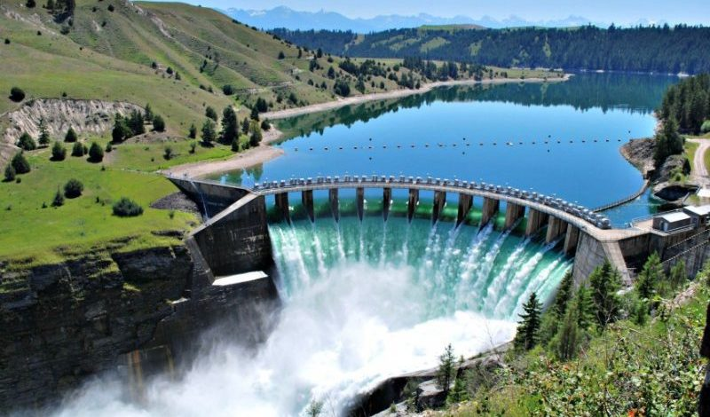
RESERVOIR

Slide 5
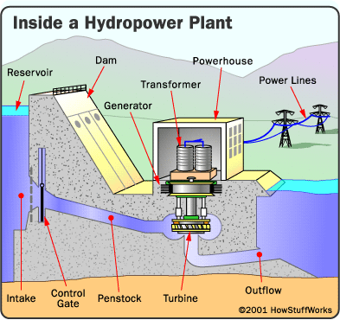

Slide 6

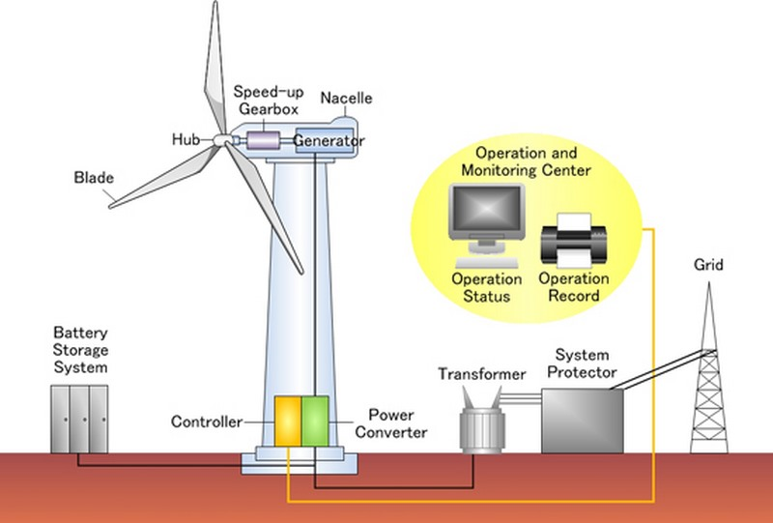

Slide 7
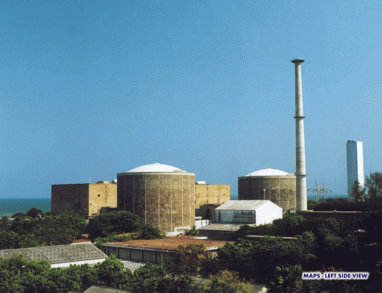
NUCLEAR POWER PLANT

Slide 8
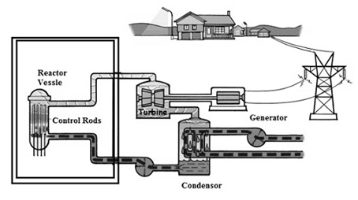
2 × 235 MW=470MW

Slide 9
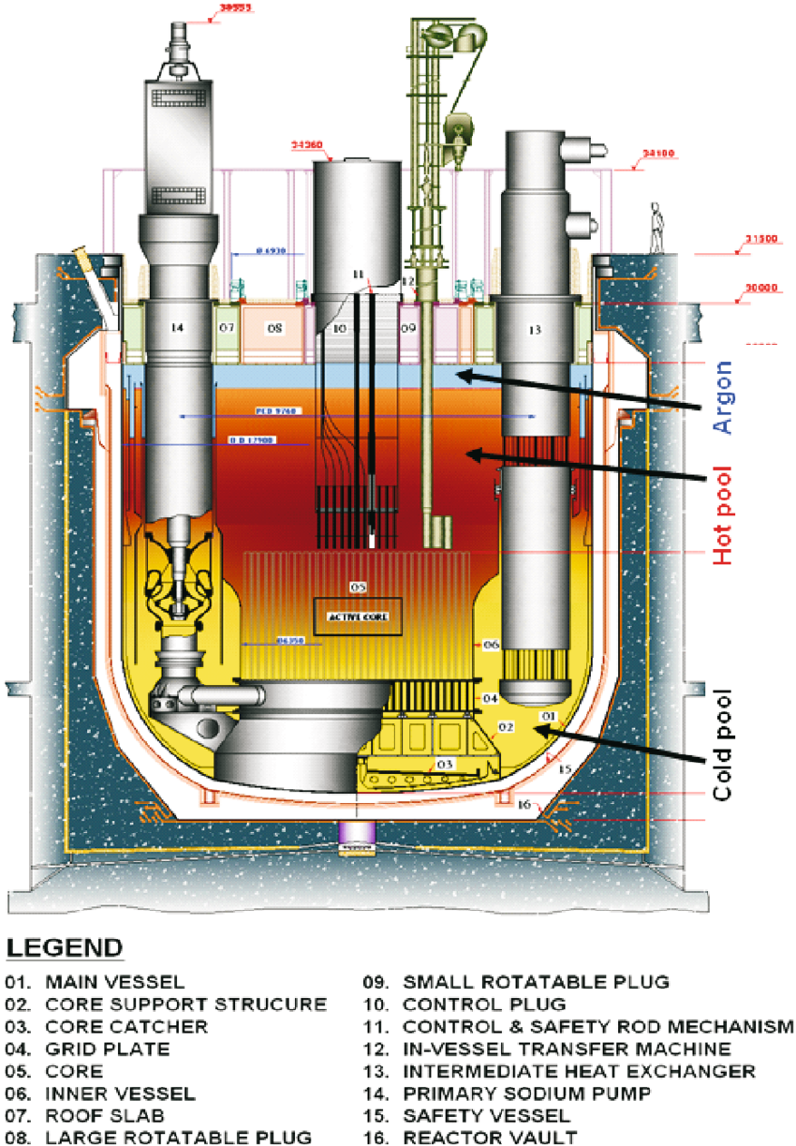
PFBR
550MWe
750MWth

Slide 10
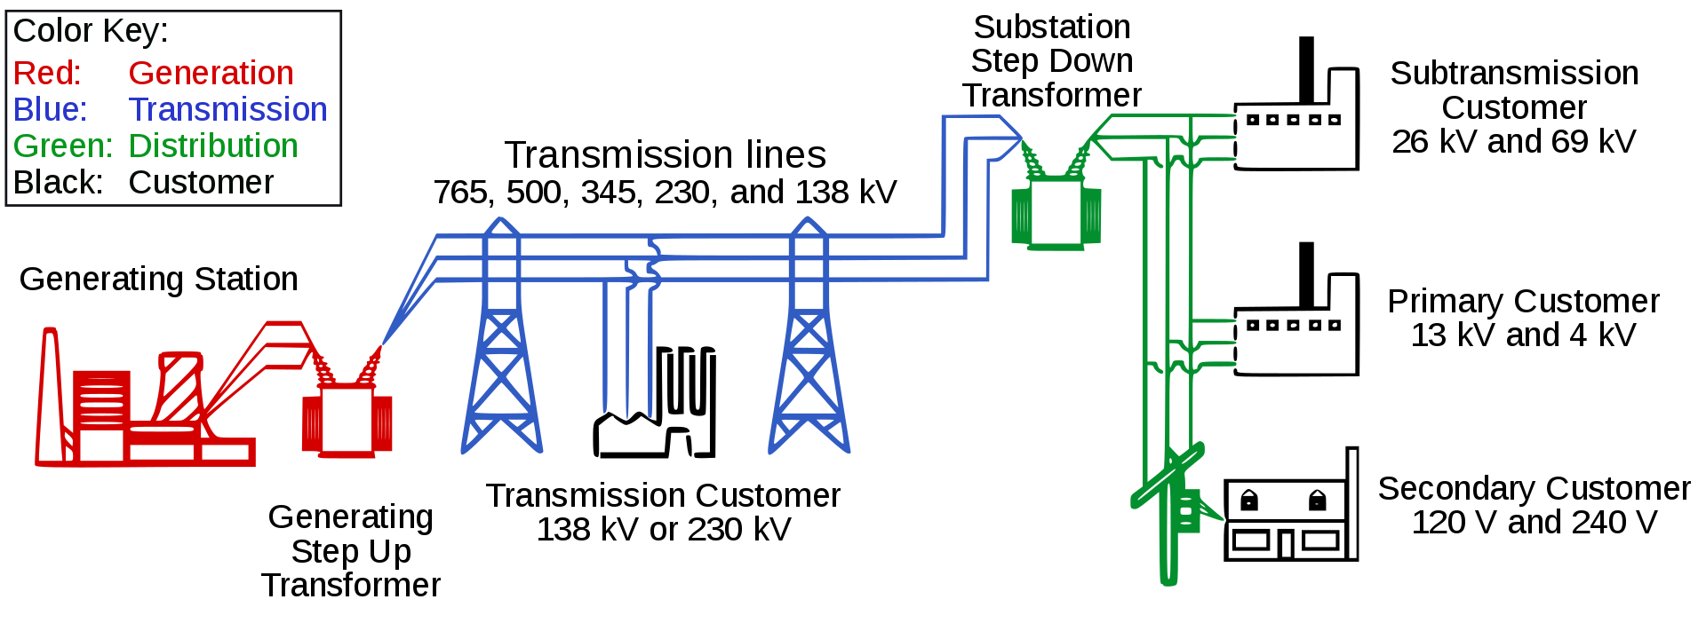

Slide 11
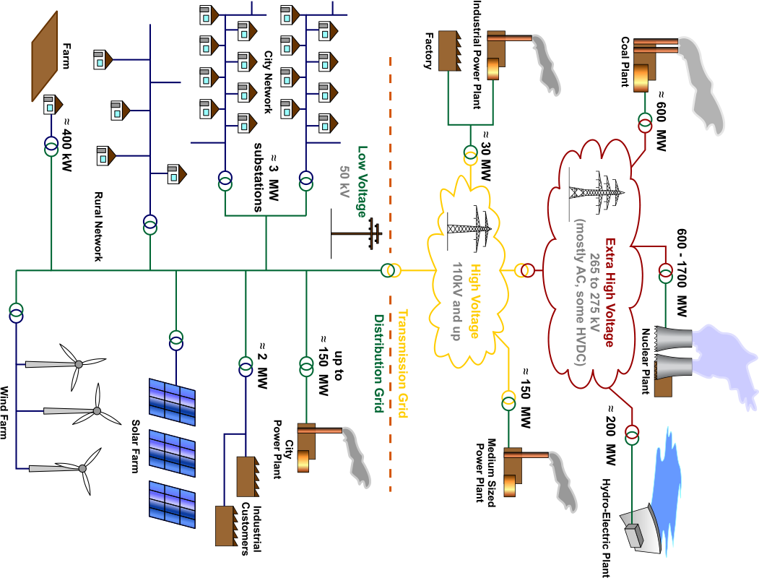
POWER DISTRIBUTION

Slide 12
There are four distinct classes of power, namely Class IV, III, II and I as well as Emergency Power Supply.
CLASS IV: The Class IV power system is an AC power that supplies the unit auxiliary loads during normal plant operation and may be subject to long term interruptions.
auxiliary load means power used to operate auxiliary equipment in the Facility necessary for power generation (such as pumps, blowers, fuel preparation machinery, and exciters)
CLASS III: The Class III power is an AC system that is normally supplied from the Class IV system. Upon loss of Class IV power it is automatically supplied from on-site stand-by generators (SGs) under the control of the Emergency Transfer Scheme (ETS). Each SG is capable of black starting and supplying the Class III requirements. The SGs are provided with an on-site fuel oil supply. Loads: MCC and switchgear
CLASS II: The Class II is an AC system which supplies uninterruptible AC power to the essential loads, which cannot tolerate power interruptions that may occur in the Class III system. The Class II power is normally supplied from Class I batteries through inverters with alternate supply from the Class III system.
MCCs or panels perform either special safety-related or personnel/equipment protection-related functions.

Slide 13
CLASS I:
The Class I is a DC system which supplies uninterruptible DC power to the essential auxiliary services. Class I power is normally supplied from Class III power through rectifiers and is backed up by batteries to ensure uninterruptible supply to Class I and Class II loads. The overall system requirement is that if AC supplies fail than the battery will supply the emergency loads without interruption for the required time.
Batteries are capable of providing uninterruptible power to the full Class II and Class I loads for a minimum period of 40 minutes following a total loss of Class III and IV power.
After this time, all class I and II loads will be lost if class III power cannot be restored.
Loads: Instrumentation panels and MCC.
Emergency power supply:
This comes into picture when all classes of power supply fails due to some natural accidents like earthquake or Tsunami. Personal attention is required to switch on this supply and is used to safe shut down the systems.

Slide 14
Types of power supplies in a Nuclear plant
CLASS IV | Power can be interrupted indefinitely Normal Alternating Current (AC) – Supplied from turbine generator and/or grid
CLASS III | Power can be interrupted up to 5 minutes AC system – Normally supplied from Class IV – Upon loss of Class IV, from Standby generator
CLASS II | Power can be interrupted up to 4 milliseconds AC System – Normally supplied form Class I DC system – Can be supplied from Class III
CLASS I | Power can never be interrupted under postulated conditions DC system – Normally supplied from Class III via rectifiers – Backup battery supply

Slide 15
Power distribution layout at CC
3 phase 415V from Sub station
Input panel 1 class IV | Input panel 2 class III (DG)
UPS 6 20kVA
Emerson
i/p 415V
o/p 230V
UPS 4 20kVA
Emerson
i/p 415V
o/p 230V
UPS 5kVA
Numeric
i/p 230V
o/p 230V
UPS 1
UPS 2
UPS 3
UPS 5
VDI RACK
DB O/P to UPS2
DB1, DB2 ANUNET room
DB at backbone room
VDI
Distribution Board (DB)
Network Lab Setup
Core Switch
N/W rack
LAN extender
NMS server
DNS server
Work Stations
SMP server
HPC Firewall
HPC n/w Rack
Internet
Email
Anunet
Web server
EID Servers
Bull Nova
SMP server
DAE grid
I/o room peripherals
Test machines & Servers
LASER printers
Network rack

