Slide 1
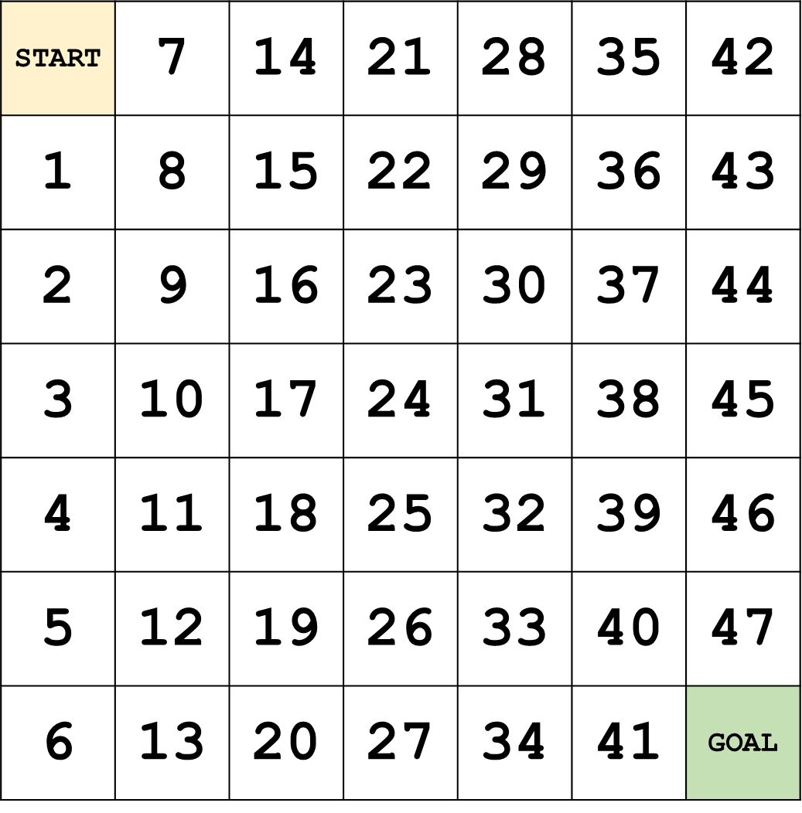

Slide 2
START | 7 | 14 | 21 | 28 | 35 | 42
1 | 8 | 15 | 22 | 29 | 36 | 43
2 | 9 | 16 | 23 | 30 | 37 | 44
3 | 10 | 17 | 24 | 31 | 38 | 45
4 | 11 | 18 | 25 | 32 | 39 | 46
5 | 12 | 19 | 26 | 33 | 40 | 47
6 | 13 | 20 | 27 | 34 | 41 | GOAL

