Slide 1
Gilbert S. Apodaca
Portfolio
Educational Technology
Boise State University
Notes:
Title Slide for about 15 seconds for intro w/ music.

Slide 2
About Me
Seven years teaching in a rural school district
Secondary Math & Science
Currently:
Middle School Math (6th , 7th, & 8th Grade)
K-8 Math Coach
Notes:
Introduction
Hello, My Name is Gilbert Apodaca, welcome to my Educational Technology Portfolio.
I am a 7th year educator in a small school district in Colorado. I teach secondary math and science.
I am also in my first year as a math coach for K-8th grade teachers.

Slide 3
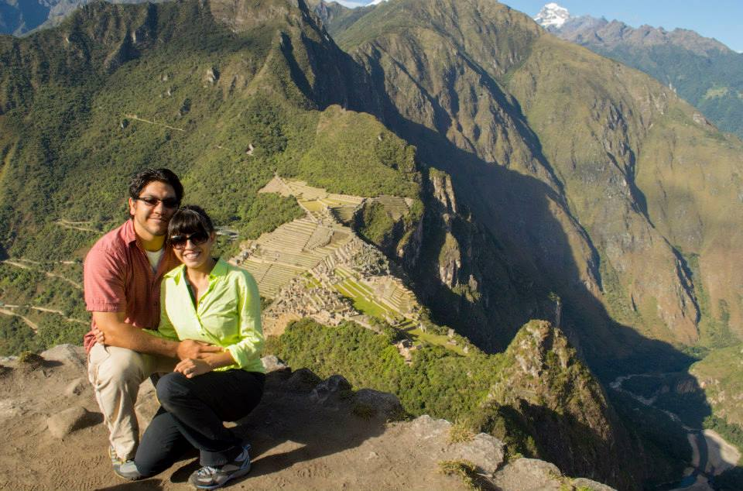
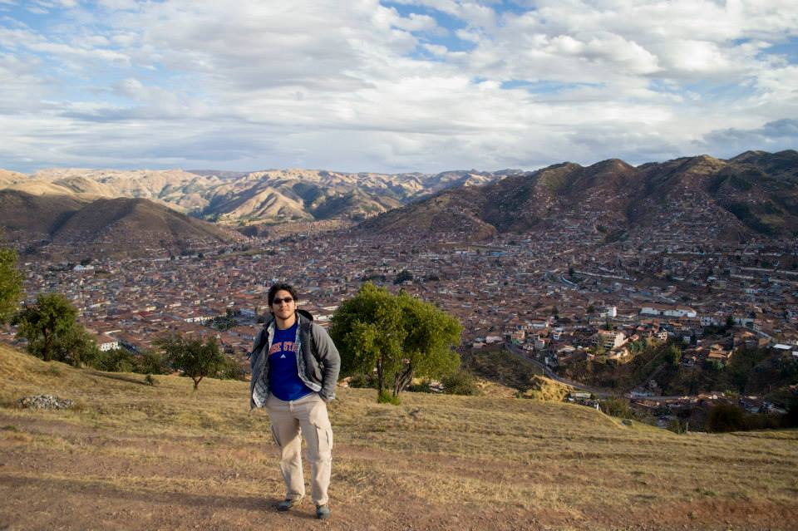
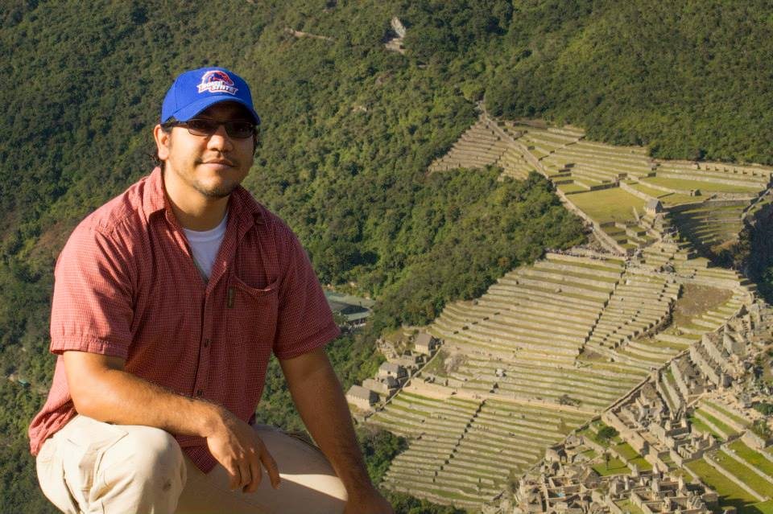
Notes:
My wife loves to travel and brings me along, which was a bit challenging with this program, but I made it work. We currently have no children but are looking to get started soon.

Slide 4
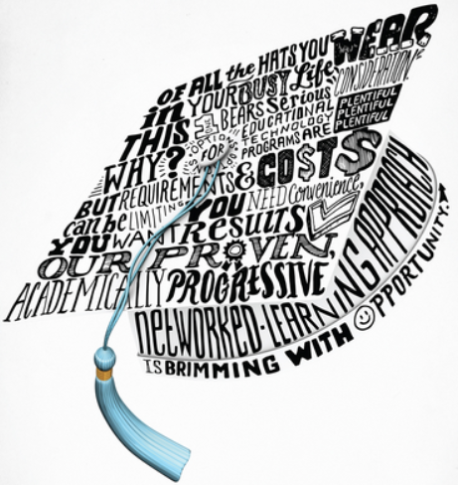
Boise State – Educational Technology
Notes:
I chose Boise State to continue my education because of the Educational Technology Program.
I firmly believe that, to be on the forefront of any profession, it is important to have a great understanding of the technology in the profession because technology drives innovation.

Slide 5
Reflection

Slide 6
Reflection
Class & Major Overview
Important Artifacts
Project Based Learning
Grant Writing
Instructional Design
Evaluation
Notes:
In this portion of the video, I am going to discuss my time in the MET program. I will discuss a few of the important classes I have taken and focus closely on four artifacts that have had a major impact in my professional career.

Slide 7
Class overview – Focus of Study
Certificate Program – Technology Integration
Notes:
I began the program in the Fall of 2012 and intend to graduate in the Summer of 2014.
In addition to completing the MET program, I am also planning on earning a certificate in Technology Integration. I have not had nothing but good experiences in all of my classes and have recommended this program to many of my peers with an interest in the subject.

Slide 8
Technology Supported Project Based Learning
Problem Based Learning Unit
Notes:
The first artifact that I am going to discuss is one that had a dramatic impact on teaching

Slide 9
Technical and Grant Writing
Complete Grant Application

Slide 10
Instructional Design
Final Instructional Design Project

Slide 11
Evaluation for Educational Technologists
Course Project

Slide 13

Thank you!
Notes:
To conclude, I would like to thank you for taking the time to view my reflection video. I would also like to thank all of my classmates and professors who have challenged me by setting high standards. I feel that there are many people that I have met in this program that are going to make a big impact on the future of education and educational technology.
I would also like to thank my school district and especially my students for being considerate of my time and helping out wherever possible.
And most importantly, my wife, I couldn’t have come this far without you.

Slide 14
Credits
Images
Boise State Poster and Logo
https://edtech.boisestate.edu/
Audio
Intro & Exit Theme: Getting Closer NOW – CSoul (Attribution, Noncommerical 3.0)
http://ccmixter.org/files/CSoul/45235
Design
Created using Microsoft Powerpoint and Camtasia Studio
Most importantly, I have to thank my wife for tolerating all of the time and hard work that I put into this program. I love you.

