Slide 1

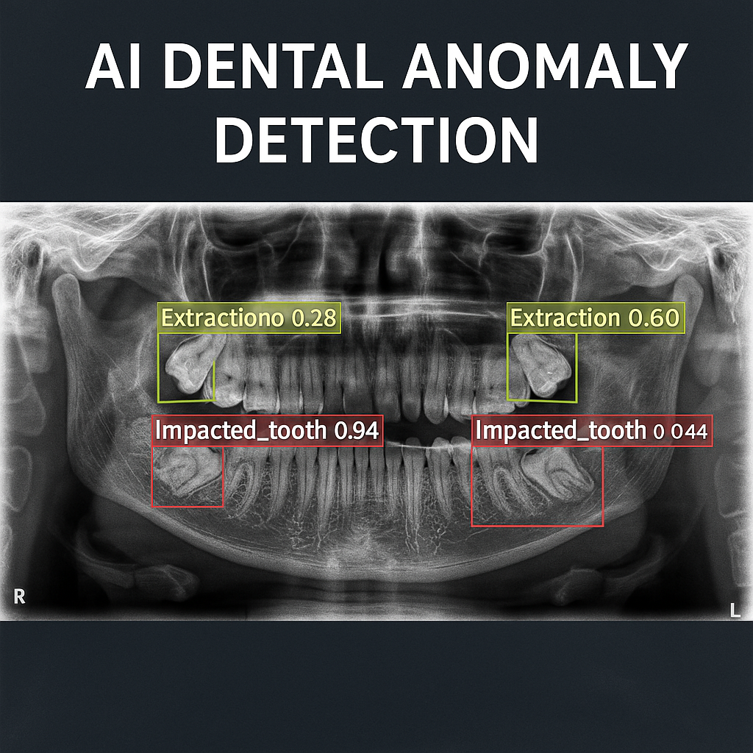
Dental Anomaly Detection through Biomedical X-rays: Deep Learning Approach
Department of Computer Engineering
Submitted By
ABDALLAH I. J. DWIKAT
Project Advisor: Prof. Dr. Rafet AKDENIZ
Project Co-Advisor: Prof. Dr. Dilara ARSLAN
June, 2025
1
Notes:
1

Slide 2
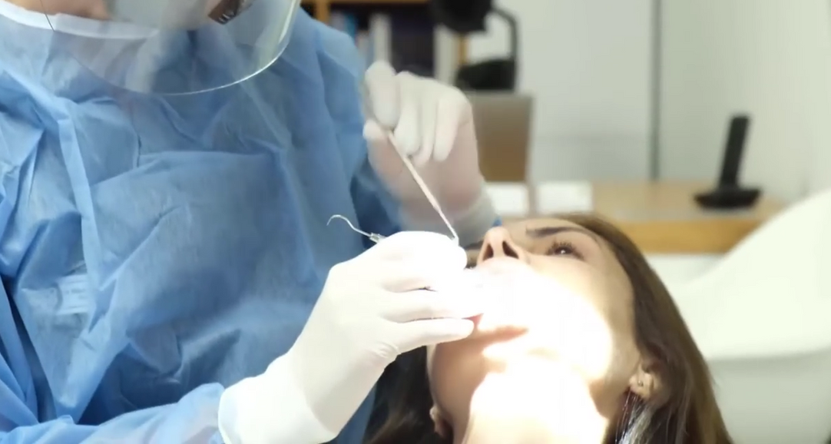
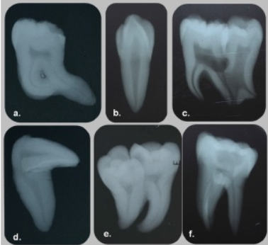
Typical types of Dental Anomalies ?
Abnormalities Detection Types:
Impacted_tooth
Filling
Implant
Root Canal
Extraction
Crown
2
Notes:
2

Slide 3
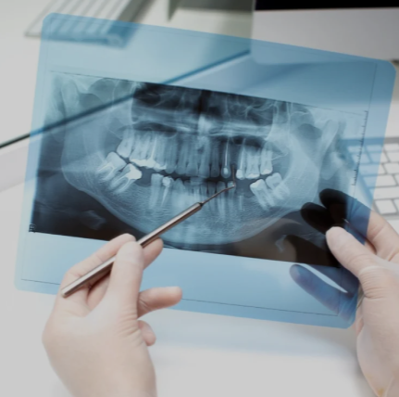
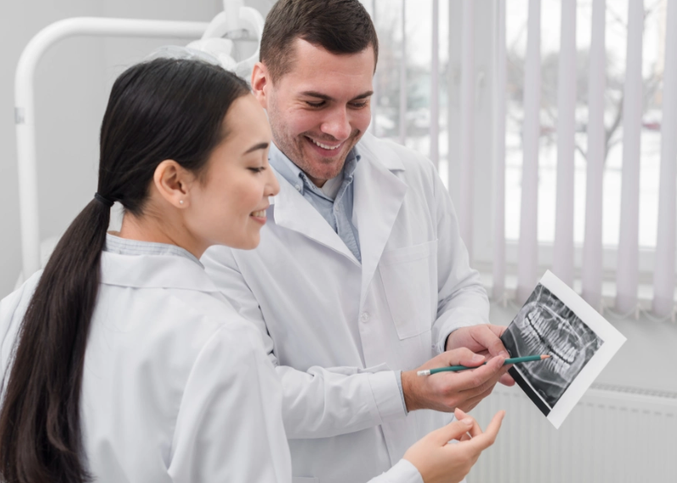
The problem / Current Issues:
Disadvantages of Manual Interpretation:
1. Time-Consuming & Inefficient
2. Human Error & Inconsistency
3. Accessibility Issues
3
Notes:
2

Slide 4
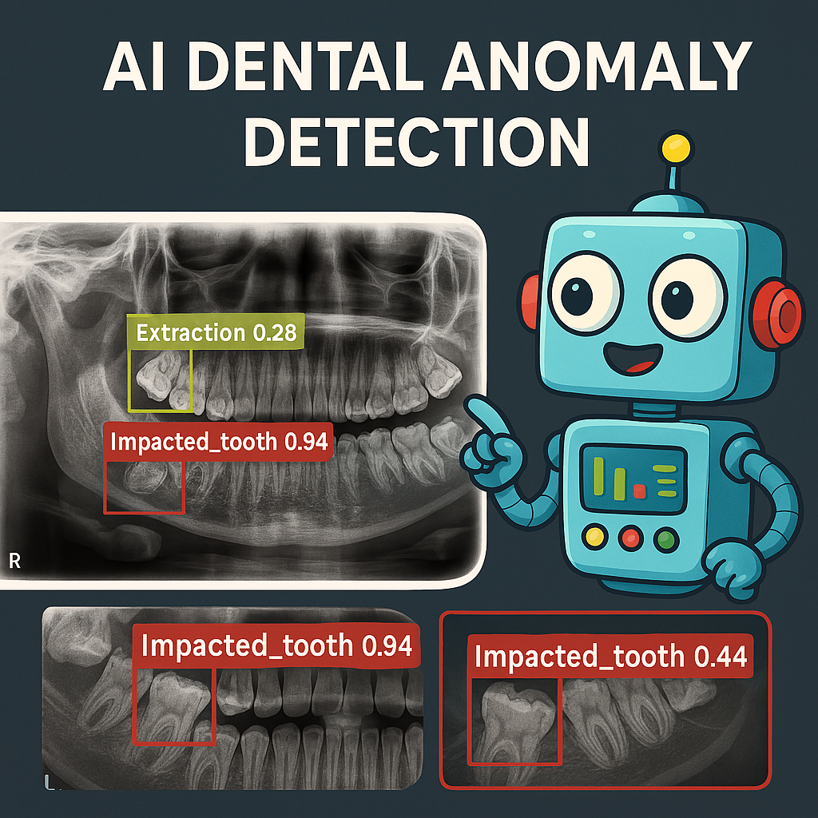
Why to Automate the process?
Benifits of Automating this process:
1. Automating detection → Faster, cheaper diagnoses.
2. Assisting dentists → Lets them focus on treatment, not detection.
3. Scalable → Can screen thousands of X-rays/day.
4. More Accurate → 95.3% mAP vs. human error rates.
Note: AI Generated Image (Copilot)
4
Notes:
2

Slide 5
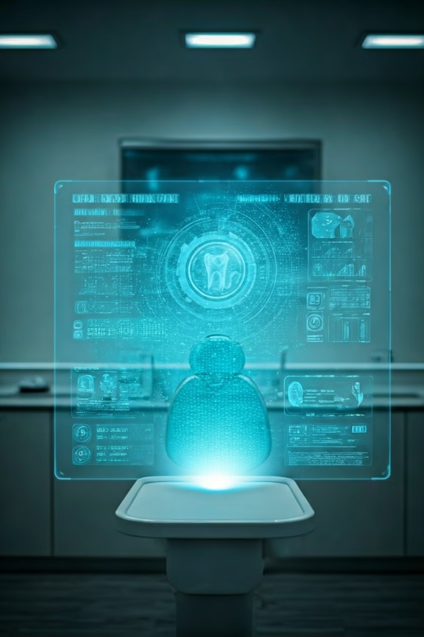



Research Purpose
Develop AI System
Reduce Errors
Create an accurate AI system for dental anomaly detection.
Reduce diagnostic errors.
Faster Screening
Develop a faster, more reliable screening method. Improve early detection of dental pathologies and patient care.
5
Notes:
4

Slide 6



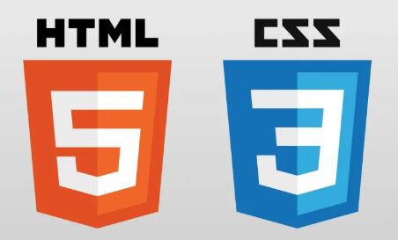
Technology Used
YOLOv8: You Only Look Once version 8
Python: Jupyter Notebook (Image Processing and model training)
Flask: Python framework, enabling integration between YOLOv8 and web interface.
User Interface: HTML and CSS
6
Notes:
4

Slide 7



Methodology: Dataset and YOLOv8
Image Processing & YOLOv8
2
Utilized for real-time detection.
1
Data Annotation
800 images with annotations
Deployment
3
Flask API and User Interface.
YOLOv8 Official Documentation: https://yolov8.org/yolov8-documentation/
7
Notes:
5

Slide 8
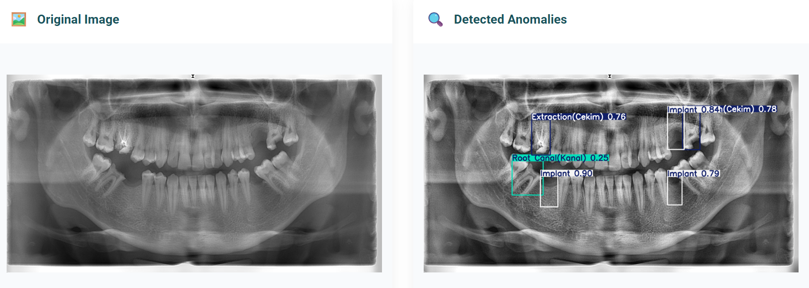

CLACHE (Contrast Limited Adaptive Histogram Equalization)
Before
After
Joudet, C. (2018). Deep Learning on Dental X-rays. Medium. Link
7
Notes:
5

Slide 9
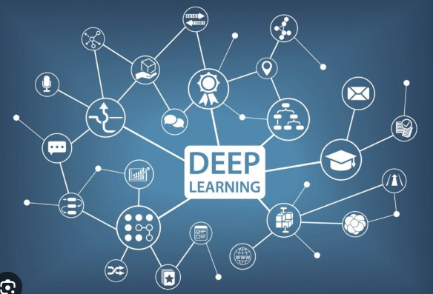






Training the model
Used Local Machine
72 hours of training moreless.
Early Stopping
Stopped after 572 epochs.
Saving the Best and the Last models
best.pt at the 561 epoch.
Early stopping is a regularization technique used to prevent overfitting by stopping the training process once the model's performance starts to degrade.
8
Notes:
8

Slide 10
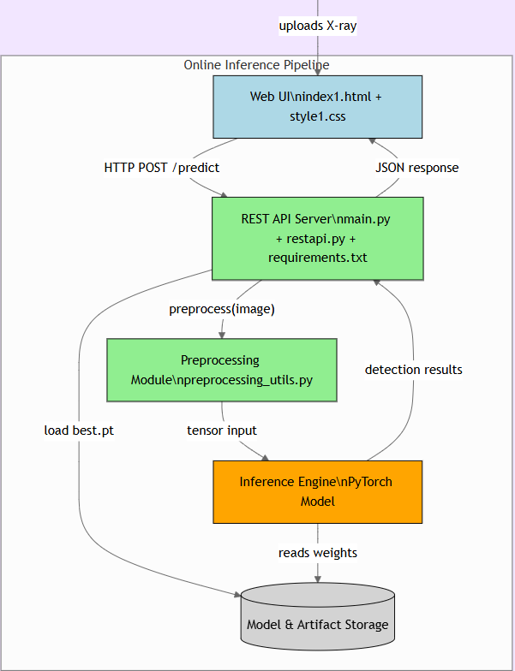
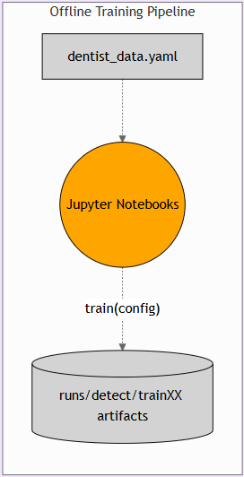
Project Architecture
1. Training Pipeline
2. Web User Interface
3. REST API server
4. Image Resizing and CLACHE
5. Read best.pt weights
6. Detect Anlomalies
7. Response to UI through REST API
https://gitdiagram.com/apodwikat/dental_anomaly_detection_graduationproject
9
Notes:
7

Slide 11
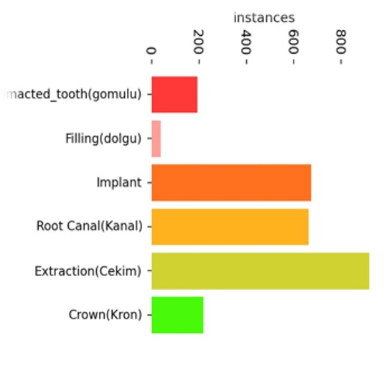
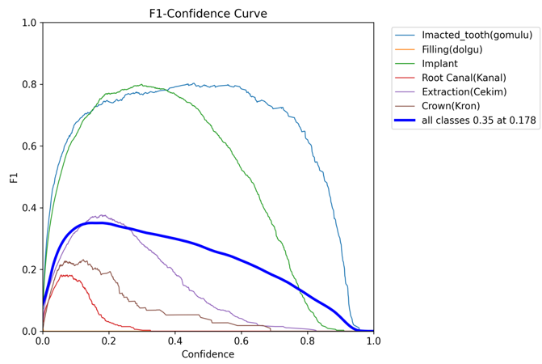
Performance Metrics
Accuracy Vs. Number of instances:
95.3%
mAP
Mean Average Precision.
96.7%
Precision
Accuracy of positive predictions.
93.3%
Recall
Ability to find all relevant cases.
10
Notes:
6

Slide 12
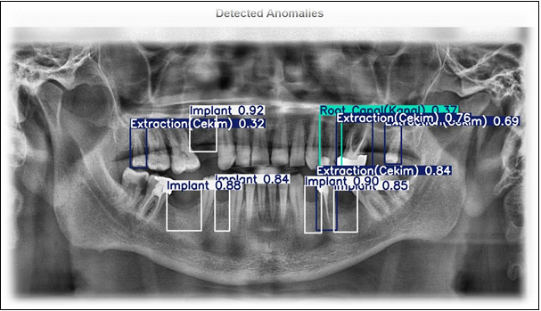
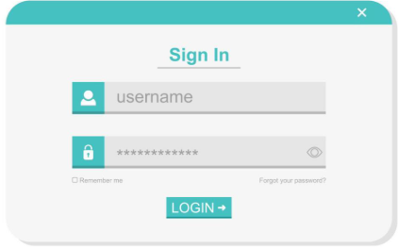

What about the Business side?
The System might be sold as monthly/yearly subscribtion for clinics so the clinic can immediately use the system right after taking the X-ray image from patient.
11
Notes:
8

Slide 13
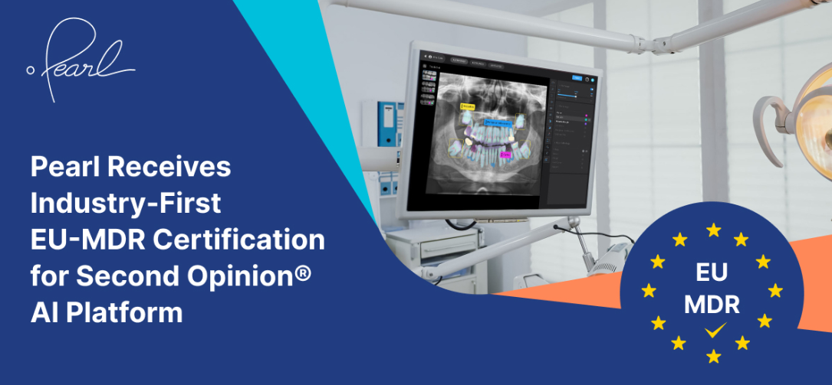
How about Ethical Perspective ?
The AI algorithm has the potential to perform even better than humans which needs:
1) Big data collection.
2) Quality of labeling
The system firstly will be considered as an assistant for the doctor.
EU Certifications already exists and some companies in market like Pearl which is raised $69.25M and is backed by investors like the American Dental Association
12
Notes:
8

Slide 14
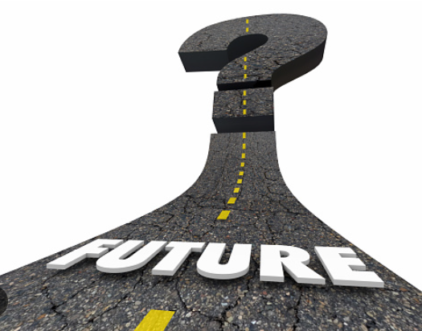
Future Work...
In Summary, The system needs a Research which by estimation can be done in one year.
Requires a team of healthcare professioanlists and Data Scientists in order to deliver a market ready product.
AI can be enhanced to provide a health report using LLM explaining the issues in human language.
13
Notes:
8

Slide 15
Acknowledgement
First and foremost, The Family Support & Encouragement
Advisor Prof. Rafet Akdeniz, Co-advisor Prof. Dilara Arslan, and Dr. Roa’a Mohammedqasem.
Radiology Support by Mühübe Yıldırım.
Gratitude to Professors & Teachers (IAU, Trento UNITN, Hungary NJE).
Appreciation for All Supporters & Motivating Friends.
Thanks for listening!
adweikat12@gmail.com
14
Notes:
8

Slide 16
References
Almalki et al. (2022). Dental Disease Classification Using OPG X-rays. Sensors, 22(19). Link
Joudet, C. (2018). Deep Learning on Dental X-rays. Medium. Link
Pereira, L. (2020). CNNs for 3D Medical Images. Master’s Thesis, IST Lisbon. PDF
Rosten & Drummond (2006). Fast Corner Detection. ECCV
Sohan et al. (2024). Review of YOLOv8. ML Conference. Link
Redmon et al. (2016). YOLO: Real-time Detection. CVPR
Jocher et al. (2023). YOLOv8 by Ultralytics. GitHub
Paszke et al. (2019). PyTorch Library. NeurIPS
Bradski, G. (2000). OpenCV Library. Dr. Dobb’s Journal
Zuidhof, G. (2019). Deep Learning for Medical Imaging. arXiv:1908.06301
Lee et al. (2018). Caries Detection via CNN. Journal of Dentistry, 77
Schwendicke et al. (2019). CNNs in Dental Diagnostics. Journal of Dentistry, 91
Hung et al. (2020). AI in Dental Radiology. Dentomaxillofacial Radiology, 49(1)
Litjens et al. (2017). Survey on Deep Learning in Medical Imaging. Medical Image Analysis, 42
Esteva et al. (2017). Skin Cancer Detection via DNNs. Nature, 542(7639)
GitHub Repository: https://github.com/apodwikat/Dental_Anomaly_Detection_GraduationProject
15

