Slide 1
Jacob Nordfalk
  Assoc. professor in Computer engineering in Denmark
  Author of 3 Java programming books, http://javabog.dk
  Active in the International Language Esperanto community
  Self-chosen unemployed in Nepal to 1st May 08

Slide 2
NepaliConverter 4
Inspired by http://madanpuraskar.org/ 's Font Converter, but it lacks many functions.
Therefore: New Open Source Java NepaliConverter project at: http://code.google.com/p/nepaliconverter/
MPP doesent have the resources to finish the work
New developers needed!

Slide 3
NepaliConverter 4
Compared to present MPPs Font Converter it
  Is much more user friendly
    People dont have to juggle with files and know about font encoding => 5 times more potential users
    Clipboard converter modes
  Can convert HTML, OpenOffice, RTF and Word
    Keeps all text formatting!
    Mixed documents with f.eks. Arial, Times, Kantipur, Preeti and is correct converted to Unicode
  Can also transliterate according to multiple transliterate chemes

Slide 4
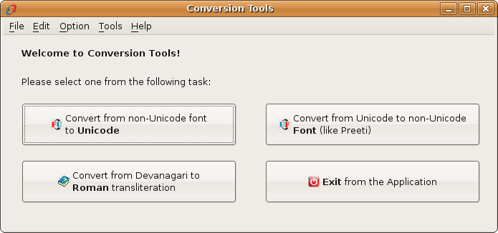
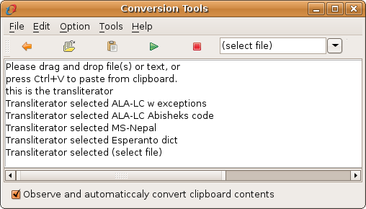
This is how the beta looks

Slide 5
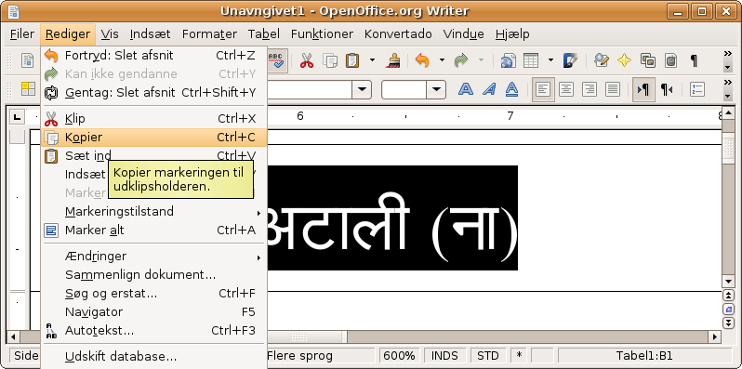
Copy into the clipboard

Slide 6
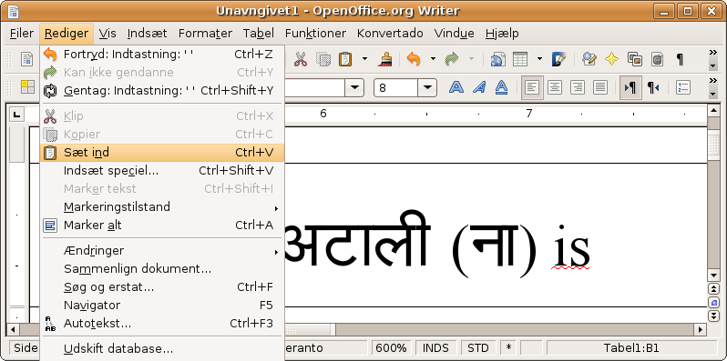
Then its automatically converted

Slide 7
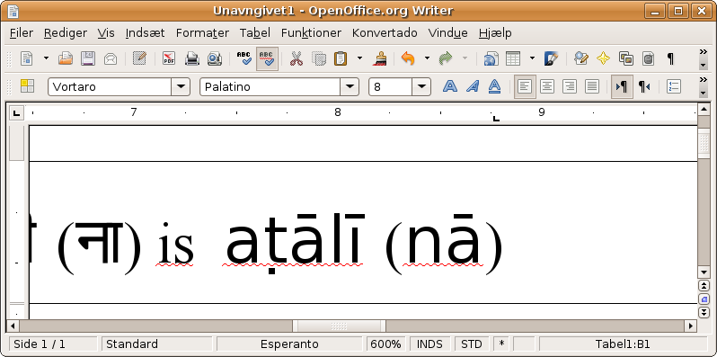
So you get the conversion result by just pasting

Slide 8
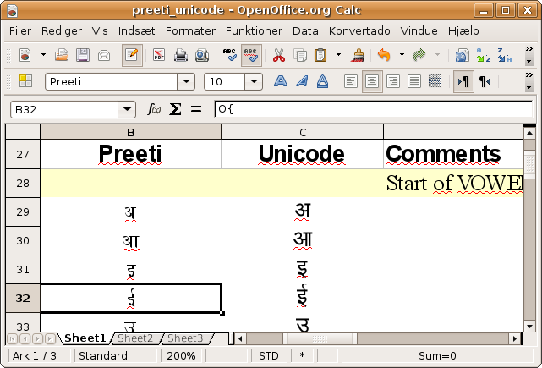
NepaliConverter 4 internals
Conversion schemes is kept in spreadsheets
    One column for e.g. Preeti, one for Unicode
    'Everyone' can improve a scheme or add a new one

