Slide 1

Decoded: Unmasking Credit Card Fraud
DataQuest 2024
Team 5: Aaron Pogrin, Oren Joffe, Julia Monte

Slide 2
Executive Summary
FusionPoint can use machine learning to predict credit card fraud for expansion into financial advisory.
Credit card fraud affects over 150 million adults a year and results in revenue loss for businesses and financial institutions, tainting their reputation.
Problem
Training Set Data
Test Set Data
1
2
3
Recommendation
Descriptive
Predictive
Prescriptive
99% Accuracy
Reached
Bank’s Risk
Minimized
Outcome

Slide 3

Preprocessing
Preparing the dataset for use
Transaction Number & Street
1
Throw Out Non-Useful Data
Look for Missing Values
2
3
Fix Date-Time
Team
Clean Data!

Slide 4
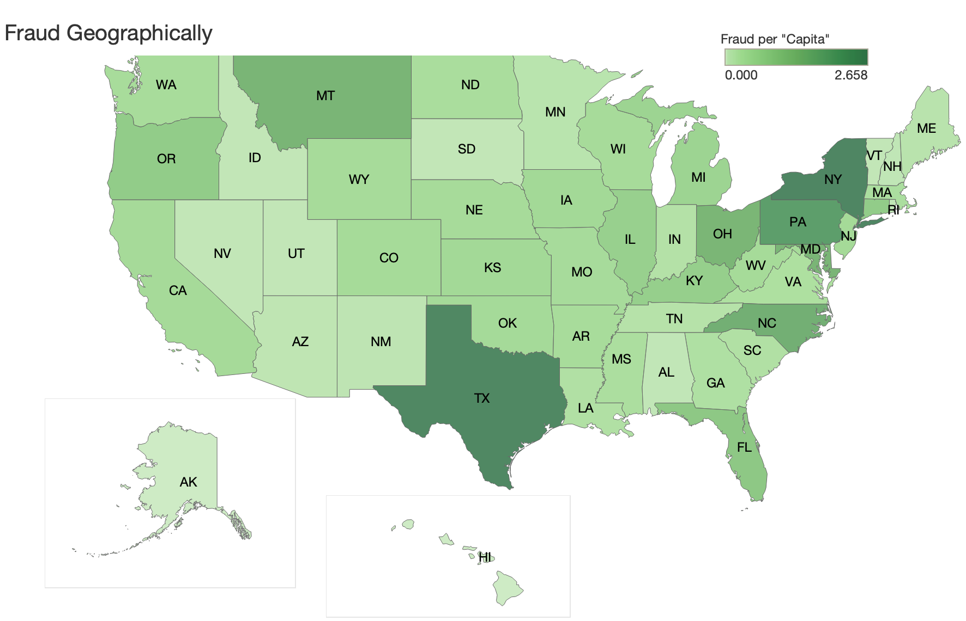
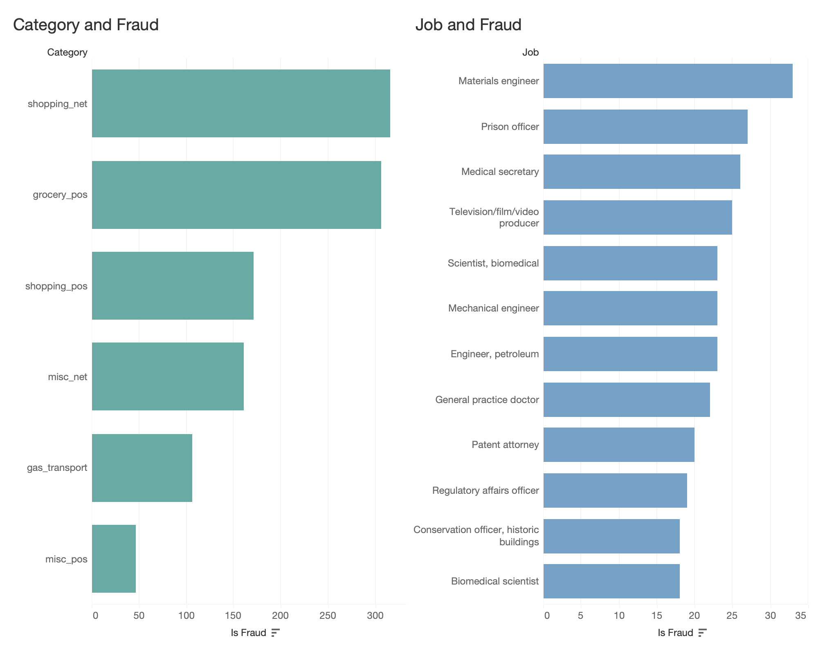
Exploratory Analytics
Taking a deeper dive into the data to guide the process.

Slide 5
Feature Engineering
Enhance model performance through feature engineering by leveraging fraud rate counts.
Rationale for New Features
Example
Most categorical variables had too many values to encode.
New features provide direct relationships between variable and fraud.
Gender | Male | Female
Count | 82,072 | 99,750
Is Fraud | 662 | 674
Fraud Rate | 0.81% | 0.68%
New Feature
Business
Category
City
State
Zip
Job
4% Highest Rau & Sons
2% Highest Shopping_net
100% Highest
Small count
16% Highest
Rhode Island
100% Highest
Small count
100% Highest
Small count
Notes:
'business', 'category', 'city', 'state', 'gender', 'zip', 'job'

Slide 6
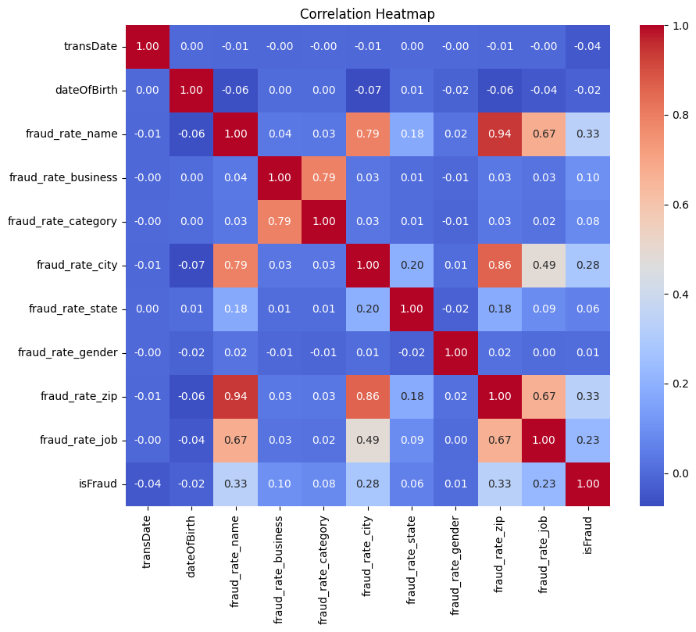
Feature Correlation and Selection
Identifying relationships between input variables and selecting the most informative features.
Improve model performance
Decrease dimensionality

Slide 7
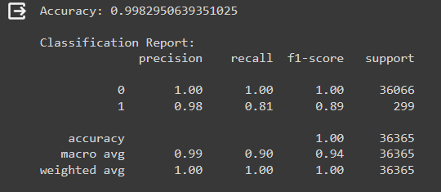
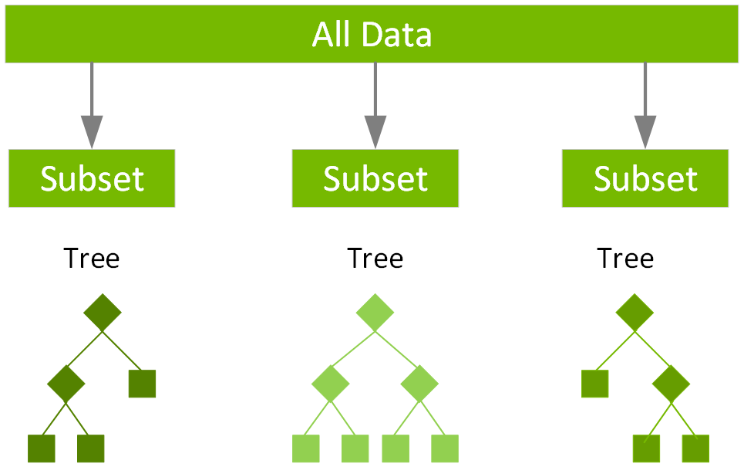
Model Selection
Selecting the optimal model to mitigate class imbalances and achieve high scores.
Why XGBoost
Execution Speed: almost always faster
Model Performance: dominates structured or tabular datasets on classification and regression predictive modeling problems.

Slide 8
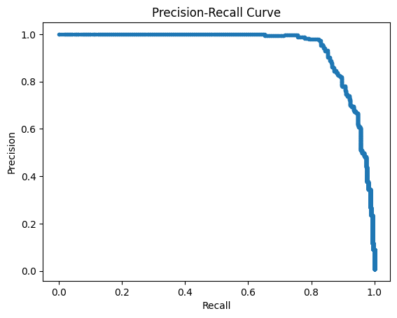
Hyperparameter Tuning and Optimization
Iteratively adjusting the configuration settings of the algorithm to maximize model performance.
Parameter Settings
colsample_bytree: 1.0
gamma: 0
learning_rate: 0.3
max_depth: 5
n_estimators: 300
subsample: 1.0
random_state: 24
Reproducibility for cross-validation.

Slide 9
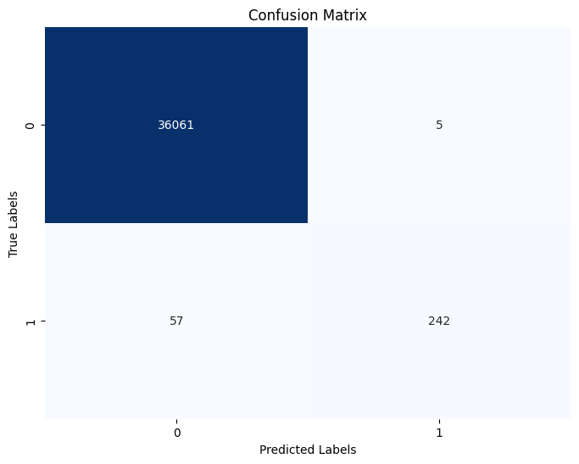
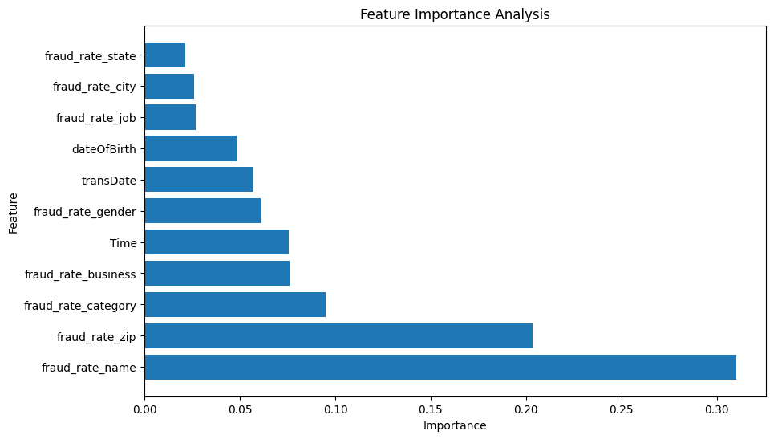
Results and Analysis
Trained XGBoost model predicts fraud accurately.
The model overpredicts a transaction as fraudulent to meet needs of banks and their customers.
Notes:
People would rather have their bank say there was fraud on their account even when there wasn’t in reality

Slide 10
Solution and Implementation
Requires model’s integration into bank’s existing infrastructure and operational workflows.
Ensure that the necessary hardware and software infrastructure are in place to support model deployment.
Integrate the machine learning model with the bank's existing fraud detection systems and workflows.
Phase 1:
Infrastructure Setup
Phase 2: Scaling Up
Phase 3:
Integration
Phase 4:
User Training
Risk Minimized
Consider deploying the model in a distributed environment or utilizing cloud-based solutions for scalability and flexibility.
Provide training and documentation for relevant staff on how to interpret and act upon the model's outputs.

Slide 11
Risks and Mitigations
Action plan to hedge against risks across all dimensions.
Risks:
Mitigations:
Risk Matrix
1
Regulatory Compliance:
Failure to comply with regulatory requirements, such as GLBA, can result in legal penalties and reputational damage.
Stay informed about regulations, implement data anonymization, and document compliance.
3
2
2
Model Performance Degradation:
Over time, the model's performance may degrade due to changes in fraud patterns, customer behavior, or data quality.
Regularly retrain the model with up-to-date data, automate monitoring for performance changes, and continuously refine features to adapt to evolving fraud tactics.
Likelihood
1
3
Cybersecurity Threats:
Models and data are vulnerable to cyberattacks, such as data breaches or model poisoning attacks, compromising the integrity and security of the system.
Implement encryption, access controls, and secure data transmission protocols. Conduct regular security audits and penetration testing, and educate staff and clients on best practices for cybersecurity and data privacy.
Impact
Notes:
GLBA (Gramm-Leach-Bliley Act): Focuses on financial institutions and their handling of customer information in USA

Slide 12
Thank You

