Slide 1
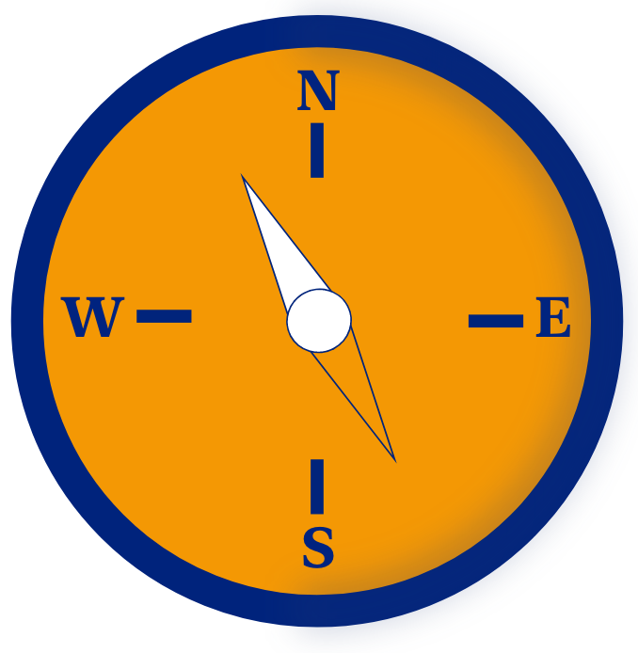

OriCert. Learn with orientation and certify it.

Slide 2

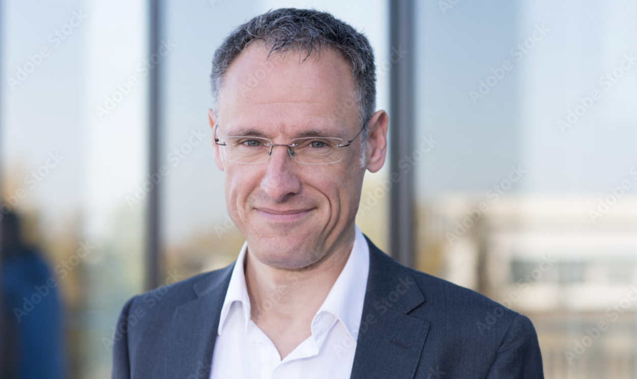

Personas
Emily, 22 years old
Board member of a student initiative
Her goals:
strengthen the presence of the initiative
raise money
recruit motivated people
Her difficulties:
tight budget,
recruiting is difficult as people do not see the benefit of student initiatives
Markus, 47 years old
Employer of a local medium-sized company
His goals:
grow company’s revenue
recognize and recruit talents
keep empolyees long-term within the company
His difficulties:
Missing budget for recruiting
Brain drain
Bad cv
Karli, 47 years old
First semester as a computer science student
Her goals:
New technical skills
Work as a team
Presentation
Her difficulties:
Overwhelmed by the offer of student initiatives
No overview-site
She needs a short explanation of the things she will learn

Slide 3

Problem: Students have difficulties to orientate themselves
80%* of the Students do not have a clear career path in front of their eyes
Many students are confronted with the lack of orientation for local student initiatives and can not make a choice
*Source: https://www.jobteaser.com/de/advices/453-geldsorgen-und-einsamkeit-aber-keine-verzweiflung-fazit-nach-einem-jahr-pandemie-fuer-studierende

Slide 4
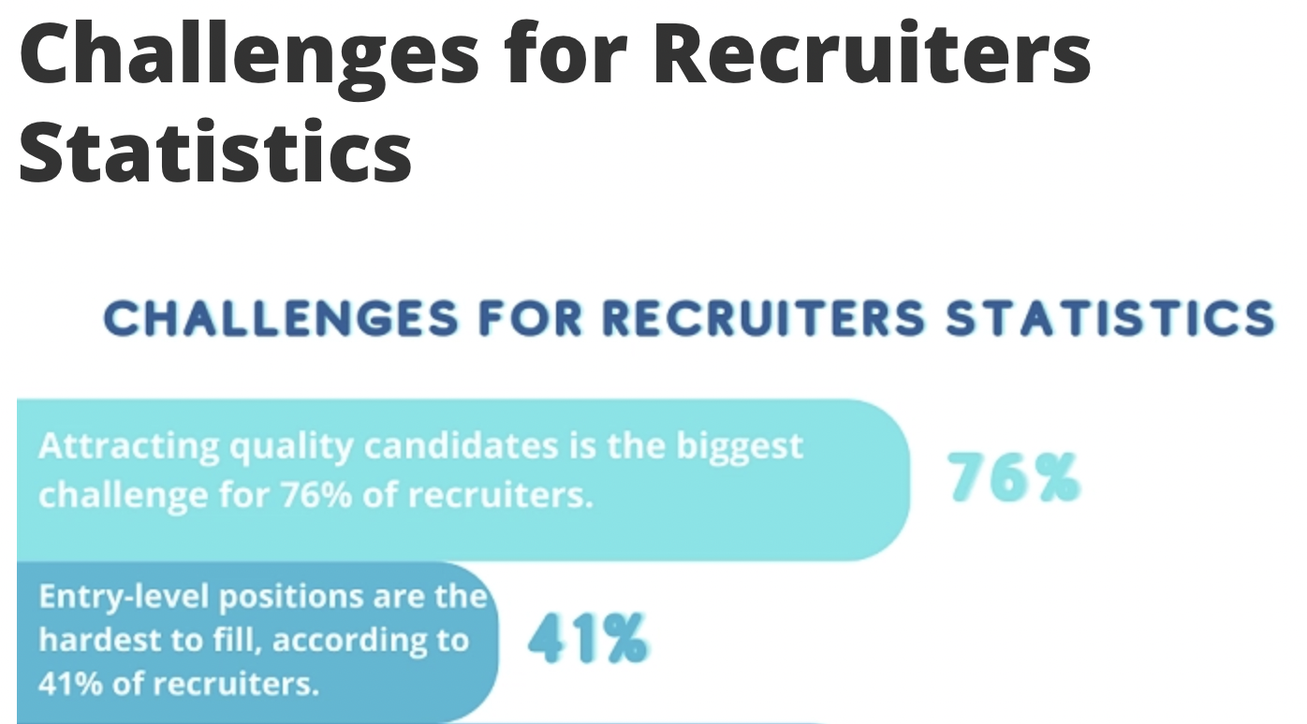
Problem: Companies have a hard time to aquire the right talents
Certificates

Slide 5
Our Product: is beneficial for the recruitment process of companies
Trustworthy Curriculum Vitae with certificates in order to simplify the recruitment process for the companies
Benefit for students: can show their skills & have a complete and sound Curriculum vitae
Certificates are managed and provided by the student initiatives or organizations

Slide 6
Certificates
Im

Slide 7
What we implemented and how it works?

