Slide 1
BlackHawk
Team Red Wings
Andre Oliveira, Project Manager
Mim Cobaj, triple l33t programmer
Tyler White, NP-killa

Slide 2
Overview
Create an online storage of PDFs to simplify the hassle of giving presentations
Allow presentations to be viewed in live-time by audience members (both in-person and not)
Create a collaborative, live-time, whiteboard for office hours

Slide 3
Architecture Design

Slide 4
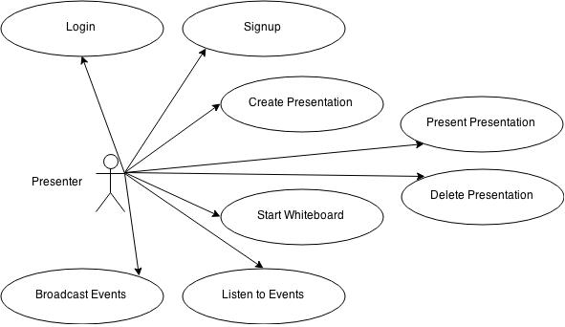
Use Cases

Slide 5
Content Objects
Presenter
_id : MongoObjectID
name : String
email : String
password : String
Presentation
_id : MongoObjectID
author_id : MongoObjectID
title : String
pdf_src/pdf_path : String/Buffer*
1
0.*

Slide 6
Our Stack - MEN
MongoDB
Express
Passport
User Authentication
Socket.io
Websockets / Real-time
Mongoose
Database Object Model (ORM-ish)
NodeJS

Slide 7
The Architecture
NodeJS
Express
MongoDB
Passport
Internet
…
Mongoose
Socket.io

Slide 8
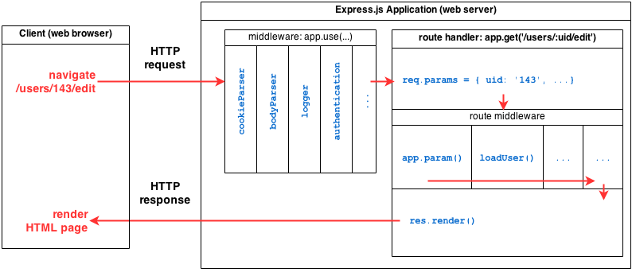
Express - Middleware

Slide 9
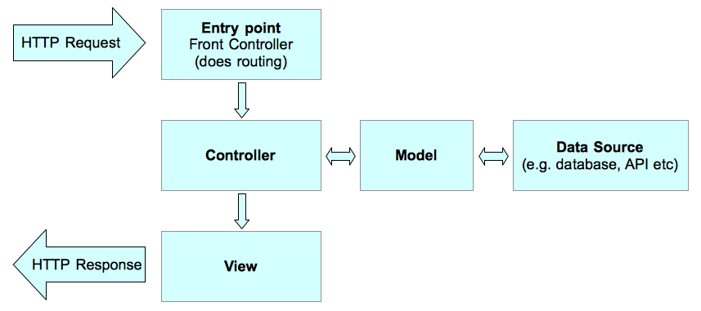
Architecture Design Pattern MVC

Slide 10
Navigation Design

Slide 11
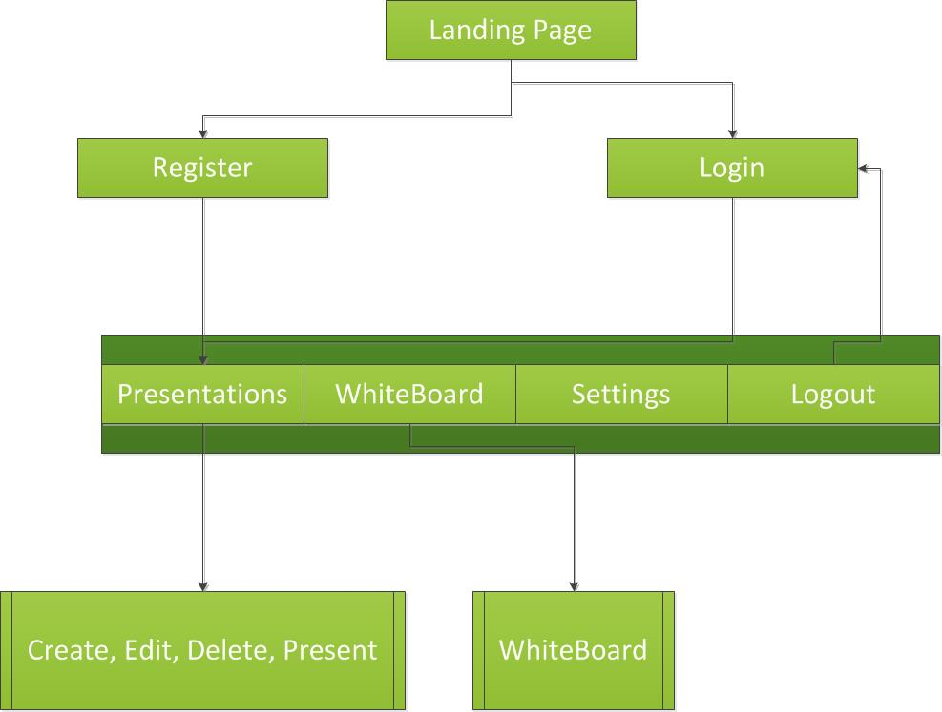
Navigation

Slide 12
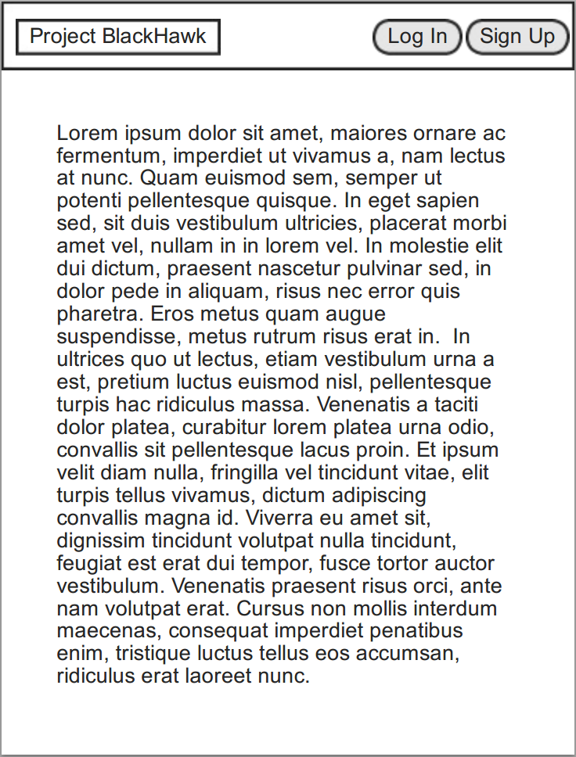
Landing Page

Slide 13
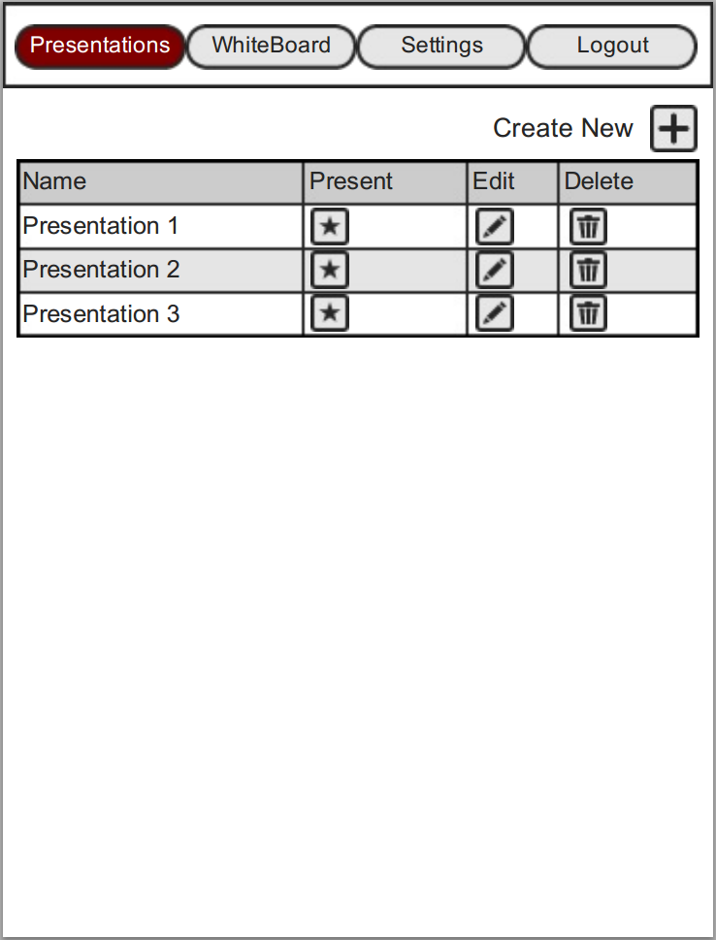
Presentations

Slide 14
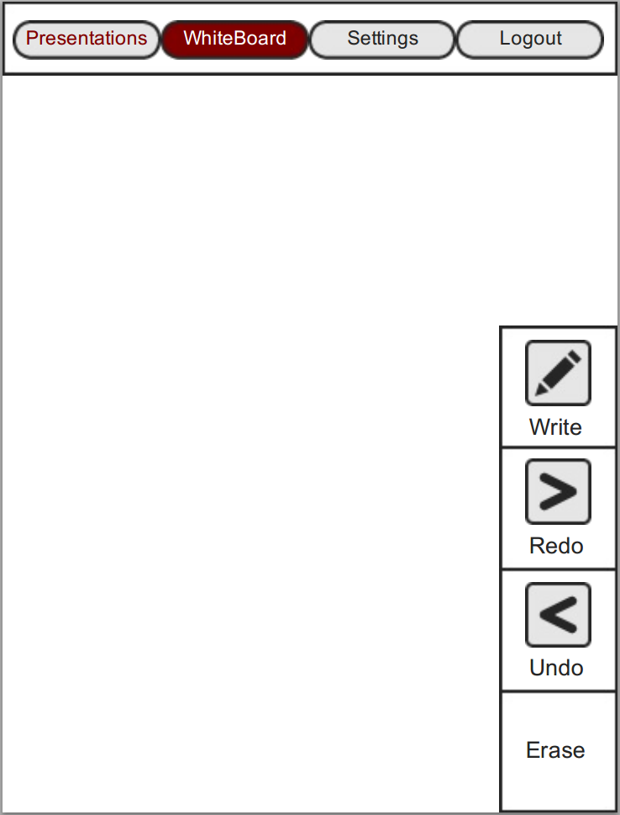
WhiteBoard

Slide 15
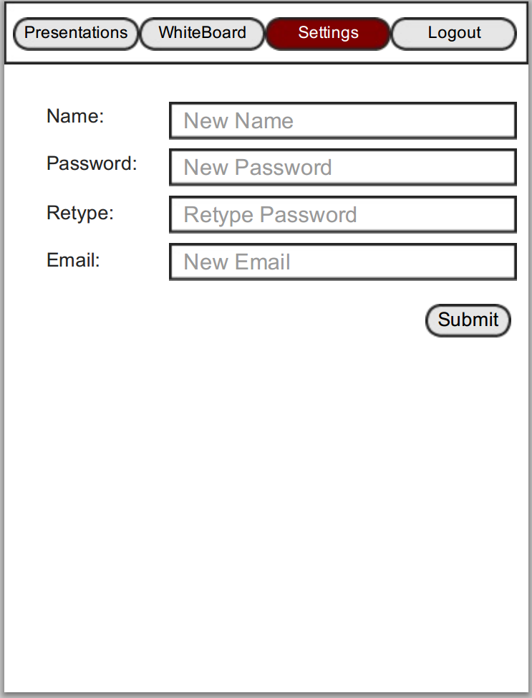
Settings

Slide 16
Progress

Slide 17
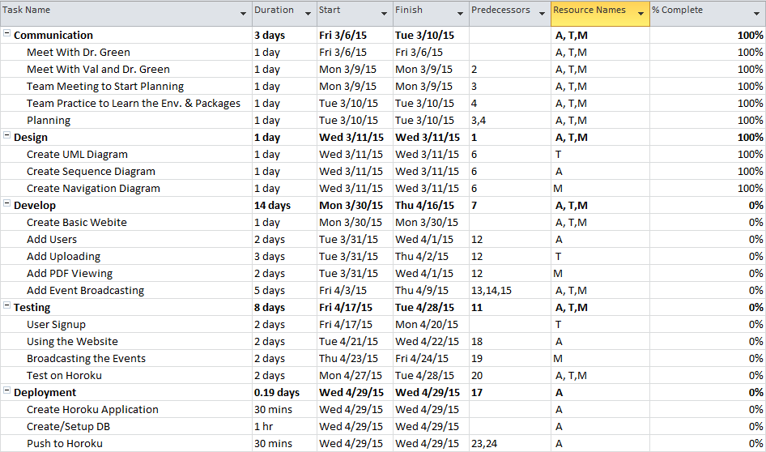
Timeline - MS Project

Slide 18
Time Logs
http://snoopy.rlc.manhattan.edu/~aoliveira01.student/soft_eng/log.html

Slide 19
Questions?

Slide 20
Thank you

