Slide 1
Revamp Multiverse MMO development
A Dev-Ops Project for a legacy Java MMO Game server

Slide 2
The status-quo
The Project
Wikipedia
Archive at way-back machine
Magnetar wiki
Codebase
Sourceforge.net
GitHub
Magnetar ( Based on source forge., authorization required)
Current Deployment
Legacy ( not available, website and hosting services no longer supported )
Magnetar

Slide 3
MMO Server
Game Client
Authoring Tool

Slide 4
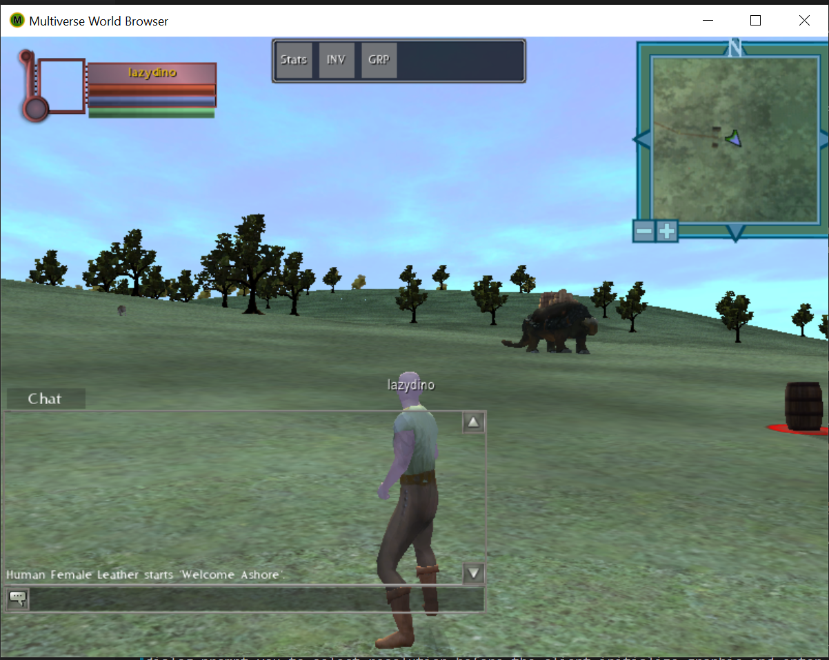
MMO server-client overview
Process (JVM instance)
Server
:/usr/multiverse/bin/multiverse.sh –w …
:/usr/multiverse/bin/master.sh start…
Process (JVM instance)
Server
Server plugin
Server
Server plugin
Multiverse Messaging System
Game Client
Message Domain
Mob (mobile object )
World Server
World Database
Object Manager
Combat Plugin
Mars
Object Server
Proxy Server
World Manager
Python Scripts
Login
Master Server
Multiverse Agnostic Rules System
User
World

Slide 5
Dev-ops
Coding activity to extend functionalities of the system..
Dev
Deploy
Software Release
Workflow
Ops
Adjusting configuration parameters of software execution platform…

Slide 6

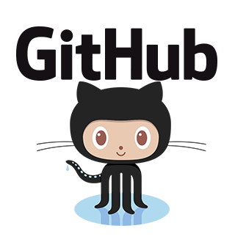


Current Workflow
Dockerfile and scripts are developed based on the Linux installation section of the wiki.
Upon updating repos commit, CircleCI spawned SSH session to inform Dokku creating a new build.
Webhook
Mini PaaS like Heroku that runs as a build server in our cloud VPS.
Dokku
Shell scripts, Dockerfile and config files
Updated codebase
Docker containers are updated and deployed.
DevOps
dev.magnetar.net
WebGL Client
Web Proxy
MMO Server
Legacy .NET Client
Web Browser
Notes:
Nor really addressing dev cycles…

Slide 7
Proposed workflow
Deliver git + dokku + docker solution.
Get rid of remote installation.
Migrate to JDK > 6.
Support dependency management build tools
Separate 3rd party libraries deployment with Maven/Gradle
Support local development/deployment.
Support Windows build
Support IDE integration
Eclipse, Visual Studio Code.
Address unit test, multi-containers using swarm mode..
MMO Server
Developer
Migrate towards Developer’s use case. ( More Dev than Ops..)

Slide 8
Path to success
Use existing workflow
Upgrade codebase to JDK 1.7+
Deploy
Analyze dependencies
Test/Integrate to new workflow
Create build using Maven/Gradle
Green tasks are not necessarily performed in strict water-fall fashion sequentially. Learning and researching activity could be done parallelly.
Finding suitable docker container
Address other concerns

Slide 9
Issues and challenges
JDK, legacy code.
Dependency management
Base docker container image.
On-premises vs Cloud vs Localhost.
Notes:
JDK 6 is EOL, different version of libraries might need to be replaced. Dependency management has to be implemented. Also, different docker based images run processes differently. The current one is using Phusion based jdk 6 container.
Eliminate the current hacks if possible to have a solution that can run on platforms from cloud to desktop, linux to windows.

Slide 10
Test cases/Demo scenario
Java/Python
Use Case for Dev: Start from IDE..
Notes:
Python server plugin.

Slide 11
Useful Wiki sections
Installing/running on Linux
Install
Run
JDK 6 issue
Developing plugins
Create basic plugin
Programmer’s guide
Notes:
Python server plugin.

