Slide 1
Guideline of Tensorflow Model

Slide 2
Outline
Model Graph definition
Training Program
Use collection to store tensors, i.e., grad summary, etc.
Use list to specify variables to restore, to be fixed/trained

Slide 3
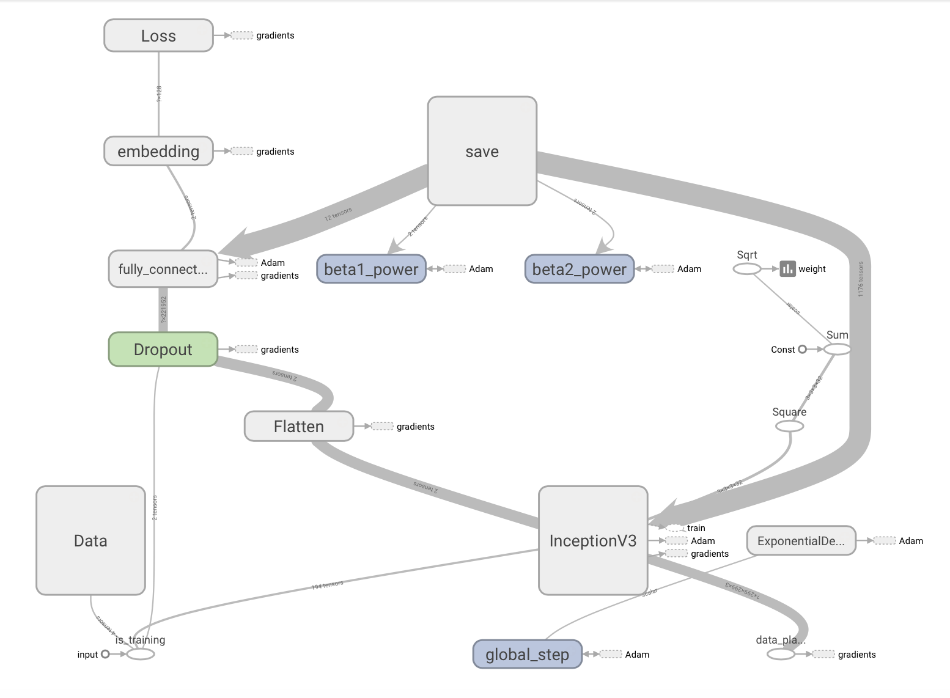
Main Graph

Slide 4
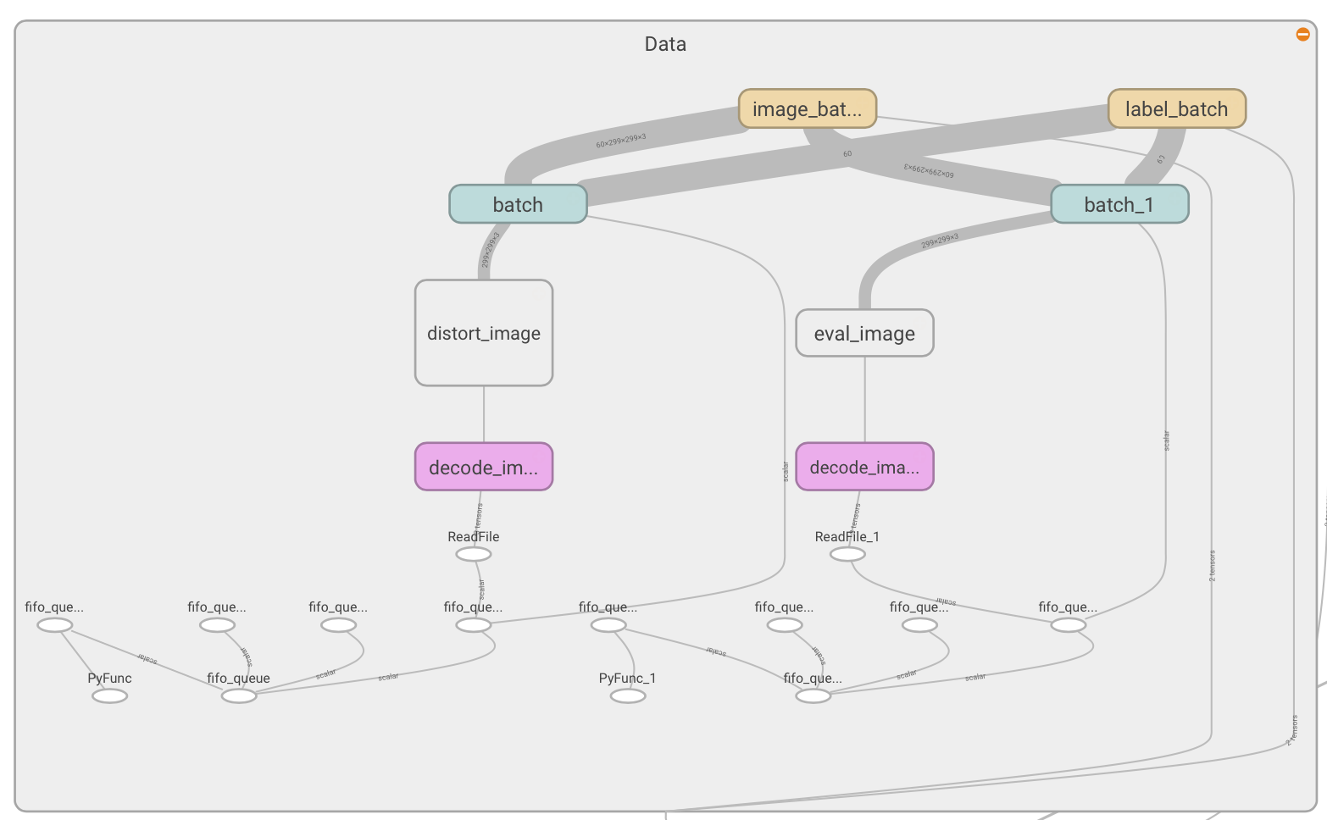
Data
Train
Test
Data Preprocessing
Multi-thread data Loading

Slide 5
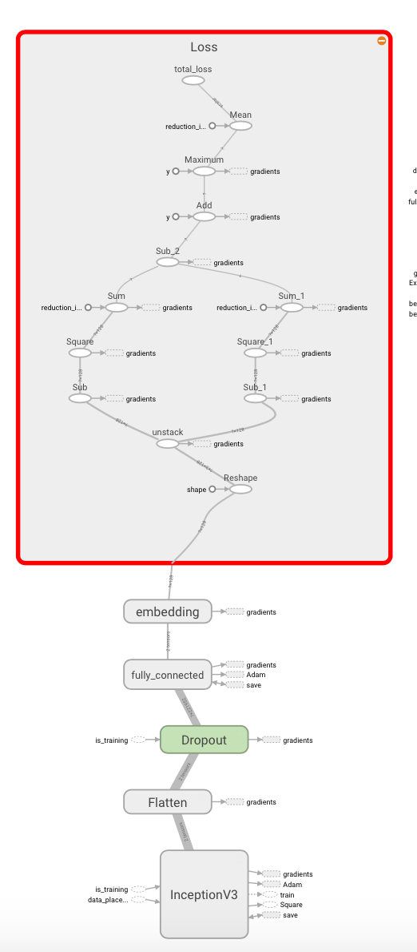
Loss & Embedding
Loss
Embedding Network

Slide 6
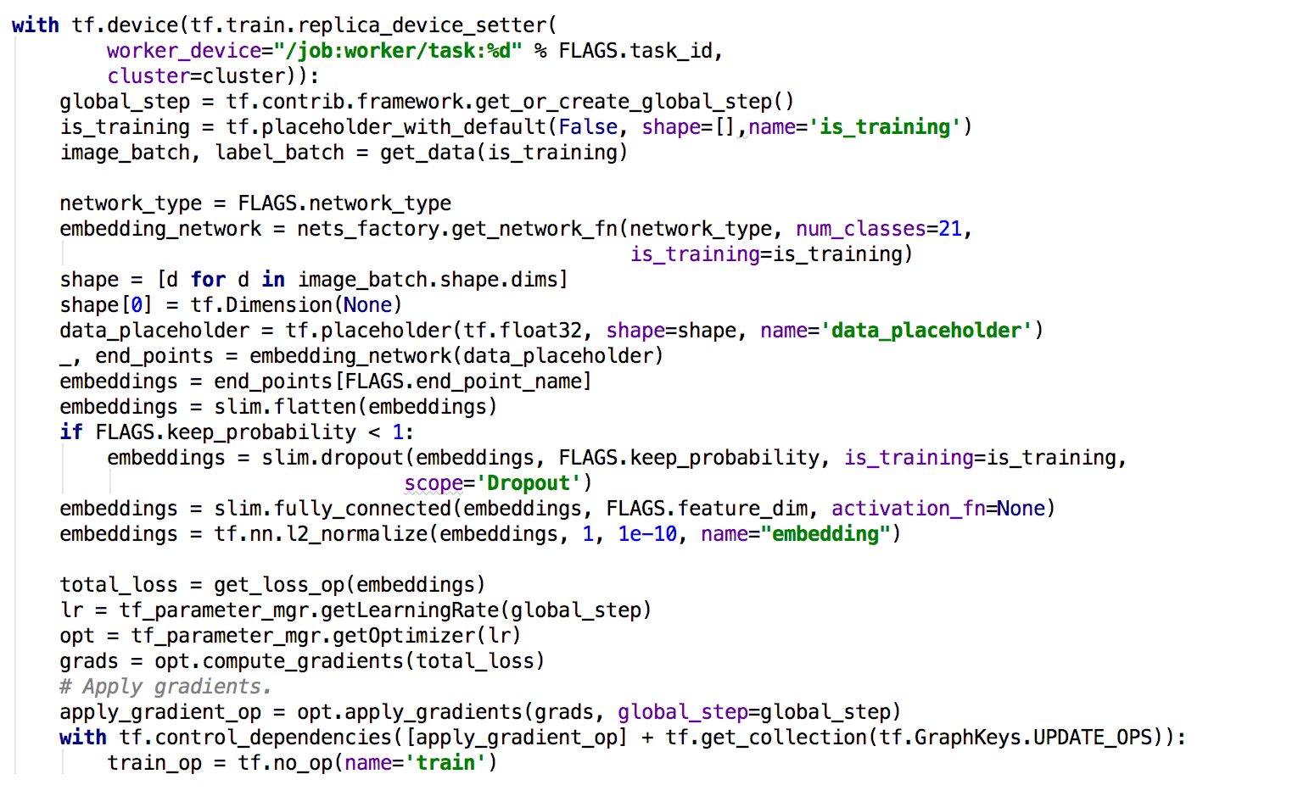
Model Definition

Slide 7
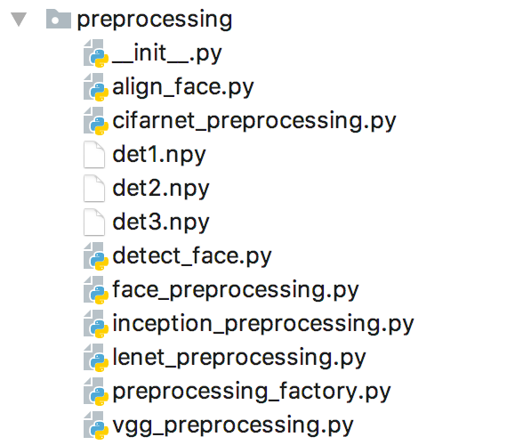
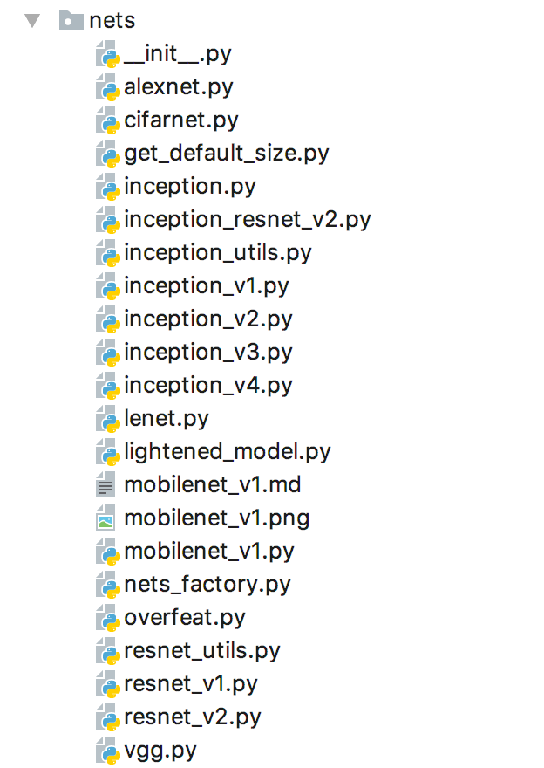
Data Preprocessing & Embedding Network Model

Slide 8
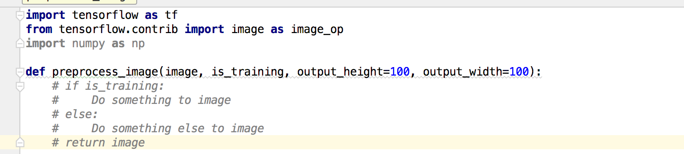
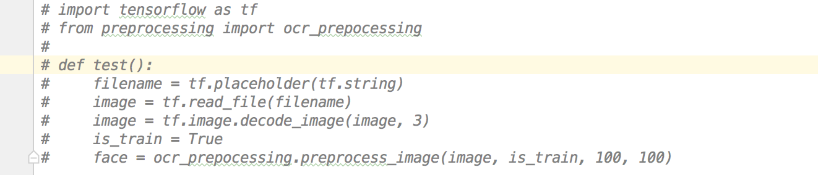
Steps to create a new preprocessing
Add a new function in the preprocessing/ directory, where you implement the following interface
Create a test function, test the result of your preprocessing method
Add your preprocessing into the preprocessing_facetory.py

Slide 9
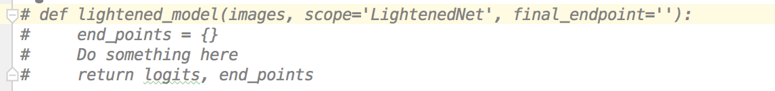
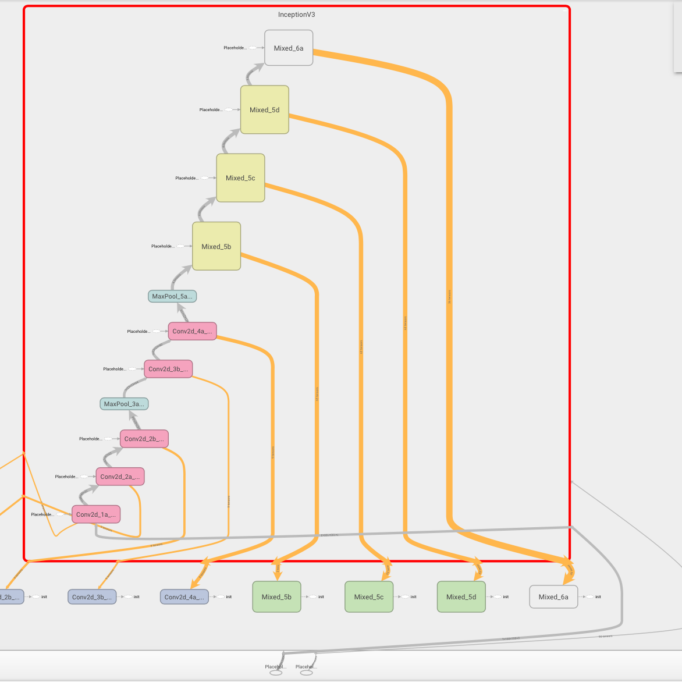
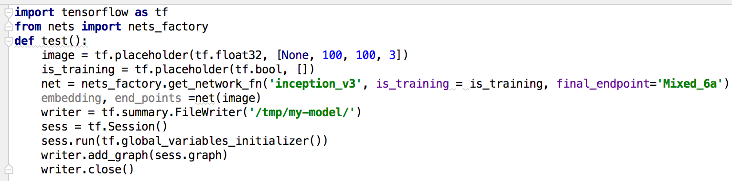
Steps to create a new embedding network
Add a new function in the nets/ directory, where you implement the following interface
Create a test function, visualize the model you create via tensorboard
Add your preprocessing into the nets_facetory.py

Slide 10
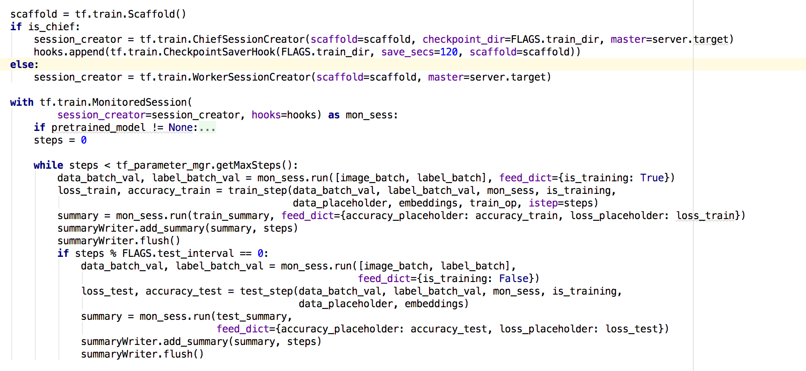
Model Training

