Slide 1
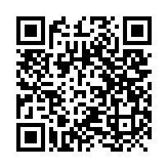
Instructions and links
Please visit tinyurl.com/how2trainnn to download the files. Keep the link in mind because more notebooks will be placed in the future.
A comprehensive documentation of PANNA may be found at: https://pannadevs.gitlab.io/pannadoc/index.html or by scanning

