Slide 1
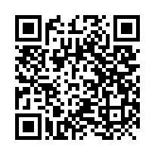
Instructions and links
Please visit tinyurl.com/how2trainnn to download the files. Keep the link in mind because more notebooks will be placed in the future.
A comprehensive documentation of PANNA may be found at: https://pannadevs.gitlab.io/pannadoc/index.html or by scanning

Slide 2
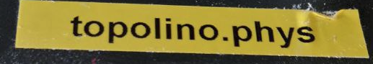

Remote-connect to your workstation
Go to your computer’s terminal.
Type `ssh your_SISSA_username@station_name.station_domain.sissa.it`. Then enter your SISSA password. For example, my computer is named ‘topolino.phys’.
I should type: `ssh atan@topolino.phys.sissa.it`. Then write your password
Once logged in, you can get the course notebook by cloning the repository:
`git clone https://github.com/apolmiguel/how2trainyournetwork_course.git`
Follow the `README.md` inside the root folder for installations.

Slide 3
Jupyterlab in your remote-ssh
‘jupyter-lab --no-browser --port=8888’
Check the actual port in the generated link. Say it’s still 8888.
Open a new terminal and type:
‘ssh –L 8888:localhost:8888 user@domain.it’
Now you can open the original link in jupyter.
For cineca-leonardo:
https://wakeful-waiter-378.notion.site/cineca-4b4e27781c834a2ba89d29db81557db4?pvs=4

Slide 4
Where we are
Francesca – 417
Abdul – 468
Apol – 410
Stefano - 405

Slide 5
Available workstations:
crozzon.phys
(check 321 computers)
topolino.phys (but let me know –Apol)

