Slide 1
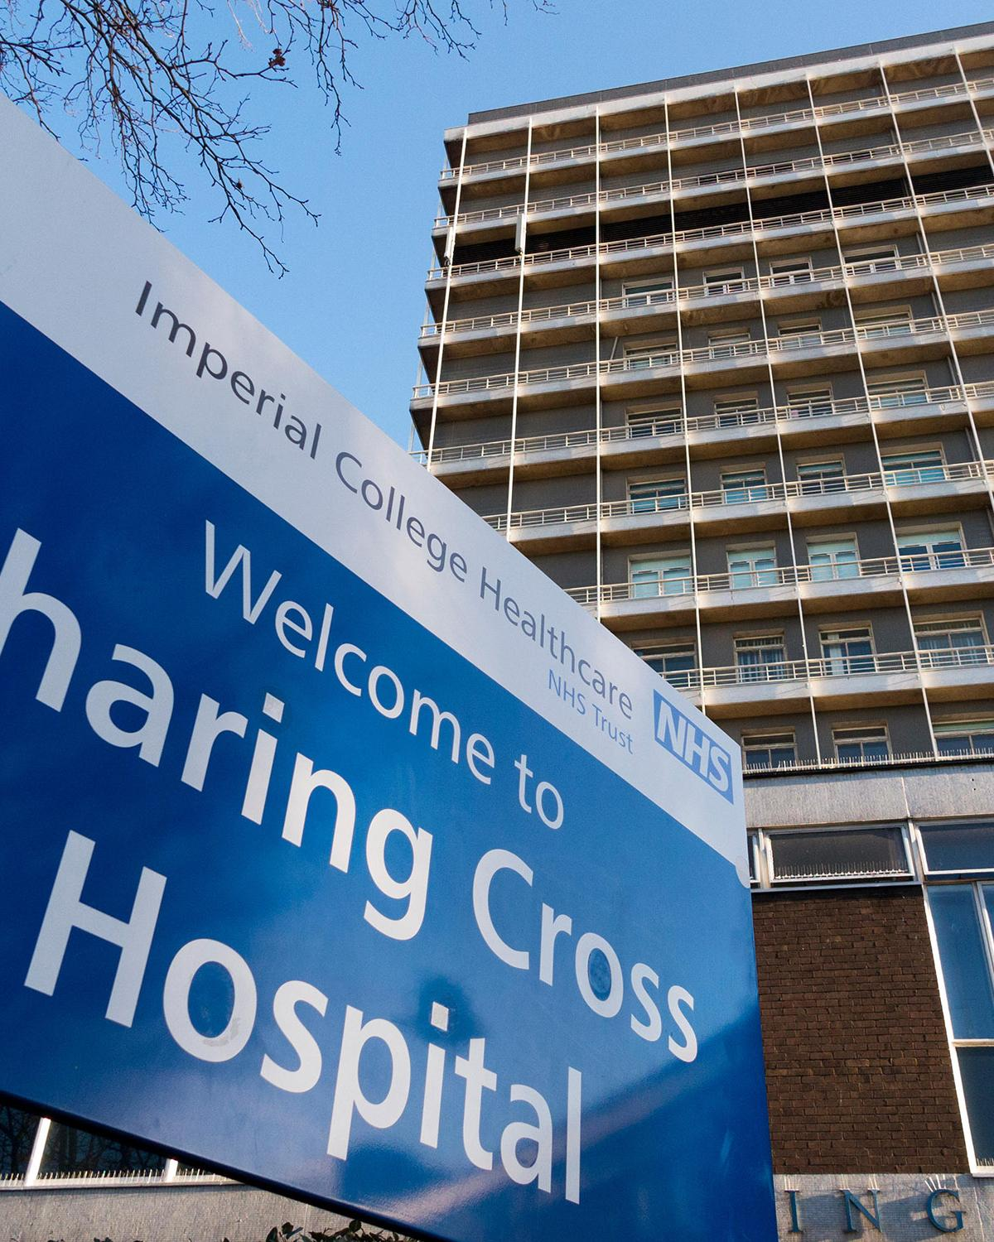
Cancer Incidence and Prevalence
Scotland-only
January 1994 to December 2017

Slide 2
Notes on the Data
Data for all cancers exclude non-melanoma skin cancers.
Difficulties in reporting these largely benign cancers, with a low mortality rate, mean that they are conventionally excluded from all-cancers data sets.

Slide 3
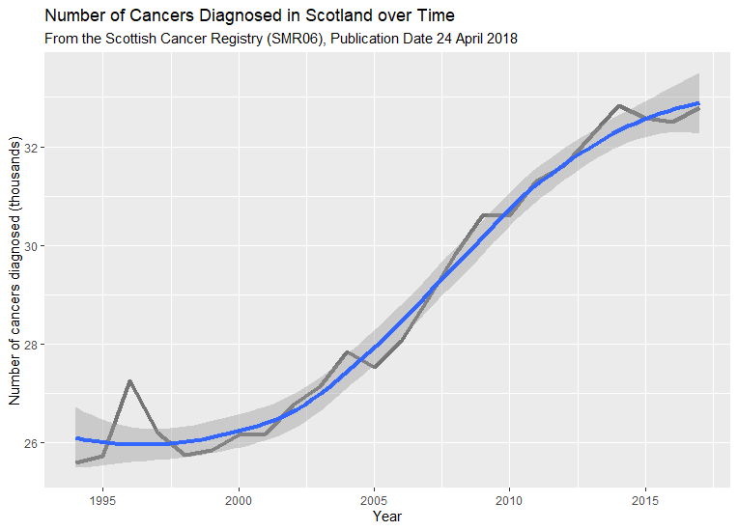
Total Incidences
The number of recorded incidences of cancers is increasing.
Up ⯅ 28.1% since the start of the recorded data.
Up from ~29,000 to ~33,000 (⯅ 13.3%) over the previous decade.

Slide 4
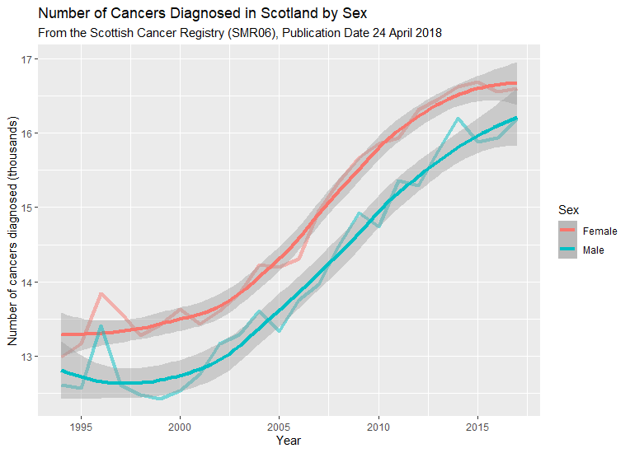
Total Incidences by Sex
Incidences are increasing for both sexes…

Slide 5
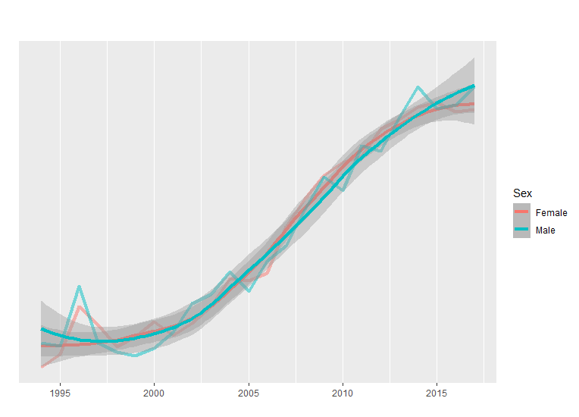
Total Incidences by Sex
Incidences are increasing for both sexes…
…at approximately the same rate.

Slide 6
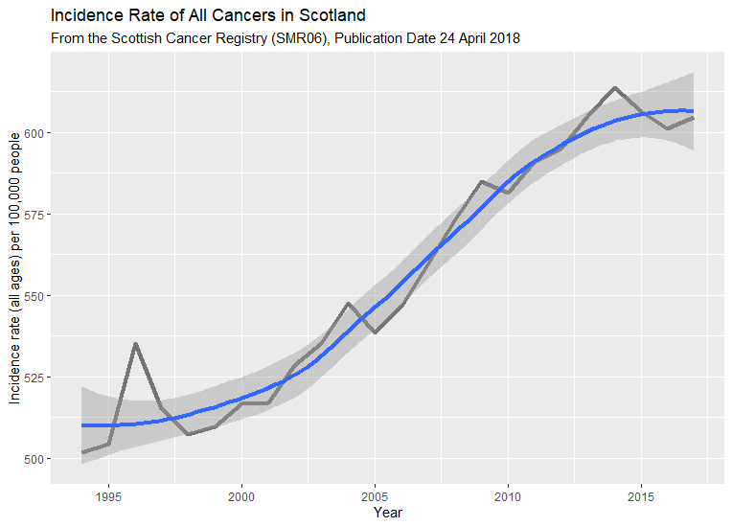
Risk of Cancer
The relative risk of all cancers (across all ages) is increasing over time.
Up ⯅ 20.3% since the start of the recorded data.
2018 relative risks up ⯅ 0.5% over the previous year.

Slide 7
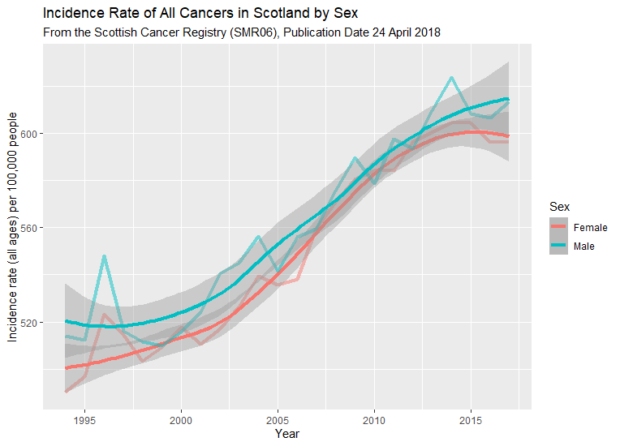
Risk of Cancer by Sex
Historically, women have a lower rate of cancer incidence than men.
The sex gap in cancer incidence is widening.

Slide 8
Contrasts by Sex
Despite more females than males being diagnosed with cancer, the risk of cancer is, and always has been, higher in males than females.
This is partly due to the difference in average life between the sexes.

