Slide 1
CHINA
Shanghai postpones national college, high
school entrance exams by a month
CGTN(With input from Xinhua)
Updated 14:47, 07-May-2022
32001298 杨晨露
Time：2021.05.07

Slide 2

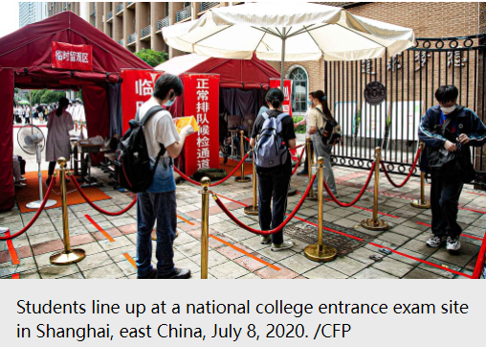
China's Shanghai has postponed the national college entrance exam, known as Gaokao, by a month to July 7-9 due to the COVID-19 situation in the city, officials told a press briefing on Saturday.
The local high school entrance exam was also put back for another month or so to July 11-12.

Slide 3
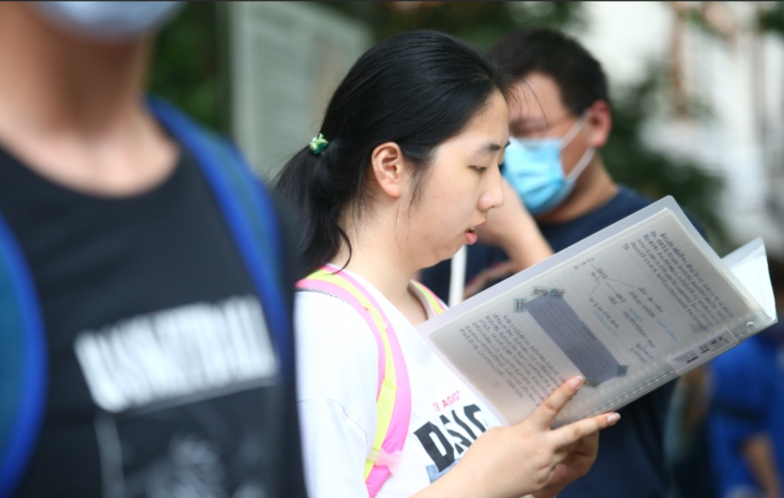
Over 50,000 students will sit the college entrance examination and another 110,000 students will attend the senior high school entrance examination, while laboratory exams for physics and chemistry and foreign language listening tests will be canceled.

Slide 4

Special rooms will be set up for students under concentrated quarantine or with abnormal COVID-19 test results, ensuring every student will be able to take the exams, said Chen Qun, vice mayor of Shanghai.
Since March 12, all primary and secondary schools in Shanghai have switched to online teaching, and kindergartens and nurseries have been closed.
Shanghai reported 253 confirmed locally transmitted COVID-19 cases and 3,961 local asymptomatic cases on Friday, the municipal health commission said Saturday.

Slide 5
CHINA
Thank you

