Slide 1
P0894 – realloc() for C++
Victor Dyachenko, Antony Polukhin
2018-11

Slide 2
The problem
Contiguous containers (std::string & std::vector) have to relocate all the elements every time they increase the capacity. Even when adjacent memory block of required size is available.
C language uses realloc() which has behaviour inappropriate for C++ object model
capacity
free memory

Slide 3
Solution
Add an optional function to allocator’s interface:
Add similar wrapper function to std::allocator_traits that just always returns false if allocator doesn’t define such function:
Make std::string & std::vector use this function.
bool resize_allocated(pointer p, size_type cur_size, size_type new_size);
static bool resize_allocated(Alloc &a, pointer p, size_type cur_size, size_type new_size);

Slide 4
What has the call to do?
Check if the buffer can be expanded/shortened.
Return false if not.
Resize the buffer and return true otherwise.
bool resize_allocated(pointer p, size_type cur_size, size_type new_size);

Slide 5
What has the container to do?
Just use the resized memory buffer if the call succeeds (true is returned).
Fallback to the current buffer relocation approach when the call fails (false is returned).

Slide 6
Expected performance impact
No performance impact is expected when the used allocator doesn’t define resize_allocated() function. The code in the container effectively becomes if(false) { … } which can be eliminated by optimizer.
If used allocator defines such function and the call succeeds we eliminate new buffer allocation call + elements copy/move calls + old buffer deallocation call.
If used allocator defines such function and the call fails we have an additional call + boolean check overhead (which expected to be compensated by successful calls).

Slide 7
Backward compatibility impact
The feature is a pure library extension of std::allocator_traits interface. Just one additional customization point.
We can decide don’t touch std::allocator interface at all or allow implementation to define or not to define resize_allocated() function. The first approach is fully backward compatible but users don’t get the feature “for free” – they have to manually replace the allocator.

Slide 8
Intended ship vehicle
We target the nearest Standard update (C++20) because the earlier the STL containers can use this feature the earlier we can get support in the system allocators (like jemalloc, etc).

Slide 9
Bonus feature #1
Combine with P0401 - Extensions to the Allocator interface (Jonathan Wakely). Add some feedback from allocator – allow allocator to tell the actual size of the allocated block via an additional output parameter:
bool resize_allocated(pointer p, size_type cur_size, size_type &new_size);

Slide 10
Bonus feature #2
Pass the preferred and the minimum requested size. The allocator has to try to satisfy the preffered size first. If failed then try to satisfy the less size (bonus #1 is included too):
The idea was borrowed from N2045 - Improving STL Allocators
bool resize_allocated(pointer p, size_type cur_size, size_type &new_size);
bool resize_allocated(pointer p, size_type cur_size, size_type &preferred_size, size_type min_size);

Slide 11
std::allocator

Slide 12
std::allocator

Slide 13
pool_allocator / monotonic_allocator
template <class T>
using pool_vector
= std::vector<T, pool_allocator<T, N>>;

Slide 14
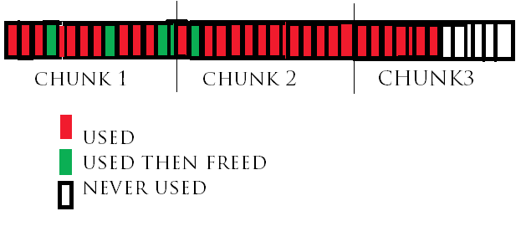
pool_allocator / monotonic_allocator
template <class T>
using pool_vector
= std::vector<T, pool_allocator<T, N>>;

Slide 15
stack_vector
template <class T, size_t N> struct stack_allocator {
aligned_storage_t<T> d[N];
bool resize_allocatoed(…); // throws if buffer is small
};
template <class T, size_t N>
using stack_vector
= std::vector<T, stack_allocator<T, N>>;

Slide 16
small_vector
template <class T, size_t N> struct small_allocator {
aligned_storage_t<T> d[N];
bool resize_allocatoed(…); // `new` if buffer is small
};
template <class T, size_t N>
using small_vector
= std::vector<T, small_allocator<T, N>>;

Slide 17
small_string
template <class T, size_t N> struct small_allocator {
aligned_storage_t<T> d[N];
bool resize_allocatoed(…); // `new` if buffer is small
};
template <size_t N> using small_string
= std::basic_string<char, char_traits<char>, small_allocator<char, N>>;

Slide 18
small_deque
template <class T, size_t N> struct small_allocator {
aligned_storage_t<T> d[N];
bool resize_allocatoed(…); // `new` if buffer is small
};
template <class T, size_t N>
using small_deque
= std::deque<T, small_allocator<T, N>>;

