Slide 1
VANGUARD · WISER QUANTUM CHALLENGE
Constraint-safe
quantum-guided
portfolio optimization
EXACT SAFETY
17 guardrail families
MEASURED SCALE
300,000 assets
REAL HARDWARE
8–28 qubits
A scalable classical solver with a safe, auditable quantum proposal interface
Final challenge presentation · August 2026
Notes:
Open with the invariant: search methods may propose assets, but allocation and validation control the final portfolio.
[Sources]
- Vanguard / WISER, Multi-Asset Portfolio Optimization challenge brief, supplied 2026.
- Repository final report, docs/portfolio_optimization_report.md.

Slide 2
WISER QUANTUM CHALLENGE
Portfolio rules matter more than circuit energy
The required output
01
Improve expected utility
An investable table of asset weights, trades, risk, income, cost, and a rationale a portfolio team can audit.
Balance risk, growth, income, drawdown, and cost
02
Respect every guardrail
Budget, holdings, groups, turnover, factors, stress, and CVaR
03
Prove what happened
Classical baselines, validation, scalability, explainability, and hardware provenance
Our standard: a poor or noisy proposal is rejected—never repaired into an unsafe recommendation.
02
Notes:
Translate the challenge from optimization vocabulary into the decision a portfolio team must make.
The solver must produce an allocation and rationale, not only a sampled bitstring.
[Sources]
- Vanguard / WISER challenge brief, pages 1–4.

Slide 3
WISER QUANTUM CHALLENGE
One safety boundary keeps every method fair
01
02
03
04
Full universe
Adaptive window
Candidate support
Accepted portfolio
Factor QP ranks all assets
Freeze most holdings; test a local change
Classical LNS or XY-QAOA proposes assets
Allocate exact weights; validate every rule
The quantum computer never assigns capital and never bypasses the independent validator.
03
Notes:
Use one phrase consistently: support selection chooses assets; allocation assigns percentages.
Every classical, random, ideal, GPU, and QPU candidate is sent to the same allocation oracle.
[Sources]
- Repository implementation: src/vanguard_portfolio/{allocation,window_search,quantum_solver,validation}.py.
- Final report, Algorithm §3.

Slide 4
WISER QUANTUM CHALLENGE
The model makes investor trade-offs measurable
min
RISK
GROWTH
INCOME
COST
λᵣ · variance
−
λg · return
−
λy · yield
+
λc · turnover cost
Hard guardrails
Capital
Composition
Risk
Implementation
100% invested
Long-only
Position min/max
Exactly K holdings
Eligible + mandatory
Group bands
Factor bands
Stress floors
95% CVaR limit
Turnover cap
Trading cost
Liquidity cap
Lower composite objective is better. It is not a percentage return.
04
Notes:
Define each term before using the symbols. The lambdas are investor preference weights.
CVaR means average loss in the worst selected fraction of scenarios.
[Sources]
- H. Markowitz, Portfolio Selection, 1952, doi:10.1111/j.1540-6261.1952.tb01525.x.
- R. Rockafellar and S. Uryasev, Optimization of CVaR, 2000, doi:10.21314/JOR.2000.038.
- Repository mathematical model: docs/mathematical_model.md.

Slide 5
WISER QUANTUM CHALLENGE
Correctness is triangulated before scale is claimed
1.41×10⁻⁹
Exact match
0.0% gap
objective spread across SciPy, OSQP, Clarabel, and Gurobi
tiny exhaustive enumeration equals Gurobi at −0.03681145
100-asset Gurobi certificate at objective −0.0384147146
Valid initialization
−0.03468764
feasible starting point
LNS / XY-QAOA / penalty QAOA
−0.03804482
same best heuristic support after allocation
Gurobi MIQP
−0.03841471
global optimum for the stated model
05
Notes:
The continuous solution is not called the sparse winner; it is a relaxation.
The heuristic closes about 90.08% of the initial-to-certified objective difference.
[Sources]
- results/final_submission/classical/continuous_backend_crosscheck.csv.
- results/final_submission/classical/tiny_exact_hybrid_summary.csv.
- results/final_submission/classical/main_100_asset_hybrid_summary.csv.

Slide 6
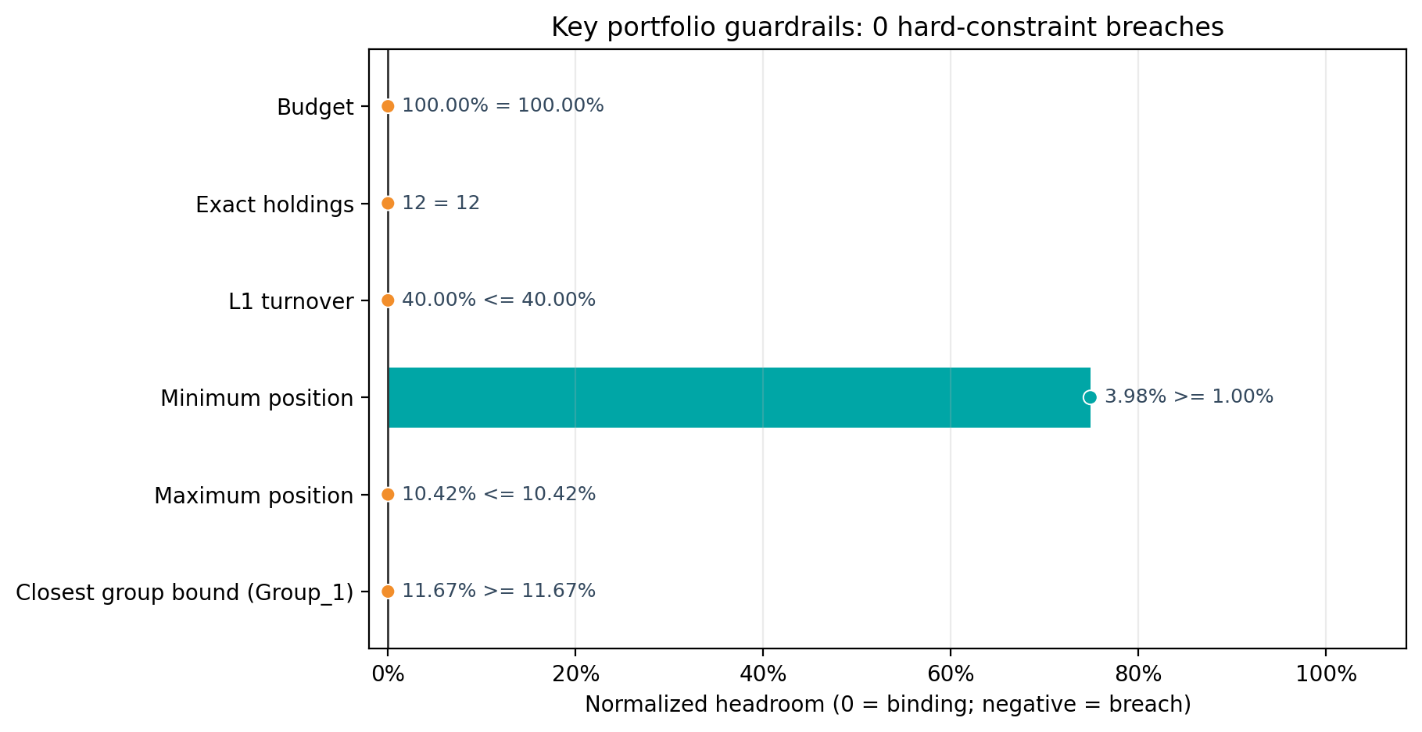
WISER QUANTUM CHALLENGE
All 17 guardrail families pass a global certificate
17 / 17
constraint families pass
244
independent row-level checks
Gurobi objective −0.0320099372 · K = 12 · reported gap 0.0%
06
Notes:
Name examples beyond the visible six rows: eligibility, mandatory holdings, return, income, factor bands, stress, CVaR, and implementation caps.
Zero breaches is backed by row-level left-hand sides, limits, slacks, and pass/fail values.
[Sources]
- results/final_submission/constraints/all_constraints_certified_summary.csv.
- results/final_submission/constraints/all_constraints_certified_families.csv.
- results/final_submission/constraints/all_constraints_certified_checks.csv.

Slide 7
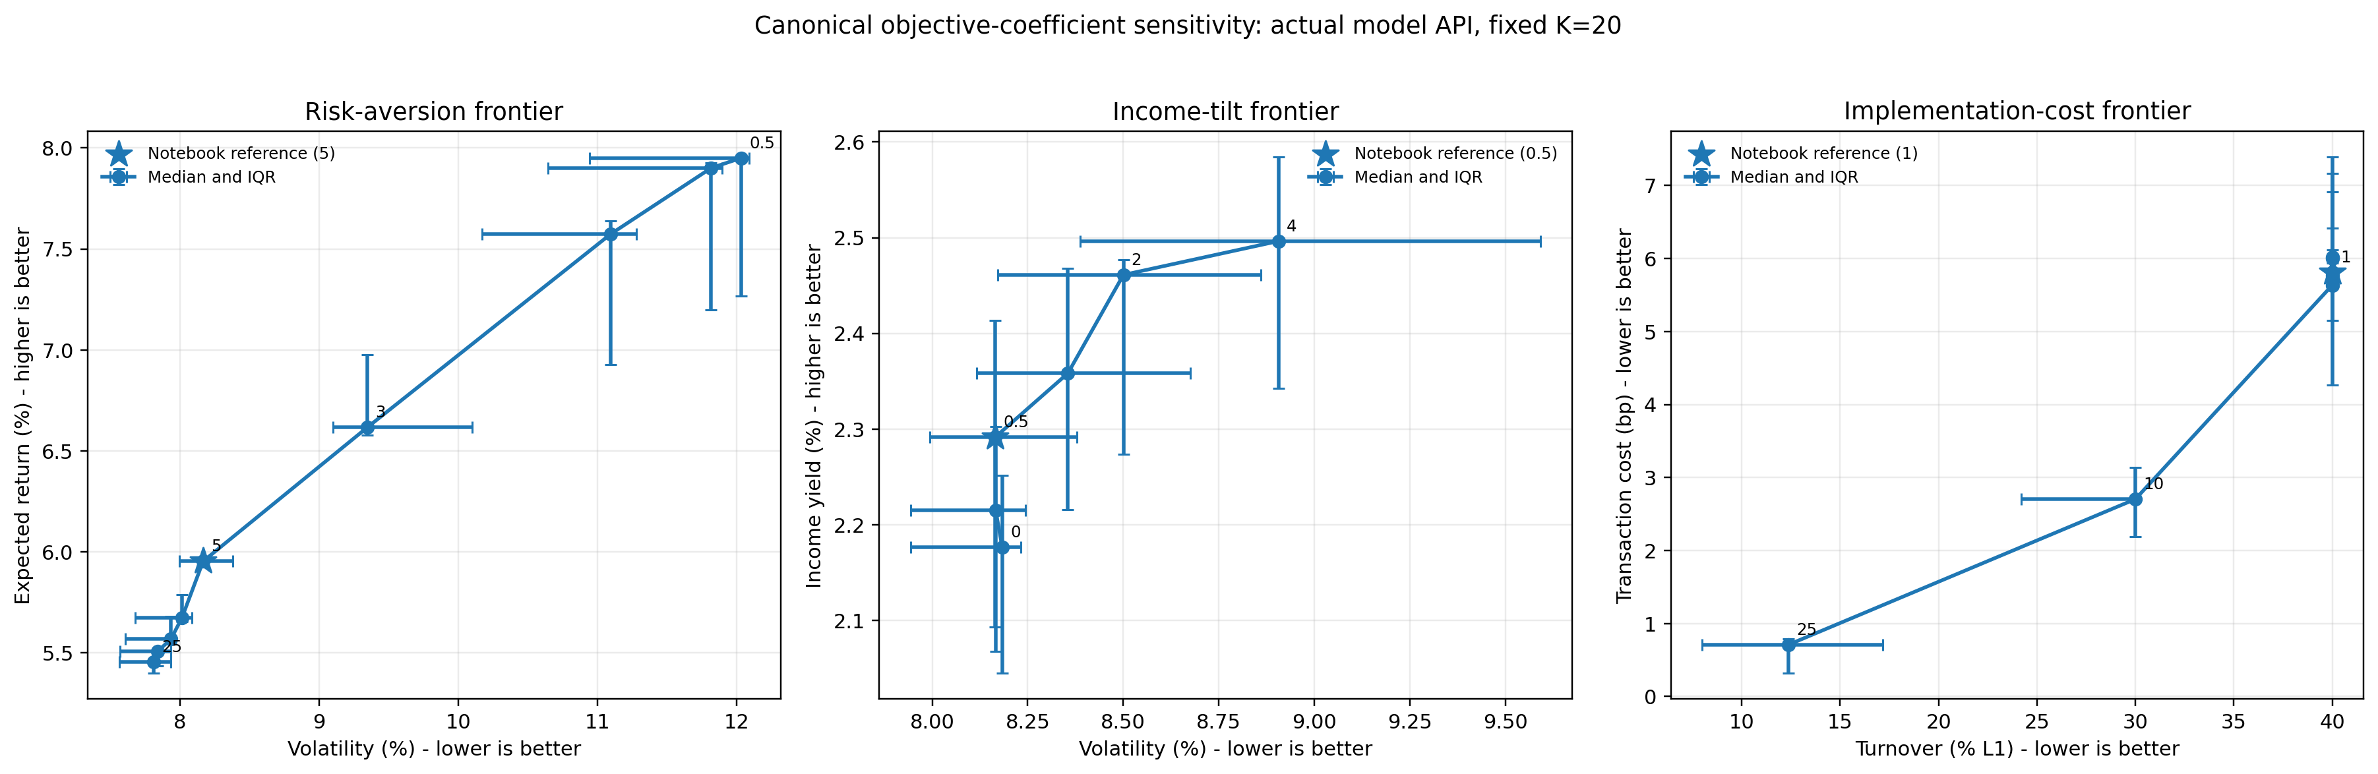
WISER QUANTUM CHALLENGE
Investor controls move the portfolio as expected
Risk
12.03% → 7.81% volatility
Income
2.18% → 2.50% yield
Cost
40.00% → 12.36% turnover
Every allocation shown: zero hard-constraint breaches
07
Notes:
The three one-at-a-time sweeps make the solver controllable rather than a black box.
Mention that the expected-return reduction on the risk sweep is the price paid for lower volatility.
[Sources]
- results/final_submission/preferences/preference_sensitivity_summary.csv.
- results/final_submission/preferences/preference_profile_summary.csv.

Slide 8
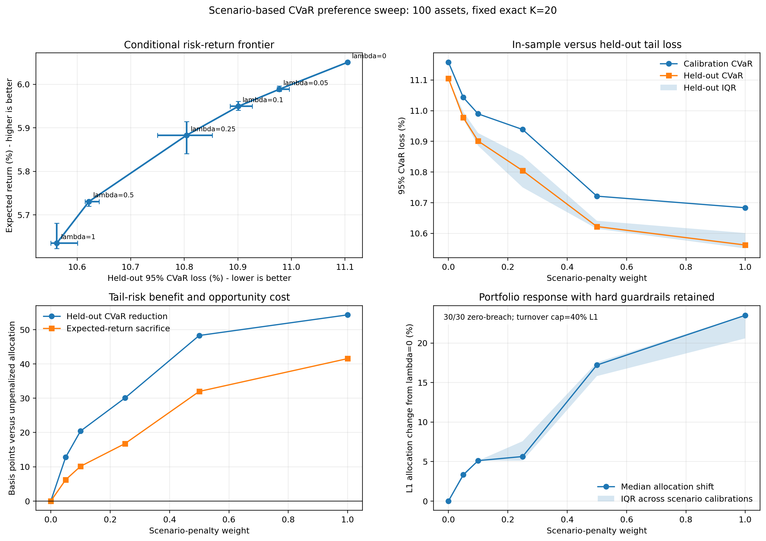
WISER QUANTUM CHALLENGE
Tail risk falls 54 basis points on a clear frontier
−54.31 bp
held-out 95% CVaR
−41.55 bp
expected return trade-off
30 / 30 allocations valid
08
Notes:
One basis point is 0.01 percentage point.
Do not call lambda=1 universally best; present it as the strongest tail point in this measured sweep.
[Sources]
- results/final_submission/preferences/scenario_penalty_summary.csv.
- results/final_submission/preferences/scenario_penalty_runs.csv.
- Rockafellar and Uryasev, 2000, doi:10.21314/JOR.2000.038.

Slide 9
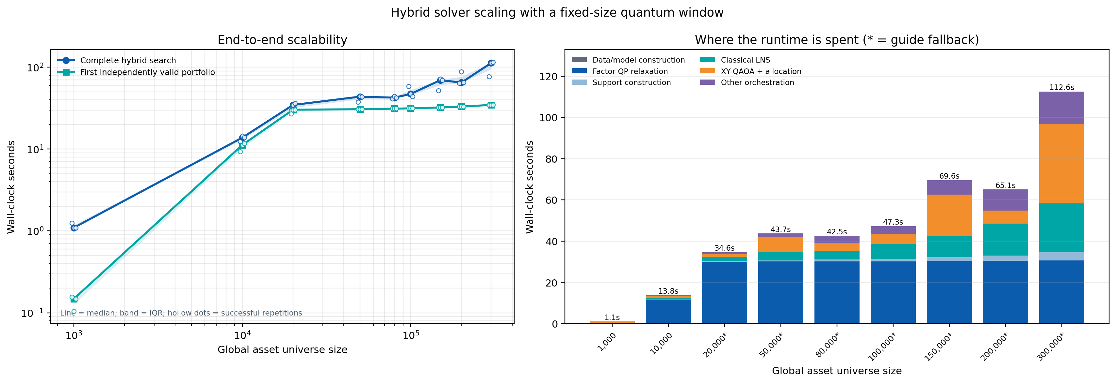
WISER QUANTUM CHALLENGE
Every repeated run stays valid at 300,000 assets
21 / 21
full three-window runs valid through 20k
27 / 27
stretch runs valid through 300k
34.69 s
median first valid at 300k
09
Notes:
Separate full-hybrid evidence through 20,000 from one-window stretch evidence through 300,000.
Asterisks above 20,000 mark guide-relaxation fallback; blank gap fields mean no solved bound.
Complete median stretch time at 300,000 is 112.60 seconds.
[Sources]
- results/final_submission/scaling/full_hybrid_to_20000_runs.csv.
- results/final_submission/scaling/stretch_to_300000_runs.csv.
- results/final_submission/scaling/stretch_to_300000_summary.csv.

Slide 10
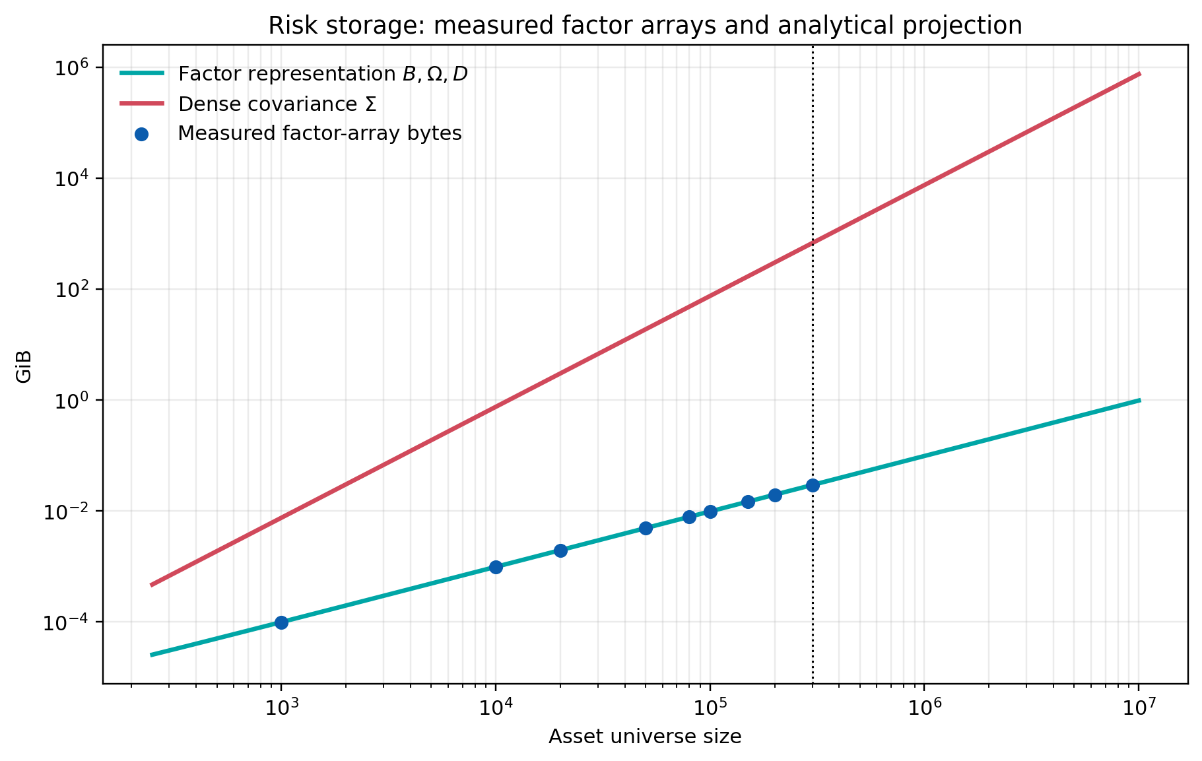
WISER QUANTUM CHALLENGE
Factor risk removes a 670 GiB memory wall
29.76 MiB
measured 12-factor arrays at 300k assets
670.55 GiB
one dense covariance at 300k assets
≈23,076× less risk-array storage
10
Notes:
The factor arrays are measured. The dense value is an analytical byte calculation; the matrix was intentionally not allocated.
Peak resident memory at 300,000 is 10.657 GiB because the process also holds solver workspaces and result data.
[Sources]
- results/final_submission/scaling/global_scaling_summary.csv.
- results/final_submission/scaling/risk_representation_projection.csv.

Slide 11
WISER QUANTUM CHALLENGE
Quantum tests 16-asset windows—not 300k qubits
300,000
16
K = 50
global candidate assets
adaptive window qubits
validated final holdings
Exact cardinality
XY mixer exchanges 10 ↔ 01 inside the ideal fixed-weight subspace
Exact allocation
Every sampled support receives continuous financial weights
Exact rejection boundary
Wrong cardinality, infeasible, duplicate, or worse candidates are rejected
11
Notes:
Correct the most common misunderstanding: asset-universe size is decoupled from quantum width.
The default 16-variable, seven-one subspace has 11,440 feasible states.
[Sources]
- Hadfield et al., 2019, doi:10.3390/a12020034.
- Wang et al., 2020, doi:10.1103/PhysRevA.101.012320.
- Repository final report, Algorithm §3.5.

Slide 12
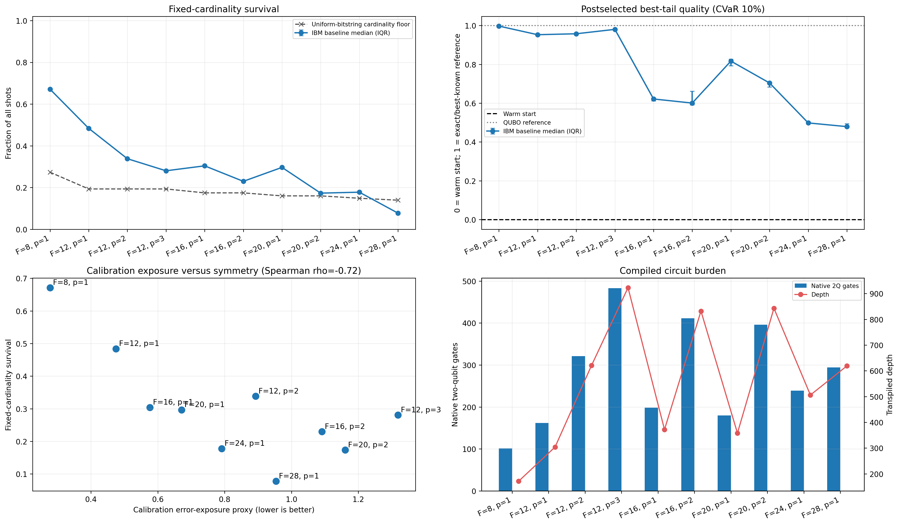
WISER QUANTUM CHALLENGE
IBM reaches 28 qubits; portfolio rules still hold
8–28 q
ten width-depth cases
29.14%
median raw cardinality survival
30 / 30
valid after allocation + validation
12
Notes:
Name the backend and campaign: ibm_kingston, calibration timestamp 2026-08-07 00:37:20-04:00, job d9qmec1dsedc73afg2d0, 8,192 shots per case.
Raw survival drops to 7.75% at 28 qubits; the safety result is post-allocation validity, not ideal hardware cardinality.
[Sources]
- results/final_submission/quantum/ibm_qpu_campaign_provenance.csv.
- results/final_submission/quantum/ibm_qpu_frontier_summary.csv.
- results/final_submission/quantum/ibm_qpu_hardware_validation.csv.

Slide 13
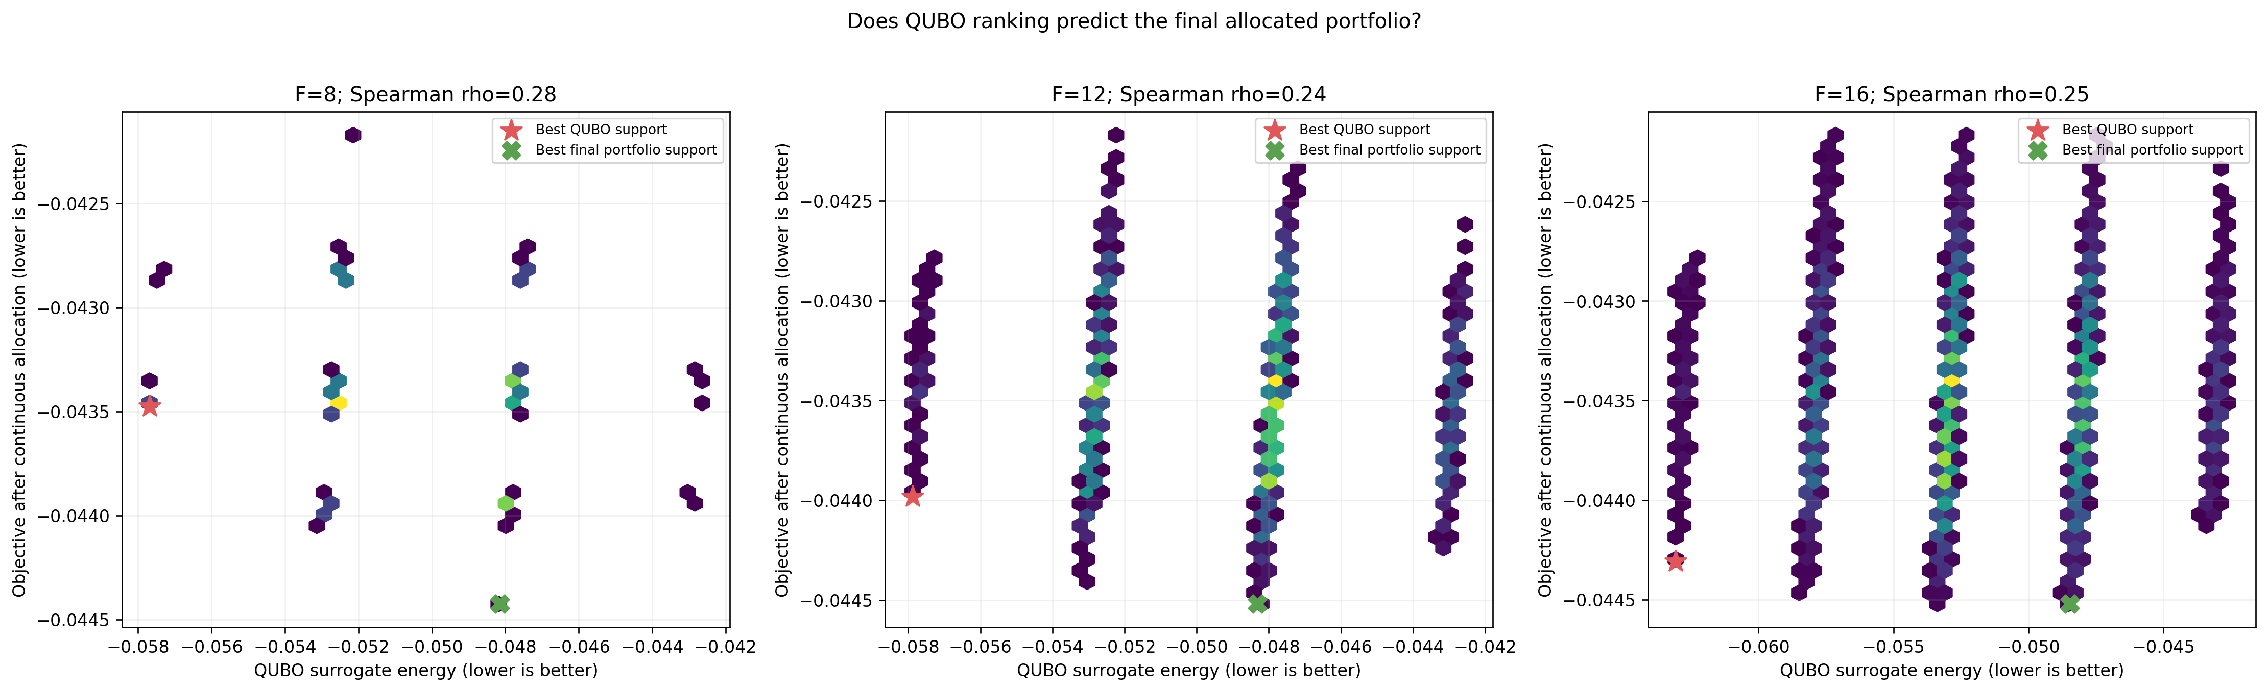
WISER QUANTUM CHALLENGE
The honest audit tells us exactly what to improve
0.237–0.276
Spearman QUBO ↔ allocation rank correlation
6 / 30
strict QPU wins over matched random
Roadmap
1 Improve the allocation-aware surrogate
2 Keep circuits shallow and calibrated
3 Match oracle-call and time budgets
13
Notes:
This is the credibility slide. State clearly: no speed, quality, or scaling advantage is demonstrated.
The allocation oracle is not merely a safety patch; weak rank alignment proves it is mathematically necessary.
[Sources]
- results/final_submission/quantum/qubo_alignment_summary.csv.
- results/final_submission/quantum/candidate_pool_fairness_summary.csv.
- results/final_submission/quantum/frozen_window_method_benchmark.csv.

Slide 14
WHY THIS SOLVER
Production-safe today.
Quantum-ready by design.
01
Proven
02
Scalable
03
Honest
Exact certificates and independent validation anchor every claim.
Factor risk and local windows reach 300,000 assets without dense covariance.
Real IBM hardware, fair baselines, and no unsupported advantage claim.
Choose the solver that can explain, validate, and reproduce every recommendation.
Notes:
Resolve the opening: this is a strong challenge submission because safety, evidence, and scale reinforce each other.
Offer the Copilot demo or questions.
[Sources]
- Repository final report and results/final_submission/claim_evidence_map.csv.

Slide 15
APPENDIX
Appendix · Every claim has a defined experiment
Case
Scale
Runs
Quantum
Certificate
Breaches
Main sparse
100 assets
1
Aer GPU
Gurobi 0.0%
0
Full gauntlet
60 / K12
1
Aer GPU
Gurobi 0.0%
0
Scenario-rich
250 / 10k
1
16q Aer
No global
0
Full scaling
250–20k
21
16q subspace
Guide where solved
0
Stretch scaling
1k–300k
27
16q Aer GPU
Fallback above 20k
0
IBM campaign
8–28q
30 obs
ibm_kingston
Hardware only
0
Synthetic / anonymized data · seeds + environments preserved · archive SHA-256 fingerprints recorded
15
Notes:
Use this slide when judges ask whether evidence tiers or repetitions were mixed.
[Sources]
- results/final_submission/evidence_summary.csv.
- results/final_submission/archive_manifest.csv.

Slide 16
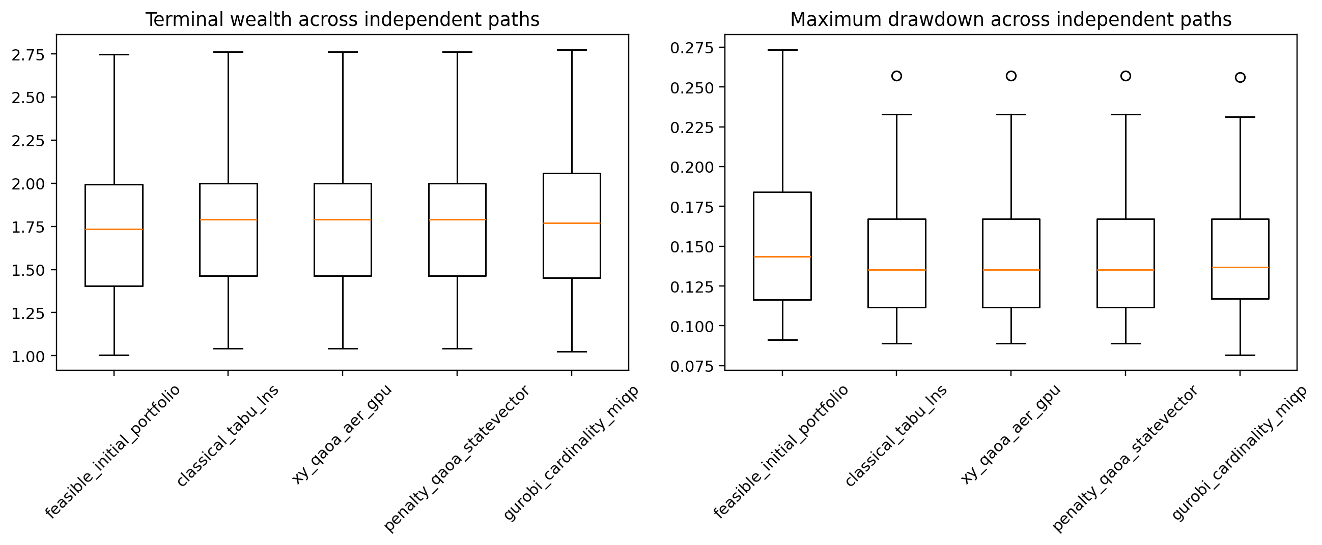
APPENDIX
Appendix · In-sample optimum ≠ every held-out win
30 synthetic paths
LNS / XY support
Median wealth 1.7909
Volatility 8.22%
Return / vol 0.7316
Max drawdown 13.53%
CVaR 4.23%
Gurobi global optimum
Best modeled objective, but not every held-out statistic
16
Notes:
This appendix prevents an overfit interpretation of the certified in-sample optimum.
The paths are generated robustness tests, not future forecasts.
[Sources]
- results/final_submission/classical/main_100_asset_backtest_summary.csv.
- results/final_submission/figures/main_backtest_robustness.png.

Slide 17
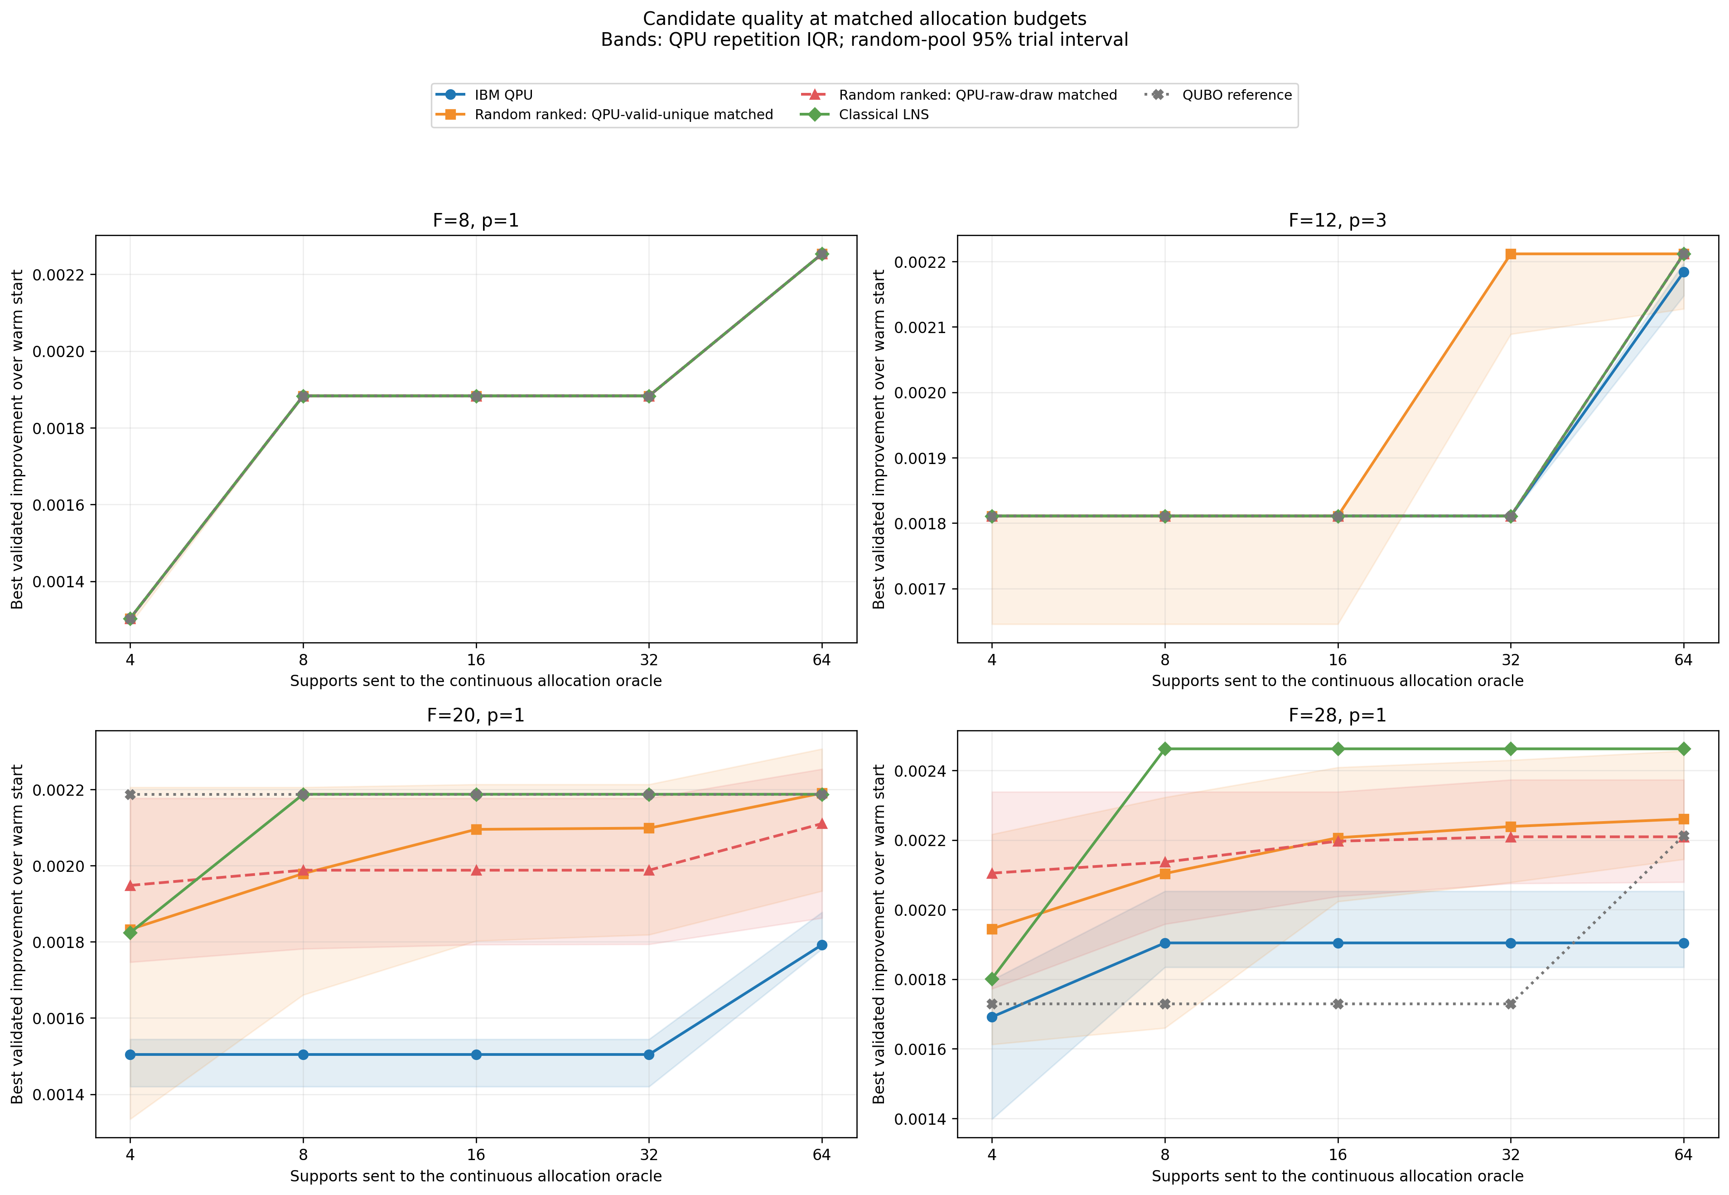
APPENDIX
Appendix · Matched budgets make comparisons fair
The comparison controls
• same frozen window
• matched allocation budget
• identical oracle
• identical validator
• strict wins separated from ties
Result
Random / classical proposals usually match or beat the QPU at larger widths.
17
Notes:
Use when judges ask whether random received more post-processing or more candidate evaluations.
[Sources]
- results/final_submission/quantum/candidate_pool_fairness_summary.csv.
- results/final_submission/figures/candidate_pool_fairness.png.

Slide 18
APPENDIX
Appendix · Four labels prevent overclaiming
CERTIFIED
Enumeration or a mixed-integer incumbent and bound match
Tiny, 100-asset, 60-asset gauntlet
BOUNDED
Valid sparse portfolio compared with a solved continuous lower bound
Full-hybrid rows with solved guide
HEURISTIC
Every guardrail passes, but no global quality bound is available
10,000-scenario case and stretch scale
HARDWARE
Measured circuit and post-allocation behavior on a named QPU
IBM campaign; not an advantage claim
A fixed-support QP can be exact on one asset set without being a global sparse certificate.
18
Notes:
Use this slide to answer any question about the meaning of optimal, exact, valid, or scalable.
[Sources]
- Final report, Algorithm §3.6.
- results/final_submission/claim_evidence_map.csv.

