Slide 1
WISER QUANTUM CHALLENGE • FINAL SUBMISSION
Submission evidence
Scalable, safeguarded
DOM optimization
516
aggregate rows across 14 audited families
+1.86 pp
objective capture vs default on 100 groups
A feasibility-first hierarchy from greedy planning to bounded QAOA proposals.
100k
generated orders: greedy + exact LNS
Greedy • exact recourse • exact LNS • bounded QUBO/QAOA
Andrei Pomorov | Aug 2026
513 validated plans • 18 QPU jobs • 8,192 shots/job
Notes:
[Sources]
- reports/challenge_submission_report.md
- reports/final_report.md
[/Sources]
Open with the audited scope: 516 rows, 513 validated plans, and the final scaling/hardware matrix.

Slide 2
WISER QUANTUM CHALLENGE
02
DOM is constrained allocation
INPUT
DECISION
OBJECTIVE
Orders, lines, and loads
Choose one outcome per order group
Maximize validated service value
demand, value, and service rules
eligible DC/date alternatives
protected cumulative ATP
dock and optional resource limits
fulfilled value − shipping
− thresholded unmet penalty
xgc ∈ {0,1}
1 when group g selects candidate c; 0 otherwise.
Subject to
Unfilled demand is explicit and penalized.
cumulative ATP • capacity • eligibility • load cohesion • integer balance
Why it is hard
Shared inventory couples groups. The solver must preserve a feasible incumbent while coordinated local search reopens only the decisions that interact.
Model and terms: docs/mathematical_formulation.md • docs/data_guide.md
FINAL SUBMISSION
Notes:
[Sources]
- docs/data_guide.md
- docs/mathematical_formulation.md
[/Sources]
Explain objective capture and why load cohesion plus cumulative ATP make the problem coupled.

Slide 3
WISER QUANTUM CHALLENGE
03
The solver hierarchy keeps feasibility deterministic
1 Validate
2 Construct
3 Polish
4 Explore
5 Repair + verify
Schema, dates, domains, ATP, capacity
Load-atomic greedy feasible incumbent
Exact policy recourse optimizes quantities
Exact LNS or sampled QUBO proposal
Exact recourse + independent validator
Quantum neighborhood (optional)
1
Feasible start
2
Mixer
3
Optimization
4
Evidence
linear W-state per group
path XY preserves one-hot structure
cached angles + exact controls
raw quality, gaps, and Wilson intervals
Implementation: src/domopt/classical.py • src/domopt/hybrid.py • src/domopt/quantum.py • src/domopt/hardware.py
FINAL SUBMISSION
Notes:
[Sources]
- docs/solver_method.md
- src/domopt/hybrid.py
- src/domopt/quantum.py
[/Sources]
Emphasize that samplers propose; exact recourse and the validator accept or reject.

Slide 4
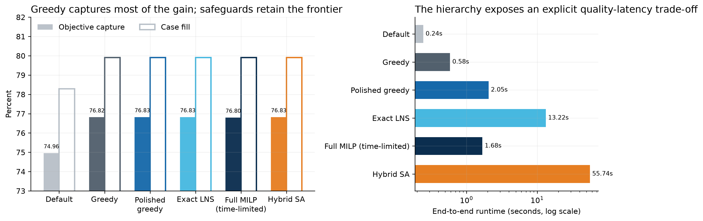
WISER QUANTUM CHALLENGE
04
Greedy captures most of the gain in 0.58 s
76.83%
79.91%
objective capture after exact polish
case fill rate
2.05 s
0
polished-greedy runtime
validator residual violations
+197.2 on the synthetic coordination trap
Exact LNS and QAOA proposals recover the same coordinated gain after exact recourse.
Greedy adds +1.86 pp capture vs default; the time-limited full MILP retains a nonzero gap.
Evidence: results/final/figures/submission_solver_summary.png • submission_coordination_summary.png
FINAL SUBMISSION
Notes:
[Sources]
- results/final/figures/submission_solver_summary.png
- results/final/figures/submission_coordination_summary.png
- reports/challenge_submission_report.md
[/Sources]
The full MILP is time-limited and has a nonzero gap; do not call that row exact.

Slide 5
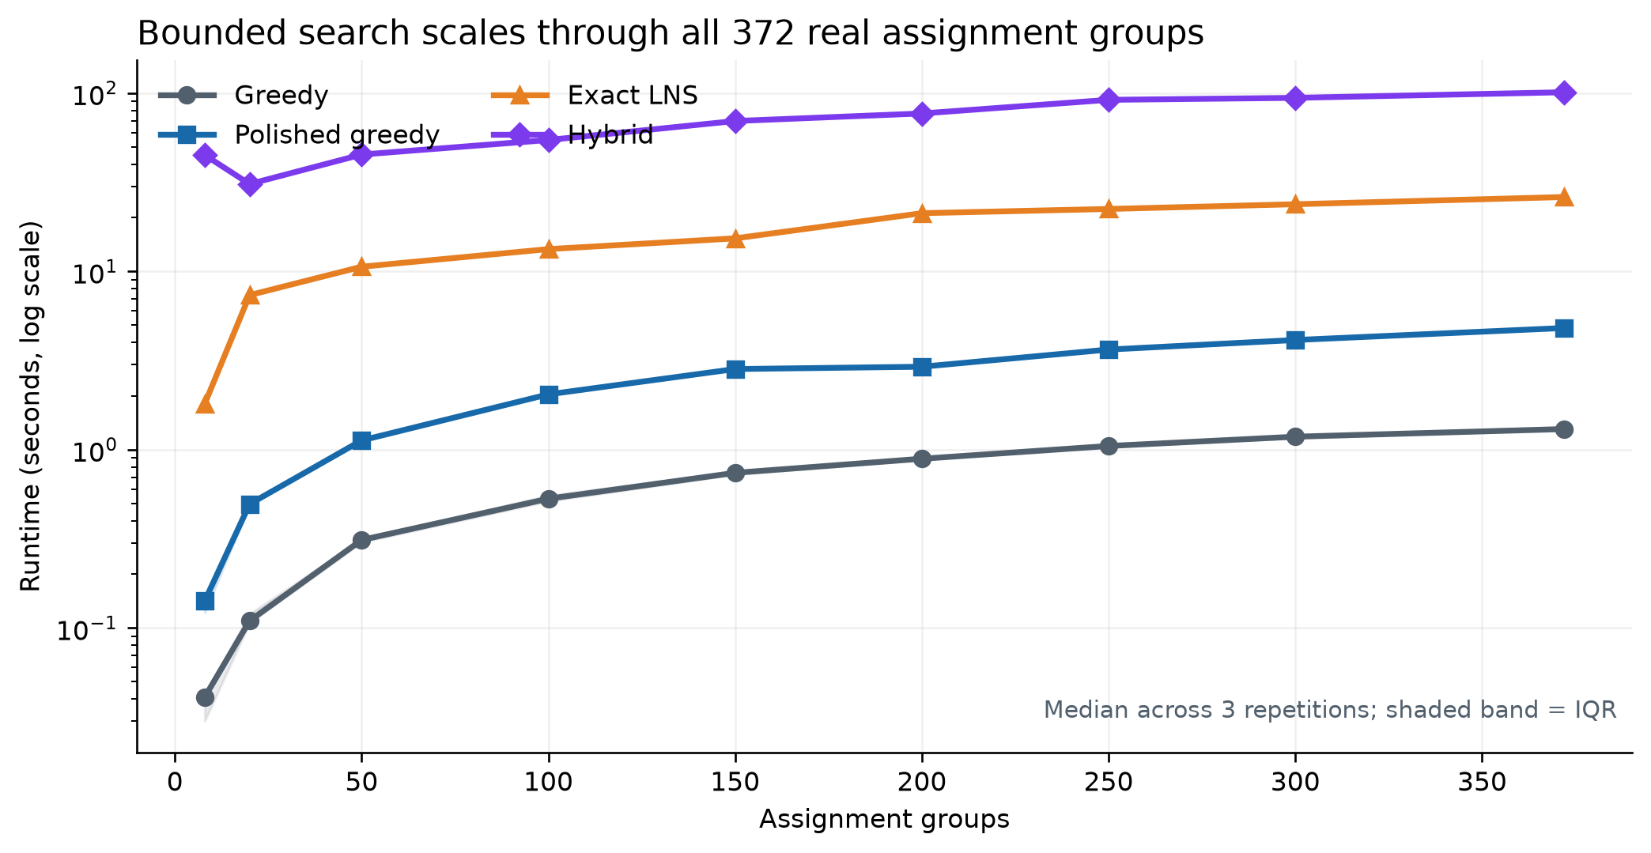
WISER QUANTUM CHALLENGE
05
Bounded search scales through all 372 real groups
FAST
Greedy
1.31 s median at all 372 groups; feasible incumbent for every planning run.
QUALITY
Exact LNS
26.14 s median and the strongest full-scope capture in the repeated study.
HYBRID
Fixed-width QUBO
101.17 s median; at most 16 variables at full real scope.
Generated: greedy + exact LNS reach 100k orders; hybrid reaches 20k with a 32-variable QUBO.
Evidence: results/final/figures/submission_scaling_summary.png • notebooks/nestle_challenge_experiments.ipynb
FINAL SUBMISSION
Notes:
[Sources]
- results/final/figures/submission_scaling_summary.png
- reports/final_report.md
[/Sources]
At 372 real groups the local hybrid QUBO is at most 16 variables; generated scaling reaches 32.

Slide 6
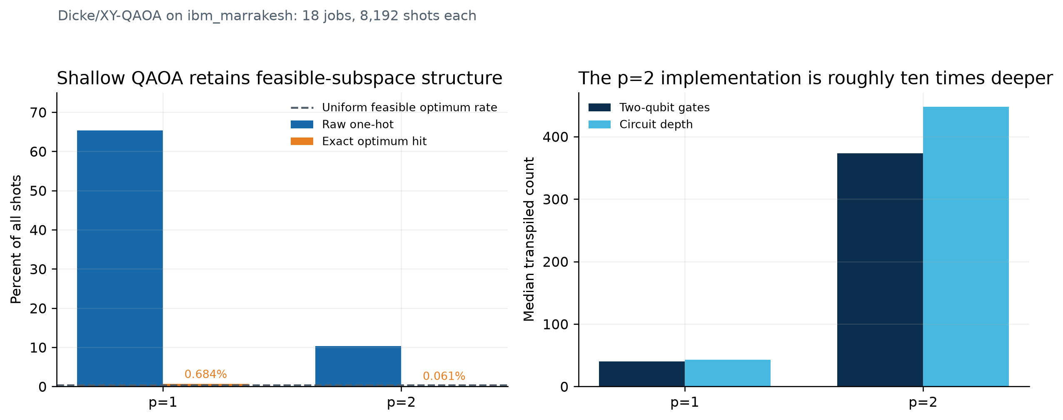
WISER QUANTUM CHALLENGE
06
Shallow QAOA better preserves feasibility
p = 1
65.34%
40 two-qubit gates • depth 43
median raw one-hot feasibility
p = 2
10.36%
373 two-qubit gates • depth 448
median raw one-hot feasibility
Interpretation
p=1 exact hit: 0.684% vs 0.391% uniform control. Exact recourse validates every final plan.
18 QPU jobs • 8,192 shots/job • runtime uses a log scale because queue outliers reach about 12,021 s.
Evidence: results/final/figures/submission_ibm_depth_summary.png • results/final/ibm/figures/ibm_hardware_stress.png
FINAL SUBMISSION
Notes:
[Sources]
- results/final/figures/submission_ibm_depth_summary.png
- results/final/ibm/figures/ibm_hardware_stress.png
- reports/final_report.md
[/Sources]
QAOA is the proposal method. ibm_marrakesh is the processor/execution target. Queue time is separate from execution.

Slide 7
WISER QUANTUM CHALLENGE
07
Deploy classical now; measure QAOA
Improvement roadmap
RECOMMENDATION
Production path
NOW
Shadow-mode pilot
Confirm DCs, calendars, capacity • measure planner acceptance and realized service
FAST: release polished greedy after certification.
QUALITY: trigger exact LNS for material conflicts.
CERTIFY: validate every plan and record residuals.
COPILOT: review changes, rationale, and downloads.
NEXT
Scalable search
Adaptive LNS • rolling uncertainty • solver-engine benchmark • learned conflicts
R&D
Bounded QAOA
Shallow p=1 • angle transfer • sequential stopping • calibrated mitigation
FEASIBLE FIRST
SCALABLE
QAOA: BOUNDED + MEASURED
The advantage is a solver that scales now and makes every future proposal auditable.
Decision guide: reports/planner_view.pdf • challenge evidence: reports/challenge_submission_report.pdf • setup: README.md
FINAL SUBMISSION
Notes:
[Sources]
- reports/planner_view.md
- README.md
- docs/challenge_checklist.md
[/Sources]
Close on deployable classical value, a shadow-mode pilot, and a bounded measurement program for future QAOA.

