Slide 1

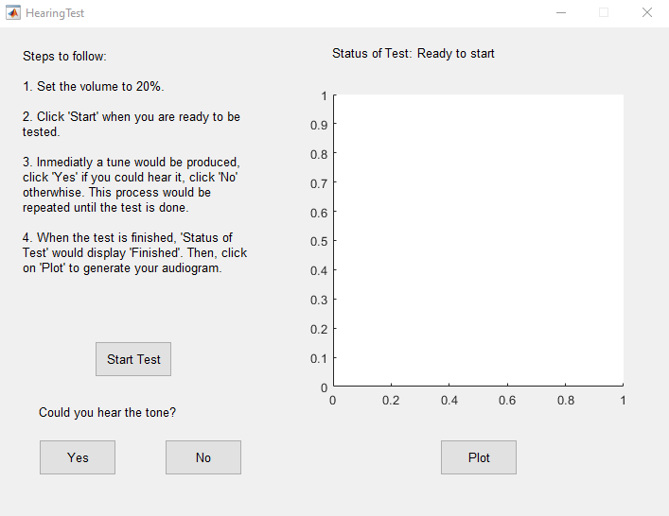
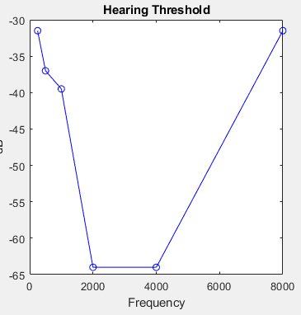
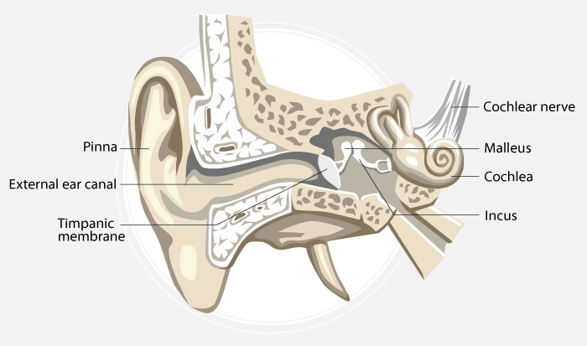
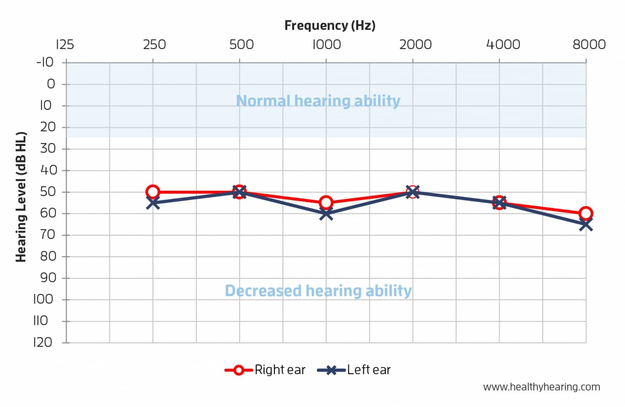
Frequency Response: Hearing Test
Andrew Pond, Leonardo Perez, University of Utah
Background
The human ear doesn’t perceive all frequencies the same. It responds differently depending on the frequency given.
The purpose of this study is to measure the frequency response of people’s hearing.
Results
Conclusion
Our hearing frequency response is nonlinear. Very low and very high frequencies are harder to hear.
Future Work
Calibrate testing equipment (headphones)
Speed up test, takes a long time to complete
Widen frequency spectrum from 250Hz-8000Hz to 40Hz-20kHz
Compare our results with “Bekesy Audiometry in Analysis of Auditory Disorders” [1], see if our results match up
Shown is a hearing test we completed.
Observations:
Low frequencies are not perceived very well
From around 2000Hz to 4000Hz, sounds are easily perceived
As frequency increases again, hearing response gets worse.
Methods
Using a GUI, the user sweeps through a range of audible frequencies, based on “Bekesy Audiometry in Analysis of Auditory Disorders” [1].
Literature cited
Jerger, James. "Bekesy audiometry in analysis of auditory disorders." Journal of Speech and Hearing Research 3.3 (1960): 275-287.
Acknowledgments
University of Utah - Department of Electrical and Computer Engineering
Further information
Please see https://pubs.asha.org/doi/abs/10.1044/jshr.0303.275 for more detailed explanation of the hearing test method used.

