Slide 1
Suicide rates and risk - Prediction and Analysis
Aishwarya Ponkshe

Slide 2
Why is Suicide rate and risk prediction important?
Suicide and depression is a precarious and serious problem faced by people all over the world.
With increasing stress levels due to unemployment, low income and high debts, suicide rates have also started to rise up
In the year 2015, about 788,000 people died by suicide at a global rate of 10.7 per 100,000 person-years.

Slide 3
Dataset used for this analysis
https://www.kaggle.com/russellyates88/suicide-rates-overview-1985-to-2016
The United Nations Development Programme’ – Human Development Reports. Human Development Data (1990-2018) | Human Development Reports
This dataset consists of the following important attributes –
- Country
- Year
- Sex
- Age group
- Number of suicides
- Population
- Suicides/100k population
- Human Development Index for the year
- GDP for the year in dollars

Slide 4
Main goals of the project
Classify the instances in the dataset based on whether they are at a risk of suicide or not.
2. Clustering the instances in the dataset based on their economic condition
3. Predict the number of suicides based on the input predictors to the model
4. Forecasting the total number of suicides for the future years by training the model on the historical data

Slide 5
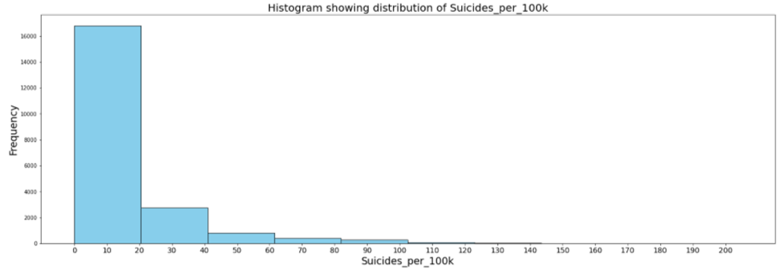
Exploratory Data Analysis through Visualizations
What is the data distribution with respect to suicides per 100k of the population?
More data exists for suicide per 100k count in the first 2 bins ranging 0-20.

Slide 6
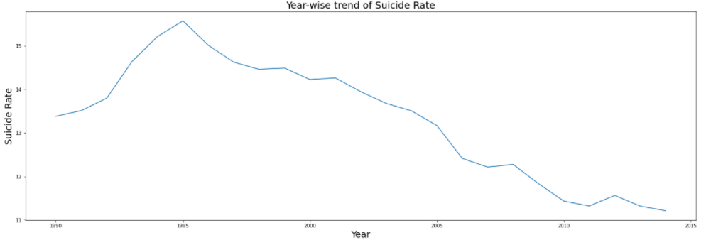
How has the suicide rate changed over a period of time?
The trend seems to be decreasing in the recent years, whereas it was highest in 1995.

Slide 7
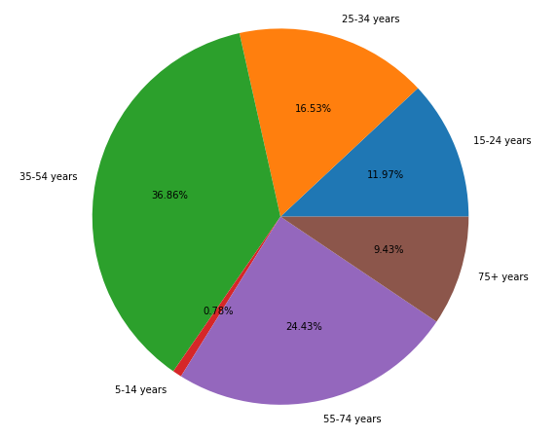
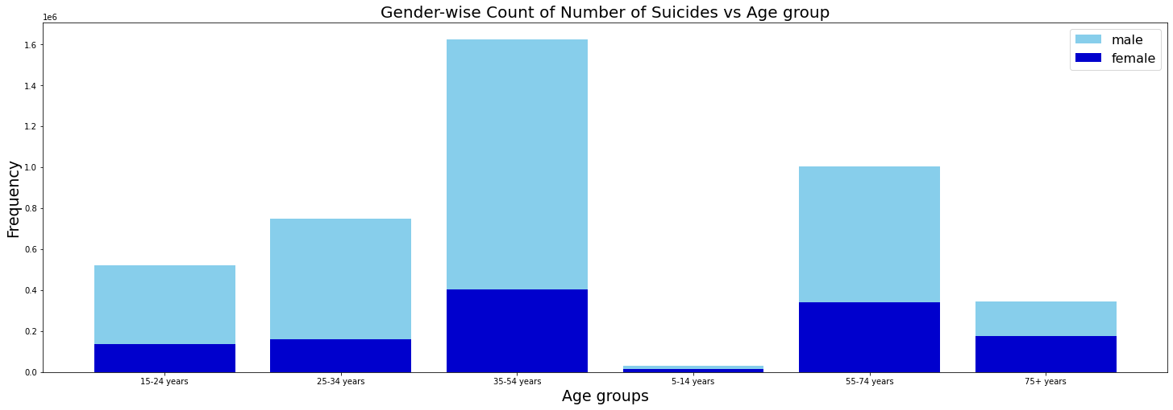
Which age groups and gender are at a high risk of suicides?
The highest number of suicide cases have been reported for individuals in the age group 35-54 years. And in this group the number of males is disturbingly high.

Slide 8
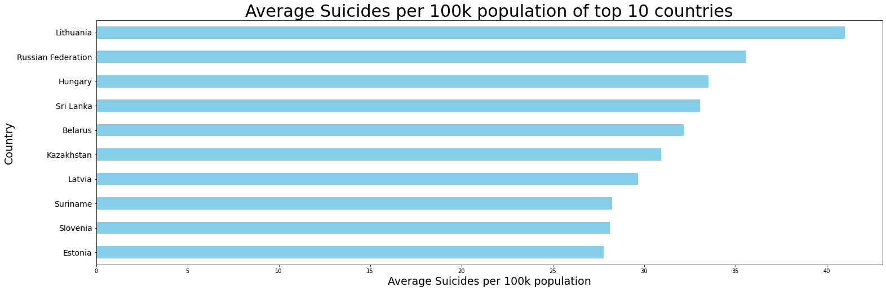
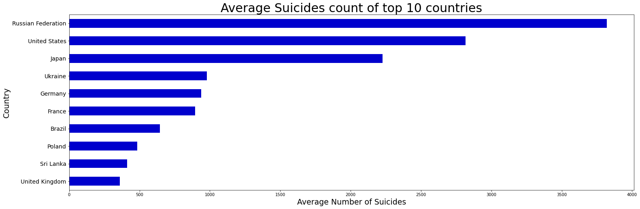
Countries across the globe at highest risk of suicides

Slide 9
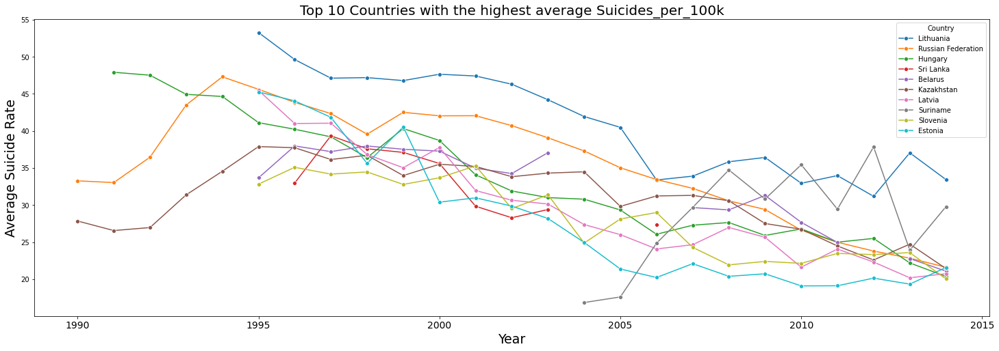
Top 10 countries having the highest average Suicides rates - A line plot showing the trend in the rise/fall of the rate over the years.

Slide 10
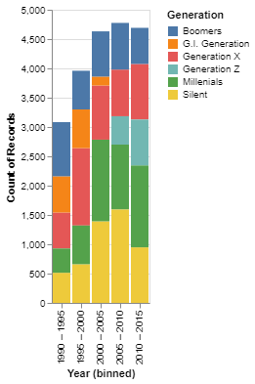
Which Generation is affected the most over the years?
1990-1995 had most cases for the Boomers Generation.
1995-2000 had most cases for the Generation X.
2000-2005 had most cases for the Silent Generation.
2005-2010 also had most cases for the Silent Generation.
2010-2015 had most cases for the Millennials Generation.

Slide 11
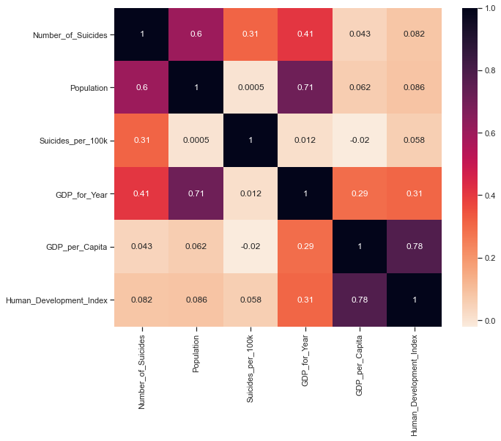
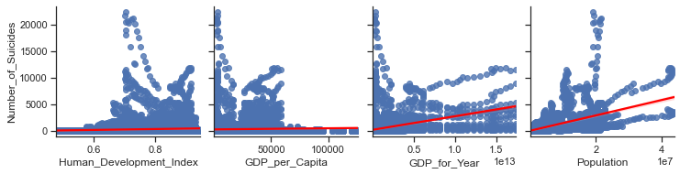
Population and GDP_for_Year have an increasing trend in the regression line can be seen and it can be said that as the Population and GDP per Year increases, the number of suicides also increase.
Population is highly correlated with GDP_for_Year. HDI is highly correlated with GDP_per_capita.

Slide 12
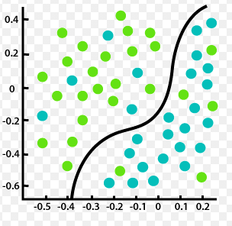
Goal 1: Classify the instances in the dataset based on whether they are at a risk of suicide or not.
Classification models used :
Logistic Regression
Support Vector Machines (SVM)
K Nearest Neighbors (K-NN)

Slide 13
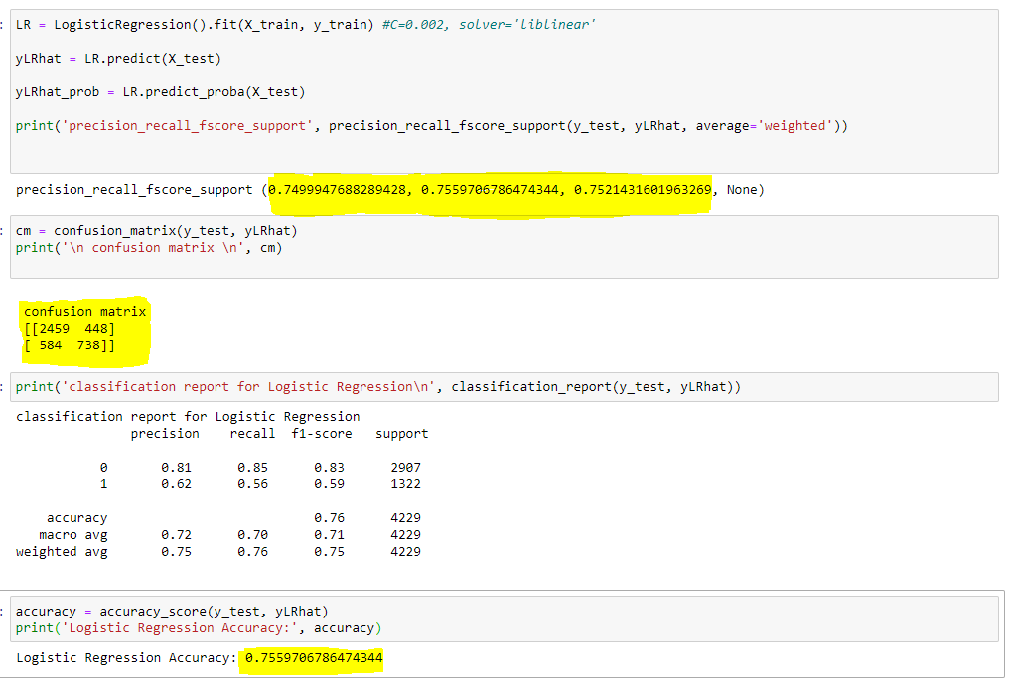
Model Results: Logistic Regression

Slide 14
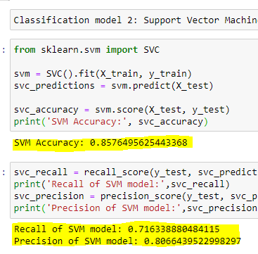
Model results : Support Vector Machines (SVM)

Slide 15
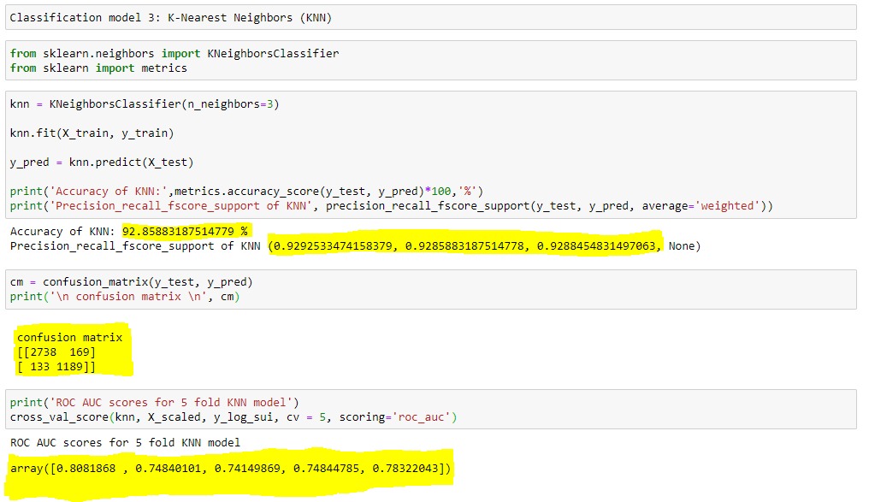
Model Results: K Nearest Neighbors (K-NN)

Slide 16
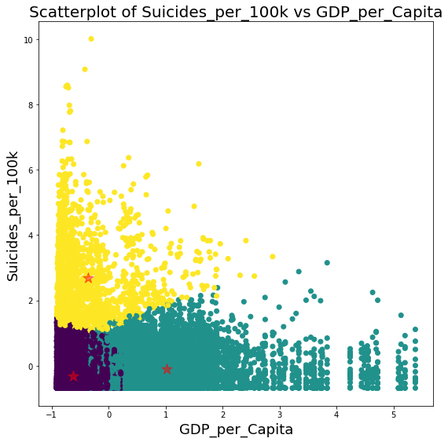
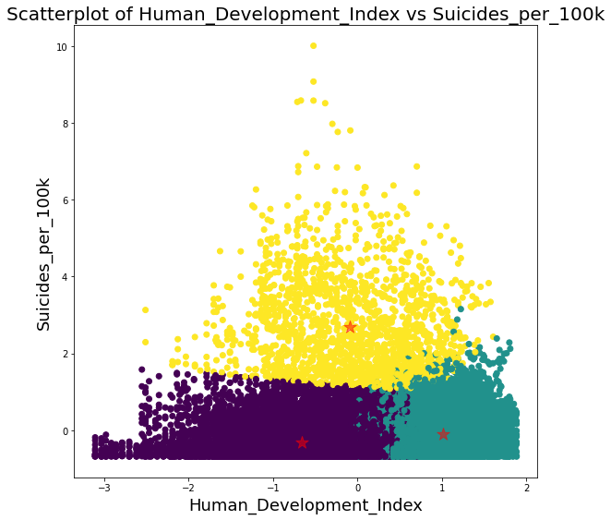
Goal 2: Clustering the instances in the dataset based on their economic condition

Slide 17
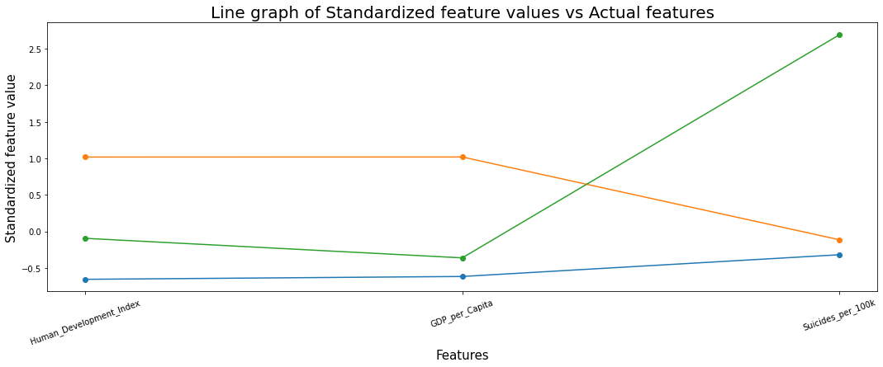
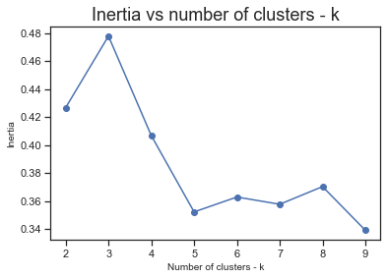
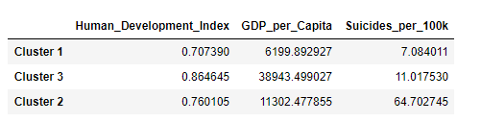
Analysis

Slide 18
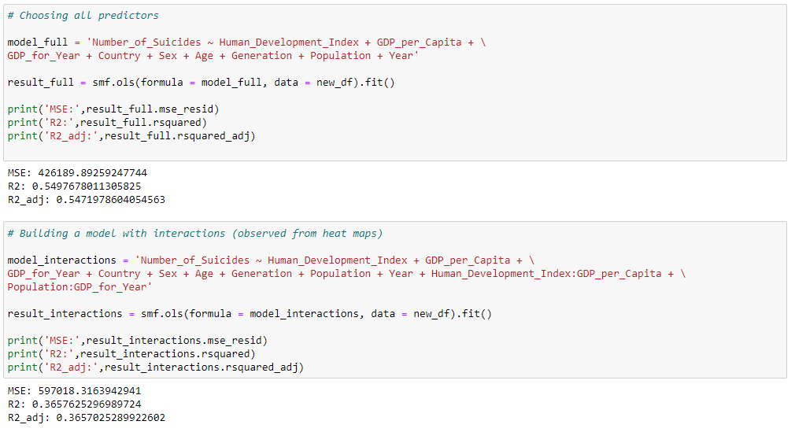
Goal 3: Predict the number of suicides based on the input predictors to the model
Different approaches used towards feature selection:
Full model
Adding Interactions

Slide 19
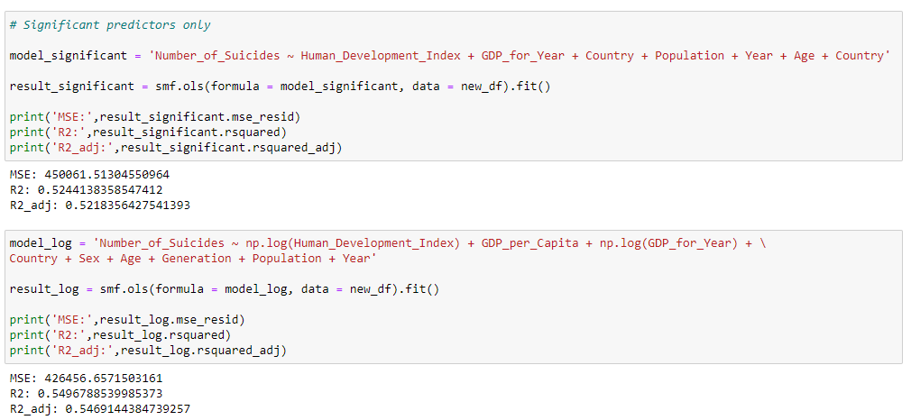
Goal 3: Predict the number of suicides based on the input predictors to the model
Different approaches used towards feature selection:
3. Using significant predictors only
4. Using Log Transformations

Slide 20
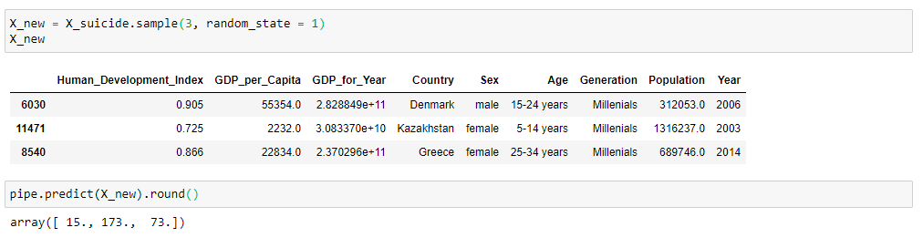
Predicting Number of suicides for 3 random instances in the dataset

Slide 21
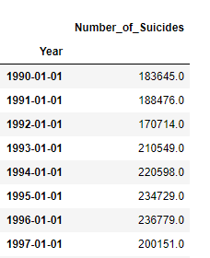
Goal 4 : Forecasting the total number of suicides for the future years by training the model on the historical data.
Since Year was an important predictors in Number of Suicides prediction, I used time series for forecasting the Number of suicides using Auto ARIMA.
Input to the model →

Slide 22
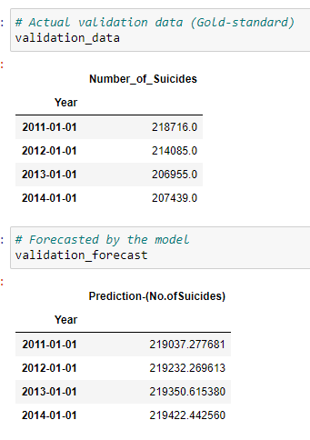
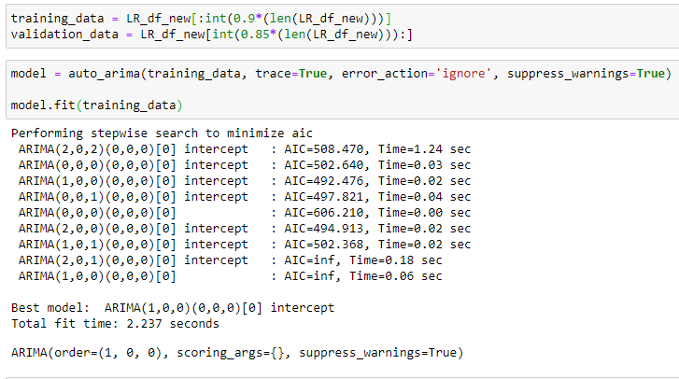
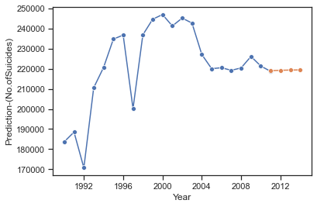
Forecasting on validation data

Slide 23
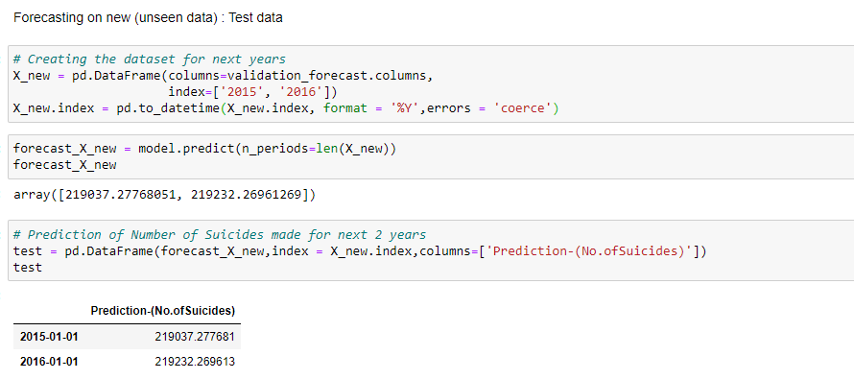
Forecasting on test data

Slide 24
Conclusion and Discussions
The models built would help a lot in identifying instances (which group of individuals in a country, age group, generation, sex) are at a higher risk of committing suicides.
Future suicide numbers could be forecasted, and preventive measures could be taken well in advance.
This study focuses only on the economic impact on suicide rates for a group of individuals since the dataset used has features such as – GDP per capita, Human Development Index, Population, etc.
However, there are other factors due to which the mental health is affected such as – depression, mental health disorders, family history, etc.
If such a dataset is combined with the economic factors, the model could predict better and give more accurate results.

Slide 25
Thank you!!

