Slide 1


BEFORE WE START
Introduction to R and RStudio
What R is, what RStudio is, and what all those windows are for
No code today. Just the map of the place.
Notes:
Welcome. Before we write a single line of code, I want you to know what you are actually opening when you double-click that blue icon, and why there are four windows instead of one. Nothing today is something you have to memorise.

Slide 2
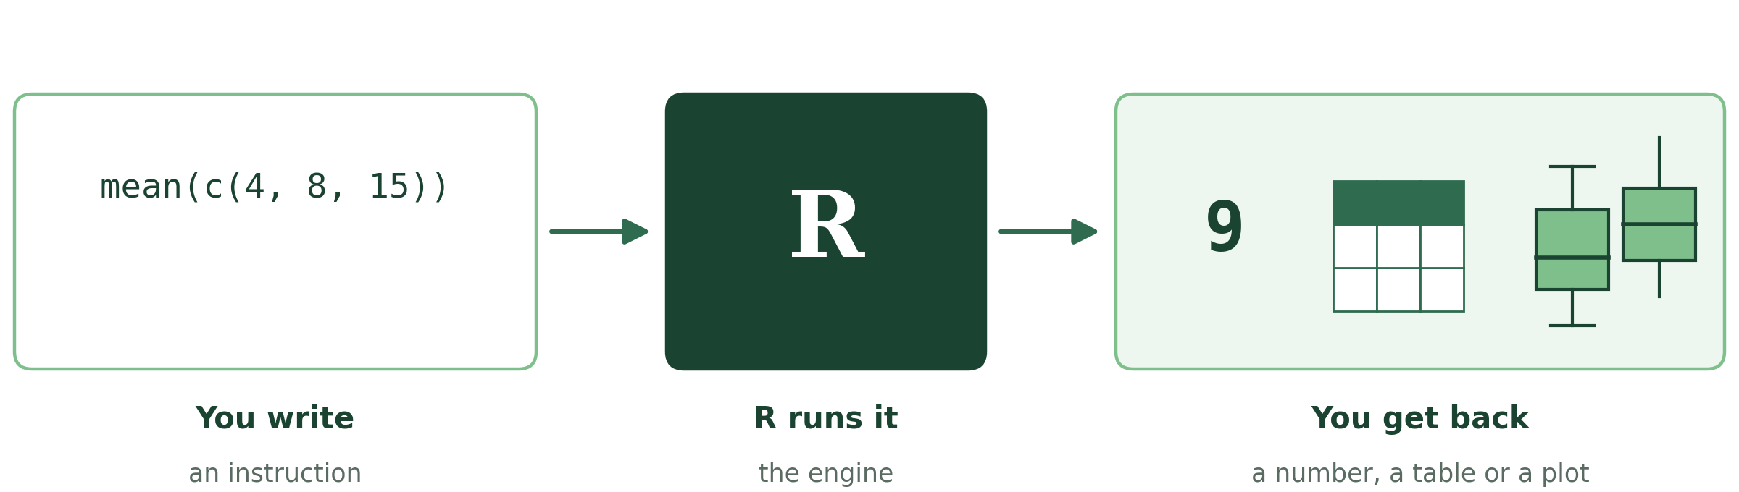
THE LANGUAGE
What is R?
R is a programming language created by statisticians, for working with data. You write instructions, R carries them out and gives you back numbers, tables or figures.
Free and open
Built for data
Written, not clicked
Enormous community
No licence, no subscription. Windows, Mac and Linux.
Statistics, tables and plots are part of the language itself, not an add-on.
Everything you do is a line of text you can save, re-read and re-run.
Over 20,000 extensions, and an answer online for almost any question.
R is used everywhere data is analysed: research labs, hospitals, banks, newspapers, public health agencies.
Notes:
R was born in the 1990s in a statistics department, and that shows: things other languages need libraries for - a mean, a linear model, a boxplot - are built in. It is free in both senses: you pay nothing, and anyone can see and improve the code. That is why it became the standard in academia, and increasingly outside it.

Slide 3
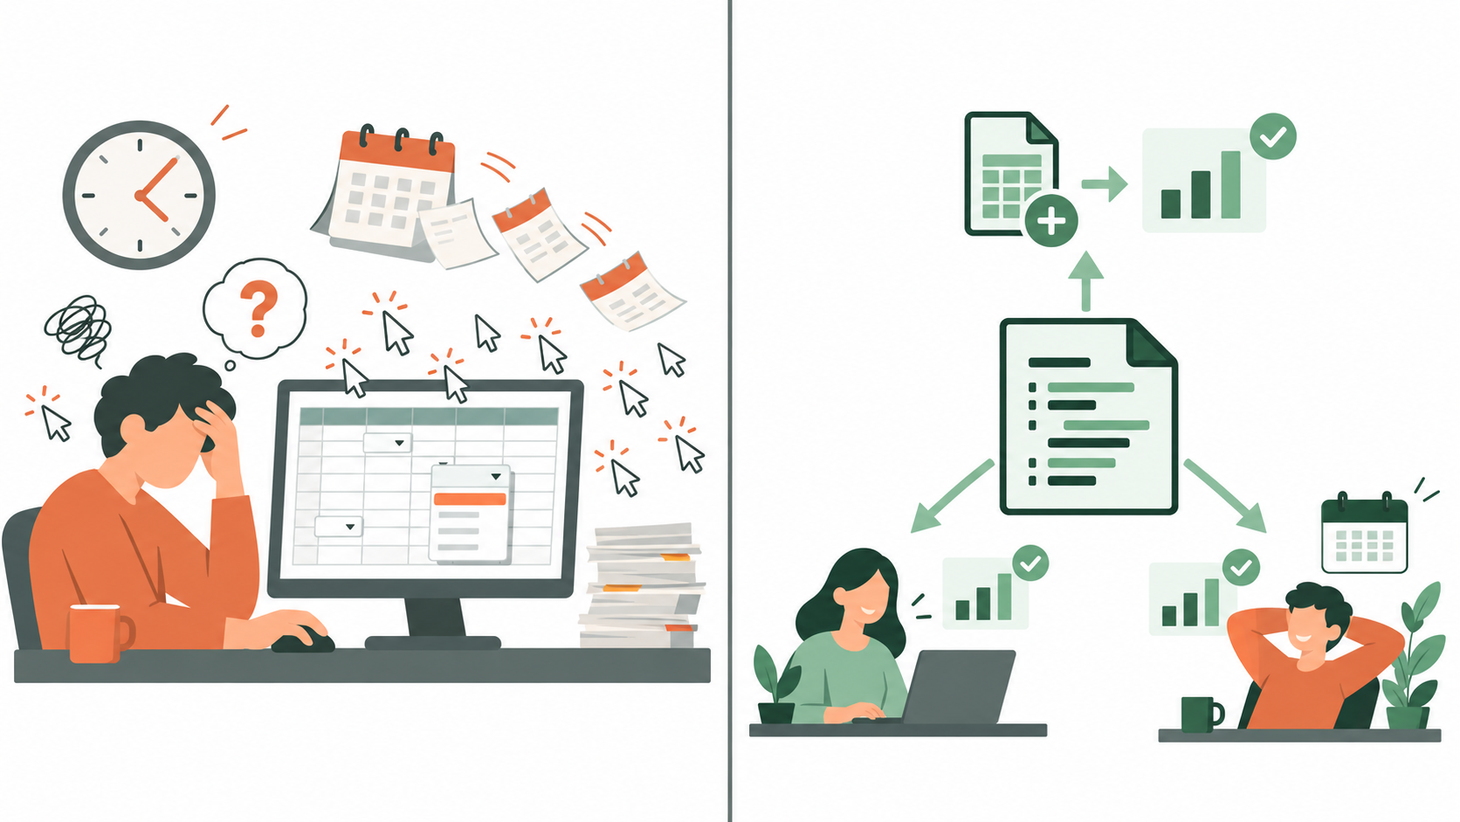
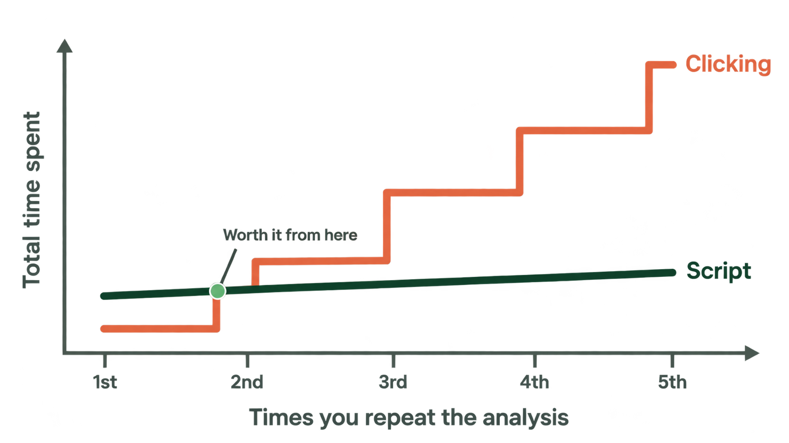
THE POINT OF ALL THIS
Why write code instead of clicking?
This is what people mean by REPRODUCIBLE analysis. It is the single best reason to learn R.
Notes:
This is the slide I would like you to remember if you forget everything else. The first week in R is slower than the same work in a spreadsheet - that is honest and it is normal. What you buy with that week is that the analysis is written down. When a reviewer asks how you filtered your samples, the answer is a line of text, not a memory of which buttons you pressed last March.

Slide 4
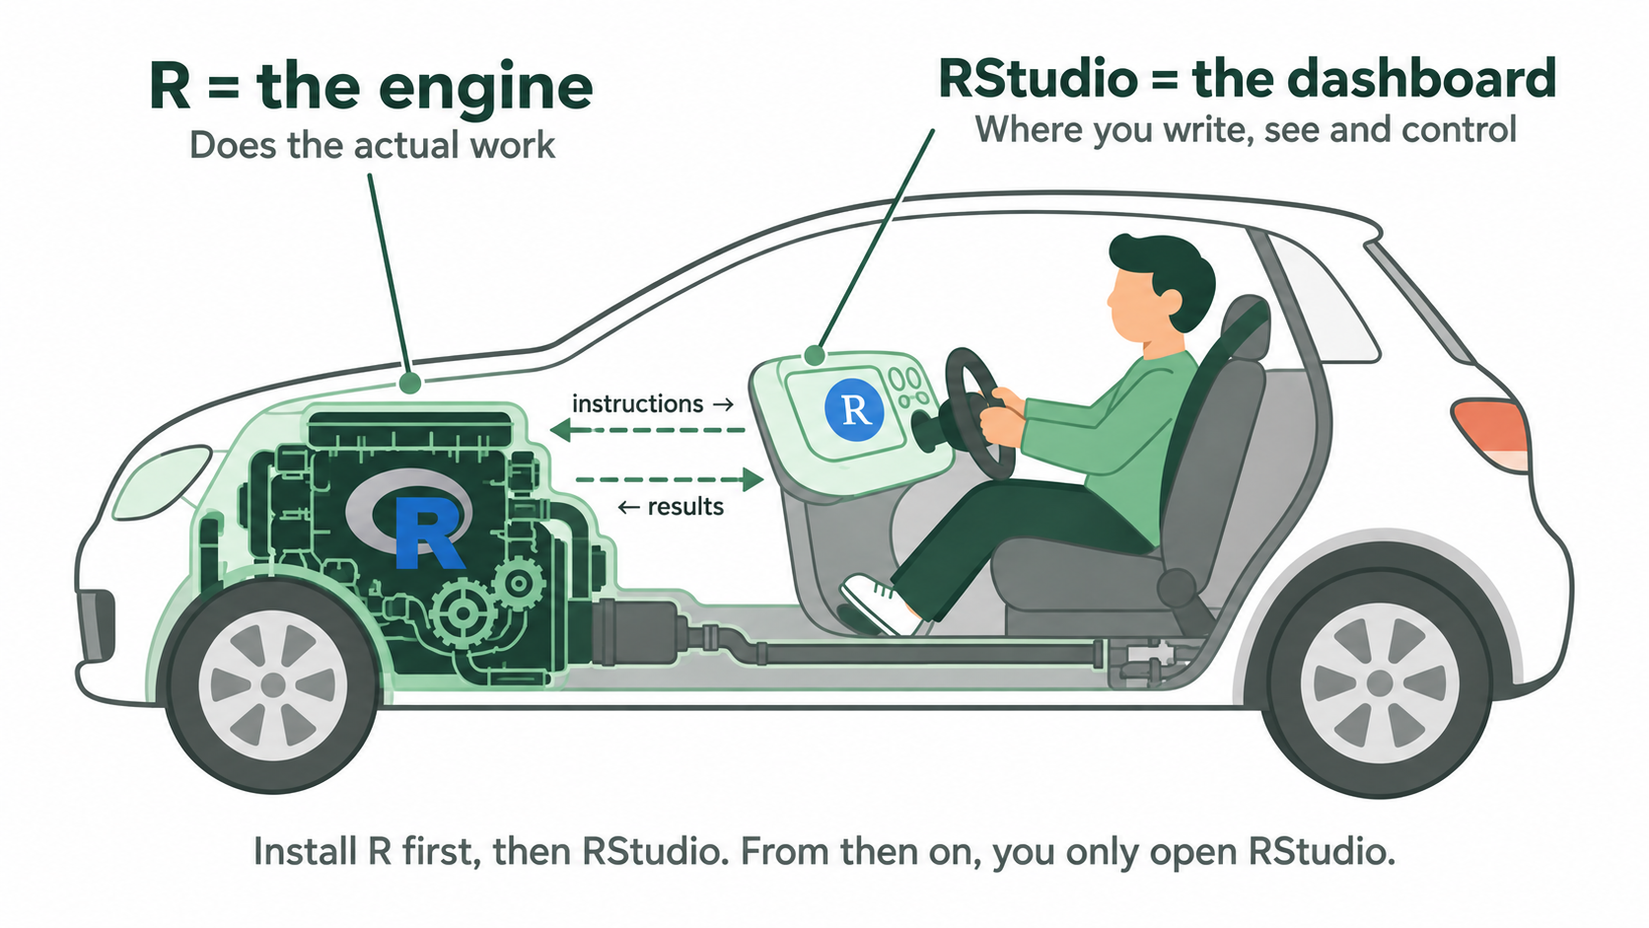
TWO DIFFERENT THINGS
So what is RStudio then?
R = the engine
RStudio = the dashboard
The program that actually does the work. On its own it is a bare window where you type commands. You install it, but you will almost never open it directly.
A comfortable workplace built around R: an editor, the console, your objects, your files, your plots and the help pages, all in one window.
Notes:
The car analogy works well here: R is the engine, RStudio is the dashboard and the steering wheel. If you install only RStudio, nothing works - there is no engine. If you install only R, everything works but it is uncomfortable. Order matters: R first, RStudio second, because RStudio looks for an R installation when it starts.

Slide 5
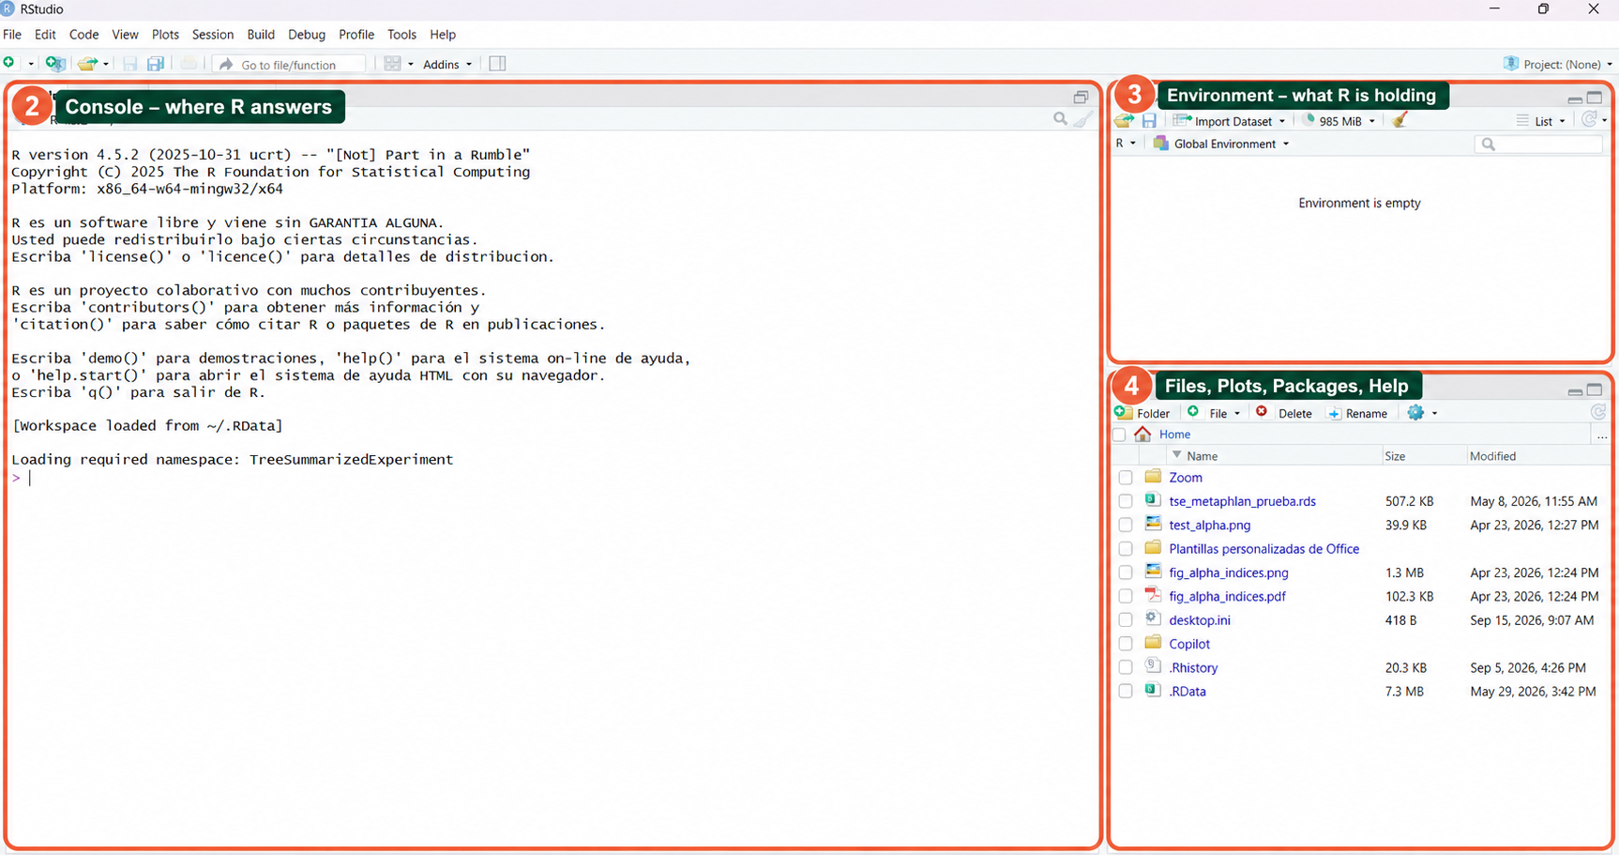
THE RSTUDIO WINDOW
Four panes, and that is all there is
1
Source - the editor
2
Console - where R answers
3
Environment - your objects
4
Files, plots, packages, help
Notes:
This is what you will see when you open RStudio - and yes, the first time it looks like too much. It is always the same four panes, always in the same corners, and you can resize or maximise any of them. If your window looks different, it is because a pane is collapsed, not because something is broken. We will go one by one.

Slide 6
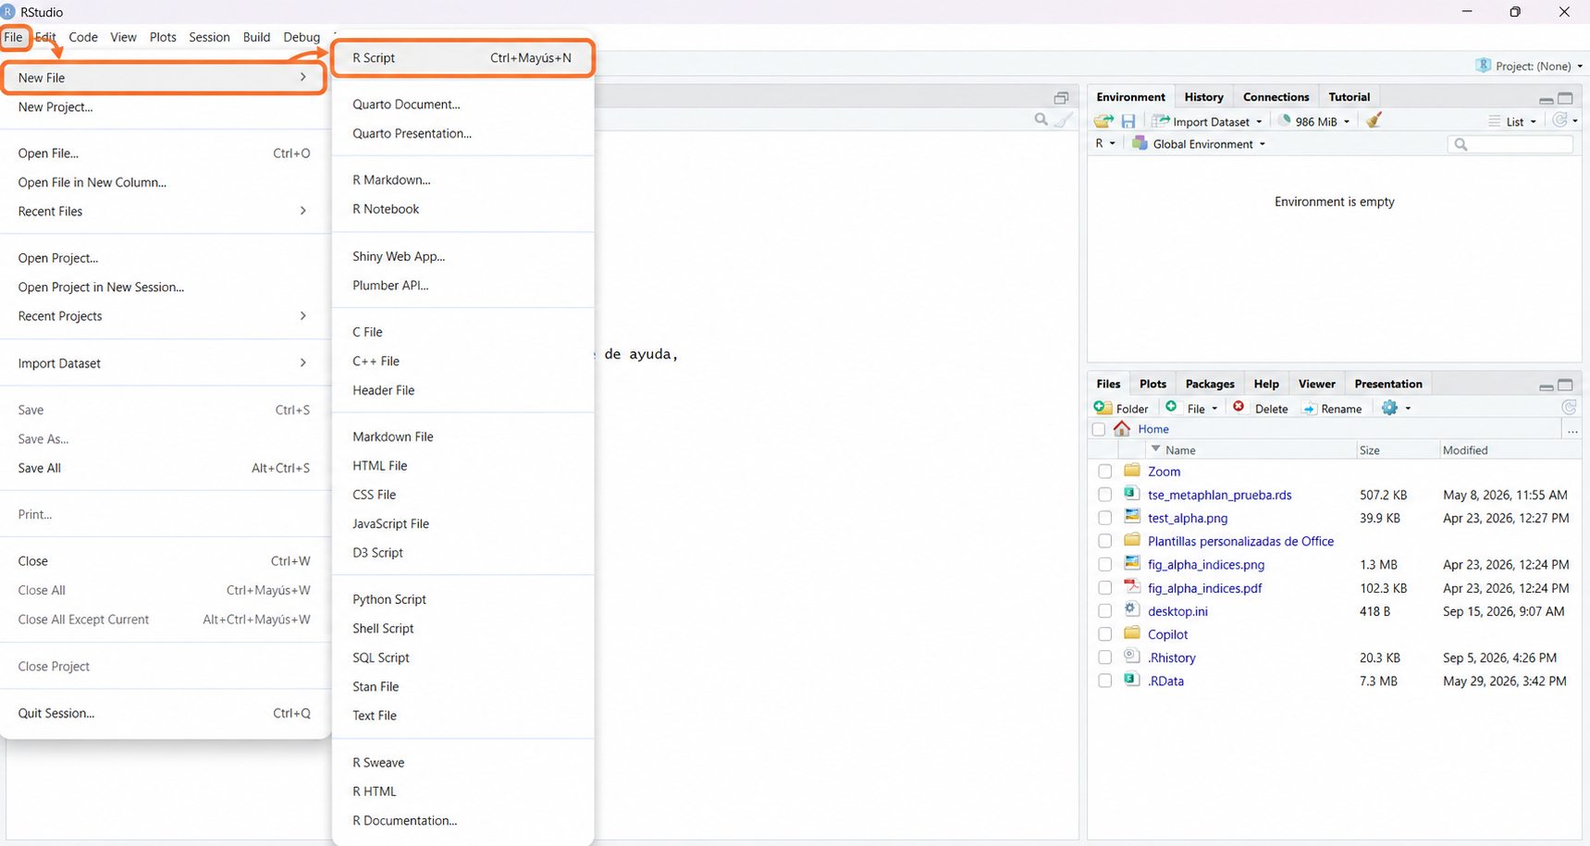
THE RSTUDIO WINDOW
Four panes, and that is all there is
1
Source - the editor
2
Console - where R answers
3
Environment - your objects
4
Files, plots, packages, help
Notes:
This is what you will see when you open RStudio - and yes, the first time it looks like too much. It is always the same four panes, always in the same corners, and you can resize or maximise any of them. If your window looks different, it is because a pane is collapsed, not because something is broken. We will go one by one.

Slide 7
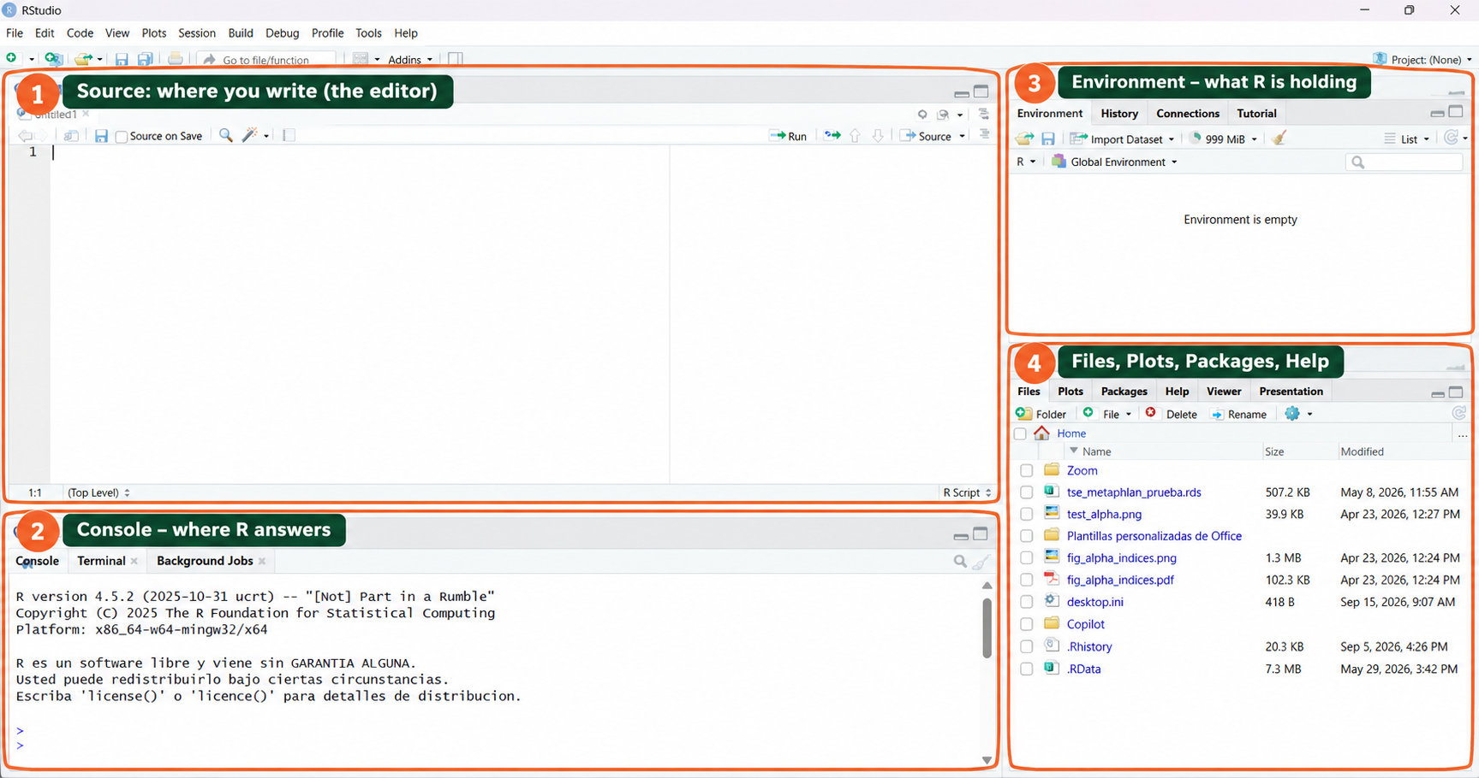
THE RSTUDIO WINDOW
Four panes, and that is all there is
1
Source - the editor
2
Console - where R answers
3
Environment - your objects
4
Files, plots, packages, help
Notes:
This is what you will see when you open RStudio - and yes, the first time it looks like too much. It is always the same four panes, always in the same corners, and you can resize or maximise any of them. If your window looks different, it is because a pane is collapsed, not because something is broken. We will go one by one.

Slide 8
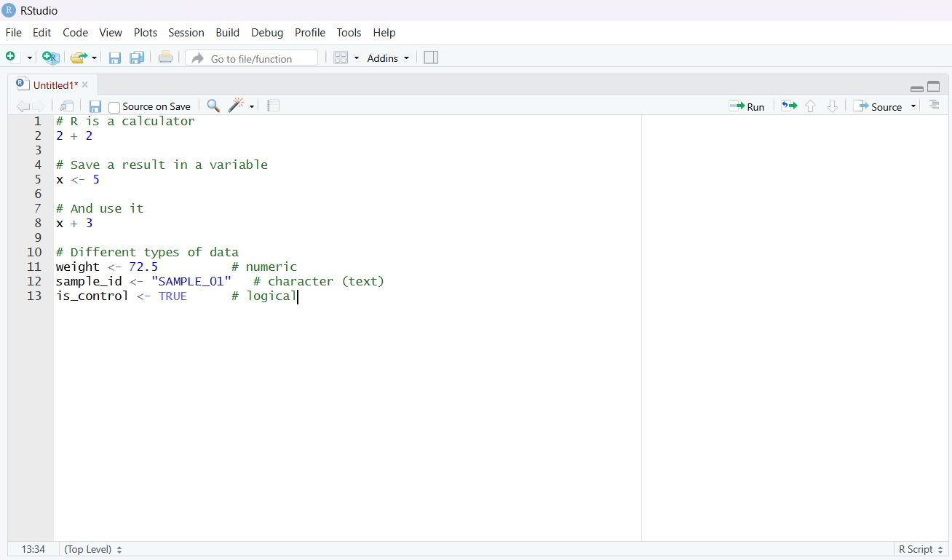
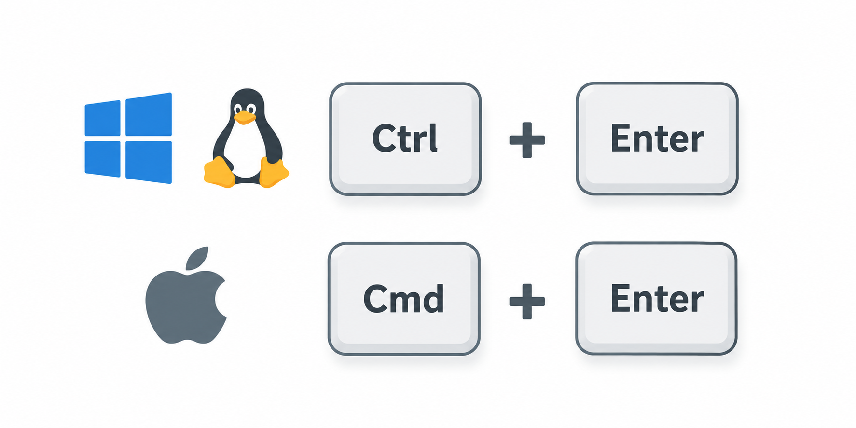
TOP LEFT
Source: where you write
1
Your script: a plain text file with the instructions, saved on your computer
Nothing here runs by itself - it is a document you are writing
You send a line to R with Ctrl + Enter (Cmd + Enter on Mac)
This is the pane you will spend 90% of your time in
Notes:
The editor is just a text editor - like Word, but for code, with colours. Writing a line here does nothing until you send it to R. That surprises people: they type, press Enter, and nothing happens. Enter makes a new line; Ctrl+Enter is what runs it. Everything you write here gets saved, which is exactly the point.

Slide 9
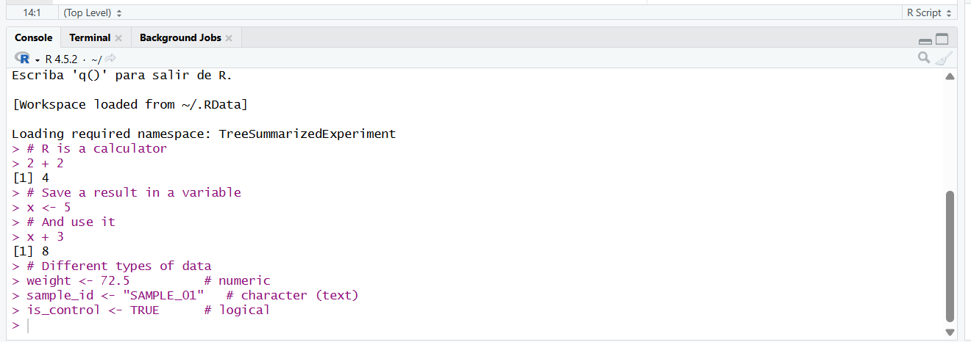
BOTTOM LEFT
Console: where R answers
2
R's own window: you send instructions here and results appear here
You can also type directly into it - but nothing you type here is saved
The > symbol means R is ready and waiting for you
Red text is not always a disaster: warnings are red too
Rule of thumb: try things in the console, keep the good ones in the script.
Notes:
The console is R itself. Notice the results printed here, and notice the red line in this screenshot - that is a real error I made: 'object not found'. Errors are completely normal, they are not a sign you are bad at this. The important habit: the console is scratch paper, the script is the notebook you keep.

Slide 10
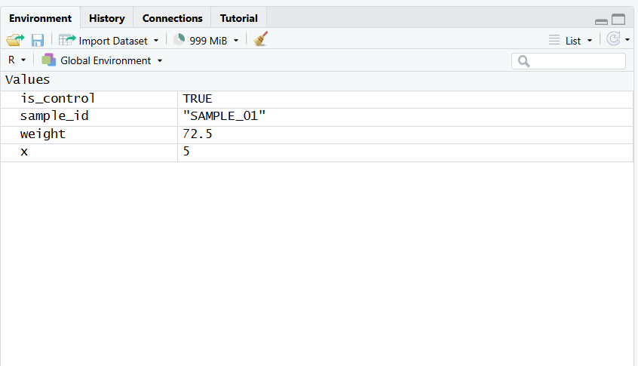
TOP RIGHT
Environment: what R is holding
3
The list of everything you have created in this session: tables, vectors, values
It lives in memory, not on disk - closing R empties it
Click a table here and it opens in a spreadsheet-like viewer
The broom icon clears everything, which is a good way to test a script
In this screenshot it says 'Environment is empty' - a fresh session, nothing loaded yet.
Notes:
This is the pane that makes the difference between confusion and clarity. Everything you create appears here. If your code says the object does not exist, look here first - it is usually just not created yet, or you spelled it differently. And a key idea: this is memory. Your data files on disk are untouched; the environment is a temporary copy R is holding for you.

Slide 11
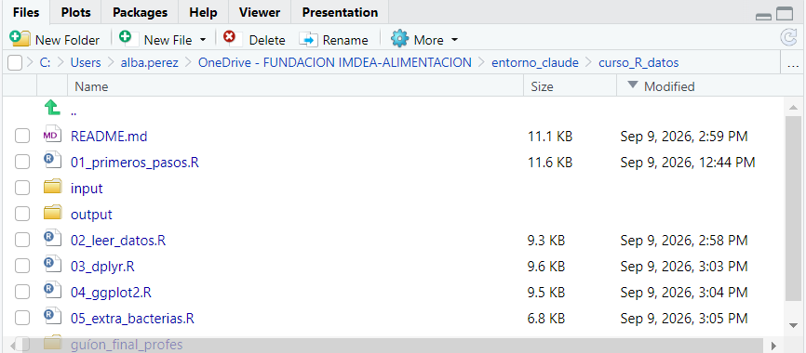
BOTTOM RIGHT
Files, plots, packages, help
4
Files: the folder you are working in, exactly as in your file explorer
Plots: every figure you draw appears here, with arrows to go back
Packages: the list of extensions installed and loaded
Help: the manual page of any function
Also here: Viewer, for notebooks and interactive output.
Notes:
This corner is a set of tabs rather than one thing. The Files tab is useful in the first weeks because it shows you where you actually are: notice in the screenshot the folder with the input and output subfolders and the scripts sitting next to them. The Help tab we will use constantly.

Slide 12
FILES YOU CAN CREATE
Two ways of writing: script or notebook
R script .R
R notebook .Rmd
Only code, plus comments after a # symbol
Results appear in the console and in the plots pane
The straightforward option - what we will use in this course
Perfect for a pipeline you run from top to bottom
Written text and code together, in blocks called chunks
Each chunk is run on its own and the result appears just below it
Exports to HTML, Word or PDF: report and analysis in one file
Ideal for explaining results to somebody else
Same R underneath. The difference is how the code and the results are laid out on the page.
Notes:
A notebook is what you would get if a script and a Word document had a child: paragraphs of text, and blocks of code whose output appears right underneath. It is how a lot of people share analyses, and this whole course could have been written as one. We will use plain scripts because there is one less thing to explain, but you should know the option exists - once you are comfortable, notebooks are excellent for reports.

Slide 13
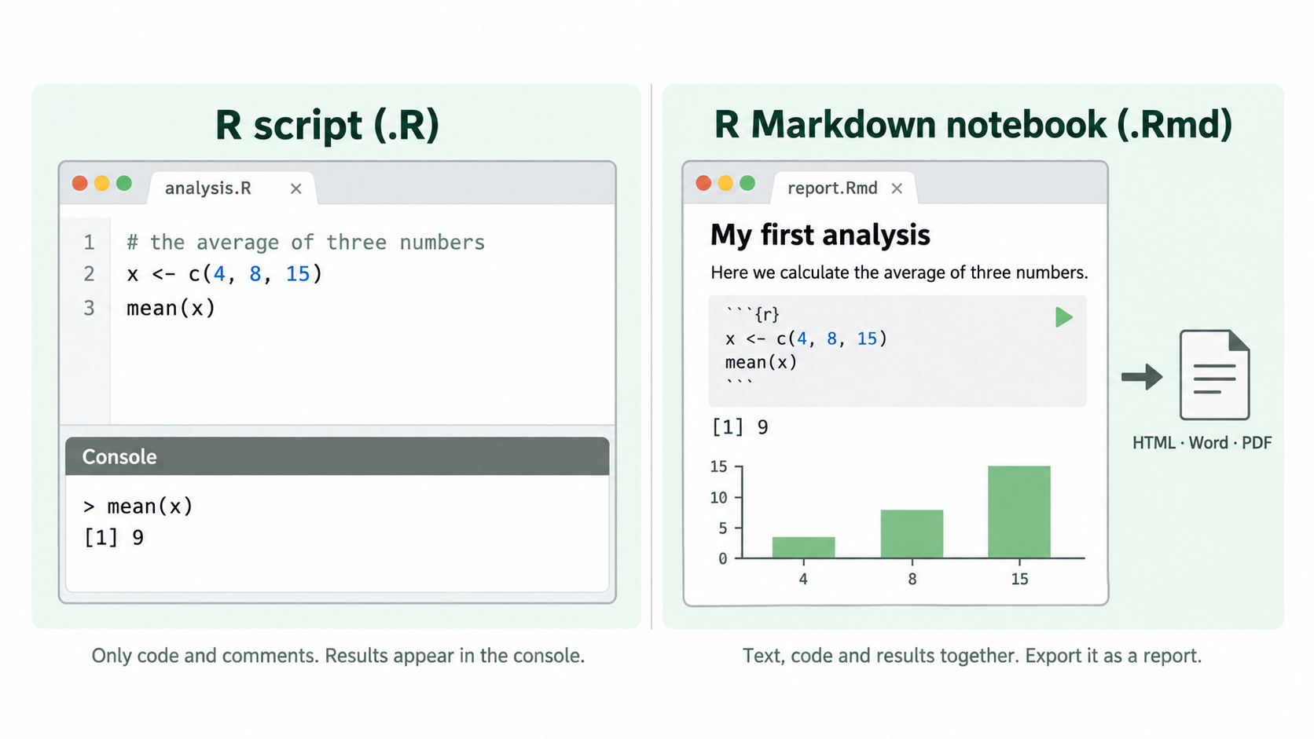
FILES YOU CAN CREATE
Two ways of writing: script or notebook
Notes:
A notebook is what you would get if a script and a Word document had a child: paragraphs of text, and blocks of code whose output appears right underneath. It is how a lot of people share analyses, and this whole course could have been written as one. We will use plain scripts because there is one less thing to explain, but you should know the option exists - once you are comfortable, notebooks are excellent for reports.

Slide 14
LIBRARIES
Packages: extending what R can do
R comes with a large set of functions built in - mean, plot, read.csv. Everything else lives in packages: collections of functions written by other people and shared freely.
Base R
Packages
What you get the moment you install R. Enough for a great deal of work - the whole first session uses nothing else.
More than 20,000 of them: dplyr for handling tables, ggplot2 for figures, and thousands of specialised ones.
Install once per computer
Load once per session
You download the package onto your machine. You never repeat it, except to update.
Every time you open R you tell it which of the installed packages you want available.
Notes:
The mental model I like: installing is buying the book and putting it on your shelf; loading is taking it down and opening it. You buy it once. You open it every time you want to read it. People get this wrong in both directions - reinstalling a package every single time, which is slow, or expecting a package to be available after a restart without loading it, which gives 'could not find function'.

Slide 15
INSTALL.PACKAGES() AND LIBRARY()
The two lines you will type most often
install.packages("ggplot2") # ONCE. In quotes. Downloads it onto this computer.
library(ggplot2) # EVERY SESSION. No quotes. Makes it available now.
Where they come from
Loading order matters
Good habit
CRAN is the official repository. Bioconductor is the one for biology and omics data, with its own installer.
Two packages can use the same function name. The last one loaded wins - a classic source of strange errors.
Put all your library() calls together at the top of the script, so anyone can see what is needed.
"could not find function" almost always means: the package is installed but you forgot to load it.
Notes:
Note the quotes: install.packages needs them because at that moment the package is just a name, a string of text. library does not, because by then R knows it as a thing. Nobody remembers this rule at first and it does not matter - the error message tells you. Also mention that installation can take a minute and prints a lot of red text that is not an error.

Slide 16
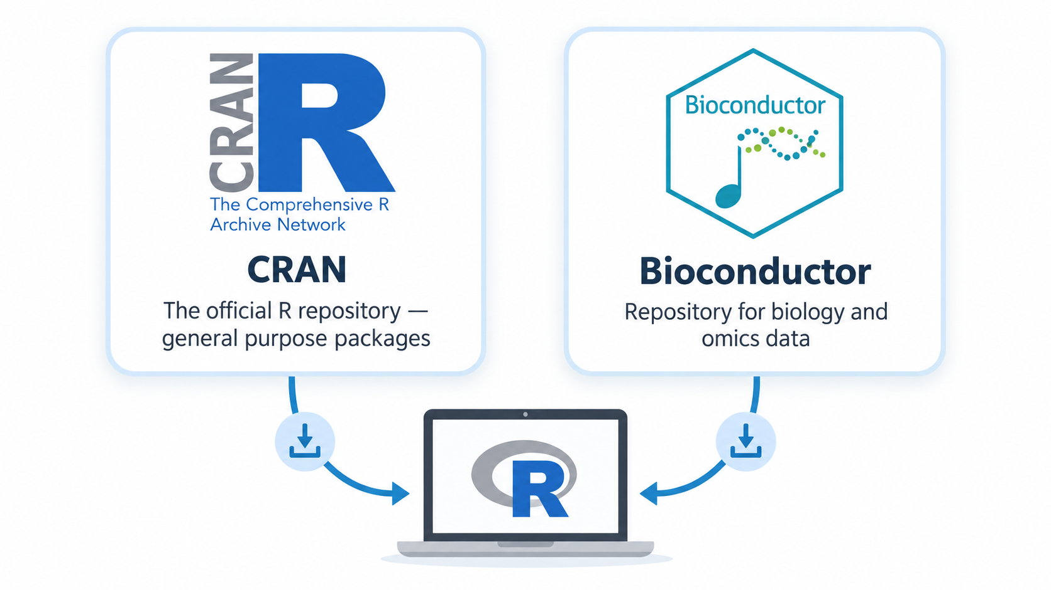

Slide 17
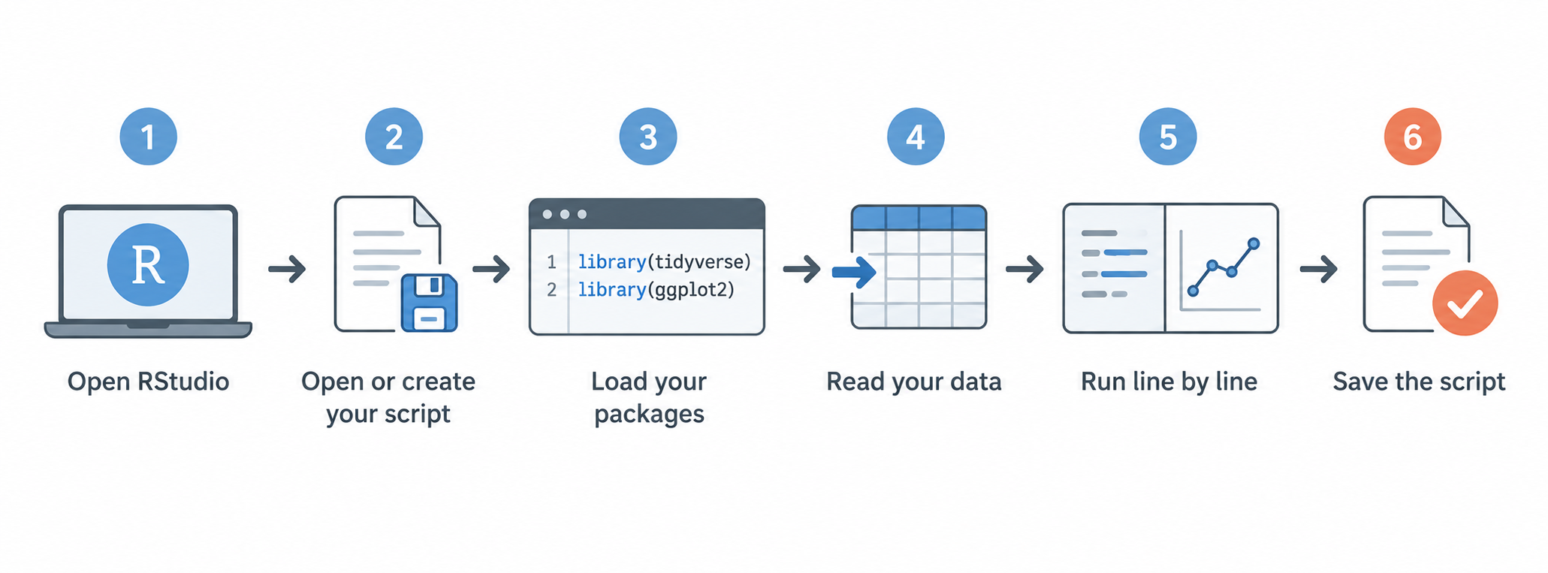
PUTTING IT TOGETHER
What a working session looks like
Notes:
None of this is a rule; it is just the rhythm you will fall into. The one piece I would insist on is the last: save the script, not the results. Results are cheap - you can always run the script again. A script you never wrote down is gone forever.

Slide 18
What to take away
R the language that does the work
Console where R answers you
Source where you write and save code
Files / Plots / Help your folder, figures and manual
library() every session
install.packages() once per computer
RStudio the window you actually open
The script the only thing that must be saved
Next session: we open RStudio and start writing - variables, vectors, tables and our own data.
Nothing here has to be memorised. You will meet all of it again, in practice.
Notes:
Close by lowering the stakes: none of this needs memorising today. The only thing I want them to leave with is the map - four panes, an environment that is memory, a script that is the real deliverable, and packages you install once and load every time.

