Slide 1
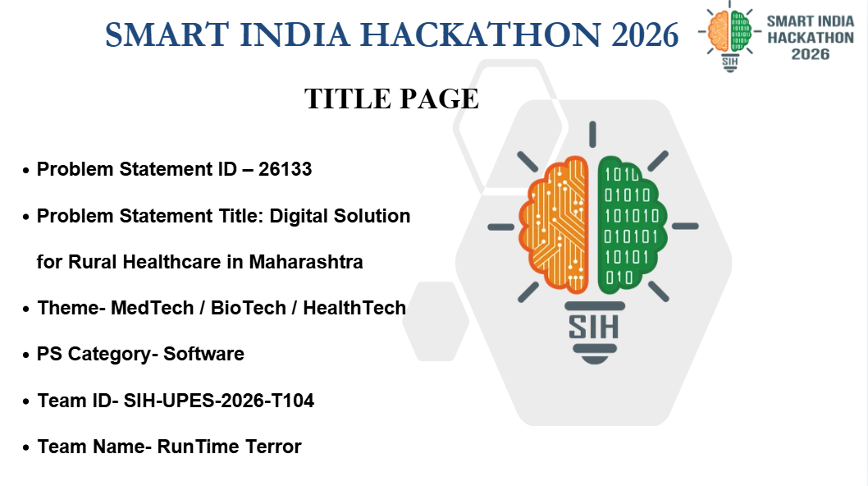

Slide 2


RunTime Terror
PROPOSED SOLUTION
· · ·
⚠ PROBLEM
✓ OUR SOLUTION
✖
Paper-based healthcare
Lost records & fragmented history across sub-centres & district hospitals.
✖
✓
Voice-first interface
Speak or tap icons in local languages (MR/HI/EN); zero typing needed.
✓
Sunita Tai AI Guide
Spoken interactive voice assistant guiding villagers & staff step-by-step.
✖
Long waiting times
Hours wasted traveling 40+ km only to queue in the sun.
✖
✓
Instant teleconsultation
Connect with PHC doctors via audio/video call with local ASHA support.
»
✖
Poor connectivity
System crashes & data loss in low-network rural pockets.
✖
✓
Smart appointments
Pre-book slots and view live token queue status from home.
✖
Low digital literacy
Complex text-heavy interfaces unusable for frontline workers.
✖
✓
Offline healthcare access
Local SQLite caching with background auto-cloud sync when network returns.
✖
Lost referral records
High patient drop-off between primary health care tiers.
✖
End-to-end patient journey
ABDM/FHIR QR Health Passport linking triage, referrals, labs, & care.
✓
@SIH Idea submission
2

Slide 3
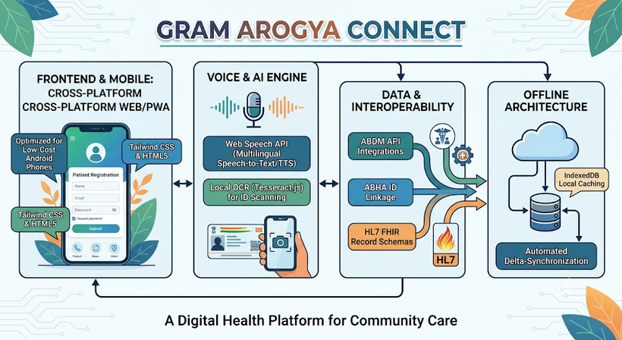
RunTime Terror
TECHNICAL APPROACH
TECHNOLOGIES TO BE USED
• Frontend & Mobile: Cross-platform Web/PWA (Tailwind CSS, HTML5) optimized for low-cost Android phones.
• Voice & AI Engine: Web Speech API for multilingual speech-to-text/TTS; local OCR (Tesseract.js) for ID scanning.
• Data & Interoperability: ABDM API integrations, ABHA ID linkage, HL7 FHIR record schemas.
• Offline Architecture: IndexedDB local caching with automated delta-synchronization.
METHODOLOGY & IMPLEMENTATION FLOWCHART
→
→
→
→
Frontline Field Entry
(ASHA/ANM)
Local Encrypted
Cache
Auto-Sync
Hotspot
ABDM Health
Grid
District Hospital
Portal
@SIH Idea submission
3

Slide 4
RunTime Terror
FEASIBILITY AND VIABILITY
ANALYSIS OF FEASIBILITY
Technical Feasibility
Operates 100% offline with zero cloud dependency during field entry; lightweight memory footprint.
Operational Feasibility
Directly fits ASHA/ANM workflows with icon-driven, voice-supported local UI.
Financial Viability
Built on an open-source stack with minimal infrastructure cost per primary health centre.
POTENTIAL CHALLENGES & STRATEGIES
Challenge: Zero connectivity in remote tribal villages.
»
Strategy: Local SQLite storage with auto-sync mesh upon signal return.
Challenge: Low tech literacy among field staff.
»
Strategy: Multilingual voice prompts (Marathi/Hindi) & Sunita Tai guided tour.
Challenge: Patient health data privacy.
»
Strategy: Role-Based Access Control (RBAC) & AES-256 local data encryption.
@SIH Idea submission
4

Slide 5
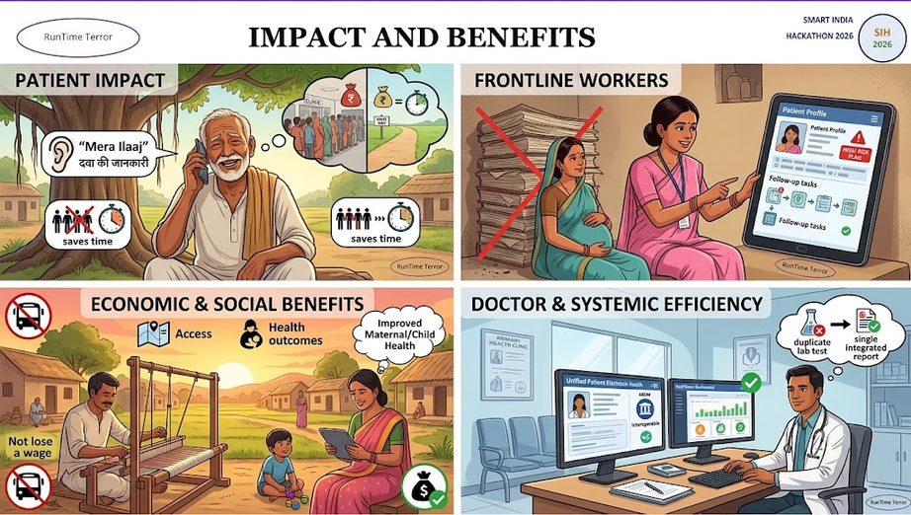
RunTime Terror
IMPACT AND BENEFITS
POTENTIAL IMPACT ON TARGET AUDIENCE
BENEFITS
• Patients: Saves 2-3 hours of wait time, cuts travel costs, provides audio dosage instructions in native language.
• Frontline Workers (ASHAs/ANMs): Eliminates paper registers and automatically flags high-risk maternal/chronic follow-ups.
• Doctors & Health Officials: Gives instant access to patient medical histories and real-time district medicine inventory.
• Social: Equal healthcare access for remote villages; improved maternal and child health outcomes.
• Economic: Reduces out-of-pocket medical travel expenses and prevents lost daily wages.
• Systemic: Stops duplicate lab tests through ABDM-compliant interoperable records.
@SIH Idea submission
5

Slide 6
RunTime Terror
RESEARCH AND REFERENCES
DETAILS / LINKS OF REFERENCE AND RESEARCH WORK
ABDM (Ayushman Bharat Digital Mission) Building Blocks & Health Data Management Guidelines.
1
MoHFW Rural Health Statistics (RHS) Report on PHC Specialist Shortages & Referral Friction.
2
HL7 FHIR (Fast Healthcare Interoperability Resources) Standards for Electronic Health Records.
3
Field research on frontline worker (ASHA/ANM) digital adoption in Maharashtra Sub-Centres.
4
@SIH Idea submission
6

