Slide 1
Analyzing Survey on Mental Health in Tech Workplace
Presented by:
Apoorv Goel
Harish Yadav
Nipun Soni

Slide 2
Contents
About the Survey
Objective
Dataset and Acknowledgments
Data Wrangling
Data Visualization and Insights
Machine Learning and Insights
Conclusions
Recommendations

Slide 3
About the Survey
Survey was taken in the year 2014 by Open Sourcing Mental Illness (OSMI)
non profit corporation dedicated to raising awareness, educating, and providing resources to support mental wellness in the tech and open source communities
Some of the questions asked –
Are you self-employed?
Does your employer provide mental health benefits as part of healthcare coverage?
Do you think that discussing a mental health disorder with your employer would have negative consequences?

Slide 4
Objective
To find strongest predictors of mental health illness in the workplace in order to improve the workplace for both employees and employers
Can you predict whether a patient should be treated of his/her mental illness or not

Slide 5
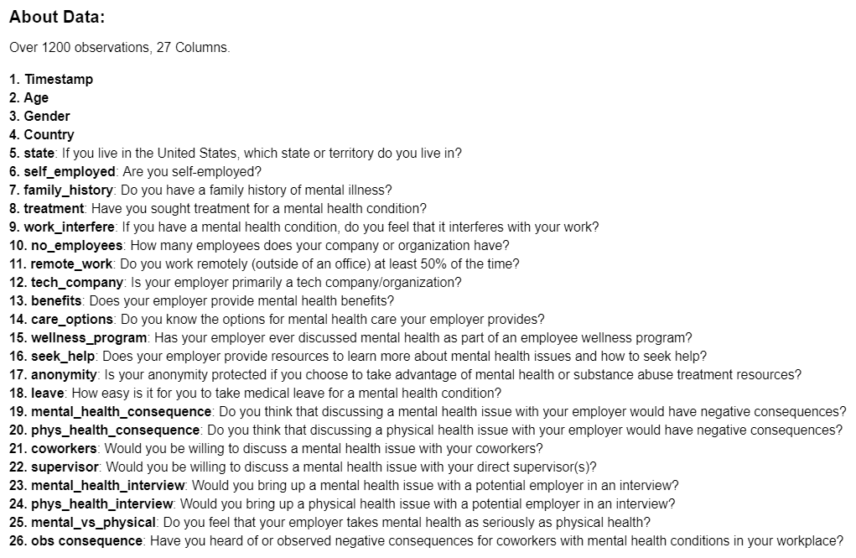
Dataset and Acknowledgements
Dataset taken from Kaggle
Over 1200 survey responses received for 25 questions asked
References:
https://www.kaggle.com/kairosart/machine-learning-for-mental-health
https://beckernick.github.io/logistic-regression-from-scratch/

Slide 6

Data Wrangling
Dropping Unnecessary columns
Timestamp, comments etc.
Removing Outliers
Age (keeping it between 18 and 75)
Renaming Categorical values
Gender, self_employed etc.

Slide 7
Insights – What data is telling us?

Slide 8
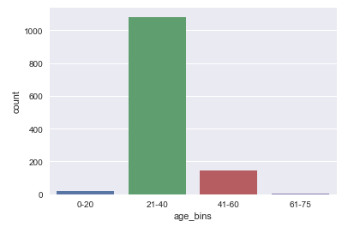
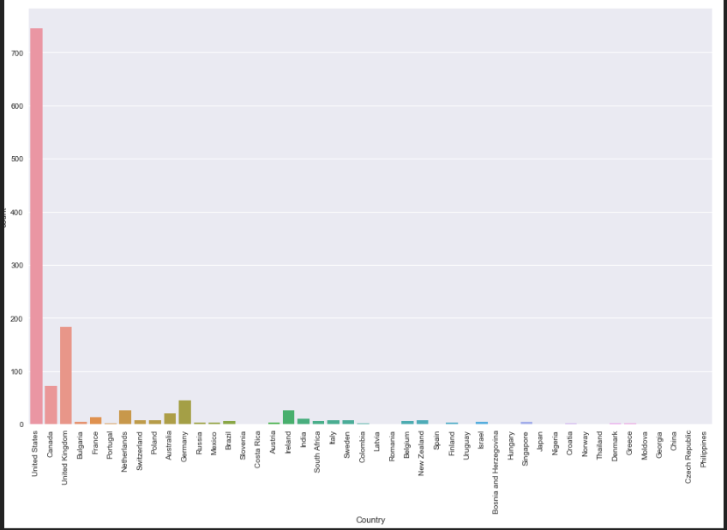
• Most of the people working in tech industry who have responded to the survey fall between 21-40 years of age. • A high percentage of the surveyors are from USA.

Slide 9
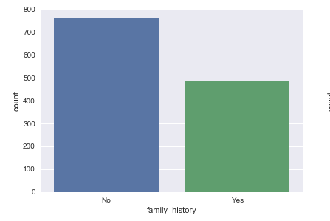
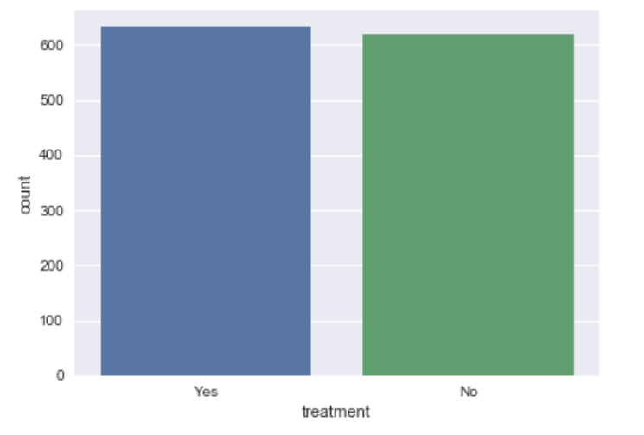
• Most of the people in the tech industry do not have a family history of mental illness. • More than 50% of the people surveyed are experiencing mental health issues, indicated by treatment.

Slide 10
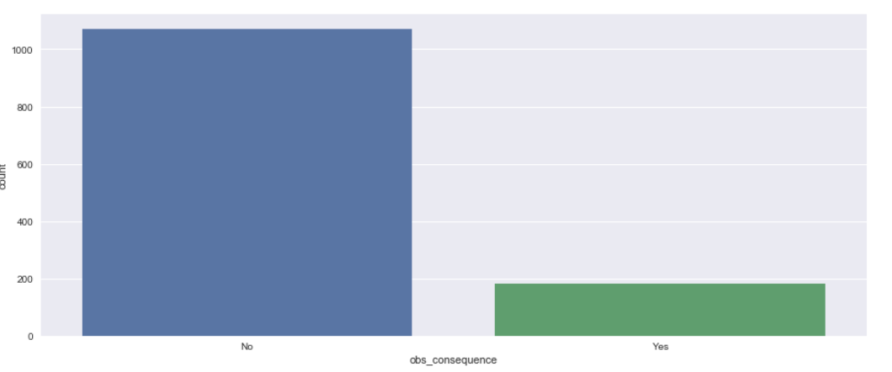
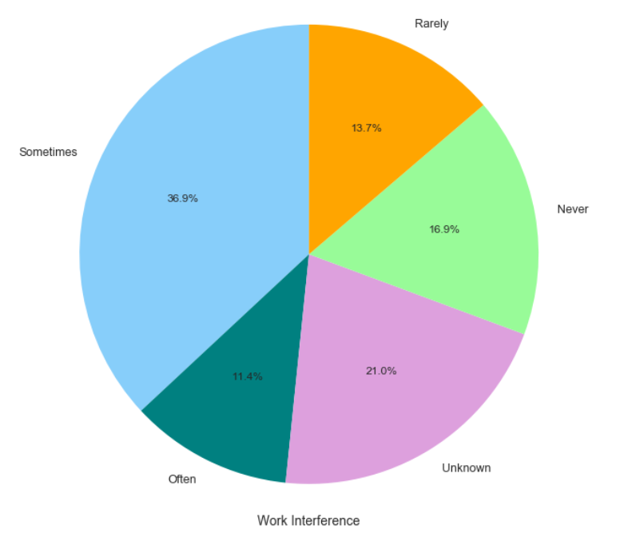
• Close to 50% people claimed that they often encounter interference with their work due to their mental health issues. • Majority of people have not seen negative consequences for co-workers with mental health issues in their workplace.

Slide 11
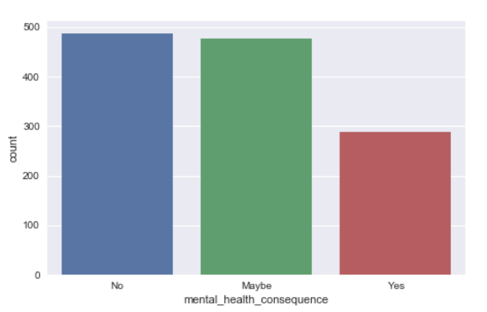
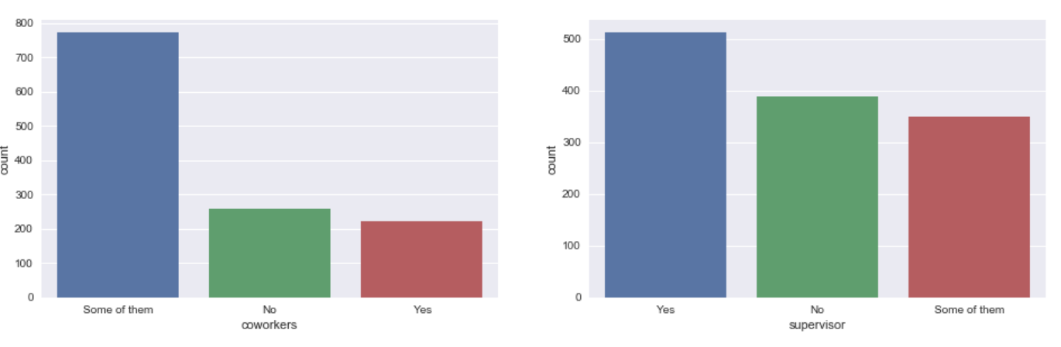
• A large proportion of surveyors are willing to discuss their mental health with their co-workers, showing a positive and healthy work environment in most of the tech companies. • Most of the employees are more comfortable to discuss mental health issues with Supervisor than compare to coworkers.

Slide 12
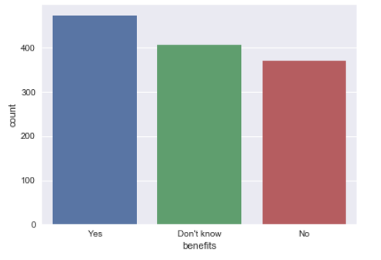
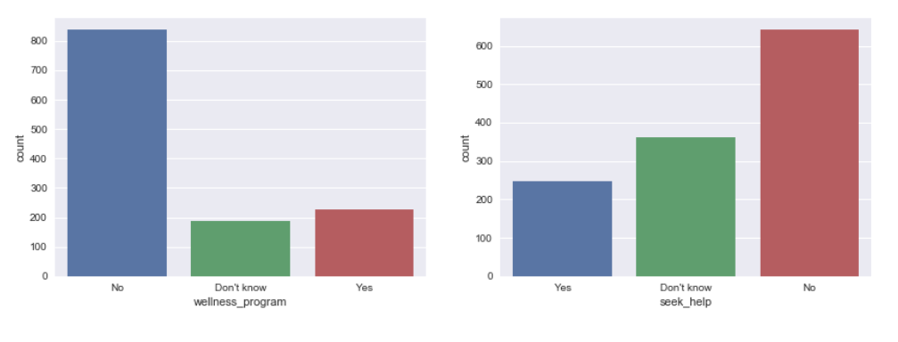
Most of the respondents indicated that their employer provides mental health benefits.
A great number of people report that employers are not discussing mental health as a part of an employee wellness program, showing lack of awareness by the employers towards their employees.
Quite surprisingly, larger number of employers doesn’t provide any resources to learn about the mental issues and how to seek help to their employees, which again shows the lack of awareness towards mental health issues by the employers.

Slide 13
Machine Learning
Data Split: 70:30 ratio
Used CrossValidation to tune models
Models:
Logistic Regression
Self Implementation of Logistic Regression
ExtraTree Classifier
DecisionTree Classifier
RamdomForest Classifier
Bagging
Boosting/AdaBoost

Slide 14
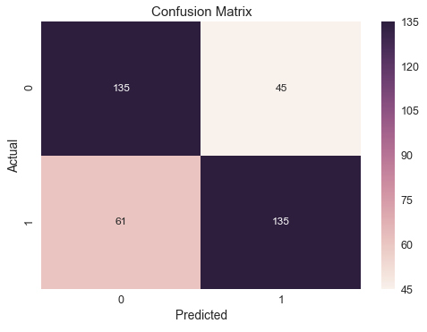
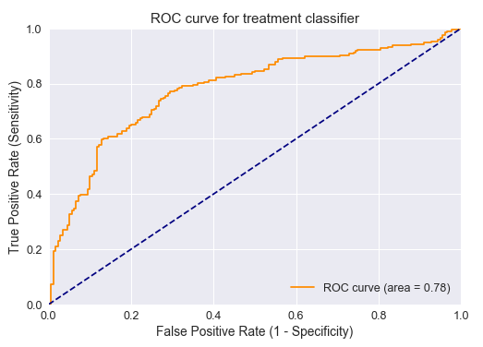
Logistic Regression
Accuracy: 0.718085106383
Classification Error: 0.281914893617
False Positive Rate: 0.25
Precision: 0.75

Slide 15
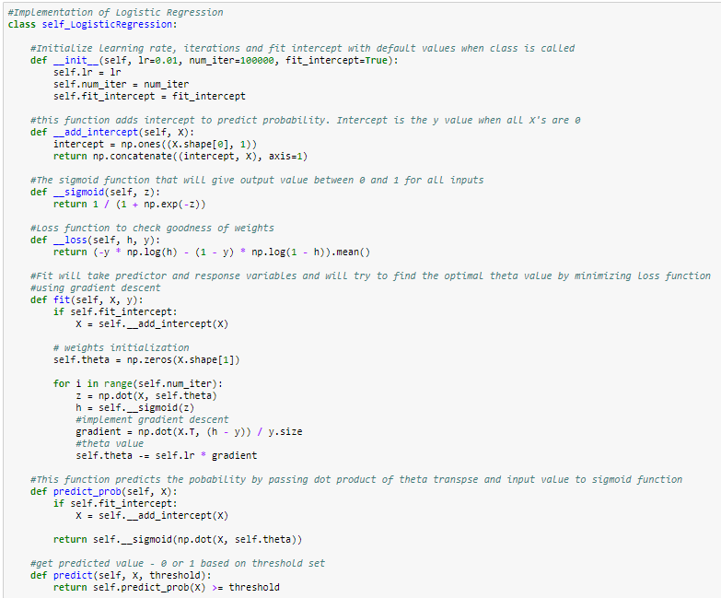
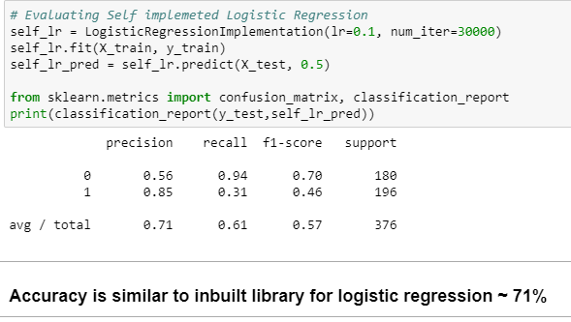
Self Implementation of Logistic Regression

Slide 16
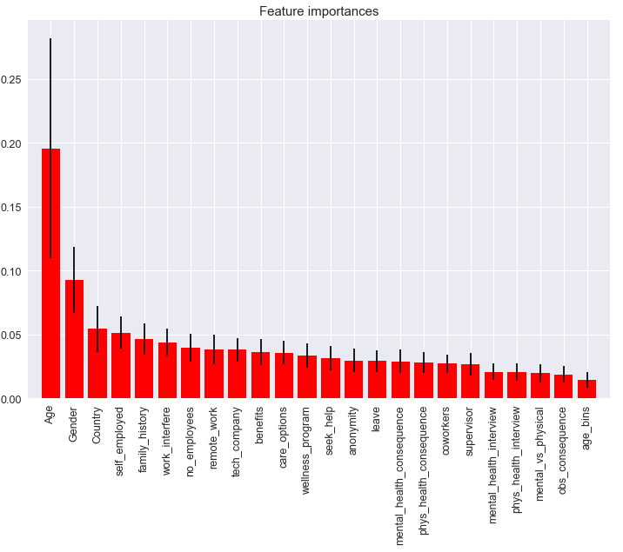
ExtraTree Classifier
Important Features:
1. Age
2. Gender
3. Country
4. self_employed
5. family_history
6. work_interfere
7. fuelType

Slide 17
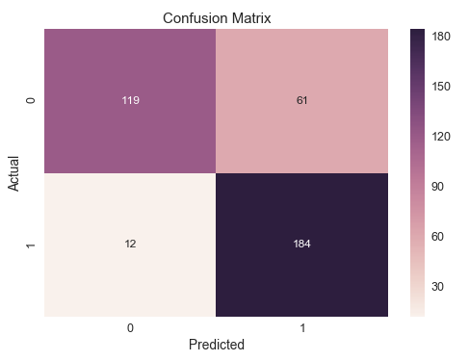
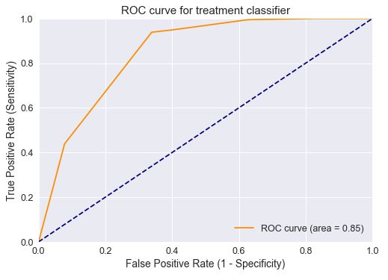
DecisionTree Classifier
Best Params: {'criterion': 'entropy', 'max_depth': 3,
'max_features': 17, 'min_samples_leaf': 7,
'min_samples_split': 2}
Accuracy: 0.80585106383
Classification Error: 0.19414893617
False Positive Rate: 0.338888888889
Precision: 0.751020408163

Slide 18
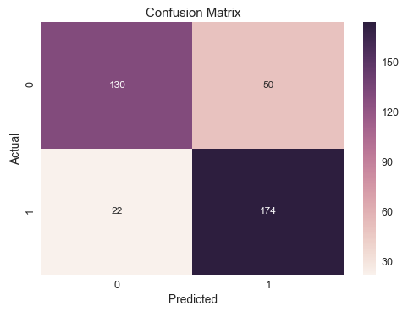
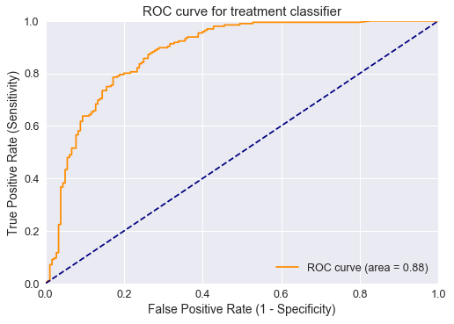
RandomForest Classifier
Best Params: {'criterion': 'entropy', 'max_depth': 3,
'max_features’: 13, 'min_samples_leaf’: 6,
'min_samples_split’: 5}
Accuracy: 0.808510638298
Classification Error: 0.191489361702
False Positive Rate: 0.277777777778
Precision: 0.776785714286

Slide 19
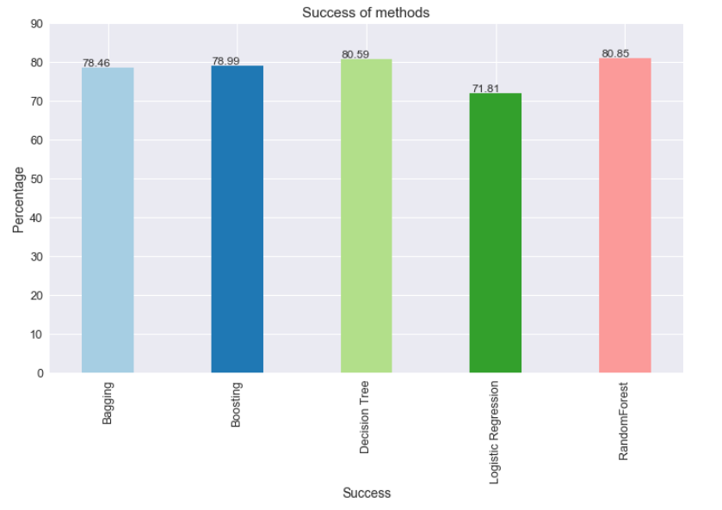
Model Results
Best Accuracy: 80.85%
Best Model: RandomForest
Most important features:
Age
Gender
Country
self_employed
family_history

Slide 20
Recommendations
For Employers –
More than 50% of employees are suffering from mental health issues. So, employers should mandate the provision health programs to its employees
Allow flexible work environment – Flexible scheduling, Modified break schedule, Work from home/Flexi-place
Provide day-to-day guidance and feedback. Also, positive praise and reinforcement will be beneficial to employees
This type of prediction model can be used in finding key factors for other issues within the organization
* Most of these recommendations will lead to policy changes in the organization which is subject to various factors like country policy, size of organization, employee data privacy etc.
For Employees –
Employees should talk to employers about their mental health issues so that they can aid them with benefit provisions like working from home, extra leaves etc.
Employees should be aware of their health coverage and aid programs provided by their employer and should actively participate in any wellness program.
Proper feedback should be given related to effectiveness of the employer’s health program while leaving the organization. This might help in improving existing health policies.

Slide 21
Thank You!!!
Questions?

