Slide 1
Medical Appointment No-shows
Presented by:
Aakash Kaushal
Apoorv Goel
Nipun Soni
Rohit Kumar

Slide 2
A person makes a doctor appointment, receives all the instructions and it’s a no-show.
Who/What to blame?

Slide 3
What is a no-show?
Basically, it’s a non-attending person who neither uses nor cancels their reservation.

Slide 4
The problem is…
People have no idea of the scale of this problem.
A recent survey concluded that as many as 42% of patients skip their appointments.

Slide 5
“An appointment missed by you is an appointment missed by two.”
A missed appointment is more than just a missed opportunity. When a patient doesn’t show up on time, it also affects people who could’ve been treated instead of that patient.
Visitors, doctors, and even hospital administration…they’re all affected.

Slide 6
Finding Reasons
Different Surveys using different datasets came up with some influencing factors :
Financial Reasons
Discouraged by long Hospital wait time
Poor Medical Literacy
Anxiety
Transportation

Slide 7
What can help ?
SMS/Reminder Calls
Ability to predict ?

Slide 8
The data we had
Gender & Age
Signs of Hypertension, Diabetes & Alcoholism
Appointment date and the date of Scheduling.
Medical Insurance
SMS Notification

Slide 9
Data and it’s Complications

Slide 10
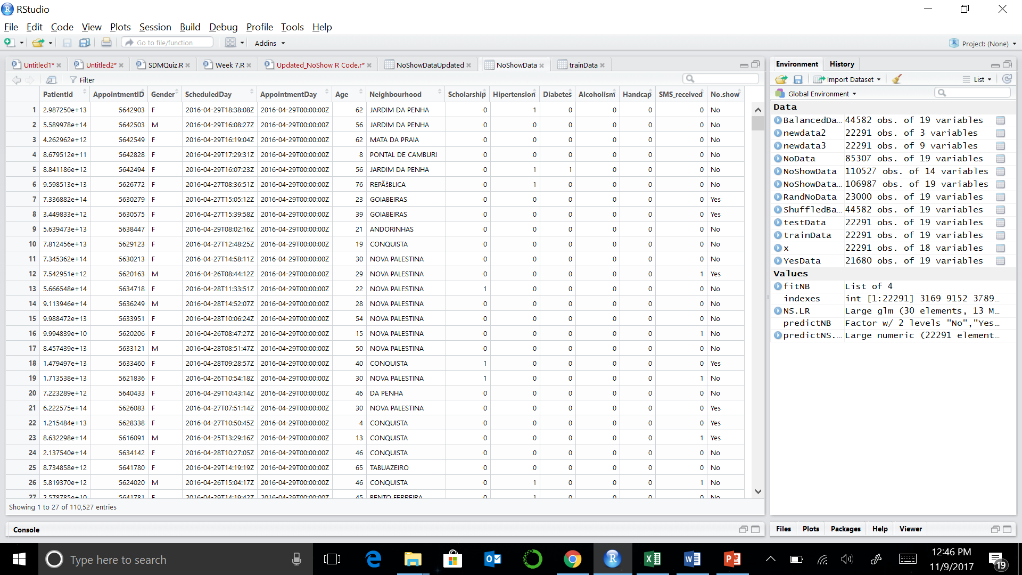
The Data

Slide 11
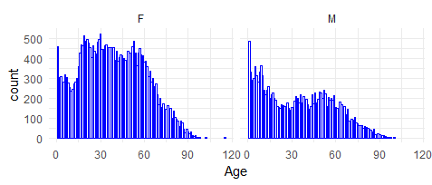

Slide 12
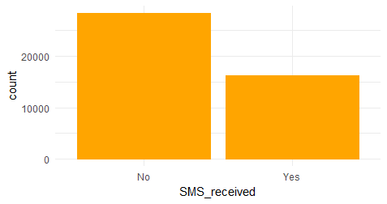

Slide 13
Data Struggles
Irrelevant Columns – Patient & Appointment ID
Date & Time Stamps – Always an issue!!
Outliers in Age – 0, negative and above 100
Junk Rows – Handicap Row values
Appointment & Schedule data Difference- Is it Relevant?
Bias Data – 80:20 Show : No-Show
Balancing the data.

Slide 14
Clean it UP!!!
Remove Patient ID, Appointment ID columns
Cleaning up date columns
Extracting date month and year from appointment and schedule day columns
Calculate difference between Scheduled and Appointment dates
Creating Balanced Data
removing negative values and values >1
Convert columns to factors

Slide 15
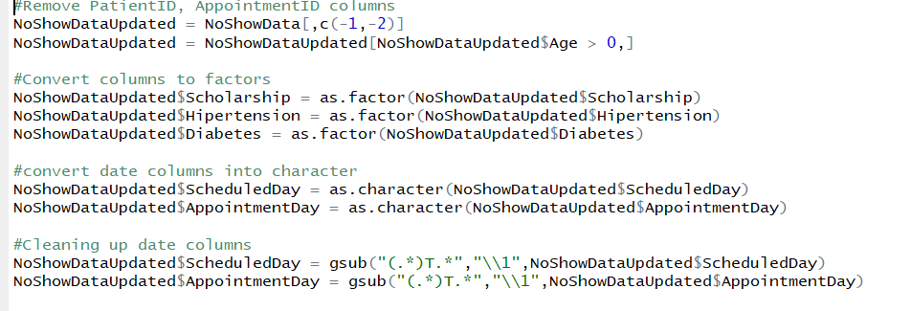
Clean it UP!!!

Slide 16
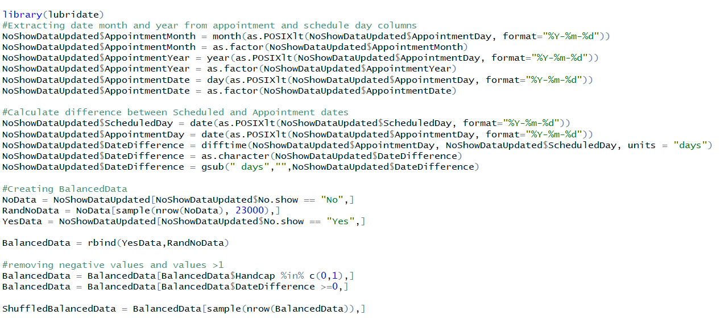
Clean it UP!!!

Slide 17
Real World Data Set is not your friend!

Slide 18
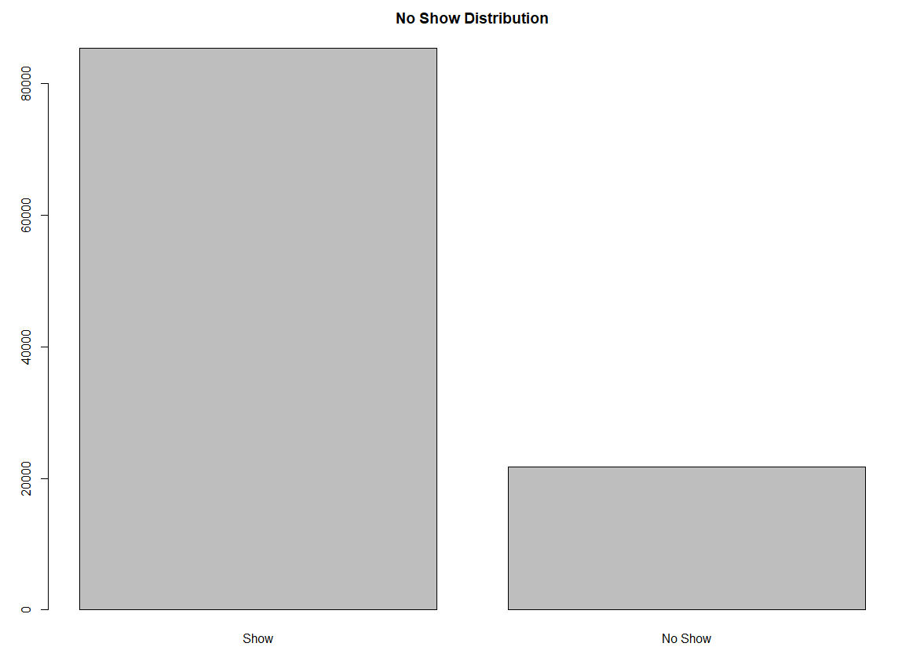
Bias in Distribution
85,000 v/s 21,000 Rows
Notes:
counts = table(NoShowDataUpdated$No.show)
barplot(counts,main="No Show Distribution",
names.arg=c("Show", "No Show"))

Slide 19
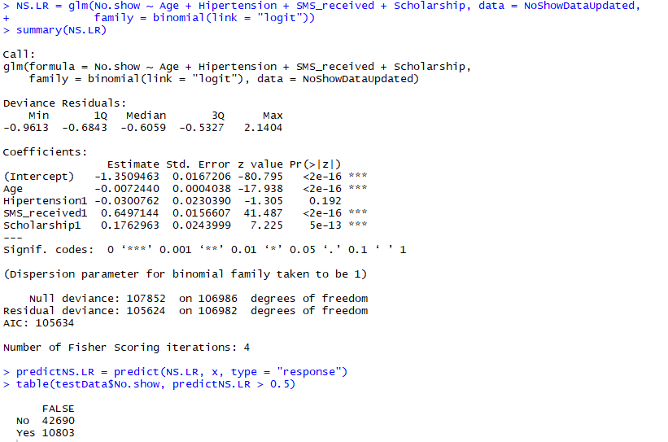
Model prediction values were biased. There were No FP, TP

Slide 20
Solution: Balanced Data
We took complete No_Show data rows(Around 21,000 rows)
We took nearly similar no of show records by random sampling.
We merged this data together so we can have nearly similar no of show and no-show data.
NoData = NoShowDataUpdated[NoShowDataUpdated$No.show == "No",] #85,307 Rows
RandNoData = NoData[sample(nrow(NoData), 23000),]
YesData = NoShowDataUpdated[NoShowDataUpdated$No.show == "Yes",] #21,608 Rows
BalancedData = rbind(YesData,RandNoData)

Slide 21
Brief overview of techniques used
As this dataset is about predicting Show/No Show of a Customer at hospital, so it’s a classification problem.
We performed classification techniques:
Logistic Regression
Naïve Bayes
Cross validation
Ridge, Lasso and PCA for dimensionality reduction

Slide 22
Statistical Modeling and Resolution

Slide 23
Dimensionality Reduction
Techniques used –
Ridge (Feature Elimination)
Lasso (Feature Elimination)
Principal Component Analysis(PCA) – Feature Extraction

Slide 24
Lasso Regression
Steps:
Converted Gender and No-show columns to 0’s and 1’s
Removed other non-numeric columns
Shuffled Data again (44594 records)
Performed Lasso and used 10 folds cross validation to find best Lambda(shrinkage coefficient)

Slide 25
Lasso R Code
#Lasso
lasso.mod <- glmnet(x1, y, alpha=1, nlambda=100)
#10 folds cross validation
set.seed(1)
cv.out <- cv.glmnet(x1, y, alpha=1, nlambda=100)
best.lambda <- cv.out$lambda.min
best.lambda
predict(lasso.mod, s=best.lambda, type="coefficients")[1:10, ]
Notes:
library(lars)
library(glmnet)
#Cleaning part 2
BalancedDataLasso = BalancedData
#Gender to 0(F) and 1(M)
BalancedDataLasso$Gender = as.character(BalancedDataLasso$Gender)
BalancedDataLasso$Gender[BalancedDataLasso$Gender == "M"] = 1
BalancedDataLasso$Gender[BalancedDataLasso$Gender == "F"] = 0
BalancedDataLasso$Gender = as.factor(BalancedDataLasso$Gender)
#No show to 0(NO) and 1(Yes)
BalancedDataLasso$No.show = as.character(BalancedDataLasso$No.show)
BalancedDataLasso$No.show[BalancedDataLasso$No.show == "Yes"] = 1
BalancedDataLasso$No.show[BalancedDataLasso$No.show == "No"] = 0
BalancedDataLasso$No.show = as.factor(BalancedDataLasso$No.show)
BalancedDataLasso = BalancedDataLasso[,-c(2,3,5,13,14,15,16,17,18)]
BalancedDataLasso$Gender = as.numeric(BalancedDataLasso$Gender)
BalancedDataLasso$Age = as.numeric(BalancedDataLasso$Age)
BalancedDataLasso$Scholarship = as.numeric(BalancedDataLasso$Scholarship)
BalancedDataLasso$Hipertension = as.numeric(BalancedDataLasso$Diabetes)
BalancedDataLasso$Alcoholism = as.numeric(BalancedDataLasso$Alcoholism)
BalancedDataLasso$Handcap = as.numeric(BalancedDataLasso$Handcap)
BalancedDataLasso$SMS_received = as.numeric(BalancedDataLasso$SMS_received)
BalancedDataLasso$No.show = as.numeric(BalancedDataLasso$No.show)
BalancedDataLasso$Diabetes = as.numeric(BalancedDataLasso$Diabetes)
BalancedDataLasso$DateDifference = as.numeric(BalancedDataLasso$DateDifference)
BalancedDataLasso$Gender[BalancedDataLasso$Gender == 1] = 0
BalancedDataLasso$Gender[BalancedDataLasso$Gender == 2] = 1
BalancedDataLasso$Age[BalancedDataLasso$Age == 1] = 0
BalancedDataLasso$Age[BalancedDataLasso$Age == 2] = 1
BalancedDataLasso$Scholarship[BalancedDataLasso$Scholarship == 1] = 0
BalancedDataLasso$Scholarship[BalancedDataLasso$Scholarship == 2] = 1
BalancedDataLasso$Hipertension[BalancedDataLasso$Hipertension == 1] = 0
BalancedDataLasso$Hipertension[BalancedDataLasso$Hipertension == 2] = 1
BalancedDataLasso$Diabetes[BalancedDataLasso$Diabetes == 1] = 0
BalancedDataLasso$Diabetes[BalancedDataLasso$Diabetes == 2] = 1
BalancedDataLasso$Alcoholism[BalancedDataLasso$Alcoholism == 1] = 0
BalancedDataLasso$Alcoholism[BalancedDataLasso$Alcoholism == 2] = 1
BalancedDataLasso$Handcap[BalancedDataLasso$Handcap == 1] = 0
BalancedDataLasso$Handcap[BalancedDataLasso$Handcap == 2] = 1
BalancedDataLasso$SMS_received[BalancedDataLasso$SMS_received == 1] = 0
BalancedDataLasso$SMS_received[BalancedDataLasso$SMS_received == 2] = 1
BalancedDataLasso$No.show[BalancedDataLasso$No.show == 1] = 0
BalancedDataLasso$No.show[BalancedDataLasso$No.show == 2] = 1
ShuffledBalancedDataLasso = BalancedDataLasso[sample(nrow(BalancedDataLasso)),]
x1 = model.matrix(No.show~., ShuffledBalancedDataLasso)[,-1]
y = ShuffledBalancedDataLasso$No.show
#Lasso
lasso.mod <- glmnet(x1, y, alpha=1, nlambda=100, lambda.min.ratio=0.0001)
lasso.mod$lambda[25]
coef(lasso.mod)[,25]
set.seed(1)
cv.out <- cv.glmnet(x1, y, alpha=1, nlambda=100, lambda.min.ratio=0.0001)
#plot(cv.out)
best.lambda <- cv.out$lambda.min
best.lambda
predict(lasso.mod, s=best.lambda, type="coefficients")[1:10, ]

Slide 26
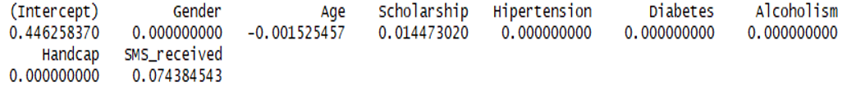
Lasso Results
Most Significant columns- Age, Scholarship and SMS_Received
Insignificant – Gender, Diabetes, HandCap, Hipertension, Alcoholism

Slide 27
Ridge Regression
Performed similar steps for Ridge regression
Change alpha to 0
cv.out <- cv.glmnet(x1, y, alpha=0, nlambda=100, lambda.min.ratio=0.0001)
predict(ridge.mod, s=best.lambda, type="coefficients")[1:9, ]
Does not push coefficients to 0

Slide 28
Ridge Results
Ridge says Age is insignificant and Alcoholism is significant
Significant columns – Alcoholism, SMS_Received, Scholarship
Got best results using columns identified by Lasso.

Slide 29

Logistic Regression
Performed on most significant columns identified by Lasso
Test : Train datasets = 50 :50
Accuracy – 57.9%
Confusion Matrix:

Slide 30
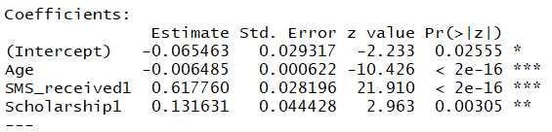
Logistic Regression Code
NS.LR = glm(No.show ~ Age + SMS_received + Scholarship, data = trainData, family = binomial(link = "logit"))
summary(NS.LR)
predictNS.LR = predict(NS.LR, x, type = "response")
table(testData$No.show, predictNS.LR > 0.5)

Slide 31
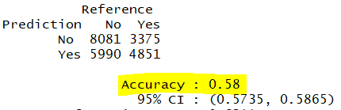
Naïve Bayes Procedure
Performed on most significant columns identified by Lasso
Test : Train datasets = 50 :50
Accuracy – 58%
Confusion Matrix and Statistics

Slide 32
Naïve Bayes code
fitNB = naiveBayes(No.show ~ Age + SMS_received + Scholarship, data = trainData)
summary(fitNB)
predictNB = predict(fitNB, x)
confusionMatrix(testData$No.show, predictNB)

Slide 33
Cross Validation
Performed 10-fold cross validation on Logistic and Naïve Bayes procedure
Naïve Bayes:
Accuracy : Between 56 to 58
Mean accuracy – 57.96%
Logistic Regression:
Accuracy : Between 55 to 58
Mean accuracy – 56.95%

Slide 34

Cross validation code
# Applying k-Fold Cross Validation
folds = createFolds(ShuffledBalancedData$No.show, k = 10)
cv = lapply(folds, function(x) {
training_fold = ShuffledBalancedData[-x, ]
test_fold = ShuffledBalancedData[x, ]
classifier = naiveBayes(No.show ~ Age + SMS_received + Scholarship, data = training_fold)
y_pred = predict(classifier, newdata = test_fold[-12])
cm = table(test_fold[, 12], y_pred)
accuracy = (cm[1,1] + cm[2,2]) / (cm[1,1] + cm[2,2] + cm[1,2] + cm[2,1])
return(accuracy)
})
cv
accuracy = mean(as.numeric(cv))
accuracy

Slide 35
Principal Component Analysis
Created 9 Principal components
Libraries used: FactoMineR, factoextra
Columns used –
Gender
Age
Scholarship
Hypertension
Diabetes
Alcoholism

Slide 36
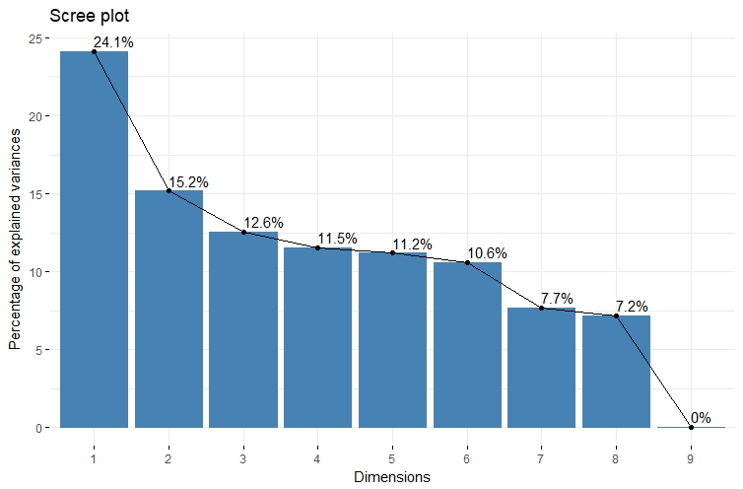
Variance Visualization - PCA
63.4% variance is explained by first 4 PCA components

Slide 37
PCA R Code
library(FactoMineR)
library(factoextra)
#Data
df = NoShowDataPCA[,c(1:8,10)]
#Apply PCA
pc = prcomp(df, scale. = TRUE)
#Get Principal Components
head(pc$rotation)
head(pc$x)
#Viszualize Variance plot
fviz_eig(pc)

Slide 38
Conclusions
Naïve Bayes procedure was slightly better than Logistic Regression as it gave us better accuracy
Feature Elimination was done better by Lasso when compared to Ridge for this dataset
Dataset could have more relevant features that would have helped increasing accuracy (ex: Disease records, Work schedule of patients, new or retuning patient, location from hospital etc.)

Slide 39
Appendix
Link for data set: https://www.kaggle.com/joniarroba/noshowappointments/data
R Code:

Slide 40
Thank You!!!
Questions?

