Slide 1
Predict Price of Used Cars
Presented by:
Apoorv Goel
Harish Yadav
Nipun Soni

Slide 2
Objective
To come up with a model which will predict price of a used Car based on different parameters.
People planning to buy/sell used cars can estimate the price more accurately based on the data patterns.

Slide 3
Contents
Dataset and Acknowledgments
Data Wrangling
Data Visualization and Insights
Machine Learning and Insights
Conclusions
Recommendations

Slide 4
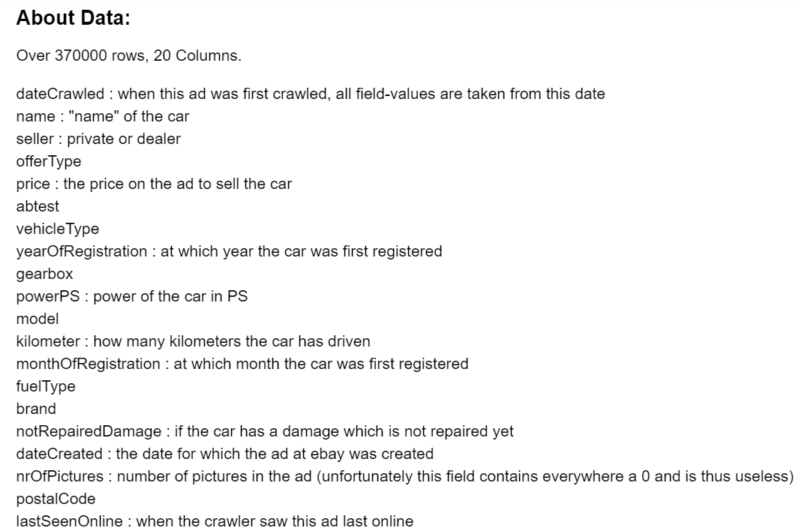
Dataset and Acknowledgments
Dataset taken from Kaggle
Data has been crawled from eBay Germany
20 features and 370K observations
References:
https://www.kaggle.com
http://scikit-learn.org
https://www.udemy.com/

Slide 5

Data Wrangling
Dropping Unnecessary columns
No. of pictures, postal code, abtest etc.
Handling Null values
Vehicle type, fuelType, model etc.
Removing Outliers
Price, year of registration
Renaming Categorical values
Gearbox, notRepairedDamage

Slide 6
Data Visualization

Slide 7
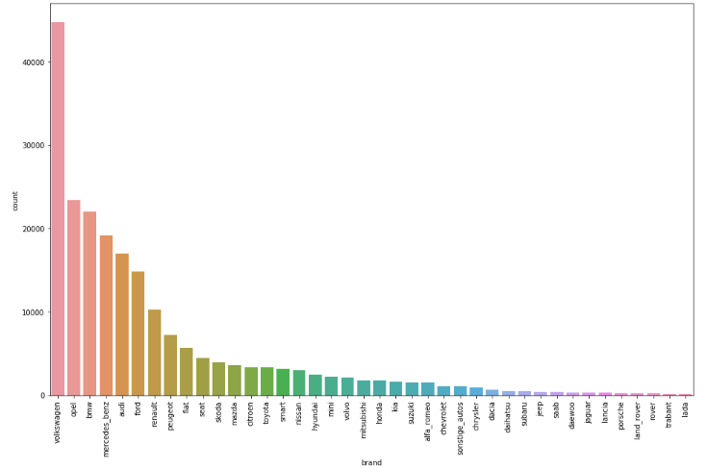
Count Plot for Brand
The most popular brands are Volkswagen, BMW, Opel, Mercedes, Audi, Ford, Renault, Peugeot, Fiat and Seat.
Volkswagen being a German company is not surprising to be on top.

Slide 8
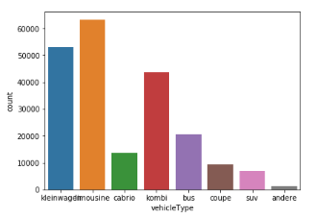
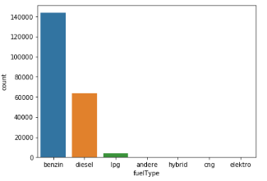
Count Plot for VehicleType & FuelType
Limousine, kombi and kleinwagen are the most popular vehicle types in the second-hand market.
Though the most of the market is ruled by the petrol/diesel cars but hybrid and other types of fuel cars are emerging slowly.

Slide 9
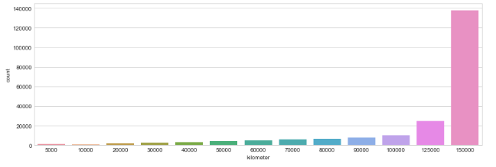
Count Plot for Kilometer
Most of the cars in the second-hand market are above 100000 km, even 150000 km. People does not frequently change cars according to our data set.

Slide 10
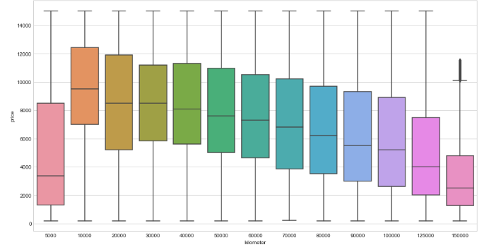
Box Plot for Price/Kilometer
Price decreases with increase in kilometers while we can see that a car with 5000 kms have lower price which can be a result of different unusual factors.

Slide 11
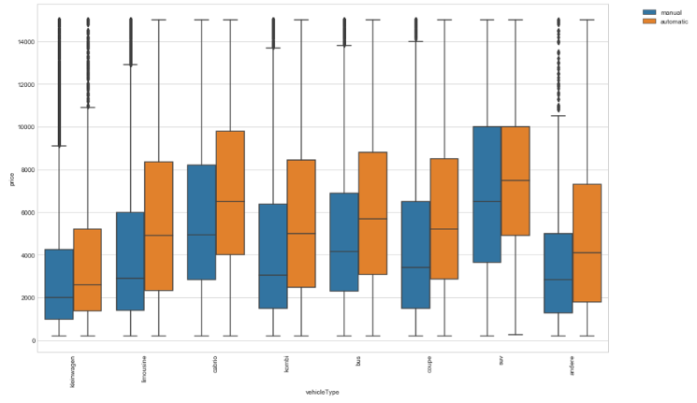
Boxplot for Price/VehicleType
Most expensive cars are SUV’s while the cheapest ones are kleinwagens and quite surprisingly Limousine resale value is less than suv.
Automatic cars are expensive than Manual cars.

Slide 12
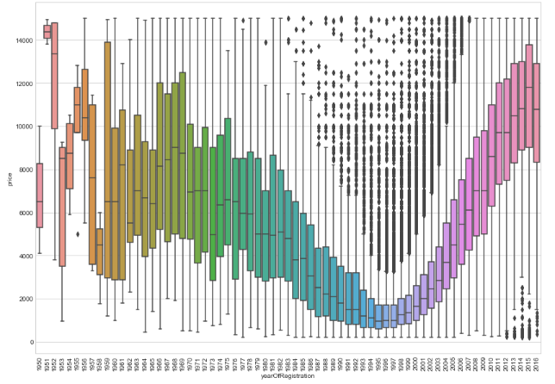
Box Plot for Price/YearofRegisteration
The price and year of registration are directly correlated as the year of registration increases the price increases. We can also see that the price also increase with old cars Maybe, 20+ year old second-hand cars can be considered as ‘Vintage Cars’

Slide 13
Machine Learning

Slide 14

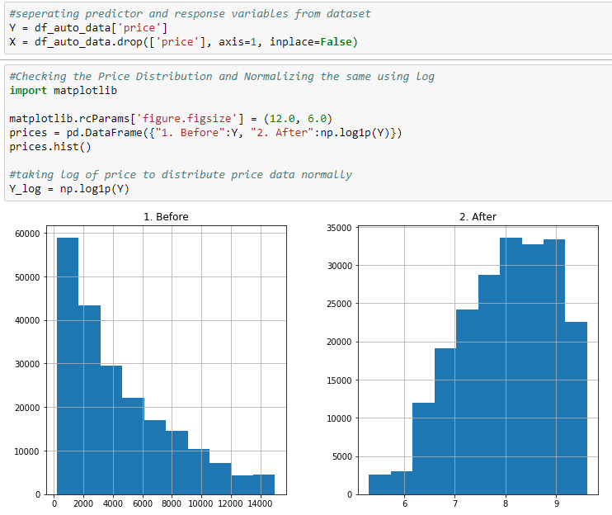
Linear Regression

Slide 15
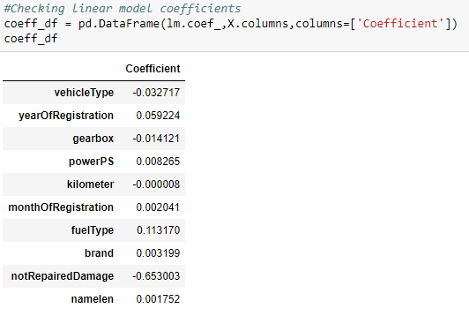
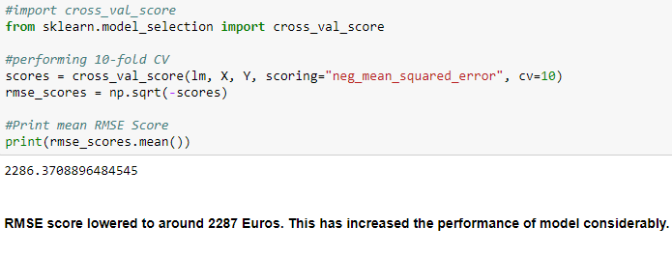
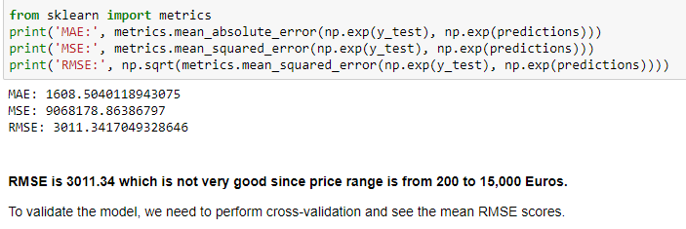
Linear Regression and Cross Validation

Slide 16
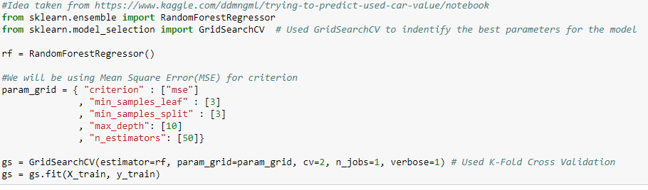
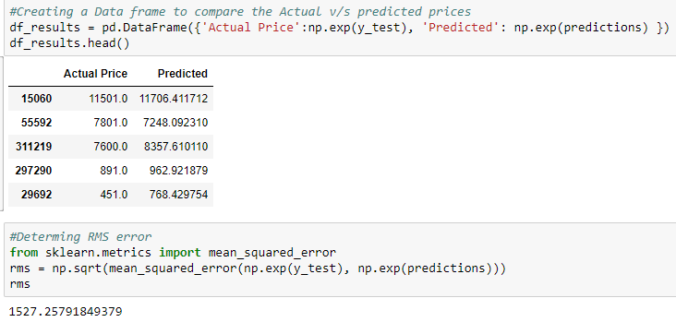
Random Forest Regressor with GridSearch
We were able to improve the RMS from over 3011.34 in Linear Regression to 1526 using RandomForest with GridSearch
Important Features:
1. yearOfRegistration (0.647461)
2. powerPS (0.203093)
3. notRepairedDamage (0.053709)
4. vehicleType (0.032251)
5. brand (0.030746)
6. kilometer (0.023484)
7. fuelType (0.004991)

Slide 17
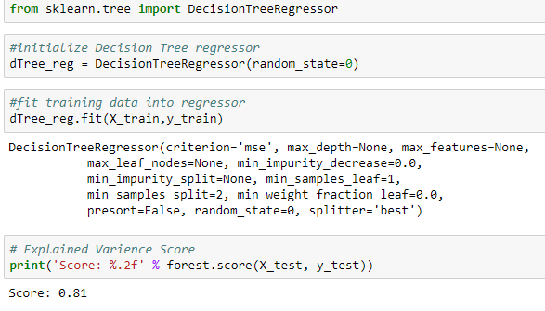
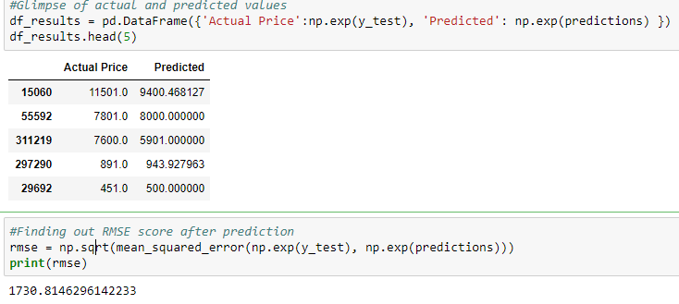
Decision Tree Regressor
RandomForest with GridSearch performed a little better than Decision Tree
Important Features:
1. yearOfRegistration (0.647461)
2. powerPS (0.203093)
3. brand (0.030746)
4. namelen (0.002568)
5. notRepairedDamage (0.053709)
6. vehicleType (0.032251)
7. monthOfRegistration (0.001300)

Slide 18
Conclusion
Parameters | Linear Regression | Decision Tree Regressor | Random Forest Regressor
RMSE | 3011/2287 | 1730 | 1527
Important Features | fuelType yearOfRegistration powerPS brand monthOfRegistration namelen kilometer | yearOfRegistration powerPS notRepairedDamage vehicleType brand kilometer fuelType | yearOfRegistration powerPS brand namelen notRepairedDamage vehicleType monthOfRegistration
Random Forest performed best in prediction.
Most Important features:
yearOfRegistration
powerPS
Brand
Nice to have:
Actual selling price of the car
Rating and reliability of seller

Slide 19
Recommendation
1. People buying used cars should look for cars that have kilometer greater than 100 for getting a diverse set of options to buy from
2. If somebody want to buy limo and other luxury cars, but do not have enough money should go for old limos. They are cheap than SUVs
Customer can buy cars with 5000 kms as there is a drastic drop in price.

Slide 20
Thank You!!!
Questions?

