Slide 1
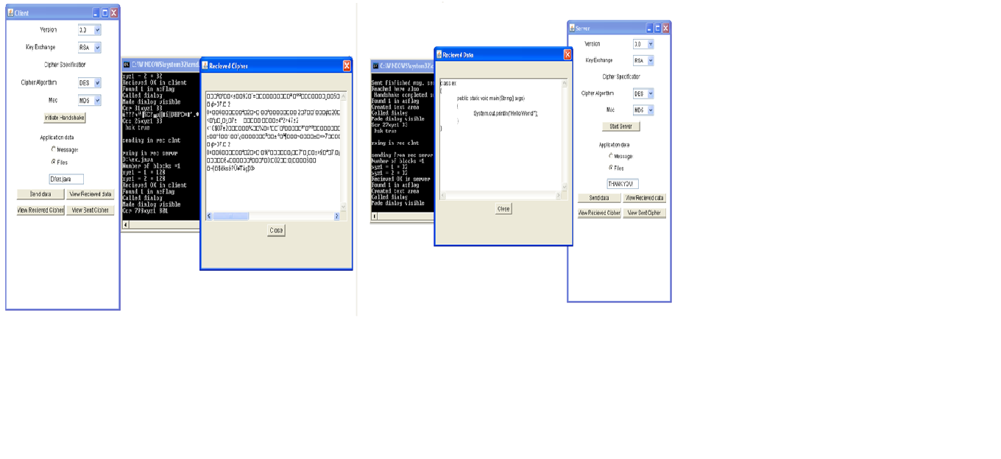
Presented by:- APOORV CHITRAY MARKANDEY SINGH VIKASH KUMAR
THE SECURE SOCKETS LAYER (SSL)
PROTOCOL
MAJOR PROJECT

Slide 2
overview
Introduction
History
sslv2
Objectives
Ssl
Handshaking
Processing
Functions
Algorithms used
s/w & h/w Requirements
Benefits
drawbacks

Slide 3
introduction
This project deals with the Secure Sockets Layer Protocol. Today, we rely heavily on the Internet for electronic data transfer, financial transactions, communication, and information retrieval and so on. Be it the success and smooth operation of a business enterprise or the convenience of the general public, the Internet has become the answer for many of our needs. But any breach in the confidentiality and integrity of the data transferred over the Internet can nullify the advantages offered and cause great loss and inconvenience to the user. Thus, the growing use of Internet necessitates the development of a protocol that would make ‘secure and reliable transfer of data’ possible and at the same time, would be flexible enough to incorporate changes as the need arises.
Secure Sockets Layer (SSL) is one such protocol that has gained widespread popularity because of its various attractions like efficiency, cryptographic security, interoperability, and extensibility.
This project deals with the implementation of the Secure Sockets Layer protocol. Here we are mainly concerned with the implementation of the client and server entities and the SSL transaction between them. This transaction comprises of the authentication, key exchange and bulk data transfer. Our implementation guarantees secure and reliable communication (message exchange) and data transfer (files) between the two entities.

Slide 4
history
Need for secure web communication
Netscape
Worried especially about credit card transaction over the web
Also worried about ease of implementation since they wanted this to be industry-standard, not proprietary
SSLv1 - 1994

Slide 5
SSLv2
SSLv2 ALSO RELEASED IN 1994
SSLv1 WASN’T WIDELY IMPLEMENTED
RULES FOR ESTABLISHING SECURE CONNECTION
RULES FOR PUBLIC KEY ENCRYPTION
OPTIONAL CERTIFICATE-BASED AUTHENTICATION FOR SERVERS AND EVEN CLIENTS
FLEXIBLE
NO SPECIFICALLY REQUIRED ENCRYPTION, COMPRESSION, OR KEY GENERATION ALGORITHM

Slide 6
**Authenticating the client and server to each other:- The SSL protocol supports the use of standard key cryptographic techniques (public key encryption) to authenticate the communicating parties to each other. **Ensuring data integrity:- During a session, data cannot be either intentionally or unintentionally tampered with. **Securing data privacy:- Data in transport between the client and the server must be protected from interception and be readable only by the intended recipient. This prerequisite is necessary for both the data associated with the protocol itself (securing traffic during negotiations) and the application data that is sent during the session itself.
THE MAIN OBJECTIVE OF SSL

Slide 7
TWO ROLES i) CLIENT:- INITIATES COMMUNICATION, LISTS POSSIBILITIES FOR CHOICES ii) SERVER:- LISTENS FOR CLIENT CONNECTIONS, CHOOSES FROM POSSIBILITIES SENT FROM CLIENTS BOTH ROLES SIMPLY ADD SECURE SOCKETS LAYER TO PROTOCOL STACK
SSL ROLES

Slide 8
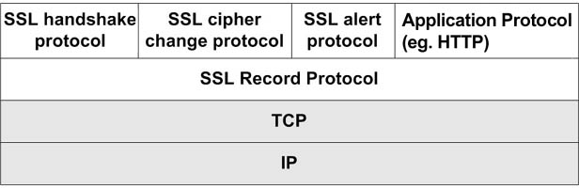
SSL BETWEEN TRANSMISSION CONTROL PROTOCOL (TCP) LAYER AND APPLICATION LAYER ACTUALLY 2 LAYERS RECORD SECURE APPLICATION CAN RUN UNDER ANY PROTOCOL THAT RELIES ON TCP, INCLUDING HTTP, LDAP, POP3, FTP
SSL and the Protocol Stack

Slide 9
HANDSHAKING PROTOCOL ESTABLISH COMMUNICATION VARIABLES CHANGECIPHERSPEC PROTOCOL ALERT TO A CHANGE IN COMMUNICATION VARIABLES ALERT PROTOCOL MESSAGES IMPORTANT TO SSL CONNECTIONS APPLICATION ENCRYPTION PROTOCOL ENCRYPT/DECRYPT APPLICATION DATA
THE FOUR UPPER LAYER PROTOCOLS

Slide 10
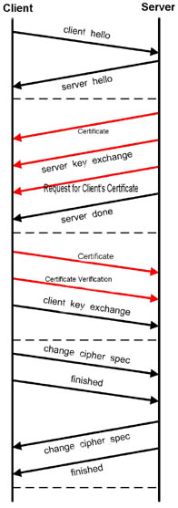
CLIENTHELLO SERVERHELLO *CERTIFICATE *=optional SERVERKEYEXCHANGE *CERTIFICATEREQUEST SERVERHELLODONE *CERTIFICATE *CERTIFICATEVERIFY CLIENTKEYEXCHANGE CHANGECIPHERSPEC FINISHED
HANDSHAKING MESSAGES

Slide 11
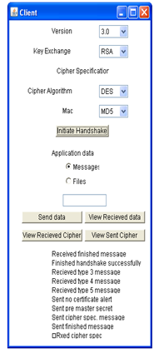
Client Sends ClientHello SSL version supported 32-byte random number SessionID List of supported encryption methods List of supported compression methods
THE PROCESS BEGINS

Slide 12
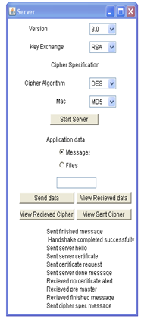
Server Sends ServerHello SSL version that will be used 32-byte random number SessionID Encryption method that will be used Compression method that will be used
THE SERVER RESPONDS

Slide 13
TO AUTHENTICATE SERVER, SERVER SENDS CERTIFICATE SERVER’S PUBLIC KEY CERTIFICATE ISSUING AUTHORITY’S ROOT CERTIFICATE WHEN CLIENT RECEIVES CERTIFICATE, IT DECIDES WHETHER OR NOT TO TRUST SERVER THIS IS THE ONLY STEP THAT MIGHT INVOLVE USER IF USER NEVER SPECIFIED WHETHER OR NOT TO TRUST ISSUING AUTHORITY BEFORE
SERVER AUTHENTICATION

Slide 14
SERVER SENDS SERVERKEYEXCHANGE ANY INFORMATION NECESSARY FOR PUBLIC KEY ENCRYPTION SYSTEM IF SEVER WISHES CLIENT TO BE AUTHENTICATED, SERVER SEND CERTIFICATEREQUEST MESSAGE THE CLIENT WOULD RESPOND TO THIS WITH A CERTIFICATE MESSAGE ENCRYPTED WITH SERVER’S PUBLIC KEY SERVER SENDS SERVERHELLODONE
STILL SHAKING HANDS

Slide 15
CLIENT SENDS CLIENTKEYEXCHANGE INFORMATION NECESSARY FOR PUBLIC KEY ENCRYPTION SYSTEM ENCRYPTED WITH SERVER’S PUBLIC KEY COMPUTE SECRET KEYS USING KEY DERIVATION FUNCTION SUCH AS DIFFIE- HELLMAN IF CLIENT IS BEING AUTHENTICATED, CLIENT SENDS CERTIFICATEVERIFY DIGEST OF PREVIOUS MESSAGES ENCRYPTED WITH CLIENT’S PRIVATE KEY
CLIENT RESPONDS

Slide 16
SPECIAL PROTOCOL WITH ONLY ONE MESSAGE WHEN CLIENT PROCESSES ENCRYPTION INFORMATION, IT SENDS CHANGECIPHERSPEC MESSAGE SIGNALS ALL FOLLOWING MESSAGES WILL BE ENCRYPTED CHANGECIPHERSPEC IS ALWAYS FOLLOWED BY FINISHED MESSAGE
ChangeCipherSpec Protocol

Slide 17
UPON RECEIPT OF CHANGECIPHERSPEC, SERVER SENDS ITS OWN CHANGECIPHERSPEC AND FINISHED MESSAGES AFTER BOTH CLIENT AND SERVER RECEIVE FINISH MESSAGES, HANDSHAKING PHASE IS OVER ALL FOLLOWING COMMUNICATION IS ENCRYPTED ENCRYPTION AND COMPRESSION METHODS CAN BE CHANGED WITH NEW CHANGECIPHERSPEC MESSAGES
THE END OF THE BEGINNING

Slide 18
I] SSL server authentication. Ii] SSL client authentication. iii] An encrypted SSL connection. This protects against electronic eavesdropper. Iv] Integrity. This protects against hackers. V] SSL includes two sub-protocols: 1. the SSL Record Protocol 2. the SSL Handshake Protocol. Vi] Record Protocol -- defines the format used to transmit data.
Processing of SSL Protocol

Slide 19
VII] HANDSHAKE PROTOCOL – USING THE RECORD PROTOCOL TO EXCHANGE MESSAGES BETWEEN AN SSL-ENABLE SERVER AND SSL- ENABLE CLIENT. VIII] THE EXCHANGE OF MESSAGES FACILITATES THE FOLLOWING ACTIONS: AUTHENTICATE THE SERVER TO THE CLIENT ALLOWS THE CLIENT AND SERVER TO SELECT A CIPHER THAT THEY BOTH SUPPORT OPTIONALLY AUTHENTICATE THE CLIENT TO THE SERVER USE PUBLIC-KEY ENCRYPTION TECHNIQUES TO GENERATE SHARE SECRETS ESTABLISH AN ENCRYPTED SSL CONNECTION.

Slide 20
THE MAIN FUNCTION OF SSL PROTOCOL IS TO ESTABLISH A SECURE CONNECTION BETWEEN A SERVER AND A CLIENT. THE SSL PROTOCOL USES RSA PUBLIC KEY CRYPTOGRAPHY FOR INTERNET SECURITY. PUBLIC KEY ENCRYPTION USES A PAIR OF ASYMMETRIC KEYS FOR ENCRYPTION AND DECRYPTION. EACH PAIR OF KEYS CONSISTS OF A PUBLIC KEY AND A PRIVATE KEY. THE PUBLIC KEY IS MADE PUBLIC BY DISTRIBUTING IT WIDELY. THE PRIVATE KEY IS ALWAYS KEPT SECRET. DATA ENCRYPTED WITH THE PUBLIC KEY CAN BE DECRYPTED ONLY WITH THE PRIVATE KEY, AND VICE VERSA.
FUNCTIONS OF SSL PROTOCOL

Slide 21
EACH PAIR OF KEYS CONSISTS OF A PUBLIC KEY AND A PRIVATE KEY. THE PUBLIC KEY IS MADE PUBLIC BY DISTRIBUTING IT WIDELY; THE PRIVATE KEY IS ALWAYS KEPT SECRET. DATA ENCRYPTED WITH THE PUBLIC KEY CAN BE DECRYPTED ONLY WITH THE PRIVATE KEY, AND VICE VERSA.
Client’s SSL version #,
Cipher settings,
e.g. data, other info. the server
needs to communicate with
the client
Server’s SSL version #,
Cipher settings,
e.g. data, other inf. The client needs
to comm with the server over
SSL.
Also send its own certificate
Authenticate the server by
some of the inf. If succeed
use all data so far to create
the premaster secret for the
session, encrypts it with the
server’s public key.
If the server has requested
client authentication (optional)
the client also signs another
piece of data known by both
the client and the server.

Slide 22
If the server has requested
client authen., the server
attempts to authen the client.
If succeed, uses its private key
decrypt the premaster secret,
then perform a series of steps
to generate the master secret
Use the master secret to generate
the session keys.
Also performs a series of
steps, starting from the
same premaster secret
to generate the
master secret.
Use the master secret to
generate the session keys
NOTE
SESSION KEYS ARE USED TO ENCRYPT AND DECRYPT INFORMATION EXCHANGE DURING THE SSL SESSION AND TO VERIFY ITS INTEGRITY.
MASTER SECRETS PROTECT SESSION KEYS IN TRANSIT.

Slide 23
Informing the client
that the future message
from here will be
encrypted with the
session key.
Then sends a separate
(encrypted) message
indicating that the server
portion of handshake
is finished.
Informing the server
that the future
message from here
will be encrypted with
the session key.
Then sends a separate
(encrypted) message
indicating that the
client portion of
handshake is finished.

Slide 24
THE SSL HANDSHAKE IS NOW COMPLETE. THE SERVER AND THE CLIENT USE THE SESSION KEYS TO ENCRYPT AND DECRYPT THE DATA THEY SEND TO EACH OTHER AND TO VALIDATE ITS INTEGRITY.
NOTE THAT BOTH CLIENT AND SERVER AUTHENTICATION INVOLVE ENCRYPTING SOME PIECES OF DATA WITH ONE KEY OF A PUBLIC-PRIVATE KEY PAIR AND DECRYPTING IT WITH THE OTHER KEY.

Slide 25
ALGORITHM USED
i] RSA
ii] DES
iii] SHA-1

Slide 26
S/W & H/W REQUIREMENT SPECIFICATION
SOFTWARE REQUIREMENT SPECIFICATION
OPERATING SYSTEM: WINDOWS XP
LANGUAGE: JAVA2SDK 1.5.0. VERSION
DOCUMENTATION TOOL: MS-WORD
HARDWARE REQUIREMENT SPECIFICATION
PROCESSOR: PENTIUM
SPEED: 250 MHZ TO 833MHZ
RAM: 512 MB
HARD DISK: 40 GB
NETWORK: LAN
LAN SPEED: 100Mbps

Slide 27
EASE OF IMPLEMENTATION FOR NETWORK APPLICATION DEVELOPERS AS EASY AS IMPLEMENTING UNSECURED SOCKETS FOR NETWORK IMPLEMENTATION DEVELOPERS SIMPLY ADD LAYER TO ESTABLISHED NETWORK PROTOCOL STACK FOR USERS ONLY NEED TO AUTHORIZE CERTIFICATES
Benefits

Slide 28
MORE BANDWIDTH NEEDED SLOWER NEEDS A DEDICATED PORT – 443 FOR HTTPS ASSUMES RELIABLE TRANSPORT FOR UNDERLYING TRANSPORT PROTOCOL NO UDP IMPLICATIONS FOR STREAMING MEDIA, VoIP
DRAWBACKS

Slide 29
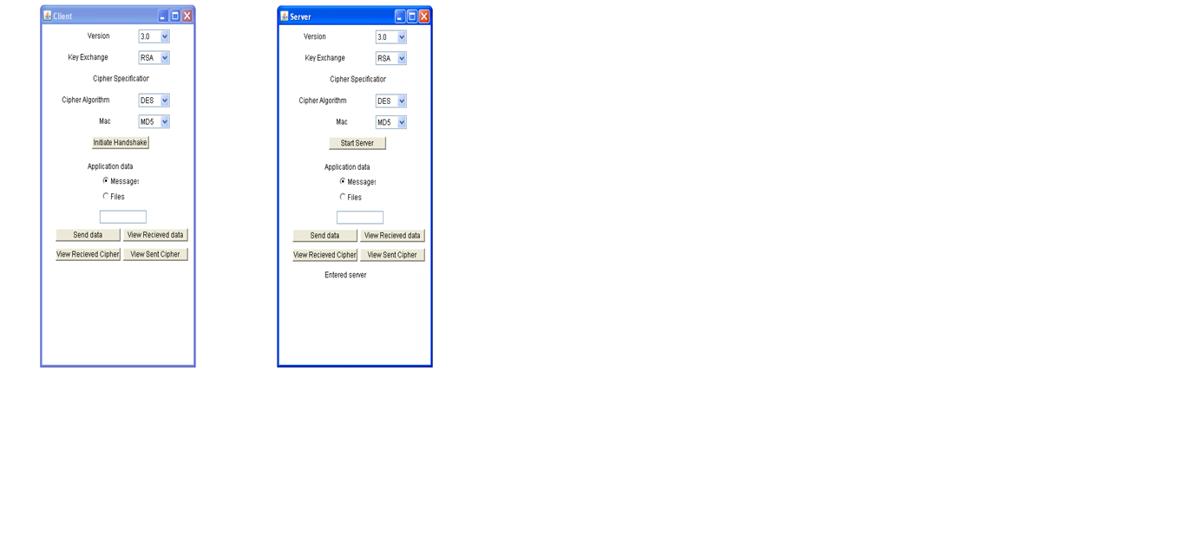
thank you…..

