Slide 1
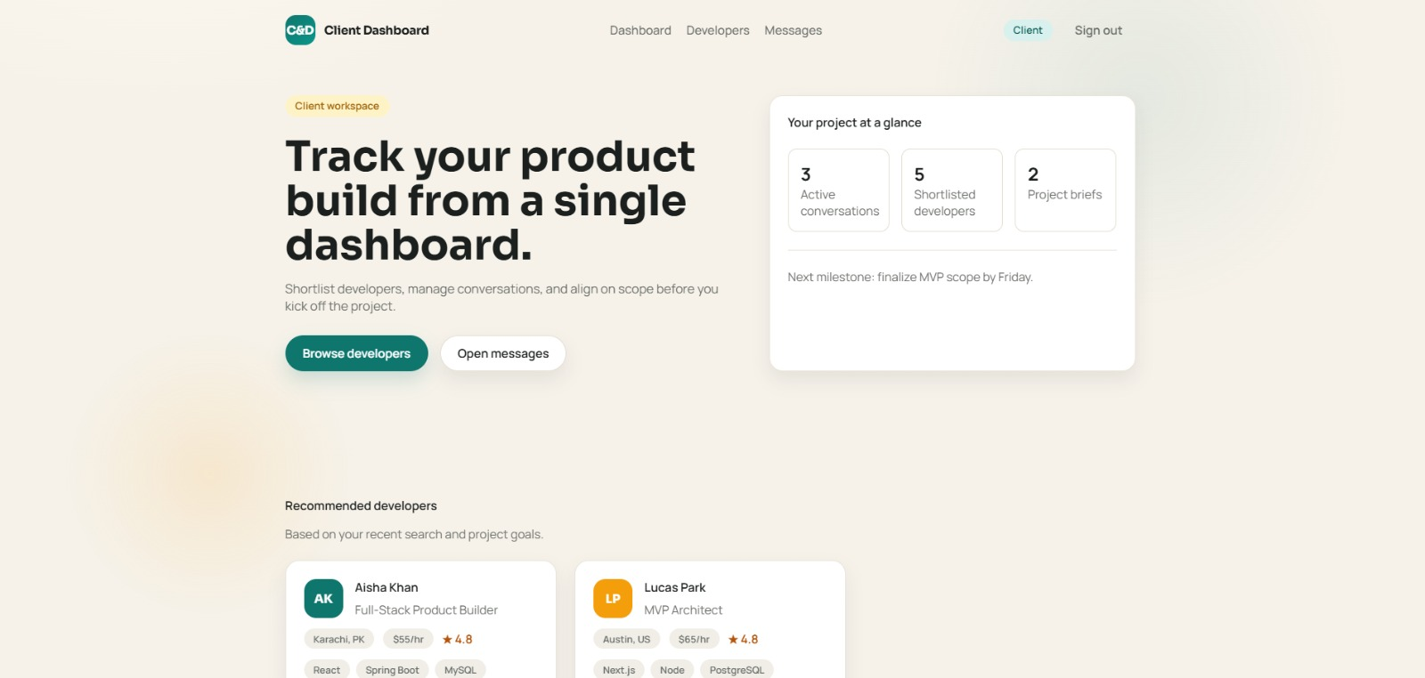
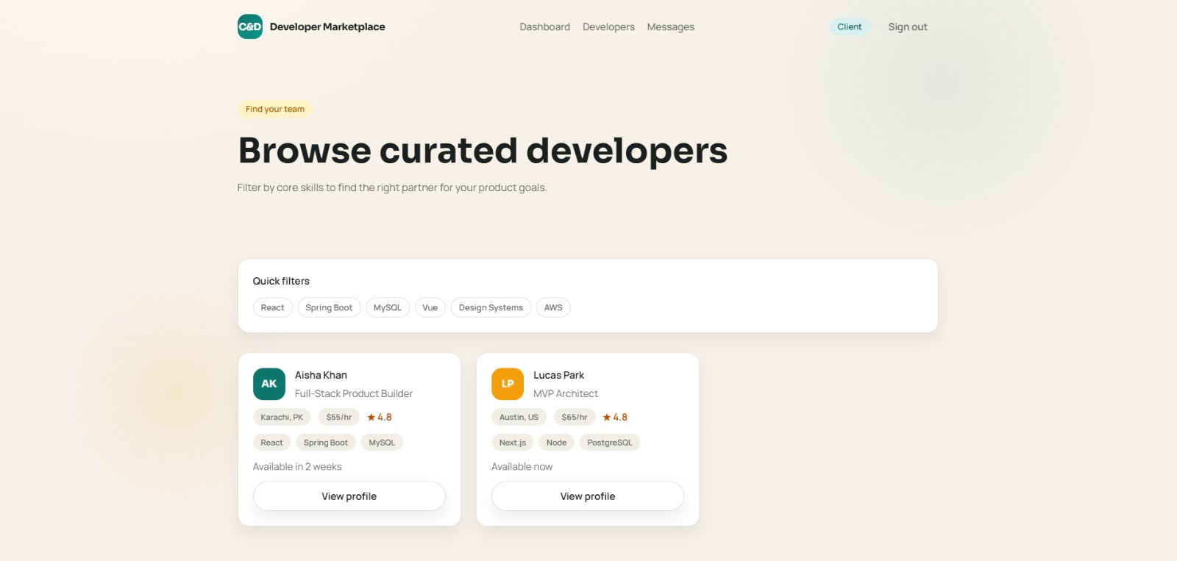
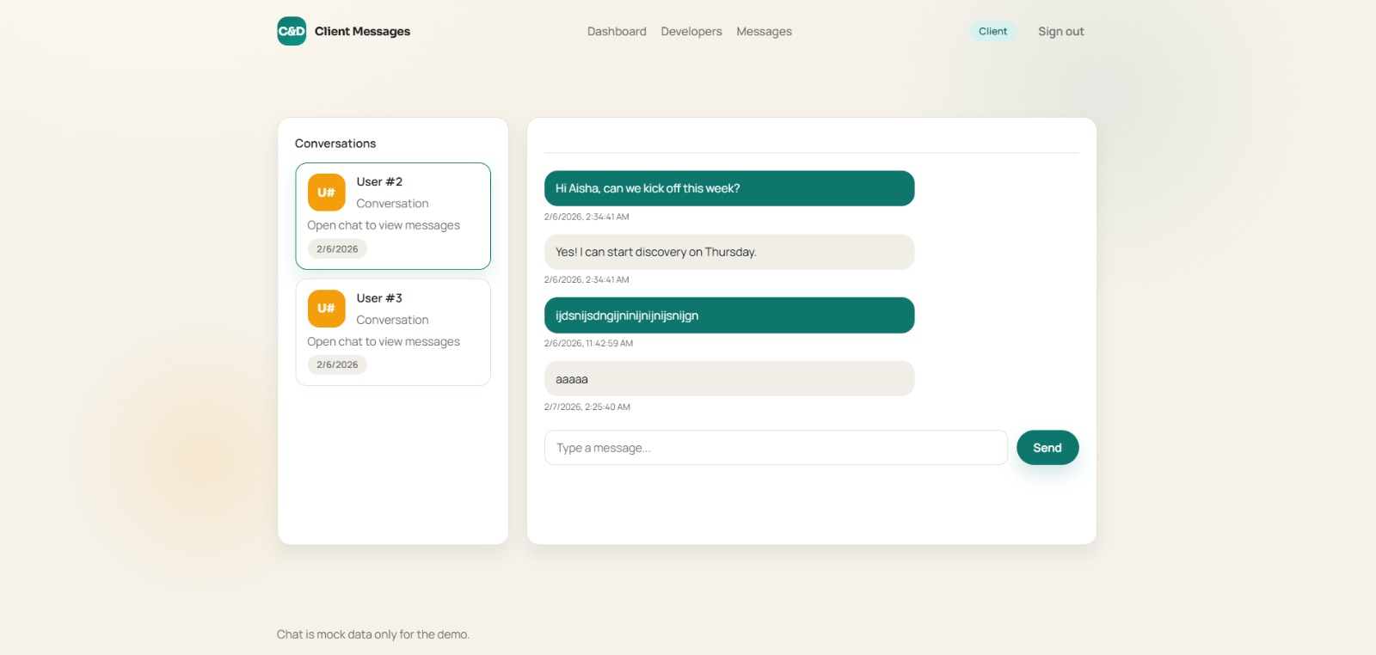
C&D
Where Client and
Developer Meet
A two-sided platform connecting clients who need software built
with developers who build it — powered by Spring Boot & MySQL.
PG-DAC Project | CDAC Delhi | February 2026

Slide 2
01 — THE PROBLEM
Finding the right dev is broken.
For clients and developers alike, the current hiring landscape is noisy, costly, and disconnected.
👤
💻
💬
Clients
Developers
Communication
No curated place to find verified developers with real portfolios and transparent rates.
No simple way to present themselves professionally and attract quality project leads.
Conversations scattered across emails and external tools — no unified thread per project.
C&D Platform — Problem Statement

Slide 3
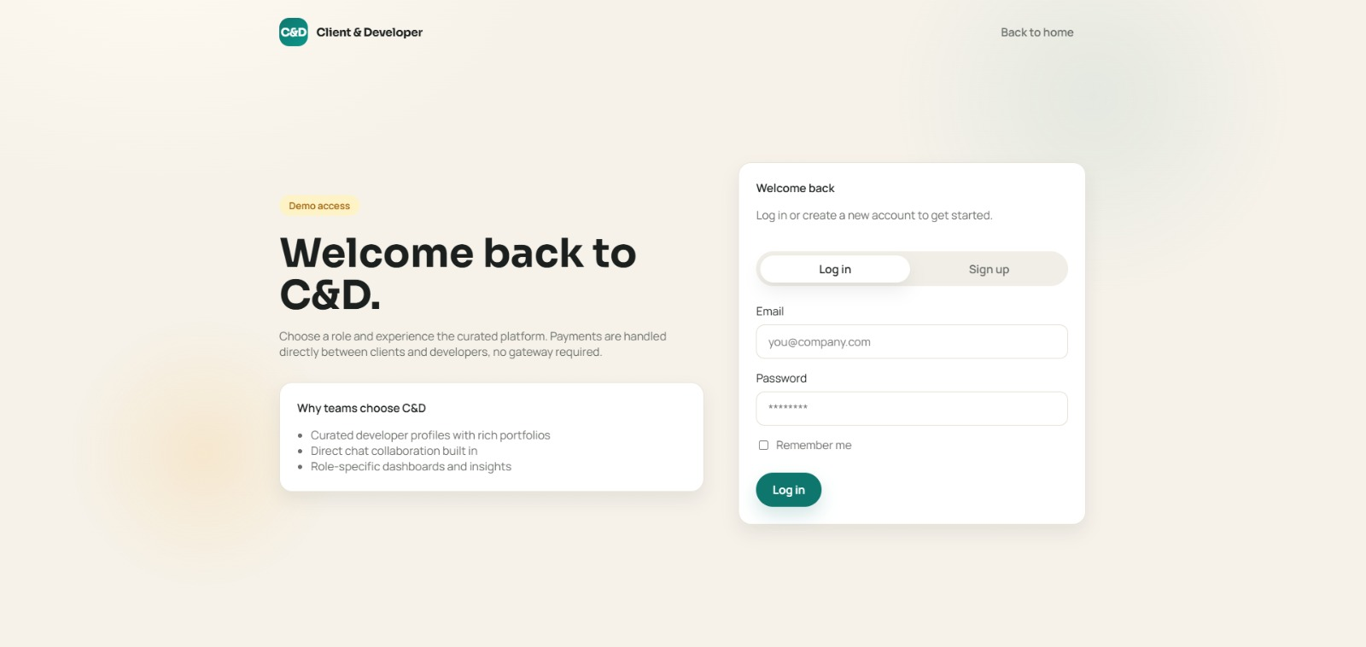
02 — OUR SOLUTION
C&D — a premium two-sided marketplace
for software hiring.
Browse curated developer profiles with skills, rates & availability
Send project inquiries directly to developers
Built-in threaded chat — no external tools needed
Developers manage portfolio projects & attract leads
Role-based dashboards for Clients and Developers
C&D Platform — Solution Overview

Slide 4
03 — TECH STACK
Built with enterprise-grade Java technologies.
⚙️
☕
🗄️
💾
Spring Boot 3.2
Java 21 (LTS)
Hibernate / JPA
MySQL 8.0
Backend Framework
Language
ORM & Persistence
Database
🌿
🎨
✅
📦
Thymeleaf
Vanilla JS + CSS
Bean Validation
Maven Wrapper
Template Engine
Frontend
Request Validation
Build Tool
C&D Platform — Technologies Used

Slide 5
04 — SYSTEM ARCHITECTURE
Clean MVC layered architecture.
Presentation Layer
Thymeleaf HTML templates + Custom CSS / Vanilla JS
API / Controller
6 REST Controllers (@RestController + @RequestMapping)
Service Layer
5 Service classes — all business logic lives here
Data Flow ↓
Repository Layer
8 JpaRepository interfaces — zero hand-written SQL
Entity / Model
8 @Entity JPA classes mapped to MySQL tables
MySQL Database
cd_platform — 8 normalised tables, seeded via seed.sql
C&D Platform — MVC Layered Architecture

Slide 6
05 — DATABASE DESIGN
8 normalised tables in MySQL.
users
developer_profiles
id, role, email, password_hash
id, user_id, name, title, bio, skills, rate, location
portfolio_projects
client_profiles
id, developer_id, title, description, tech_stack
id, user_id, company_name, industry, budget_range
inquiries
chat_threads
id, client_id, developer_id, project_summary, status
id, updated_at
chat_participants
chat_messages
thread_id, user_id (composite PK)
id, thread_id, sender_id, content, created_at
C&D Platform — MySQL Schema — cd_platform

Slide 7
06 — REST API
16+ REST endpoints across 5 domains.
/api/auth
/api/developers
/api/clients
/api/inquiries
/api/chat
POST
/login
GET
/
GET
/{id}
POST
/
GET
/threads
POST
/signup
GET
/{id}
POST
/
POST
/threads
POST
/
PUT
/{id}
GET
/threads/{id}/messages
PUT
/{id}
POST
/threads/{id}/messages
GET
/{id}/portfolio
POST
/{id}/portfolio
C&D Platform — Backend API Reference

Slide 8
07 — CLIENT FLOW
A seamless journey from login to hired.
01
Login / Sign Up
03
Client Dashboard
Role-based auth — Client or Developer
Track conversations, briefs & milestones
02
Browse Developers
04
Chat Inbox
Filter by skill, rate & availability
Threaded real-time style messaging
C&D Platform — Client User Experience

Slide 9
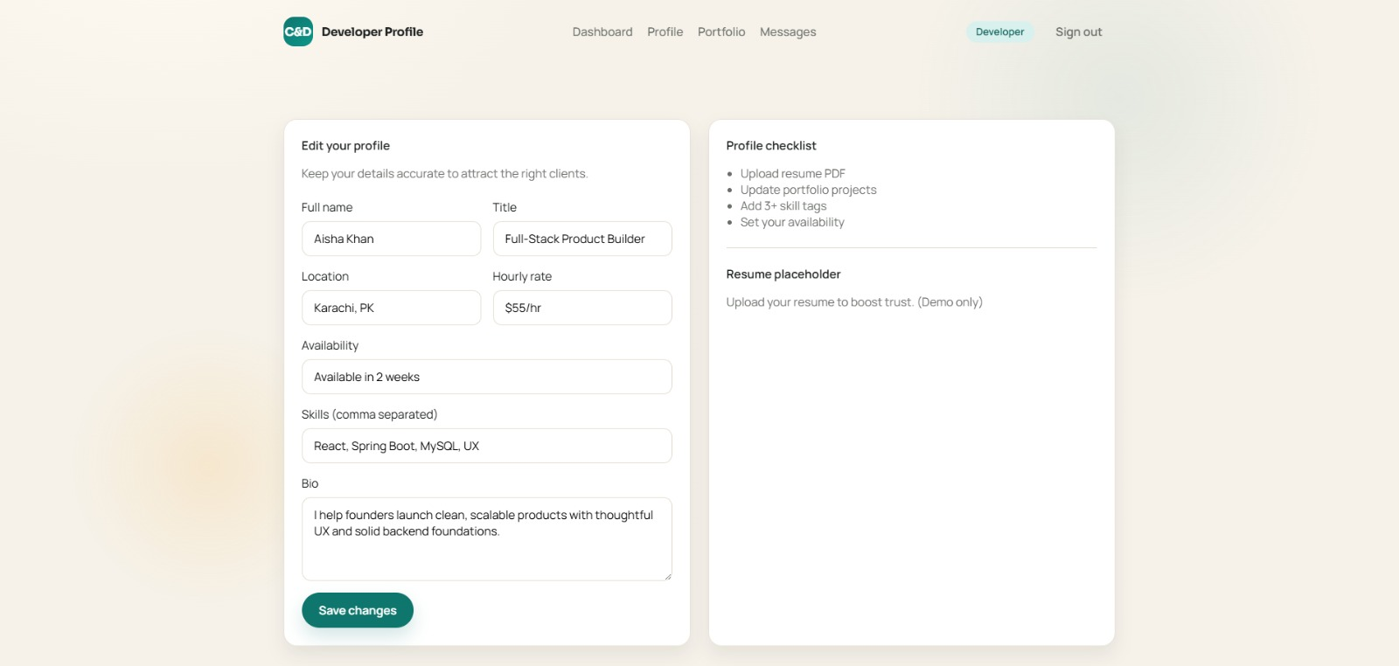
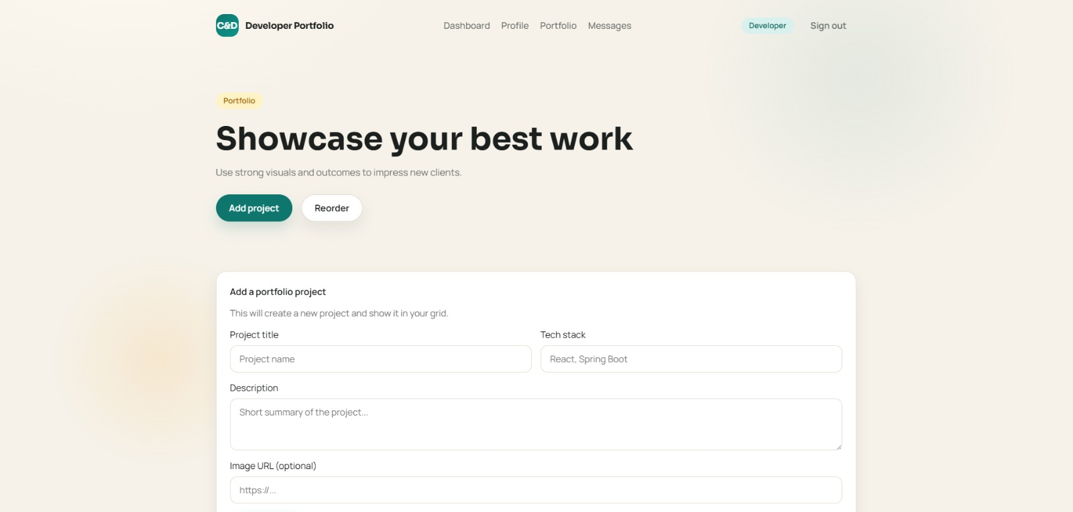
08 — DEVELOPER FLOW
Developers showcase, manage, and connect.
01 Profile Editor
02 Portfolio Manager
03 Chat Inbox
Name, title, skills, rate, bio, availability — all editable in one form.
Add and showcase past projects with tech stack and image.
Respond to client messages and manage conversations.
Sign Up / Login
→
Profile Editor
→
Portfolio
→
Respond to Leads
→
Chat with Clients
C&D Platform — Developer User Experience

Slide 10
09 — KEY FEATURES
Everything in one platform.
🔐
🔍
📁
Role-Based Auth
Developer Discovery
Portfolio Showcase
Signup/login with CLIENT or DEVELOPER role. Each role gets its own dashboard and navigation.
Browse all developers with quick-filter tags by skill (React, Spring Boot, MySQL, Vue…).
Developers add project cards with title, tech stack, description, and image URL.
📬
💬
🔄
Project Inquiries
Threaded Chat
Fallback Mode
Clients send project summaries directly to developers via the inquiry API.
Built-in two-pane messaging — thread list + active chat, with timestamped bubbles.
Frontend falls back to rich mock data if backend is unavailable — always demo-ready.
C&D Platform — Platform Highlights

Slide 11
10 — IMPLEMENTATION HIGHLIGHTS
Smart engineering decisions.
01
02
Two-Phase Dev Approach
Transactional Signup
Phase 1: full UI with mock data (always demo-ready). Phase 2: real APIs wired in — swap required minimal JS changes.
@Transactional AuthService.signup() creates User + Profile + optional Portfolio in a single atomic DB transaction.
03
04
DTO Pattern
Frontend Fallback
Java Records used as DTOs in all controllers. Decouples API contract from JPA entities, prevents lazy-load exceptions.
fetch()-first with try/catch fallback to data.js mock data. Presentation-safe without a running backend.
C&D Platform — Key Design Decisions

Slide 12
11 — TESTING
14 manual test cases — all passed.
14
14
0
100%
Test Cases Run
Tests Passed
Tests Failed
Pass Rate
Test Case | Input | Result
Developer Signup | role=DEVELOPER, email, password, name | ✅ User + Profile created
Client Signup | role=CLIENT, companyName, budgetRange | ✅ User + Client profile created
Login — correct creds | Valid email + password | ✅ userId, role, IDs returned
Login — wrong password | Wrong password | ✅ Error message returned
Browse Developers | GET /api/developers | ✅ Full developer list returned
Add Portfolio Project | POST /api/developers/1/portfolio | ✅ Project linked to developer
Send Chat Message | POST /api/chat/threads/1/messages | ✅ Message persisted and returned
Frontend Fallback | Stop backend, navigate to /client/developers | ✅ Mock data renders correctly
C&D Platform — Test Results

Slide 13
12 — FUTURE SCOPE
What's next for C&D.
Short Term
Medium Term
Long Term
Spring Security + JWT token auth
File upload — resume PDFs & portfolio images (S3)
Payment integration (Stripe / Razorpay)
Role-based access control (RBAC)
Ratings & reviews after project completion
Admin dashboard — user mgmt & analytics
WebSocket real-time chat (STOMP)
Email notifications via Spring Mail
Docker + Docker Compose packaging
Server-side search & filter API
Pagination & sorting on developer listing
Cloud deployment on AWS EC2 / Railway
C&D Platform — Planned Enhancements

Slide 14
C&D
Thank You!
C&D — Where Client and Developer Meet
Spring Boot 3.2 + Java 21 backend
8-table MySQL schema, 16+ REST APIs
Dual-role UI — Client & Developer flows
Real screenshots, tested end-to-end
PG-DAC Project | CDAC Delhi | February 2026 | Guided by Prof. Pankaj Kumar Mahto

