Slide 1
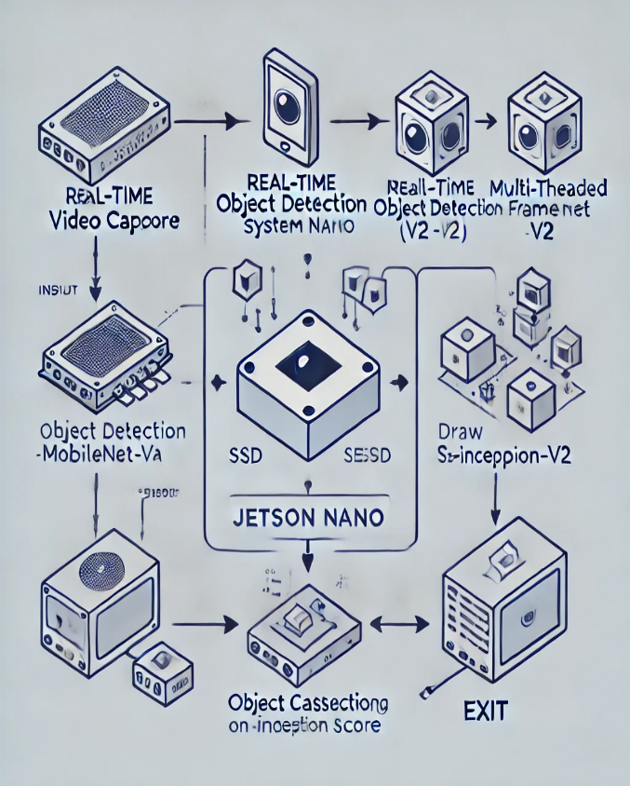
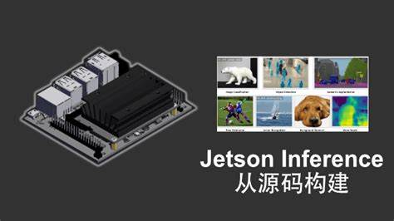

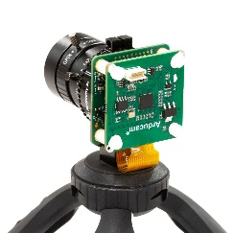
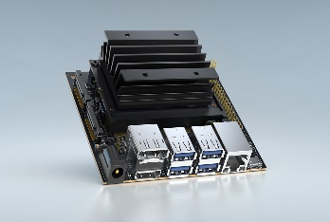

PRESTIGE INSTITUTE OF ENGINEERING MANAGEMENT AND RESEARCH DEPARTMENT OF ARTIFICIAL INTELLIGENCE AND DATA SCIENCE
Pixxel Tracker: Harnessing AI-Powered Object Detection and Motion for Real-Time Insight
Dr. Naveen R. Shahi, Jatin Dadlani, Anvesh Sharma, Apoorv Jain, Himanshu Bhadoriya
Department Of Artificial Intelligence and Data Science, Prestige Institute of Engineering Management and Research, Indore
KEY WORDS
Jetson Nano, Object Detection, Computer Vision, SSD-Mobilenet-v2, CUDA Acceleration
FLOW DIAGRAM
ABSTRACT
APPLICATION
Autonomous Vehicles: Object detection for navigation and safety.
Surveillance: Real-time detection and tracking of suspicious objects or people for enhanced security.
Robotics: Facilitating object detection to improve robot-environment interaction.
Sports Analytics: Tracking player or object movements for performance analysis.
Drone Navigation: Safe and efficient navigation by detecting obstacles.
The project focuses on developing a real-time object detection system using the NVIDIA Jetson Nano. By leveraging pre-trained deep learning models like SSD-Mobilenet-v2, PedNet, SSD-Inception-v2, and MultiBox, the system identifies objects in video streams in real-time. The implementation optimizes performance for edge devices, ensuring efficient processing with CUDA acceleration. This innovation aims to enhance automation systems, particularly in areas such as surveillance, robotics, and autonomous navigation.
TECHNOLOGY
OBJECTIVES
To develop a real-time object detection system optimized for edge devices.
To implement and optimize object detection models like SSD-Mobilenet-v2 and PedNet for NVIDIA Jetson Nano.
To integrate multi-model selection for diverse application scenarios.

