Slide 1
OCR Experiments Summary

Slide 2
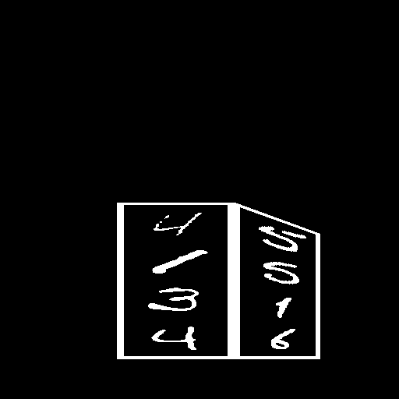


Experiment 1: Cube Faces OCR
Task: Identify vertical digits on two cube faces.
Model: ChatGPT 4.0
Accuracy: 17% (either side)
Observation: Model struggles with 3D spatial structure.

Slide 3
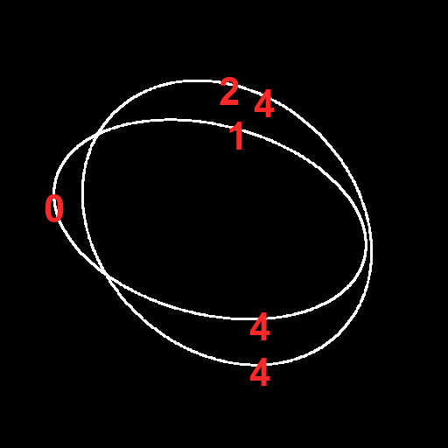
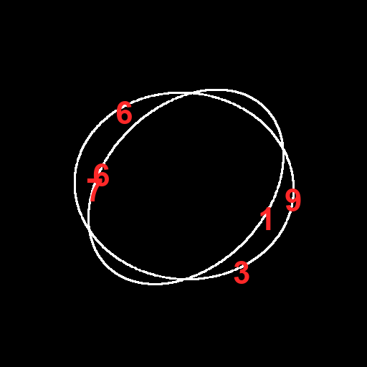
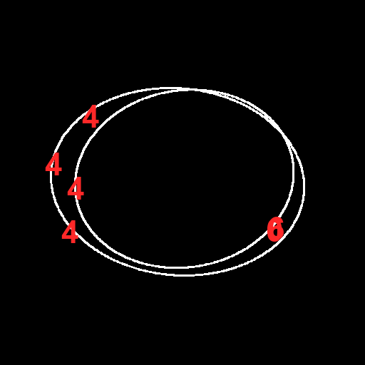
Experiment 2: Elliptical Orbit OCR
Task: Read digits placed along elliptical orbits.
Model: ChatGPT 4.0
Accuracy: 1%
Observation: Model unable to deduce orbit-based sequencing.

Slide 4


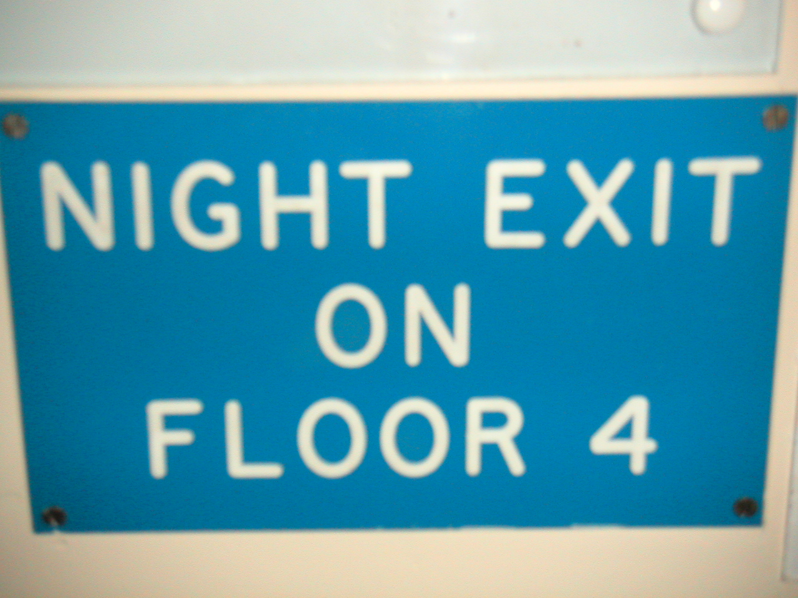
Experiment 3: Scene Text OCR
Task: Read natural text exactly as shown.
Model : chatGPT-4.0
Accuracy - 74% ( more than 90% if we exclude case error)
Observation: Performs well on standard text.
Errors mostly small (case or 1–2 letters).

Slide 5
Observations
LLM-based OCR struggles on geometric or non-linear text layouts
Cube and ellipse tasks break due to missing geometric priors
Scene OCR works when layout follows human-reading patterns

Slide 6
Hypotheisis
Attention is global but unstructured → no stable reading path
No inductive bias for curves, 3D surfaces, or orbits

