Slide 1

Age Predictor Using Biometric Features
IT 401 MAJOR PROJECT
UNDER THE SUPERVISION OF
DR. DINESH K. VISHWAKARMA
Submitted by-
Apoorv Sharma (2K15/IT/015)
Hitesh Kumar (2K15/IT/032)

Slide 2
Age Predictor
Age Predictor using Biometric Features as the name suggests , is a platform that is used to predict the age of a person using facial features.
It makes a feature matrix of face and then applies machine learning algorithms and techniques to predict age.
It takes help of convolutional neural network which comes inside deep learning.

Slide 3
Uses of Age Predictor
ELECTION POLLING BOOTH –
IT CAN BE USED TO ALLOW ONLY ELIGIBLE CANDIDATES TO CAST VOTES , THUS CAN HELP IN CUTTING DOWN LABOUR COST.
RESTRICTING ACCESS TO SPECIFIED WEBSITES –
At present , the way to confirm age of a person trying to access a particular website is very inefficient and weak.
Any non-eligible person can intrude into the website. But what if this inefficient method of verifying is replaced through live age predictor and thus only allowing persons that meet some threshold.

Slide 4
Steps involved in creating Age Predictor using Biometric Features
1. IMAGE PROCESSING :
It Involves Number Of Sub steps –
A) Face Finding
B) Grey-scaling
C) Normalization
2. MODEL PREPARATION :
It is prepared using Keras with TensorFlow as backend. Convolutional Neural Network is build using Keras

Slide 5
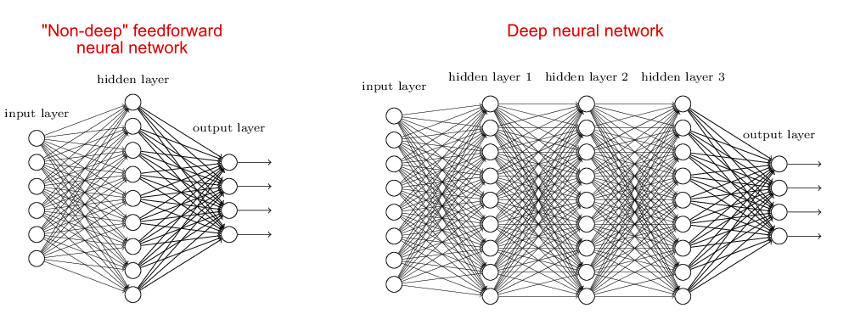
MODEL IS A CNN

Slide 6
Continued..
3. TRAINING THE MODEL :
We have used UTK Face dataset to train the model .
It consists of 20k+ face images.
Images Are Labelled By Age, gender and other features.
We are using this age as the actual age of the image.
4. BUILDING OF GUI :
We Have Used Tkinter In Python To Build Graphical User Interface .
It Is A Standard Python Interface To The Tk Gui Toolkit Shipped With Python.

Slide 7
Continued..
5. MAKING A WEBPAGE :
The last step in creating Age Predictor was to make a webpage . We have made this using Flask as backend and JavaScript as frontend.
Base64 format is used to capture the image. It is later converted in image in python Backend

Slide 8
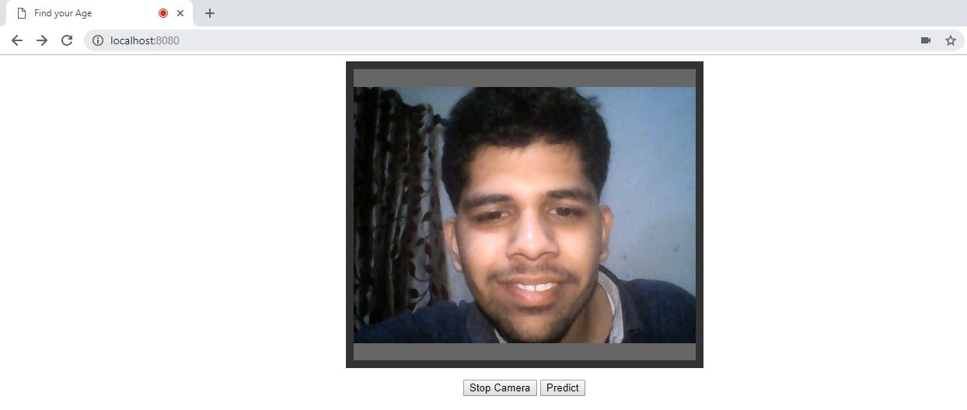
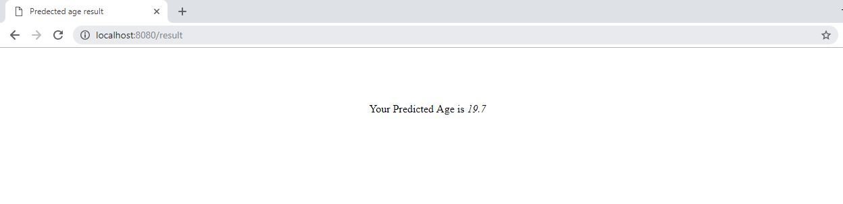
Web page Screen Shots

Slide 9
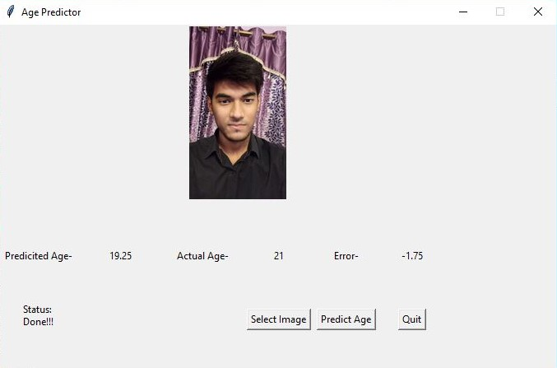
GUI Screen Shot
It is the GUI which uses the trained neural network to predict the age.
This is made using using the tkinter module of python.

Slide 10
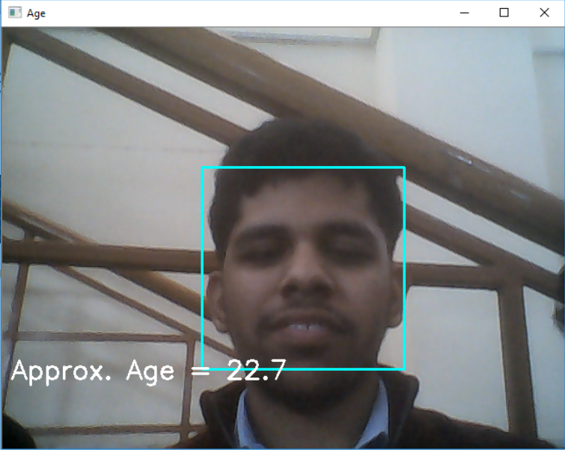
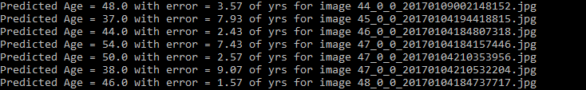
Age Prediction and Mean absolute error
Absolute Error in each image with its Predicted Age
Mean Absolute Error
Using webcam image to predict the age.
( Actual Image – 21 yrs )

Slide 11
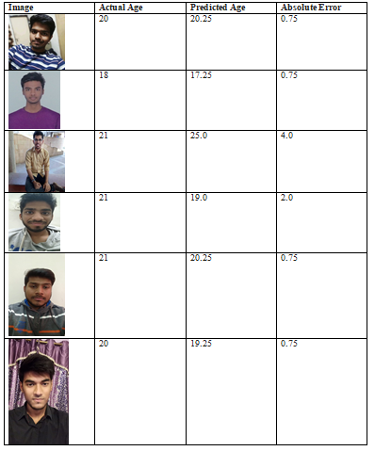
Some Sample Dataset

Slide 12
Thank You

