Slide 1
Accessibility Score Analysis of Cities
Detailed Data Analysis and Insights

Slide 2
Introduction
This presentation explores accessibility scoring for multiple cities across various categories, such as Transport, Hospitals, Schools, and Public Services.
The analysis includes:
- City-level scores
- Category comparisons
- Clustering and correlations
- Key insights and recommendations

Slide 3
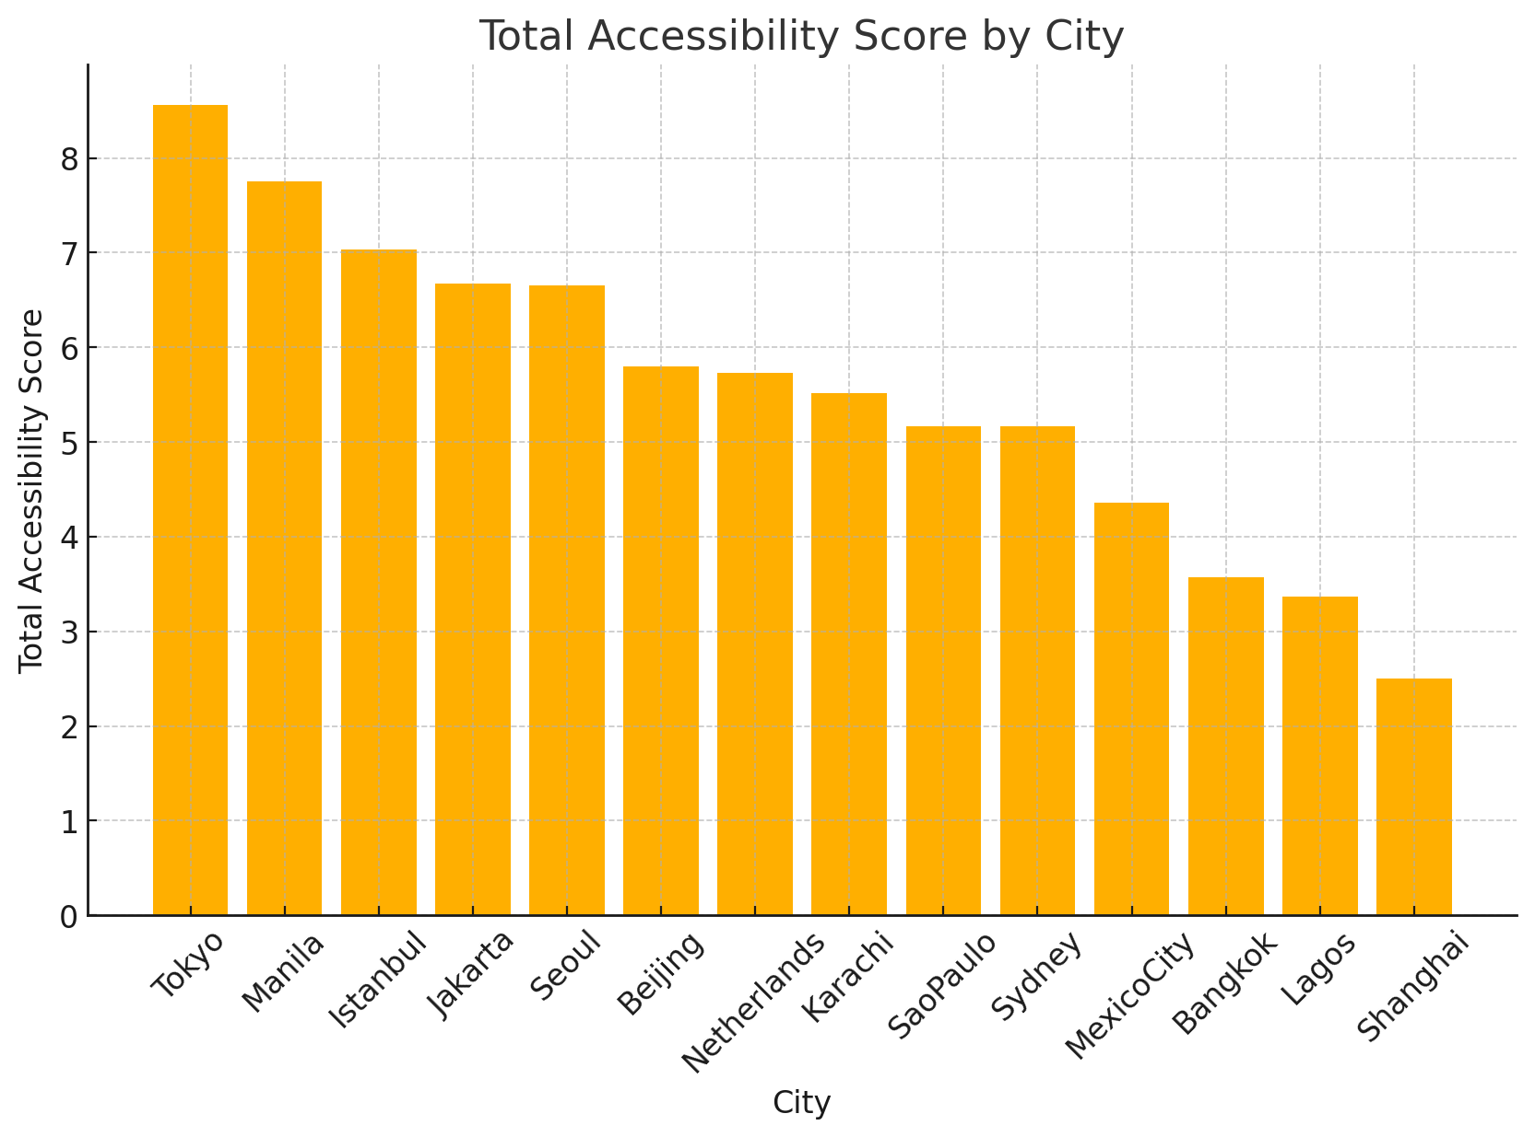
Total Accessibility Score by City
Cities are ranked by their overall accessibility scores. Istanbul and Jakarta lead with the highest overall scores, while Bangkok and Karachi are among the lowest.

Slide 4
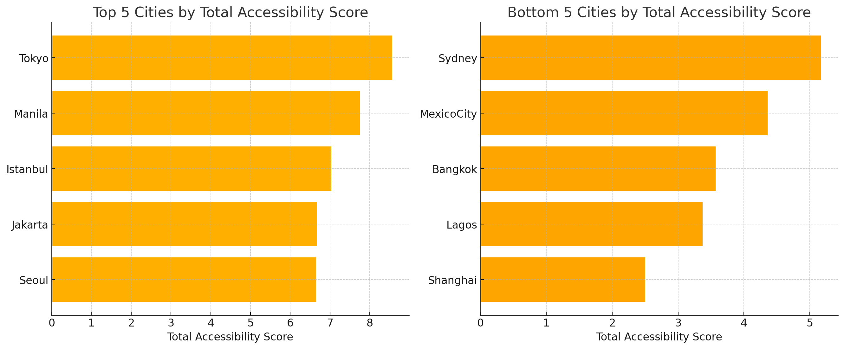
Top 5 and Bottom 5 Cities
This chart compares the best and worst performing cities in terms of accessibility. The bottom 5 cities need targeted policy actions to improve their scores.

Slide 5
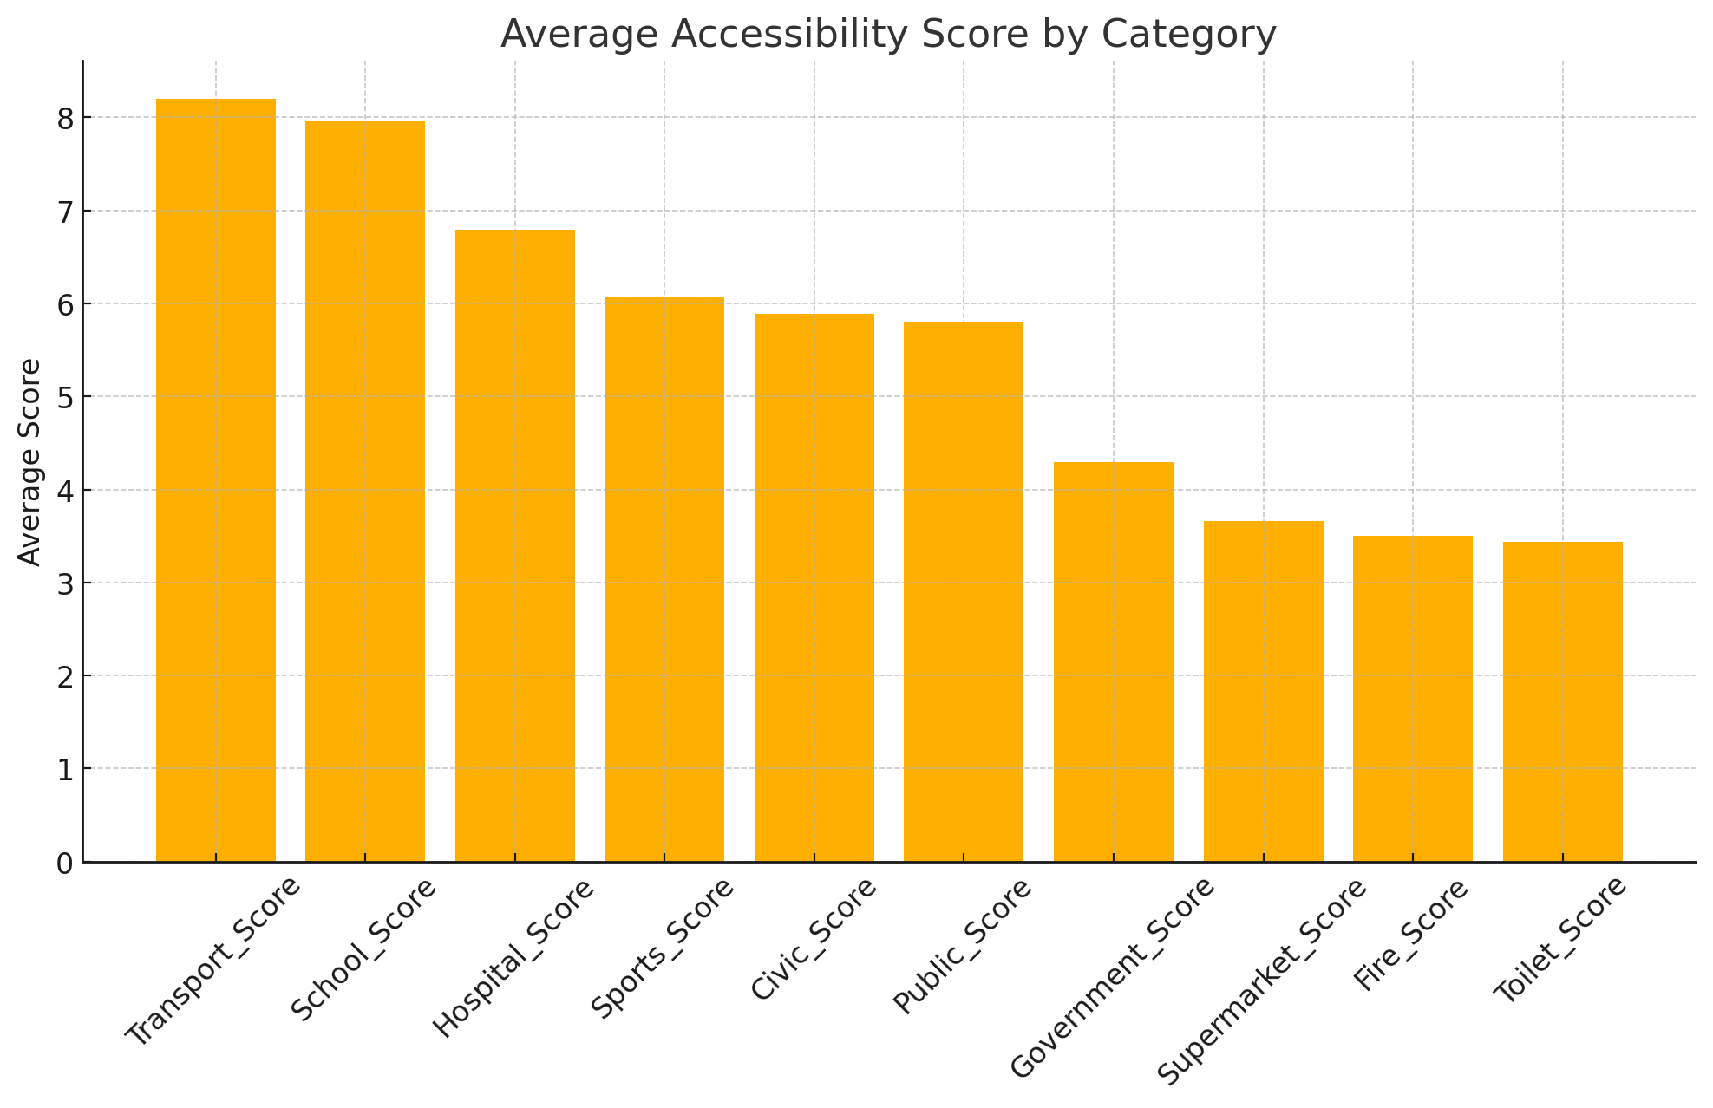
Average Accessibility Score by Category
On average, Transport and School accessibility have higher scores across all cities. Fire services and Supermarkets are the weakest categories and need focused improvements.

Slide 6
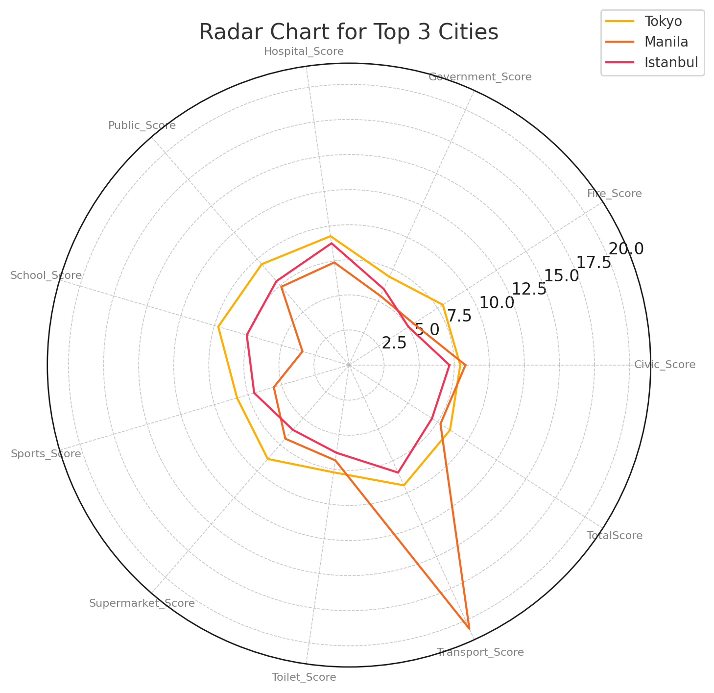
Radar Chart for Top 3 Cities
The radar chart compares Istanbul, Jakarta, and Beijing across all categories. It shows strengths in School and Transport accessibility, while some gaps remain in Fire services.

Slide 7
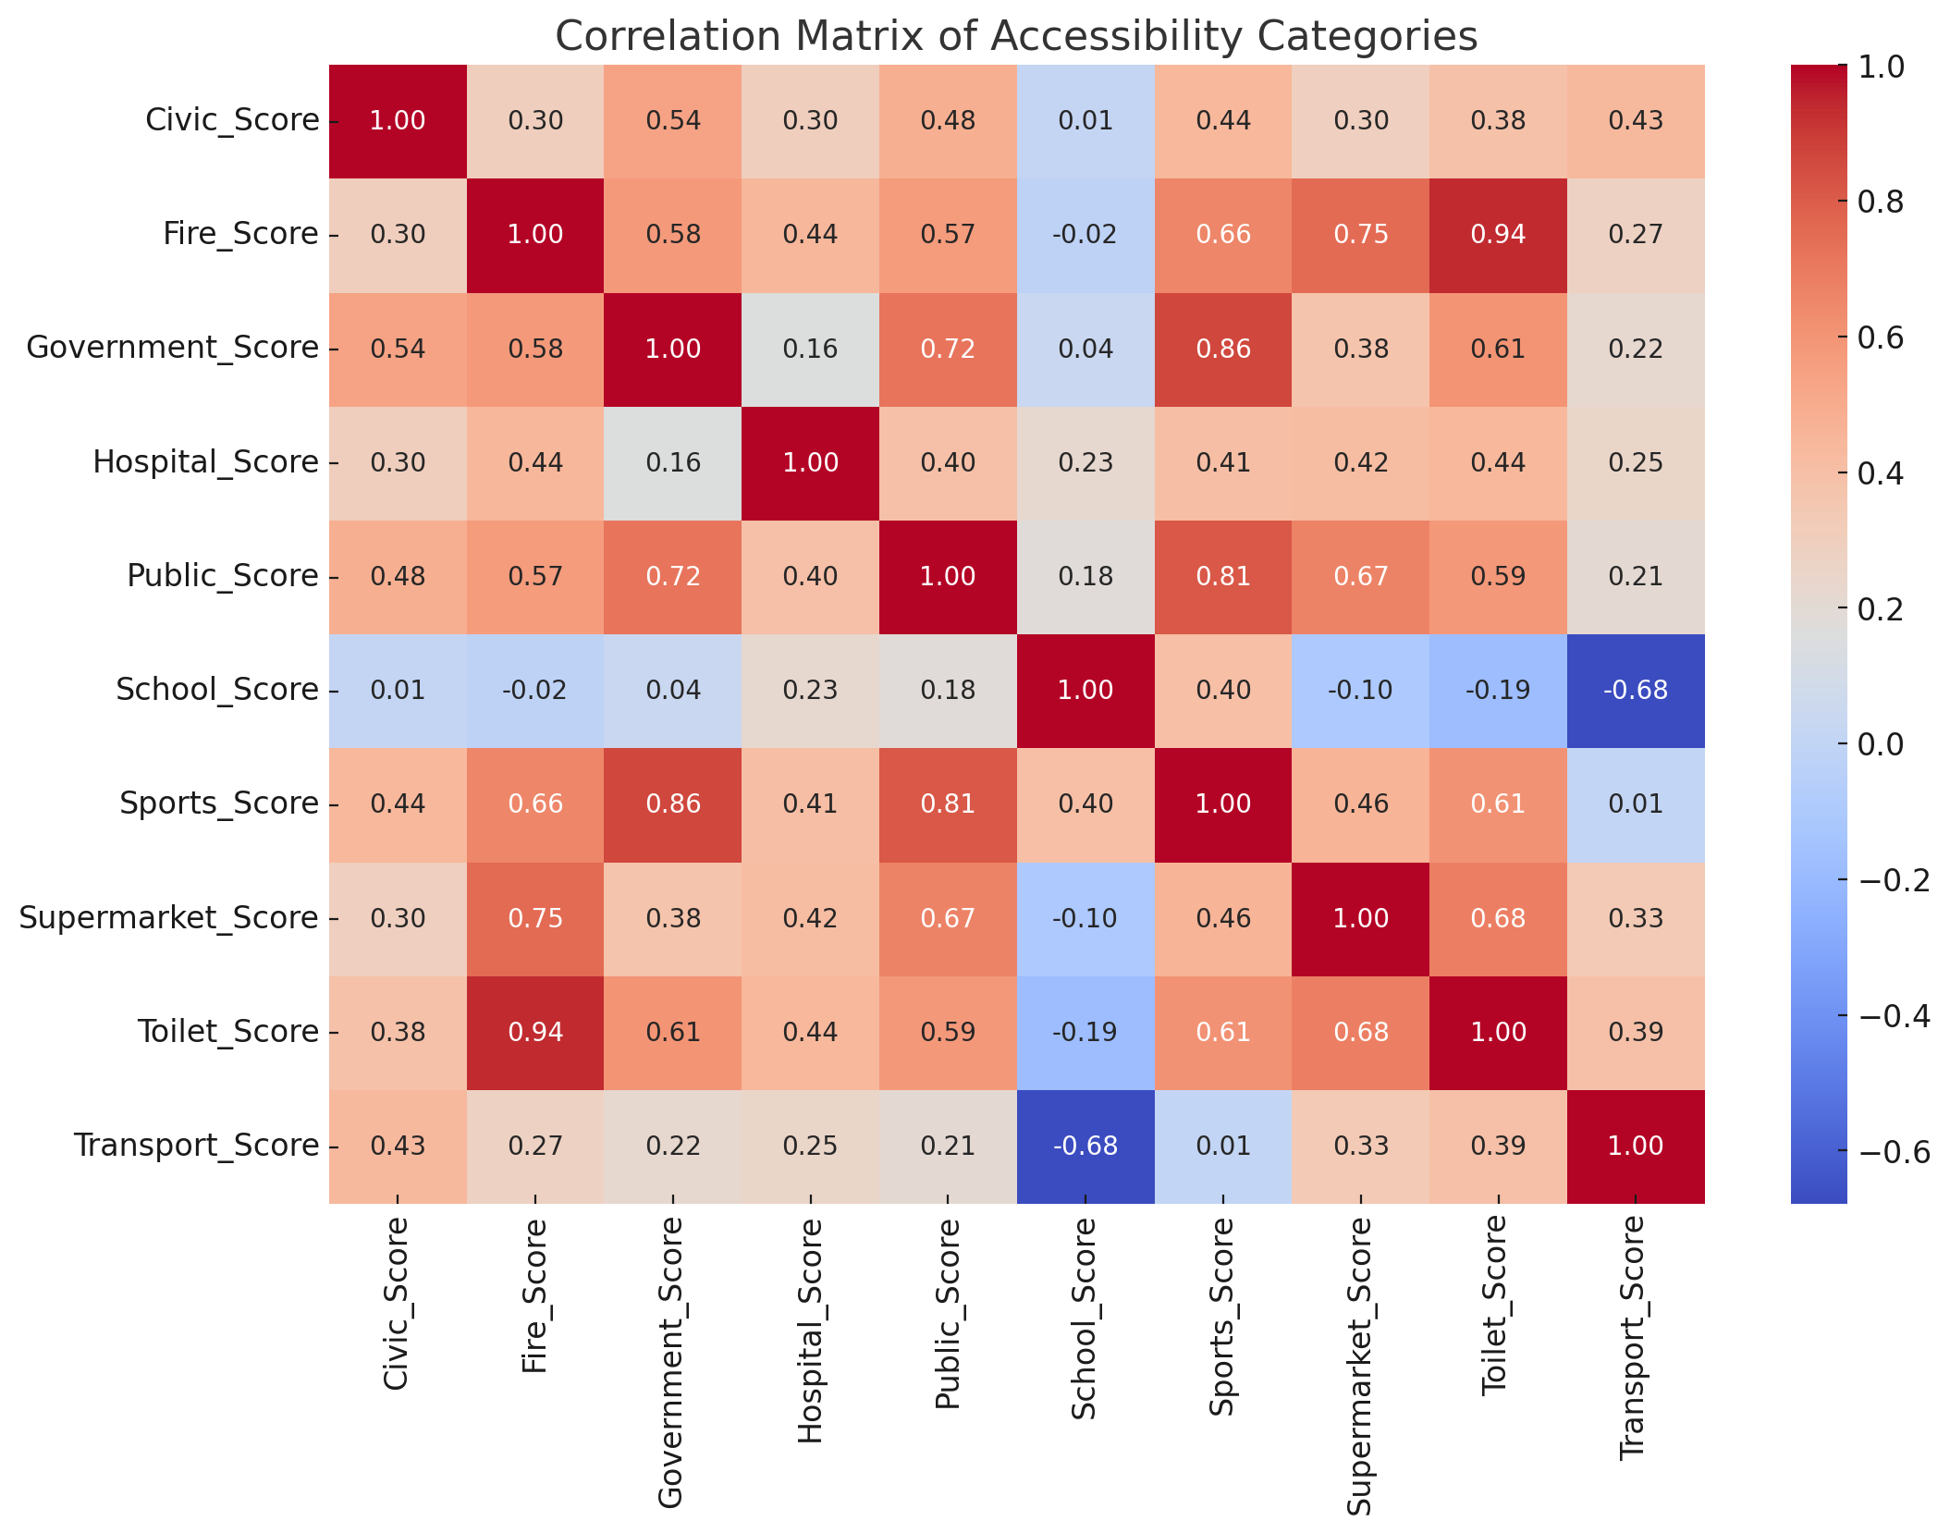
Correlation Matrix of Categories
The correlation matrix shows strong positive relationships between Hospital, Transport, and School scores. Fire services show weaker correlations, indicating unique development patterns.

Slide 8
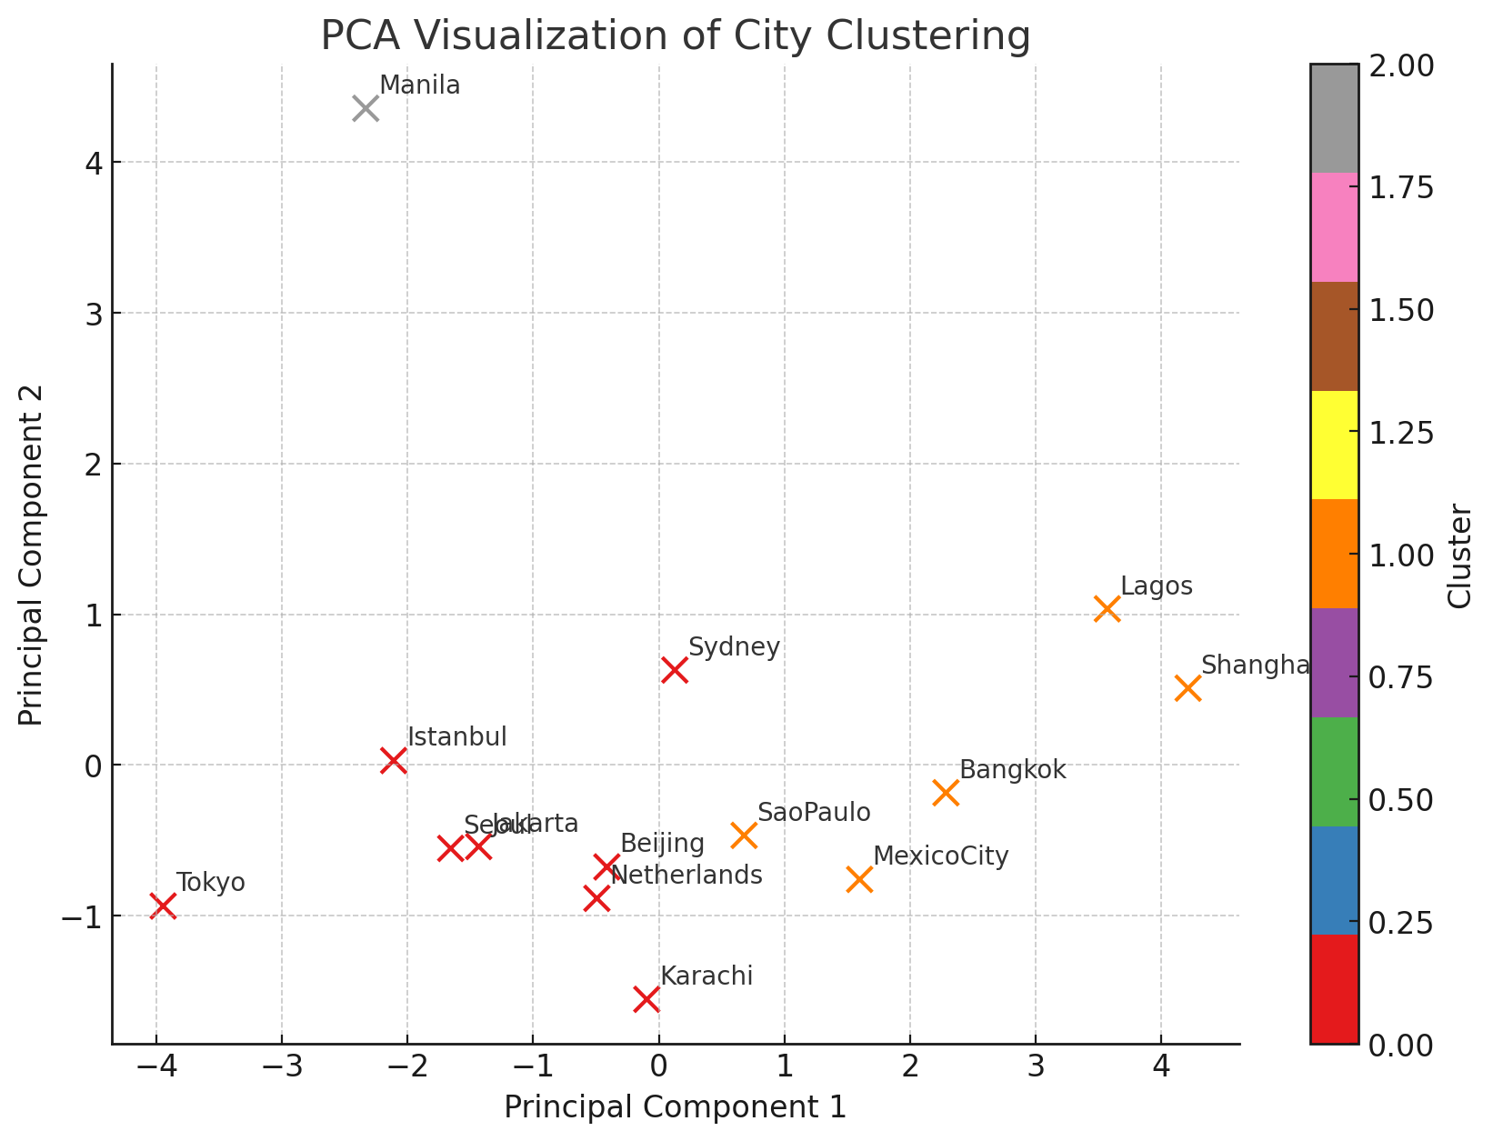
PCA Visualization of City Clustering
PCA helps visualize the clustering of cities based on accessibility profiles. Similar cities are grouped together, showing common infrastructure patterns.

Slide 9
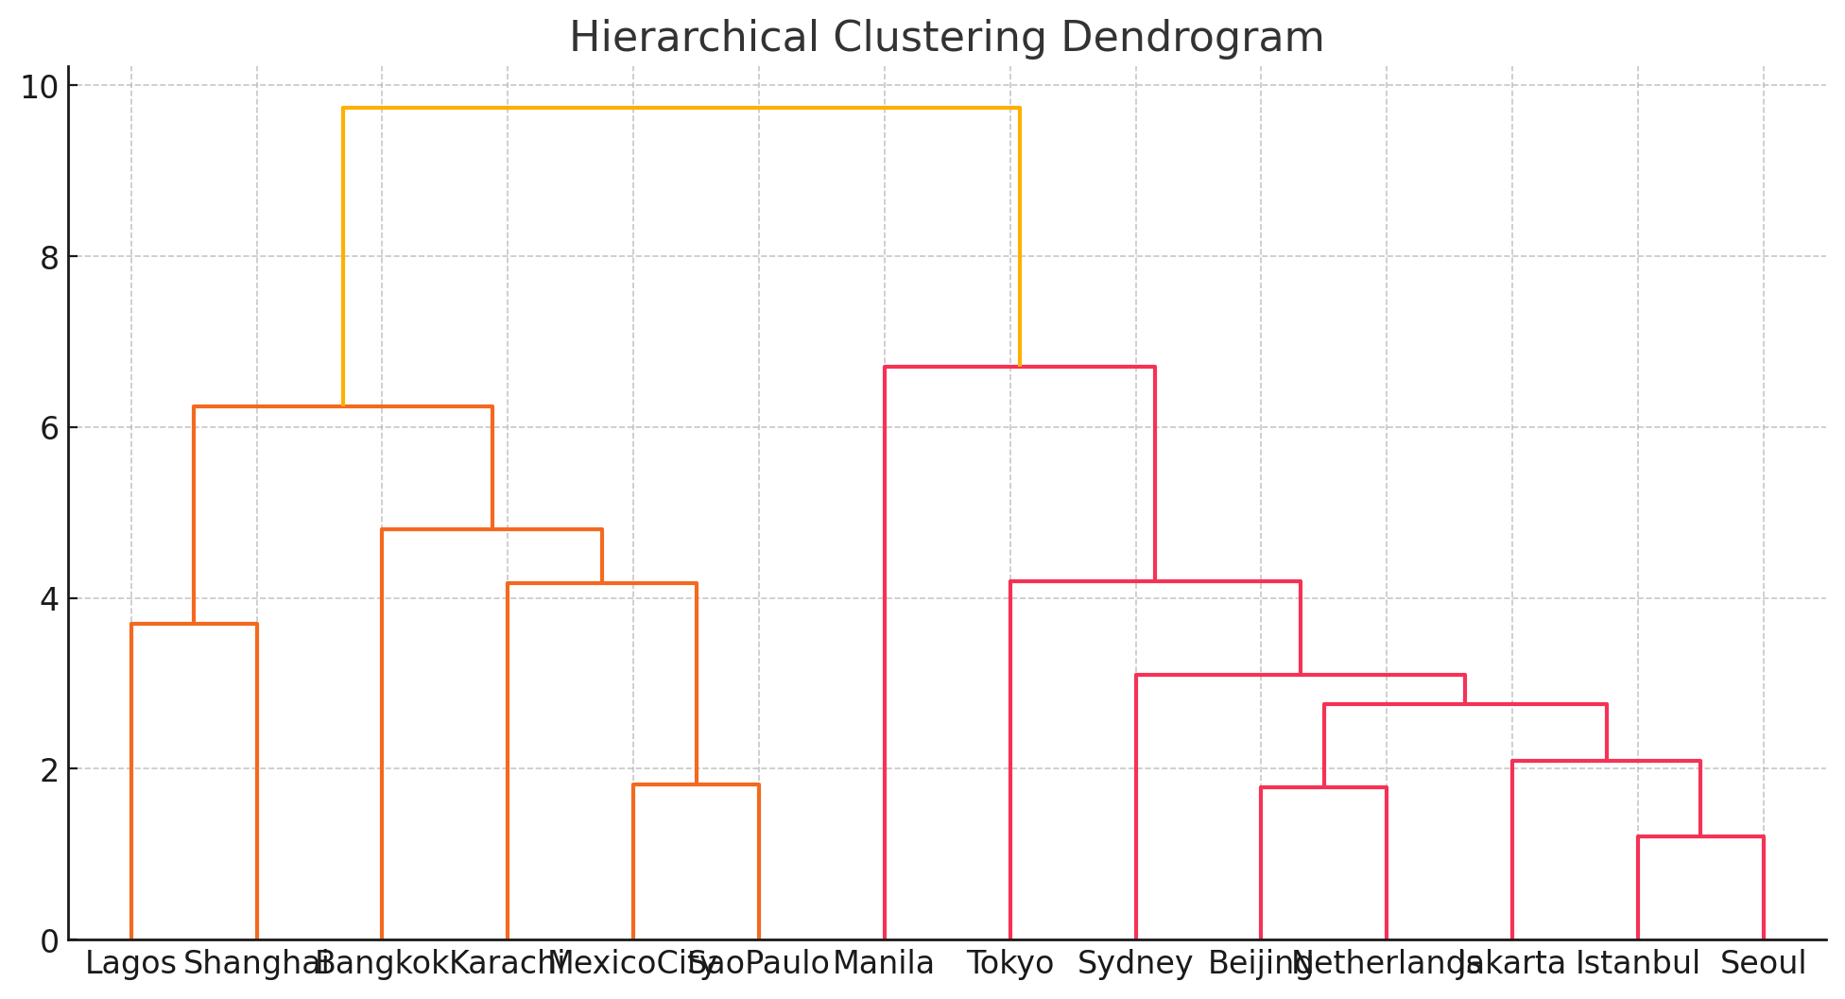
Hierarchical Clustering Dendrogram
The dendrogram presents a hierarchical grouping of cities. It shows clusters of cities that share similar accessibility characteristics, helping identify best practices.

Slide 10
Conclusion & Insights
1. Istanbul, Jakarta, and Beijing lead in overall accessibility.
2. Transport and Schools are generally well developed.
3. Fire services and Supermarkets need strategic focus.
4. Clustering revealed city groups with similar accessibility profiles.
5. Strong correlations exist between Hospital, School, and Transport access.
Recommendations:
- Improve weak categories (Fire, Supermarkets) in low-performing cities.
- Benchmark high-performing cities for best practices.

