Slide 1
CELESTE
Exoplanet Detection Using Machine Learning
Machine Learning - CSE 343

Slide 2
MOTIVATION
Exoplanets are the planets that orbit other stars outside the solar system, and have been of great interest to scientists across different fields. Their study is believed to reveal answers pertaining to how life came to existence on earth, how the solar system evolved and whether we can find another habitable planet. It’s rare for astronomers to see an exoplanet through their telescopes, known as direct imaging, and only a handful of exoplanets have been found this. Most exoplanets are found through indirect methods: measuring the dimming of a star that happens to have a planet pass in front of it, called the transit method, or monitoring the spectrum of a star for the tell-tale signs of a planet pulling on its star and causing its light to subtly Doppler shift, and other methods like gravitational microlensing, wobble method, etc., have been used but these require a huge amount of time and manpower and are also limited by the performance of astronomical telescopes. Thus, since the detection and study of exoplanets is valuable to help us, it is important to identify them first, which becomes significantly faster using classical Machine Learning techniques. We plan on using supervised and unsupervised methods for the same.

Slide 3
LITERATURE REVIEW I
IDENTIFYING EXOPLANETS WITH MACHINE LEARNING METHODS
In the paper, the authors propose the idea of using machine learning models to identify exoplanets and they try to achieve this by performing three-categorical classification with false positive, candidate and confirmed as classes on kepler dataset for supervised learning and using k-means clustering on the confirmed exoplanet dataset for unsupervised learning. By performing EDA they found out that the confirmed exoplanets follow a Gaussian distribution with respect to the log scale orbital period in the range between -2 and 4 and that false positive samples are most likely to have just one or two planets in their solar system. For feature extraction they found that variables that store the deviation of observations are highly dependent on the observed values so they were removed. Then 4 models, Decision Tree, Random Forest, Naive Bayes and Multilayer Perceptron were trained and achieved accuracies of 99.06%, 92.11%, 88.50%, and 99.79%, respectively and hyperparameters were found by experiment. Then they evaluated the performance of these models with 10-fold cross-validation. As a result, the random forest model achieved the best average accuracy of 82.39%. They also suggested to further investigate the receiver operating characteristics (ROC) and the precision-recall curves to understand the diagnostic ability of different machine learning models.
Reference: https://arxiv.org/ftp/arxiv/papers/2204/2204.00721.pdf

Slide 4
LITERATURE REVIEW II
Comparing Classification Models on Kepler Data
The paper is centered around an experiment conducted to find the most optimal classification model, best able to classify the data into two categories: CANDIDATE or FALSE POSITIVE. According to EDA conducted on the dataset by the author, two variables proved to be the most insightful - koi_depth and koi_duration since they represent the transit attributes of the astronomical body. During feature selection, they dropped off 18 features to reduce the dimensionality of the data and eliminate redundancy. Following further preprocessing, three algorithms were chosen - Logistic Regression, Decision Trees and Artificial Neural Network. Best parameters for these models were found using GridSearch with k-fold cross validation (k=5) and corresponding ROC and precision-recall curves were also plotted in order to get the best accuracy and to get the best ratio of True Positives and False Positives. The models were compared on three factors: Execution Time, Statistical Significance Test and Prediction Performance. Based on the prediction performance, Neural Network gives the best accuracy but surprisingly performs relatively poorly to Logistic Regression and Decision Trees with respect to precision and recall. Since there’s need for less False Positives, comparing between Logistic Regression and Decision Trees, Decision Trees (max-depth=6) out-perform Logistic Regression in terms of accuracy and relevancy.
Reference: https://arxiv.org/pdf/2101.01904.pdf

Slide 5
DATASET DESCRIPTION I
The Kepler space observatory was launched in 2009 by NASA. In order to find exoplanets the observatory must discover other solar systems. The observatory does this by identifying stars that have signatures that indicate transiting planets. These stars are called Kepler's objects of interest (KOI). The data we are using is a record of all the Kepler objects of interest that the Kepler space observatory has been monitoring.
Link to Colab file: Colab File
The distributions for CONFIRMED(0) and CANDIDATE (1) KOIs are pretty similar, whereas the FALSE POSITIVE (2) distributions seem to have more variation and higher medians.
There is significant separability between the FALSE POSITIVE labels and the other labels. This tells us that the data will work well when classifying FALSE POSITIVE labels with different classification models.
The above observation also tells us that there will be difficulty when trying to distinguish between CONFIRMED and CANDIDATE labels due to their points overlapping.Also, the CANDIDATE observations are not very useful to us since they are unable to give a binary answer to our problem statement - is this KOI an exoplanet or not?
Thus, it is safer to use the status CONFIRMED in koi_disposition column to be the accurate response of exoplanet identification.
CONFIRMED exoplanets also generally have much less measurement error value and less outliers data points than both FALSE POSITIVE and CANDIDATE counterparts

Slide 6
DATASET DESCRIPTION II
Features of interest include:
koi_disposition: Category of KOI from Exoplanet Archive taken. Designations are taken from pdisposition.
koi_pdisposition: Disposition using Kepler Data. Ongoing designation of KOI that describe planets with the most probable physical explanation. All data could be changed over time.
koi_period: Orbital period(days), the interval between consecutive planetary transits.
koi_duration: Transit Duration (hours), the duration of the observed transits. Duration is measured from first contact between the planet and star until last contact.
koi_depth: Transit Depth (parts per million), the fraction of stellar flux lost at the minimum of the planetary transit.
koi_fpflag_nt: A KOI whose light curve is not consistent with that of a transiting planet. This includes, but is not limited to, instrumental artifacts, non-eclipsing variable stars, and spurious (very low SNR) detections.
koi_fpflag_ss: A KOI that is observed to have transit-like events is most likely caused by eclipsing binary and other astronomical event.
koi_fpflag_co: The source of signal is from nearby star.
koi_fpflag_ec: The KOI shares the same period and epoch as another object is judged to be the result of flux contamination in the aperture or electronic crosstalk.

Slide 7
DATA PREPROCESSING I
Missing values : 2 features, namely koi_teq_err1 and koi_teq_err2, were dropped because they had more than 1000 missing values. Samples that had greater than 10 missing feature values were also removed. The rest of the missing feature values were filled with the mean of that particular feature.
Removing Candidate exoplanet samples:
The label column had values: Candidate exoplanet, confirmed exoplanet and confirmed non-exoplanet. Since we wished to classify the Kepler objects of interest(KOI) as exoplanets or not, classifying them as exoplanet candidates would have defeated our purpose. So all the Candidate exoplanet samples were dropped.
Standardization:
The data was standardized using the formula given below :
X = (x - µ)/σ
Where µ is the mean and σ the standard deviation.

Slide 8
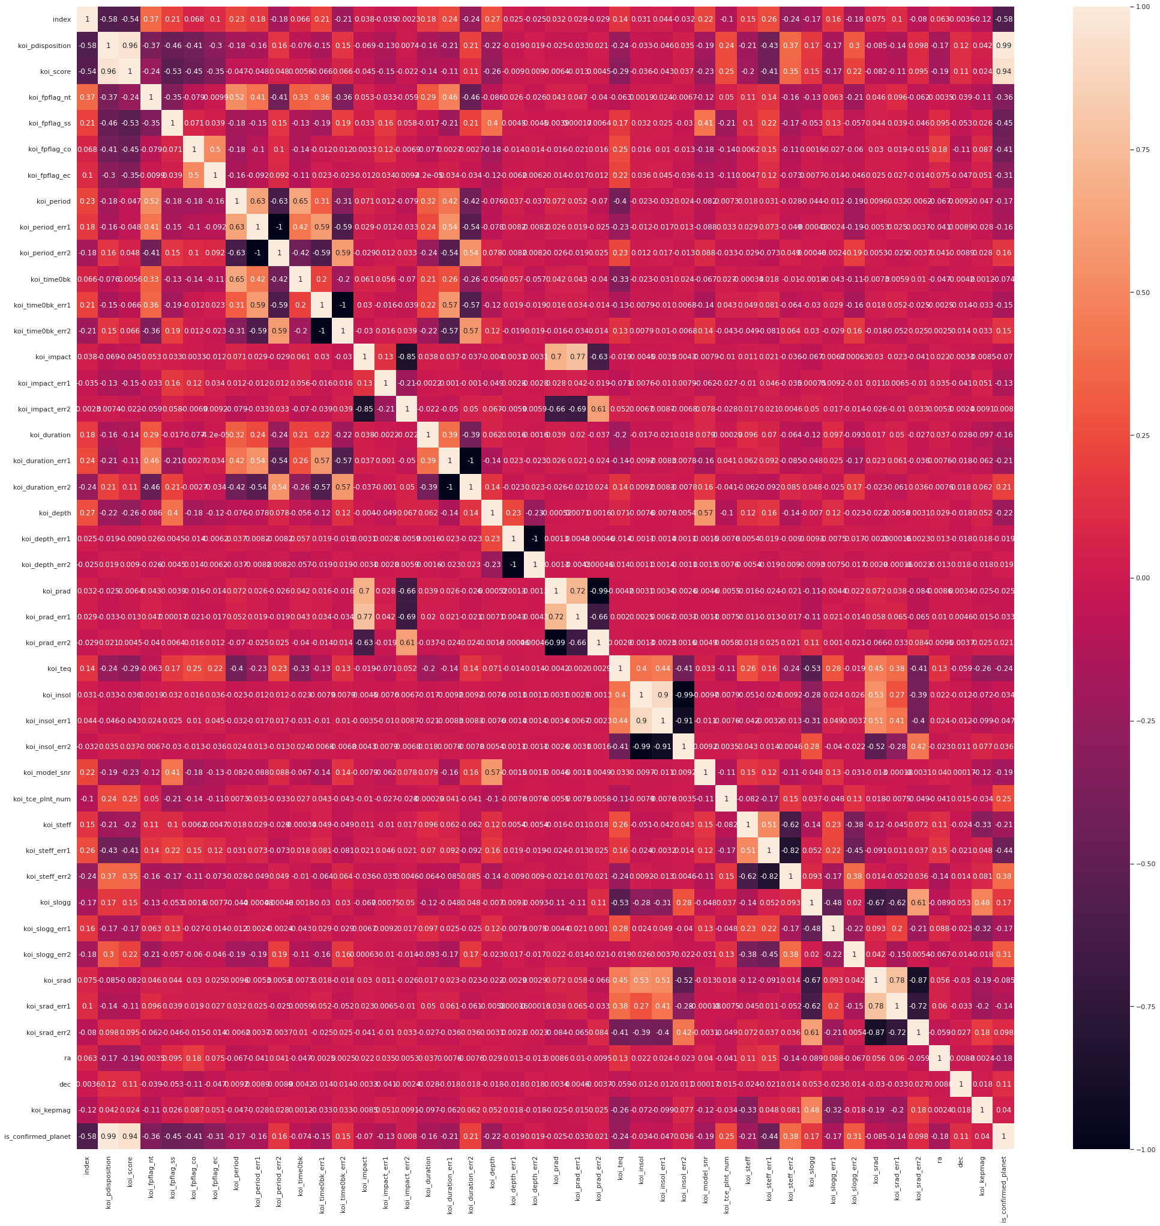
DATA PREPROCESSING II
Highly correlated features:
If two features had a correlation value of greater than 0.95 then one of those 2 features was dropped. 7 columns were dropped to the high correlation observed amongst the features. Features dropped: koi_depth_err2, koi_duration_err1, koi_insol_err,koi_period_err1, koi_prad_err2 , koi_score, koi_time0bk_err2

Slide 9
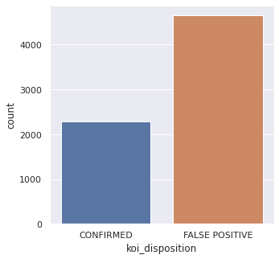
DATA VISUALIZATION
Uneven Dataset
False Positive 66.96%
Confirmed 33.03%

Slide 10
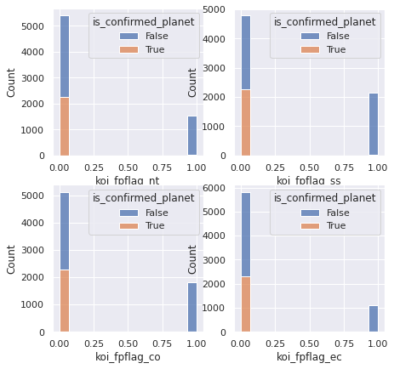
DATA VISUALIZATION
If the flags are 1, it's definitely not a planet.
If the flags are 0, 25% of the time it's a planet.

Slide 11
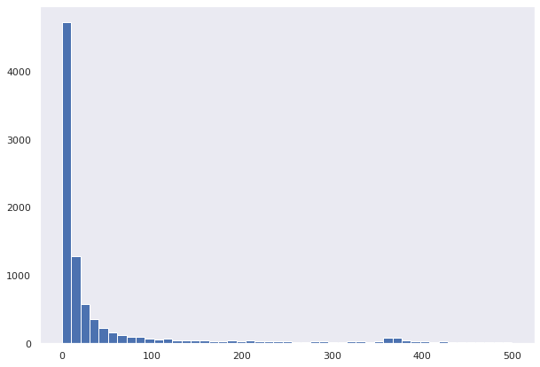
DATA VISUALIZATION
koi_period
value distribution

Slide 12
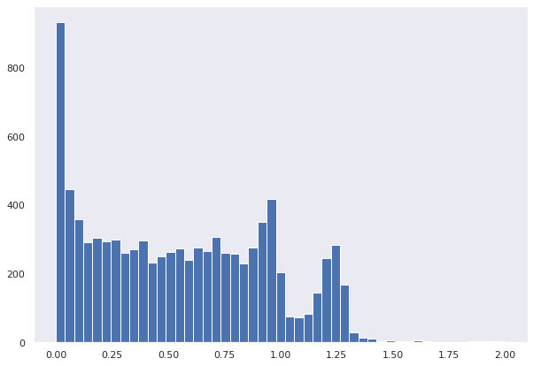
DATA VISUALIZATION
koi_impact
value distribution

Slide 13
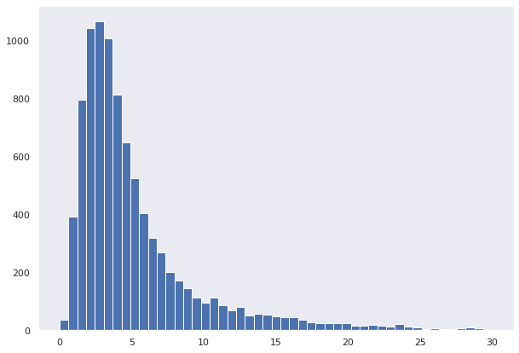
DATA VISUALIZATION
koi_duration
value distribution

Slide 14
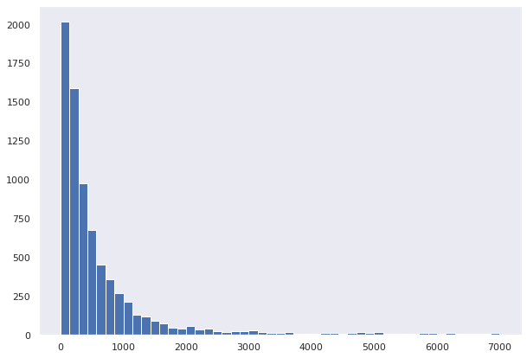
DATA VISUALIZATION
koi_depth
value distribution

Slide 15
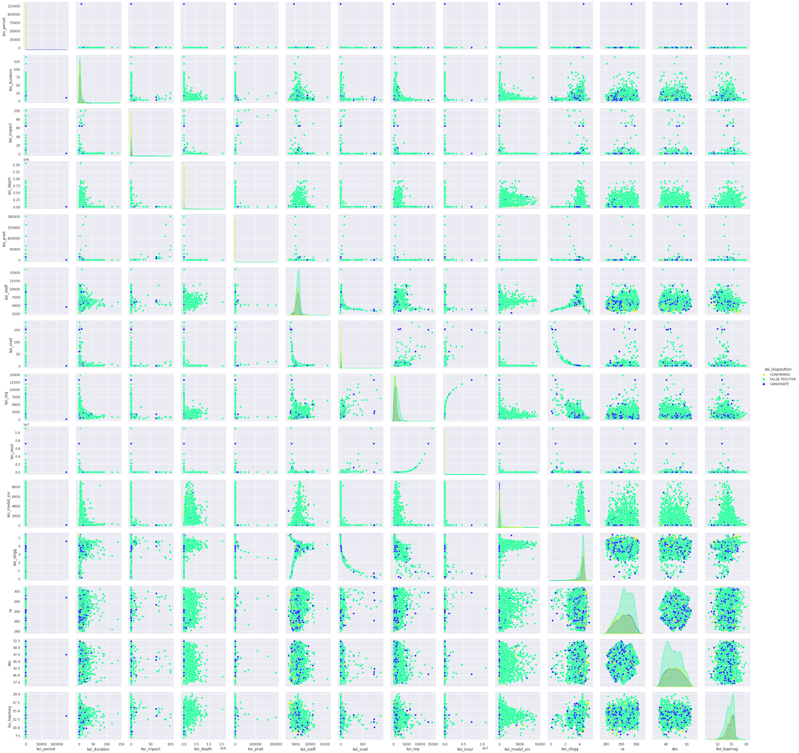

Slide 17
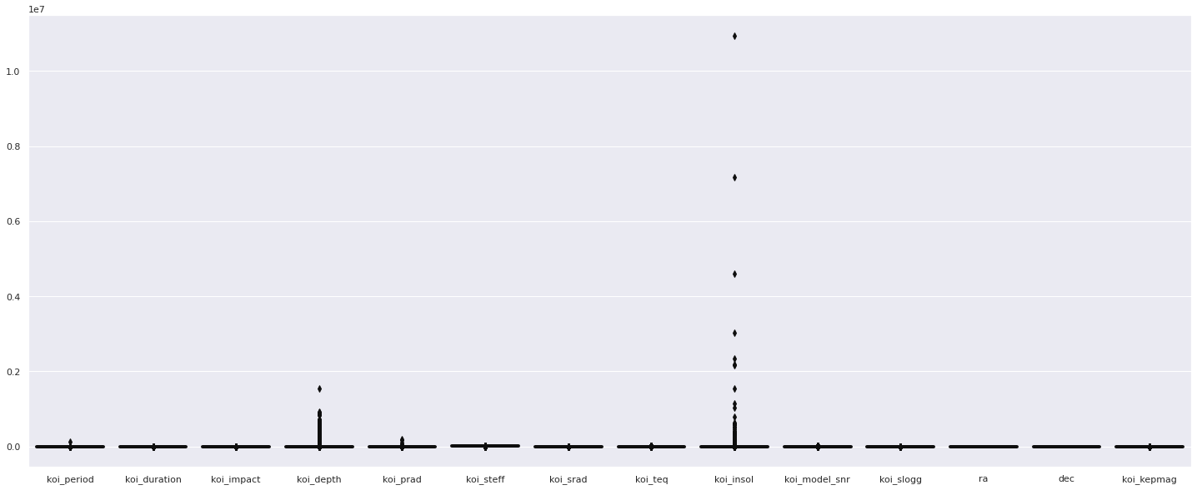
koi_insol has too many outliers compared to other features and limits us from finding out the actual data distributions of the data, therefore we try and plot a boxplot of koi_duration to get an estimate of actual distribution

Slide 18
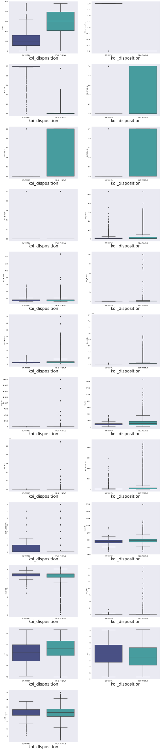
DATA VISUALIZATION

Slide 19
DATA VISUALIZATION

Slide 20
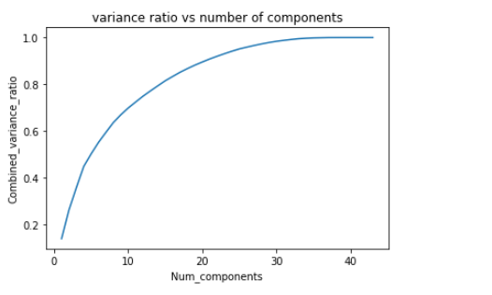
METHODOLOGY I
Data cleaning: This was quite an important step since there were a lot of missing values in our data. 6939 samples were left after data cleaning.
Data visualization: EDA was performed in order to gain insight on the data using seaborn and matplotlib.
Data Standardization: The data was standardized using standard scaler of sklearn
Feature extraction : Principal component analysis was used for feature extraction and 90 percent variance was retained. The data had 20 features after feature extraction.

Slide 21
METHODOLOGY II
Train Test split : 80:20 stratified train test split was made. This was done in order to ensure that we had sufficient training data and testing data. Also this ensured that the ratio of the classes in both train and test was nearly the same.
We built 6 different machine learning models : Random forest, Multilayer Perceptron, Logistic regression, adaboost, decision tree, Naive bayes.
Cross-validated grid search: For all the models built,Naive bayes, we used grid search with cross validation to find the best parameters. For the grid search the scoring for the model was done on the basis of accuracy.
For all the models built calculated accuracy, precision, recall, F1 score, AUROC and also plotted the AUROC curves.

Slide 22
METHODOLOGY III
Parameters that we grid searched for each model are
Random forest - Criterion: [gini ,entropy] , max_depth: [6, 8, 10, 12, 14, 16, 18], n_estimators: 80, 100, 120, 140]
Logistic regression - Penalty:[l1,l2], solver: [newton-cg, lbfgs, liblinear], C: [0.001, 0.01 ,0.1 ,1 ,10 ,100 ,1000]
Multiplayer Perceptron - Activation: [identity, logistic, tanh, relu], Solver: [lbfgs, sgd, adam] , max_iter:[300,500]
Decision tree - Criterion: [gini ,entropy] , max_depth: [2, 4, 6, 8, 10, 12],
Adaboost - Base estimator : decision tree with max depth = 1,2 and 3, n_estimators : 40,50,60,70
Support Vector Machine - C : [0.001, 0.01, 0.1, 1,10,100,1000] , kernel: [linear, rbf, sigmoid , poly]. Only for kernel poly : degree : [2,3,4,5]
XGboost : reg_lambda: [0.001, 0.01, 0.1, 1,10,100,1000] , max_depth :[6,8,10,12,14,16,18], n_estimators:[80,100,120,140]

Slide 23
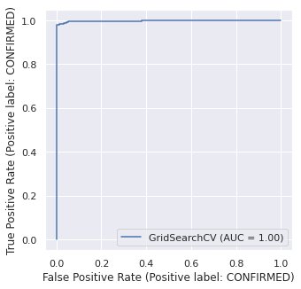
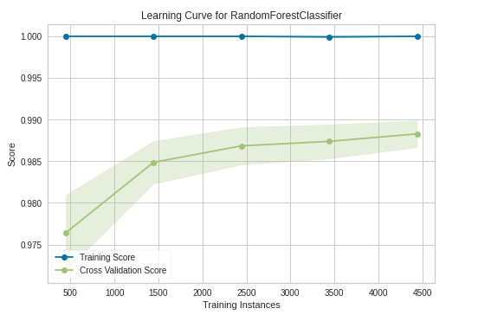
RESULTS
Random Forest
Accuracy : 0.989193083573487
Best parameters :
{'criterion': 'gini', 'max_depth': 10,
'n_estimators': 100}
Precision : 0.9841269841269841
Recall : 1.0
F1_score : 0.9919999999999999
AUROC : 0.9965793304221252

Slide 24
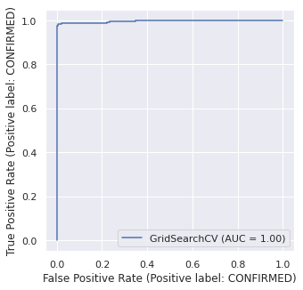
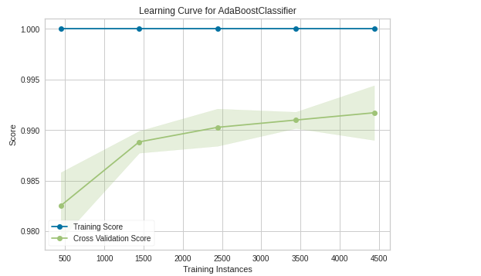
RESULTS
AdaBoost
Accuracy : 0.9899135446685879
Best parameters : {'algorithm': 'SAMME', 'n_estimators': 70
'base_estimator': DecisionTreeClassifier(max_depth=3)}
Precision : 0.9872340425531915
Recall : 0.9978494623655914
F1_score : 0.9925133689839573
AUROC : 0.9955251913415034

Slide 25

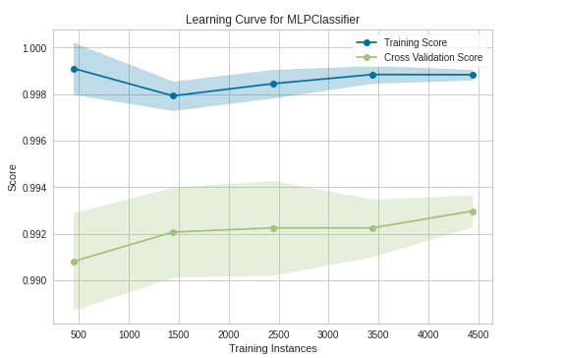
RESULTS
Multi-Layer Perceptron
Accuracy : 0.9913544668587896
Best parameters :
{'activation': 'tanh', 'max_iter': 300, 'solver': 'adam'}
Precision: 0.9882978723404255
Recall : 0.9989247311827957
F1_score : 0.9935828877005347
AUROC : 0.9967554115603137

Slide 26
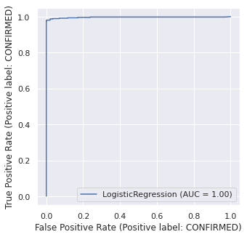
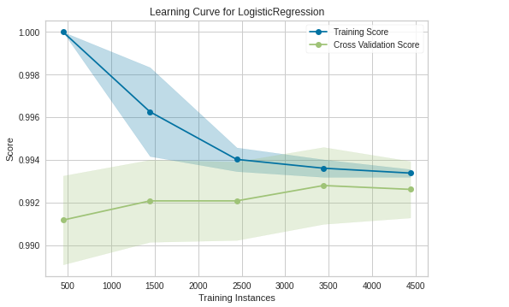
RESULTS
Logistic Regression
Accuracy : 0.9920749279538905
Best parameters :
{'C': 100.0, 'penalty': 'l2', 'solver': 'newton-cg'}
Precision : 0.9883103081827843
Recall : 1.0
F1_score : 0.9941207910208444
AUROC : 0.9963398600741888

Slide 27
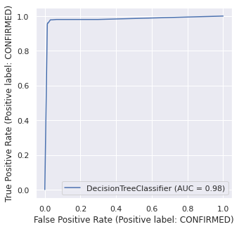
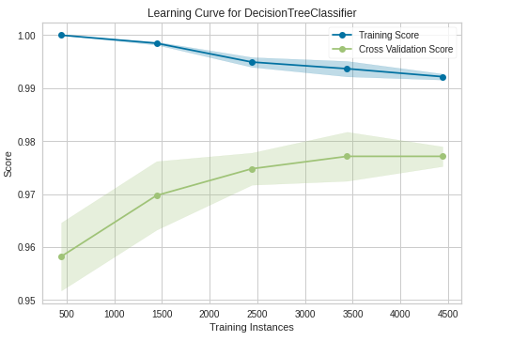
RESULTS
Decision Tree
Accuracy : 0.9762247838616714
Best parameters : {'criterion': 'entropy', 'max_depth': 6}
Precision : 0.9807073954983923
Recall : 0.9838709677419355
F1_score : 0.9822866344605475
AUROC : 0.9799185331267314

Slide 28
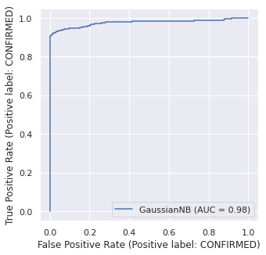
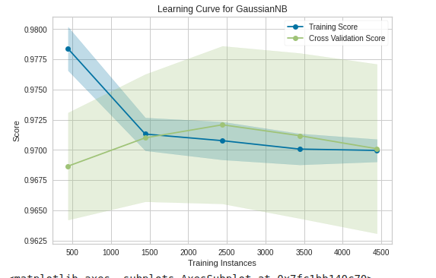
RESULTS
Gaussian Naive Bayes
Accuracy : 0.9639769452449568
Precision : 0.9573804573804574
Recall : 0.9903225806451613
F1_score : 0.9735729386892177
AUROC : 0.9766070338545335

Slide 29
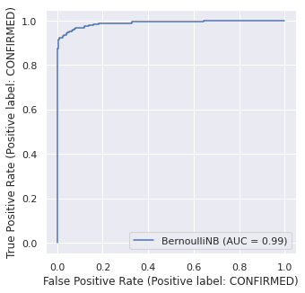
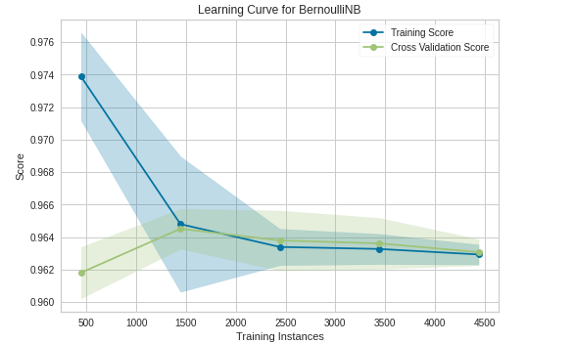
Results
Bernoulli Naive Bayes
Accuracy : 0.9668587896253602
Precision : 0.9623430962343096
Recall : 0.989247311827957
F1_score : 0.975609756097561
AUROC : 0.9886345494670611

Slide 30
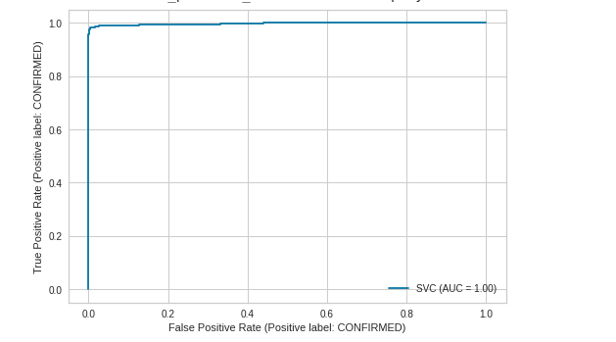
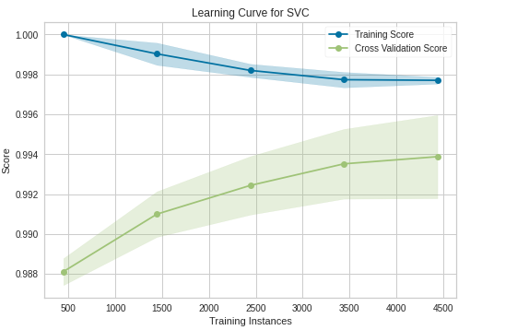
Results
Support Vector Machine Classifier
Accuracy : 0.9906340057636888
Best parameters : {'C': 10, 'kernel': 'rbf'}
Precision : 0.9914255091103966
Recall : 0.9946236559139785
F1_score : 0.9930220075147612
AUROC : 0.9974339108794665

Slide 31
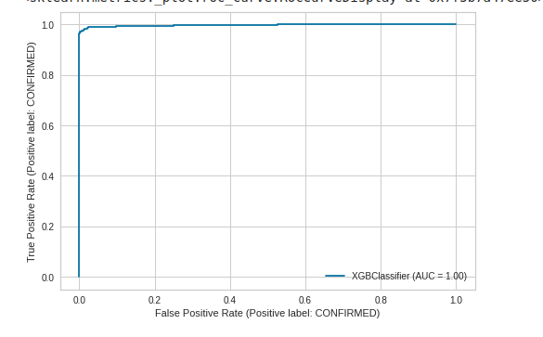
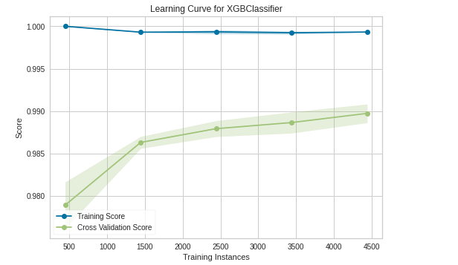
Results
XGBOOST
Accuracy : 0.9870317002881844
Best parameters : {'max_depth': 10, 'n_estimators': 140,
'reg_lambda': 10}
Precision : 0.9830508474576272
Recall : 0.9978494623655914
F1_score : 0.9903948772678762
AUROC : 0.9972226135136404

Slide 32
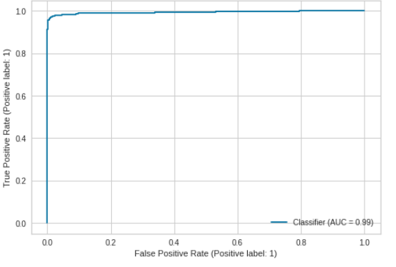
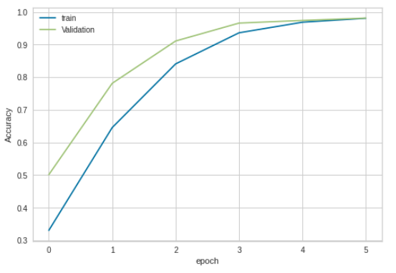
Results
Neural Network using Tensorflow
Accuracy : 0.9827089337175793
Precision : 0.984375
Recall : 0.962882096069869
F1_score : 0.9735099337748344
AUROC : 0.9939216791097337

Slide 33
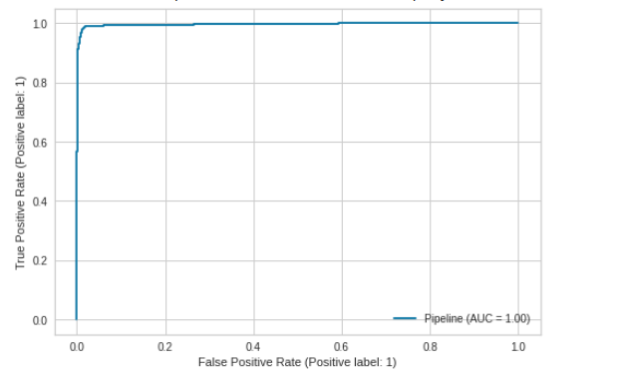
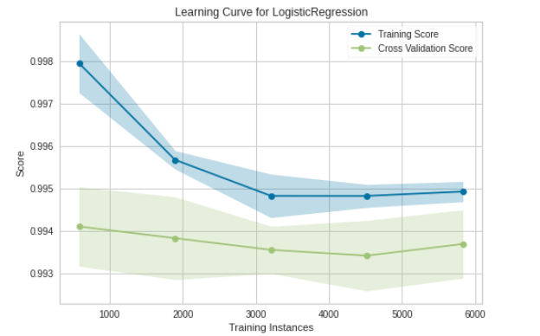
Results
Semi-supervised clustering using logistic
regression
Accuracy : 0.9870317002881844
Precision : 0.9820295983086681
Recall : 0.9989247311827957
F1_score : 0.990405117270789
AUROC : 0.9947856505611119

Slide 34
ANALYSIS
In terms of Accuracy
Logistic Regression > Multi-Layer Perceptron > SVM Classifier > AdaBoost > Random Forest > Clustering > XgBoost > Decision Tree > Bernoulli Naive Bayes > Gaussian Naive Bayes
In terms of Precision:
SVM Classifier > Logistic Regression > Multi-Layer Perceptron > AdaBoost > Random Forest > XgBoost > Clustering > Decision Tree > Bernoulli Naive Bayes > Gaussian Naive Bayes
In terms of Recall :
Random Forest = Logistic Regression > Multi-Layer Perceptron > Clustering > AdaBoost > XgBoost > SVM Classifier Gaussian Naive Bayes > Bernoulli Naive Bayes > Decision Tree.

Slide 35
ANALYSIS
In terms of F1 Score :
Logistic Regression > Multi-Layer Perceptron > SVM Classifier > AdaBoost > Random Forest > Clustering > XgBoost > Decision Tree > Gaussian Naive Bayes > Bernoulli Naive Bayes.
In terms of AUROC :
SVM Classifier > XgBoost > Multi-Layer Perceptron > Random Forest > Logistic Regression > AdaBoost > Clusterin > Bernoulli Naive Bayes > Decision Tree > Gaussian Naive Bayes

Slide 36
CONCLUSION
Logistic Regression, Multi-Layer Perceptron, AdaBoost, SVM Classifier had almost similar performance matrices.
It was observed that the Logistic regression classifier was the best based on F1-score. F1-score is the most important metric in our case. This is because in our problem the dataset is imbalanced and we assign an equal weightage to a wrong prediction for both confirmed and false positive classes.

Slide 37
TIMELINE
1. Reading up on and understanding the Kepler dataset. [1 week] - Complete
2. Data cleaning and preprocessing [1 week] - Complete
3. Data visualization and analysis [1 week] - Complete
4. Feature Extraction [1 week] - Complete
5. Developing and testing various models [4 weeks] - Preliminary Testing complete

Slide 38
TIMELINE -
5. Developing and testing various models [4 weeks] - Tuning the models, improving accuracy and precision-recall.
6. Deriving conclusions and writing final report [1 week]
7. Buffer time to tie up any loose ends [1 week]

Slide 39
Individual Contributions
1. Preprocessing Data - Shashank, Abhimanyu
2. Data Visualization - Apoorva, Tarushi
3. Data Analysis - Shashank, Apoorva
4. Feature Extraction - Abhimanyu, Tarushi
5. Development of models - All
6. Report and Slides - All

Slide 40
THANK YOU

