Slide 1

Crop Yield Prediction

Slide 2
Objective
Optimizing Agricultural Practices
Resource Planning and Management
Risk Mitigation
Research and Development
Empowering Farmers

Slide 3
Approach to solving the problem
Forecasting future weather conditions relies on analysing historical weather data.
Utilizing the predicted weather information, the next step involves anticipating the crop type.
By combining the identified crop type with the prevailing weather conditions, the final step is to estimate the expected crop yield.

Slide 4
Model summary
Regression Models:
Decision Tree Regressor
Decision Tree Regressors predict continuous numerical values
Classification Models:
Random forest classifier
collection of decision trees during training and outputs the mode of the classes (classification) from the individual trees
Time Series Models:
ARIMA MODEL
(Autoregressive Integrated Moving Average) is a popular time series forecasting model. It is used to model and predict univariate time series data.

Slide 5
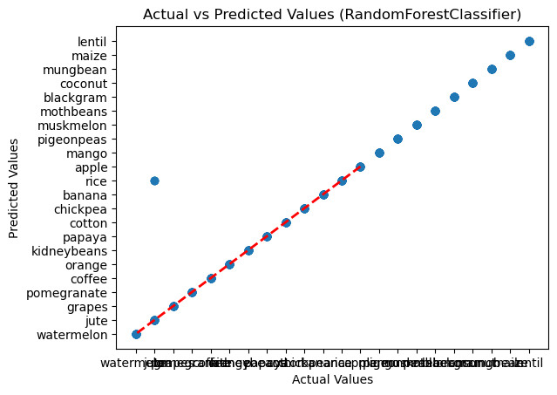
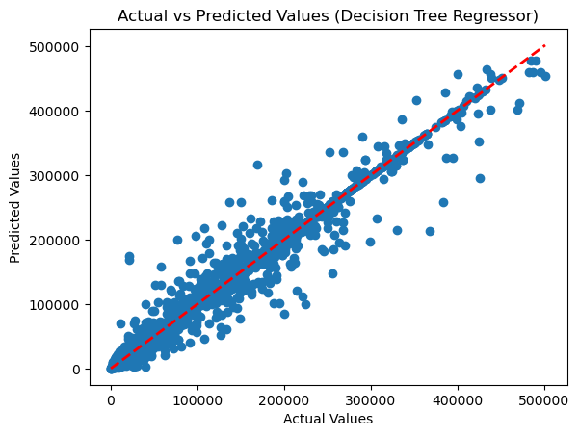
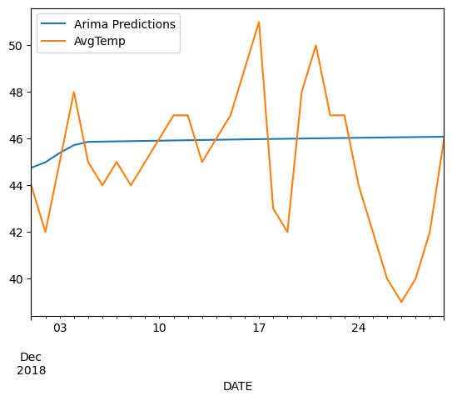
Results
Apple is a best crop to be cultivated
11:27PM
WEATHER PREDICTION
CROP YIELD PREDICTION
CROP TYPE PREDICTION

Slide 6
FLOW DIAGRAM
Future dates
temperature
1
CROP YIELD
3
Temperature
Rainfall
N
P
K
CROP NAME
2

Slide 7

References
https://paperswithcode.com/paper/a-cnn-rnn-framework-for-crop-yield-prediction
https://medium.com/swlh/temperature-forecasting-with-arima-model-in-python-427b2d3bcb53
https://iopscience.iop.org/article/10.1088/1742-6596/2161/1/012033/pdf

Slide 8
Weather Prediction
Data Collection
Data Pre-processing
Removing null values
Converting and adding date time column to separate date and time column
Model Selection
ARIMA model
Training the Models
Model Evaluation
mean_squared_error
Extracting the output and supplying it as input to other two models.

Slide 9
Crop Name Prediction
Data Collection
Data Pre-processing
Removing null values
Model Selection
RandomForestClassifier
Training the Models
Testing the models
including output from previous model prediction
Model Evaluation
accuracy_score
Extracting the output and supplying it as input to yield prediction model.

Slide 10
Crop Yield Prediction
Data Collection
Data Pre-processing
Removing unnecessary data
Removing duplicates and null values
OneHotEncoder
StandardScaler
Model Selection
DecisionTreeRegressor
Training the Models
Testing the models
including output from previous 2 models' prediction
Model Evaluation
mean_absolute_error
Yield Prediction output.

Slide 11

FUTURE PLANS
Predict the date and yield in which there is max returns based on date range.

