Slide 1


SHIP RESERVATION SYSTEM
XYZ SEA TRAVELS LTD.
PRESENTED BY-
APOORVA MISHRA

Slide 2
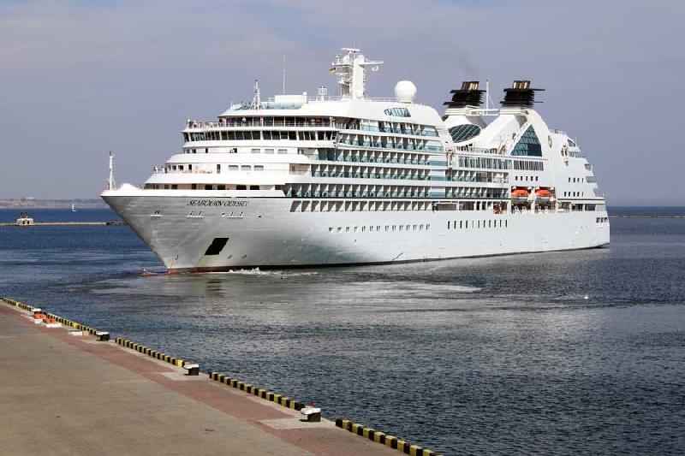
INTRODUCTION:
XYZ Sea Travels Ltd. provides sea travel services to customers across the globe.
By the help of this website, XYZ Sea Travels Ltd. is taking an initiative to make the customers more comfortable with the online reservation system for making their reservations and also managing their reservations.

Slide 3



ACCESSIBLE TO
ADMIN
CUSTOMERS

Slide 4
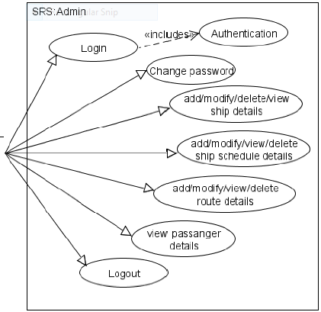
ADMIN
I can do the following tasks.

Slide 5
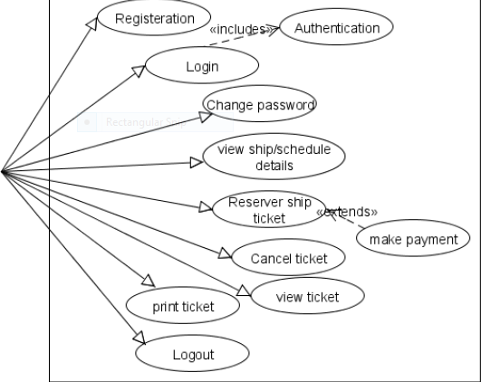
CUSTOMERS
We can do the following tasks

Slide 6

AGENDA :
The project requirements have been classified into two categories depending upon the priority:
Priority 1
1.All users (Administrator & Customer) logging into the SRS application should be authenticated using a unique login-id and password (operations to be supported based on type of user) .
2.The application should handle logout (close all open database connections, invalidate sessions, etc) .
3.The admin should be able to add ship details .
4.The admin should be able to delete ship details .

Slide 7
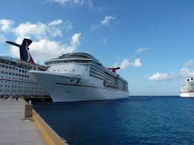
AGENDA
Priority 1:(Contd…)
5.The admin should be able to view ship details.
6.The admin should be able to modify ship details .
7.The admin should be able to add ship route details.
8. The admin should be able to add schedule details.
9. The admin should be able to view details of passengers travelling on a particular ship on a particular .
10. The user should be able to register to ‘Ship Reservation System’.
11. The user should be able to view ship/schedule details by source and destination
12. The user should be able to reserve his/her ship tickets by making payment online .
13. The user should be able to view his/her e-ticket

Slide 8

AGENDA
Priority 2:
1. All users should be able to change their password .
2. The admin should be able to delete ship route details.
3. The admin should be able to view ship route details.
4. The admin should be able to modify ship route details.
5. The admin should be able to delete schedule details.
6. The admin should be able to view schedule details .
7. The admin should be able to modify schedule details.
8. The user should be able to cancel his/her ship tickets.
9. The user should be able to print his/her e-ticket.

Slide 9
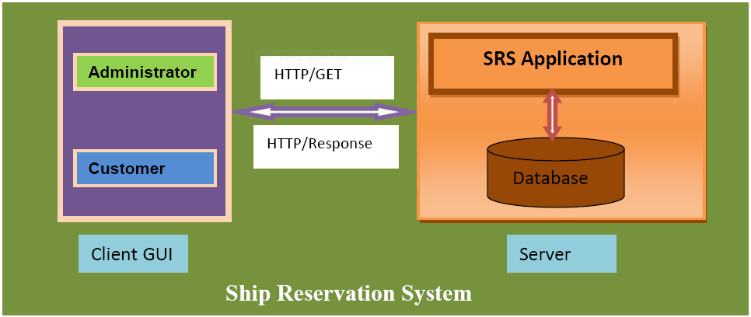
FUNCTIONAL FLOW:

Slide 10
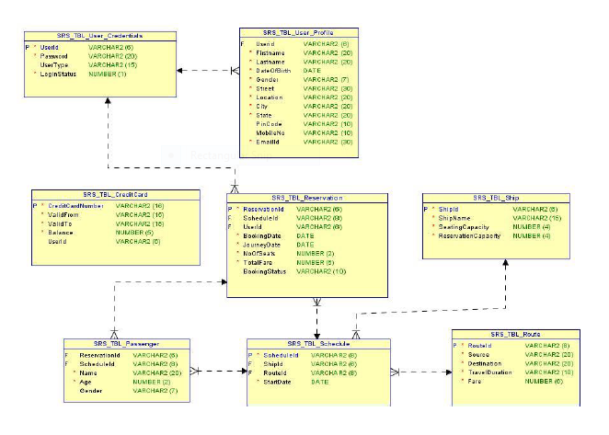
DATABASE DESIGN:

Slide 11
ASSUMPTIONS/LIMITATIONS
The administrator can set the schedule for the ships on a weekly basis.
The scope of the application is limited to only one country.
The seats are assumed to be of one type (Non-AC) only.
Booking of ships to be done one way
Seat availability to be updated upon reservation/cancellation of tickets.

Slide 12



Slide 13
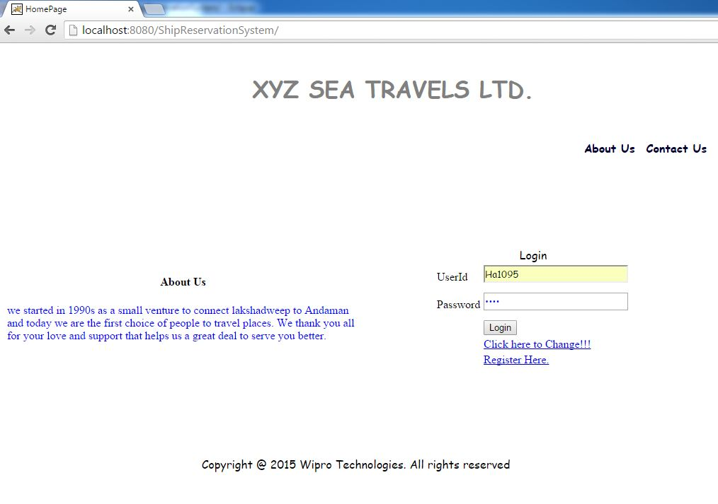

LOGIN:
Home Page

Slide 14
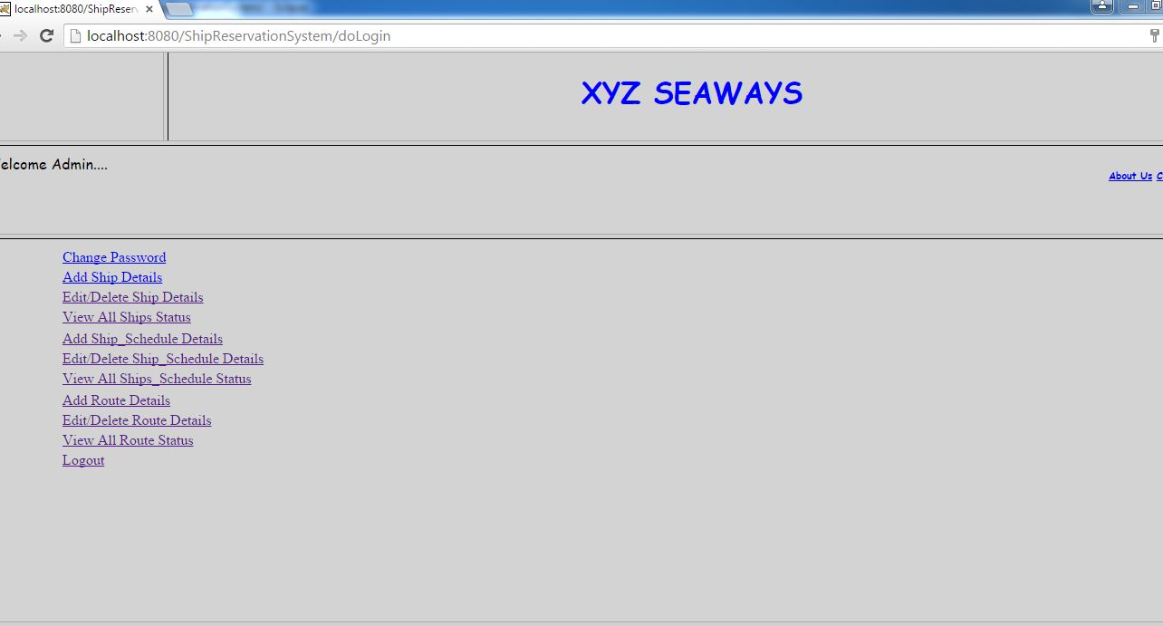
ADMIN HOMEPAGE

Slide 15
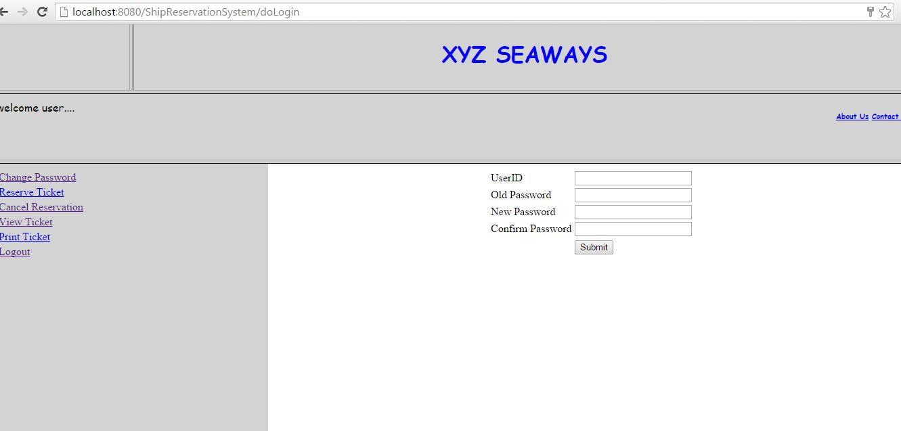
CHANGE PASSWORD
After Registration the password has to be changed

Slide 16
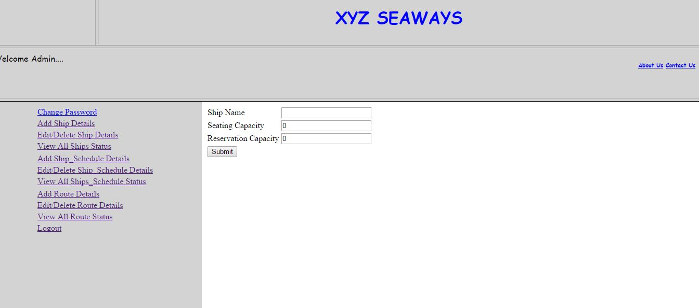
CRUD OPERATIONS FOR SHIP DETAILS
Ship Details can be added deleted and modified from here
ADD SHIP DETAILS

Slide 17
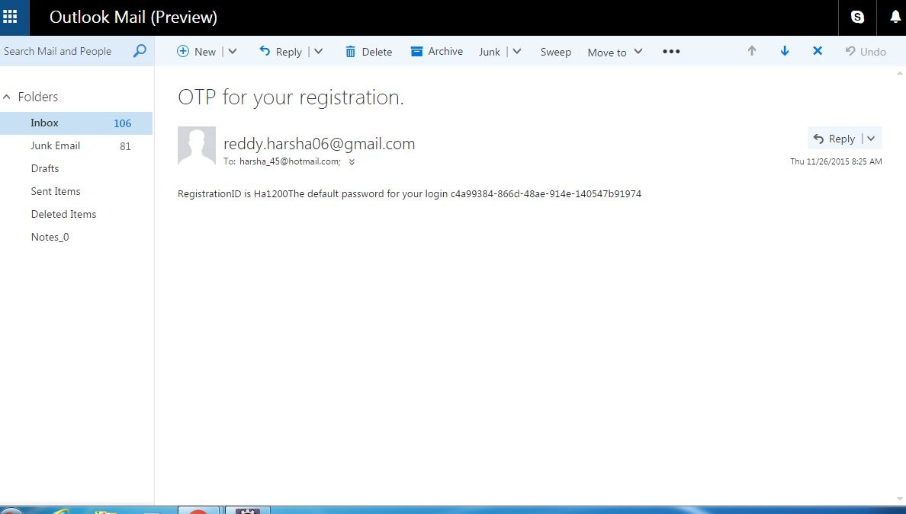
OTP GENERATED FOR ALL NEW USERS
A unique one time password is sent to the registered e-mail id each time a new user registers in the XYZ SEA TRAVELS LTD. Website.
OTP GENERATED BY ADMIN

Slide 18
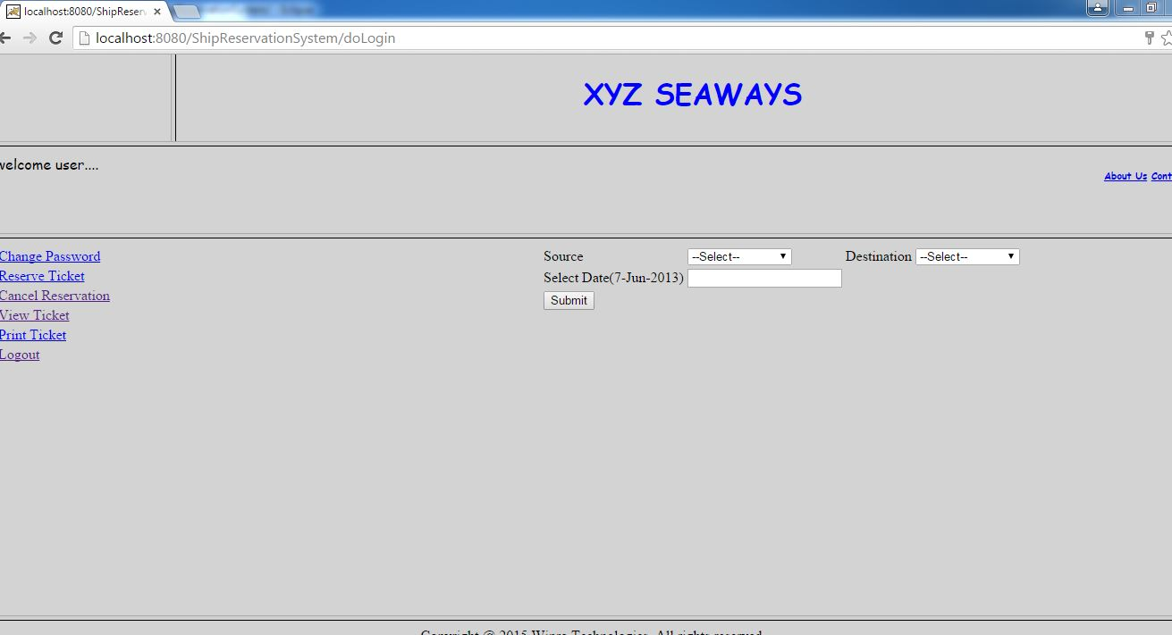
CUSTOMER HOMEPAGE

Slide 19
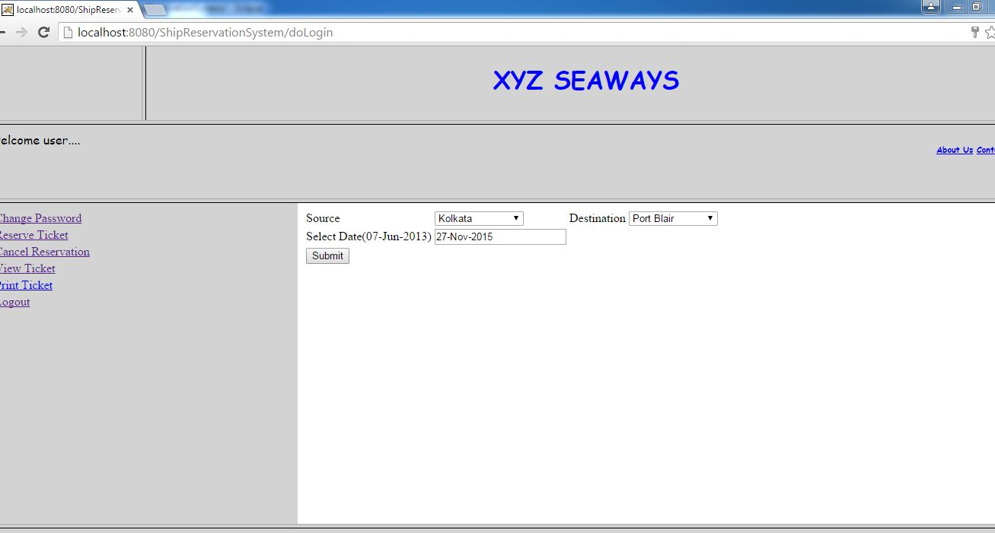
MAKE RESERVATION
MAKING RESERVATION

Slide 20
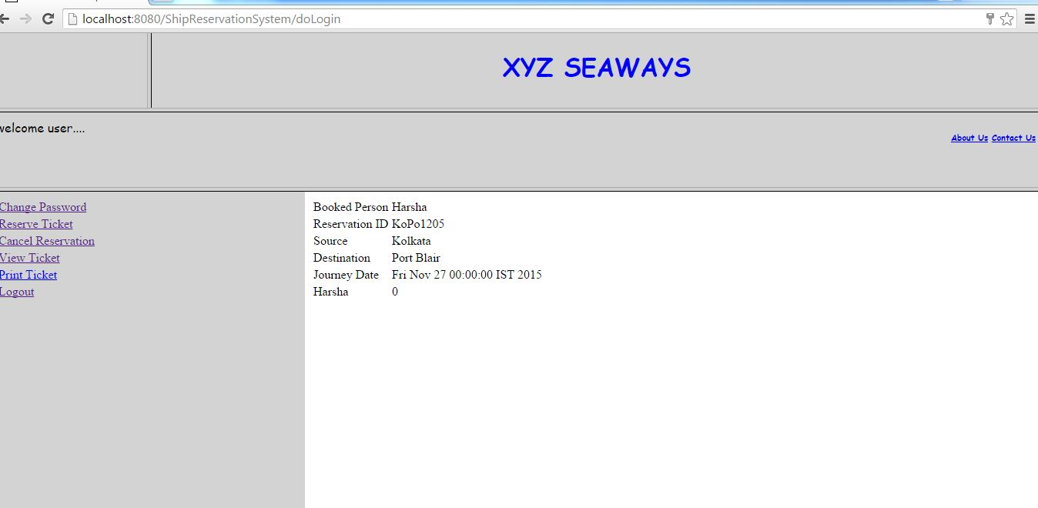
VIEW TICKET

Slide 21
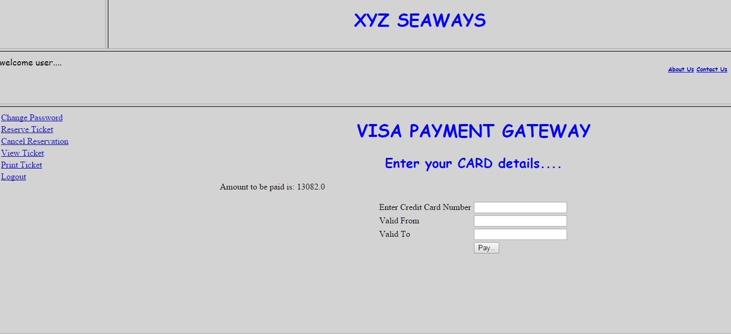
MAKE PAYMENT

Slide 22
e-TICKET
The tickets will be sent to the customer via e-mail on the registered e-mail id.
No Paper- Save Trees.

Slide 23
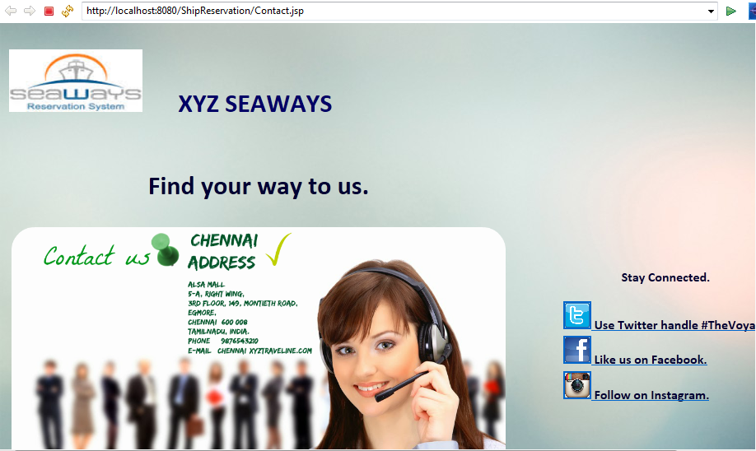
CONTACT US

Slide 24
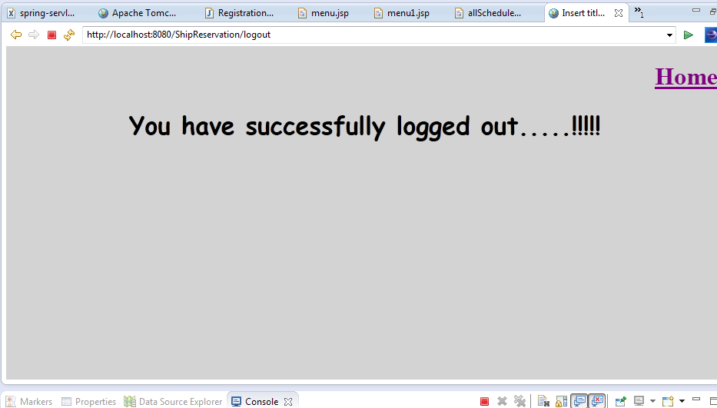
LOGOUT

Slide 25


