Slide 1
In class – Connected Components
Apoorva Jain

Slide 2
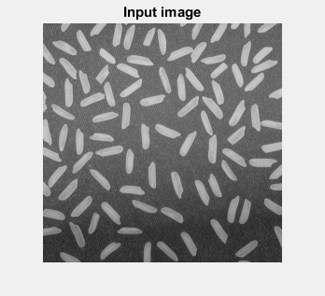

Slide 3
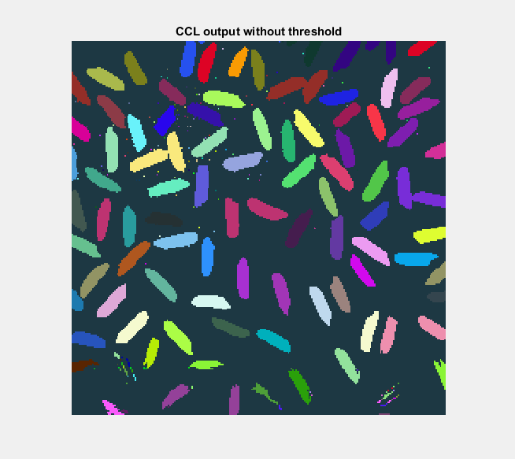

Slide 4
