Slide 1
Contour
Apoorva

Slide 2
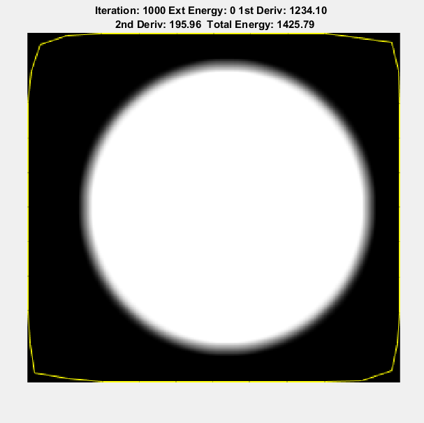

Slide 3
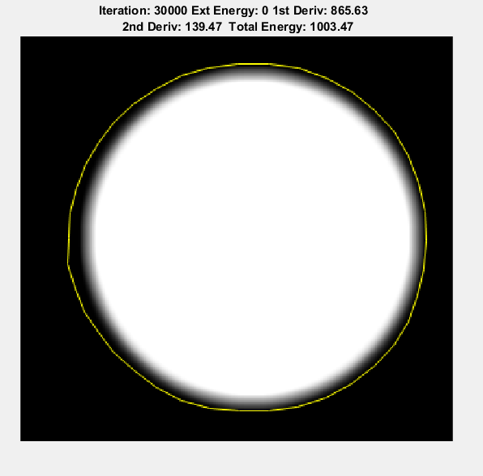

Slide 4
