Slide 1
Inclass
Apoorva Jain
800904863

Slide 2
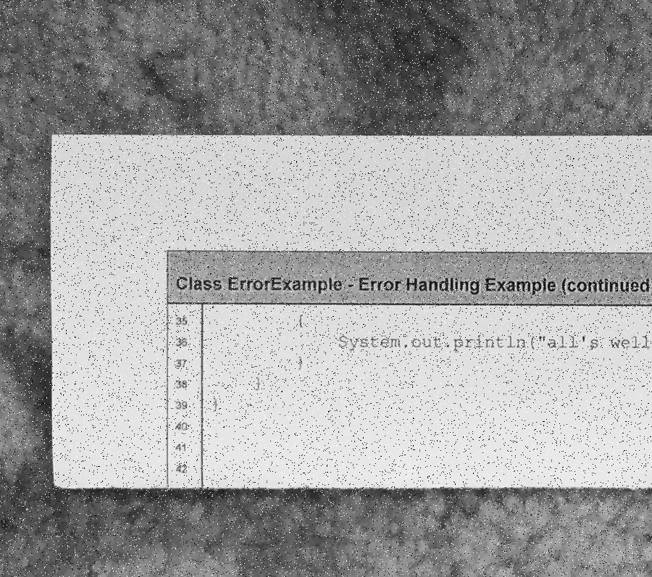
Input

Slide 3

3x3

Slide 4
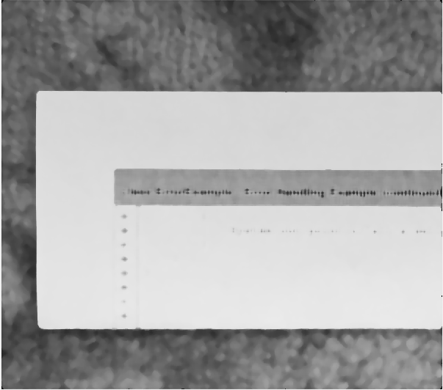
11x11

Slide 5

31x31

Slide 6
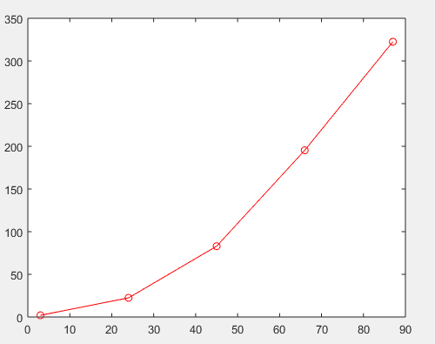
Plot

