Slide 1
IMAGE SEGMENTATION OF PePPER
APOORVA JAIN
800904863

Slide 2
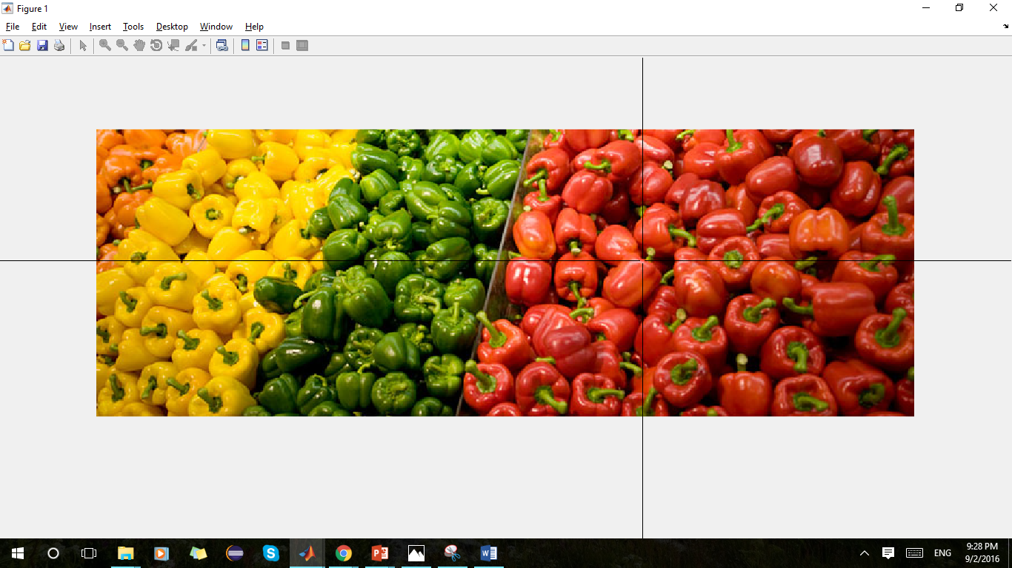
Actual image

Slide 3
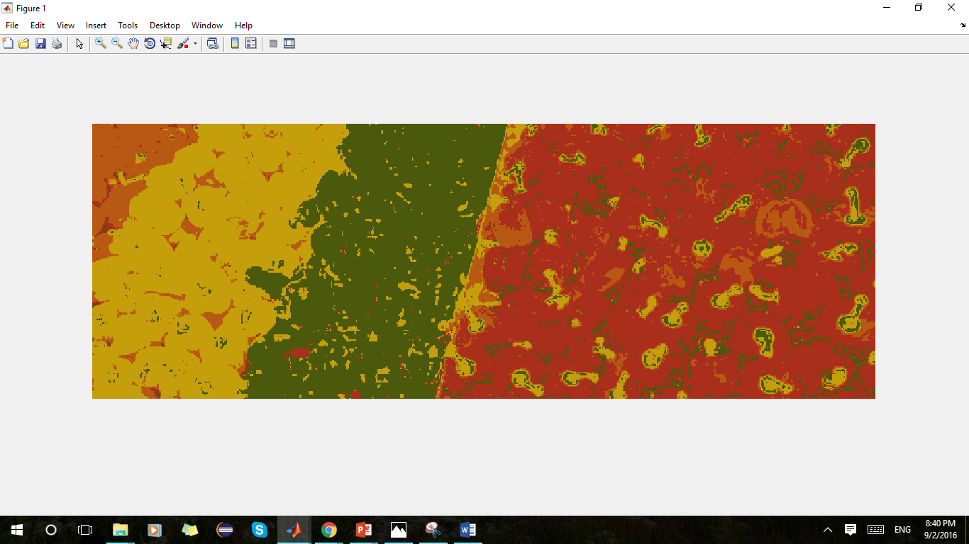
N = 1

Slide 4

N = 5

Slide 5
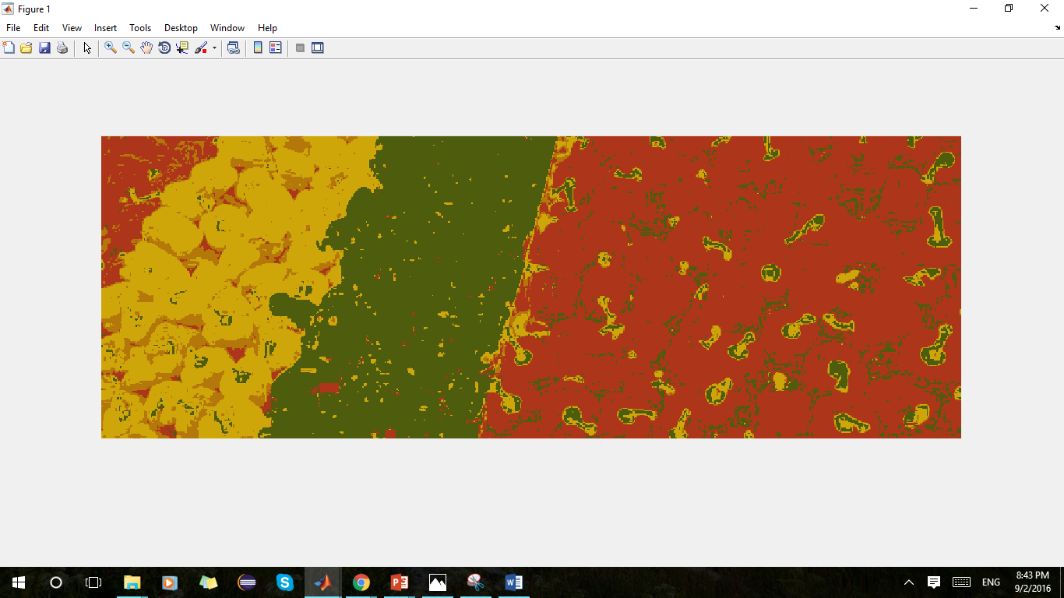
N = 10

Slide 6
Segmentation accuracy vs N
Greater the value of N, the boundary between each color becomes significant and close to real one, hence increase in accuracy
With the increase in N, within each color the shape of the object becomes distinguished, hence increase in accuracy
If the area is significantly small, and the user input is large (like orange pepper) the output deviates from the original color, hence decrease in accuracy in terms of color
With the large N, it also captures the shades of object like yellow shade, the blackish part and the green top in red pepper i.e. detailing of object increases and balances the output.
If the input point is the same for all N, it results in decreased accuracy

