Slide 1
In class Texture
Apoorva Jain

Slide 2
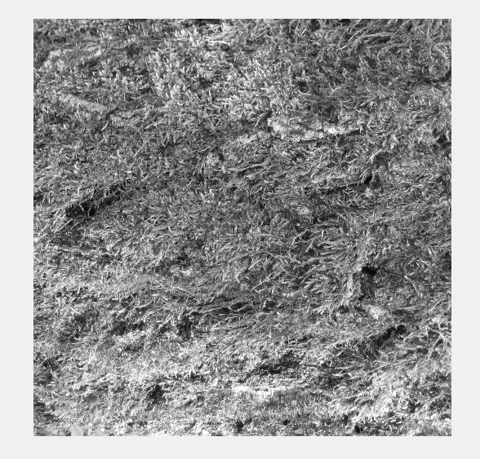
Bark1.png

Slide 3
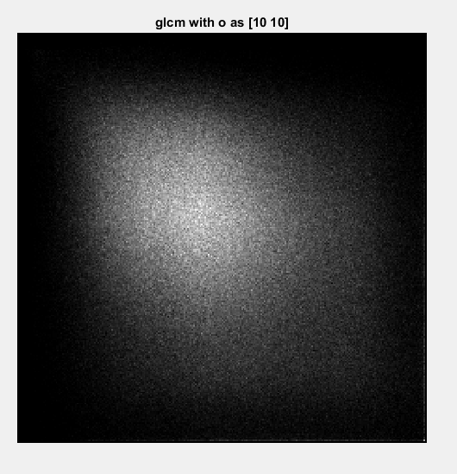
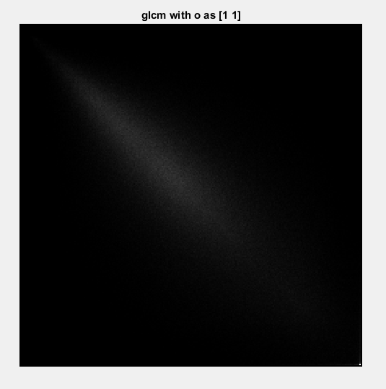

Slide 4
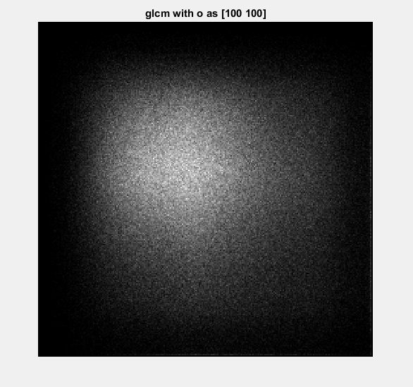

Slide 5
Accuracy
8.08

