Slide 1
Expense Manager
1: Needfinding
Team Akhil, Apoorva, Asmika, Shubham

Slide 2
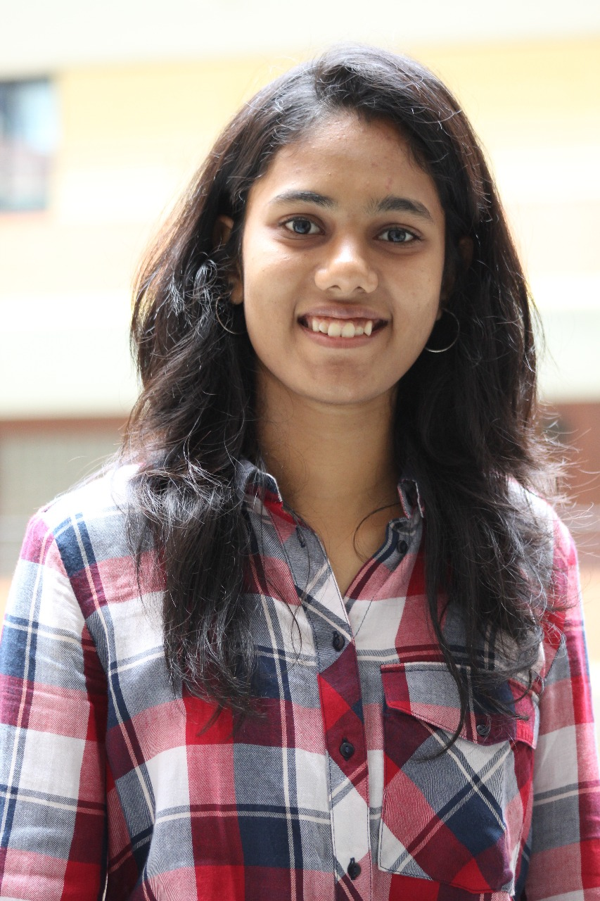
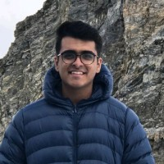
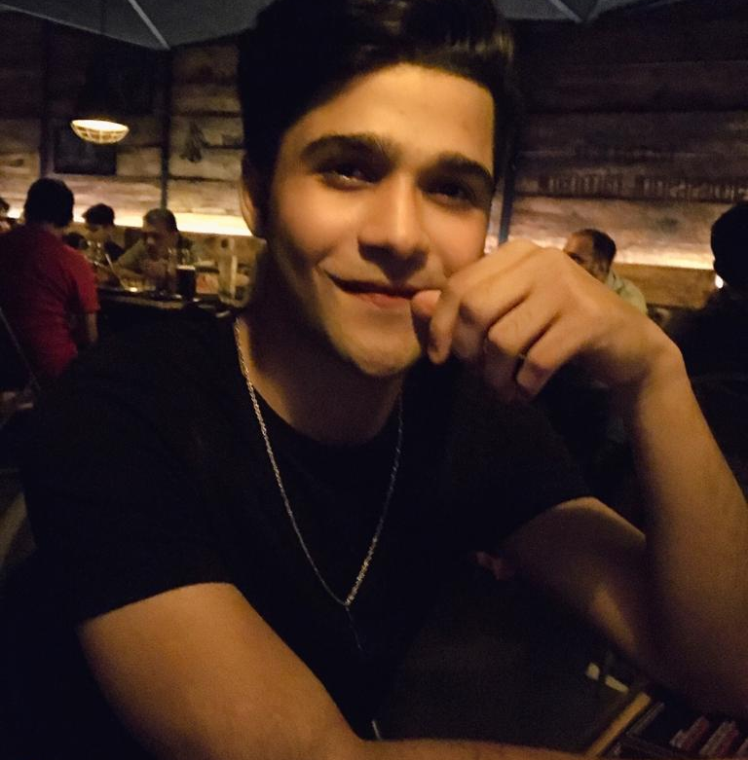
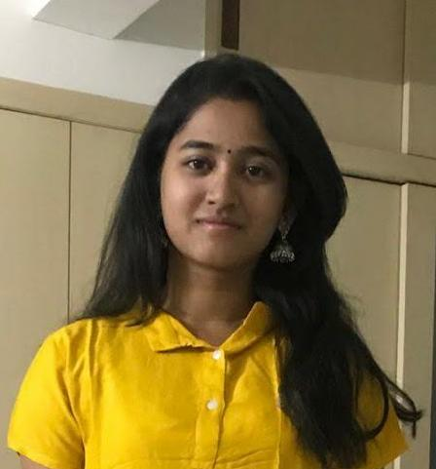
Our Team
Apoorva Choudhary
Akhil Khubchandani
Asmika Bellal
Shubham Kumar
Problem Domain: Money expenditure

Slide 3

Needfinding Methodology
1
A closer look at our participants

Slide 4

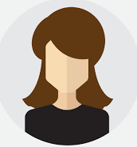
Interviewee Overview
Grad student who likes to spend money but not in a reckless fashion
A grad student majoring in computer science in Bangalore who spends most of the day in college or commuting
Notes:
Our interviewees

Slide 5

An engineer in a software company juggling life and work.

Slide 6
Questions
Take me through the average weekday/weekend of money expenditure
Have you ever tried to change your behavior surrounding your expenses?
1
How do you feel about spending your money?
2
What is expenditure to you?
3
4
Notes:
We decided to recruit while considering device usage mainly, and secondly, considering age. Two our of our interviewees were digital minimalists, and conscious of device usage. Two other interviewees were on the other end of the spectrum, spending 12-16 hours on phones or computers daily. Our interviewees ranged in age from 12 - 27 years old.

Slide 7
Interview Results
2
What our participants showed us

Slide 8
Interviewee 1: Richa
Grad student
"Changing behaviour will only make a marginal difference, the bare minimum expense remains same.”
“ I don't like to spend any money but some expenses cannot be ignored. ”
" Expenditure is the careful and efficient way of spending one's money."
Notes:
Alwyn, a graduated Stanford student who works for a startup and has to spend most of his day on his phone and computer

Slide 9

Interviewee 2: Vaibhav
Engineer currently working in a company
“Month ends are sometimes tough situations to handle”
“Average weekday expense is around Rs. 150”
“ Expenditure to me is that i am earning.”

Slide 10

Interviewee 3: Akshaya
Grad student
“On an average weekday: Rs.150 - Food/travel
On an average weekend : Rs.350- Lunch/shopping”
“Not that great when I spend it on unflattering things like travel. However, I don't mind spending it on food/clothing”
“ Spending money in a way that makes it worth it and not guilty in retrospect”
Notes:
Aria, a junior at Harvey Mudd, at home over quarantine
Jumped hard into digital minimalism in the last month

Slide 11
Analysis
3
Tensions, contradictions, surprises in the interview

Slide 12
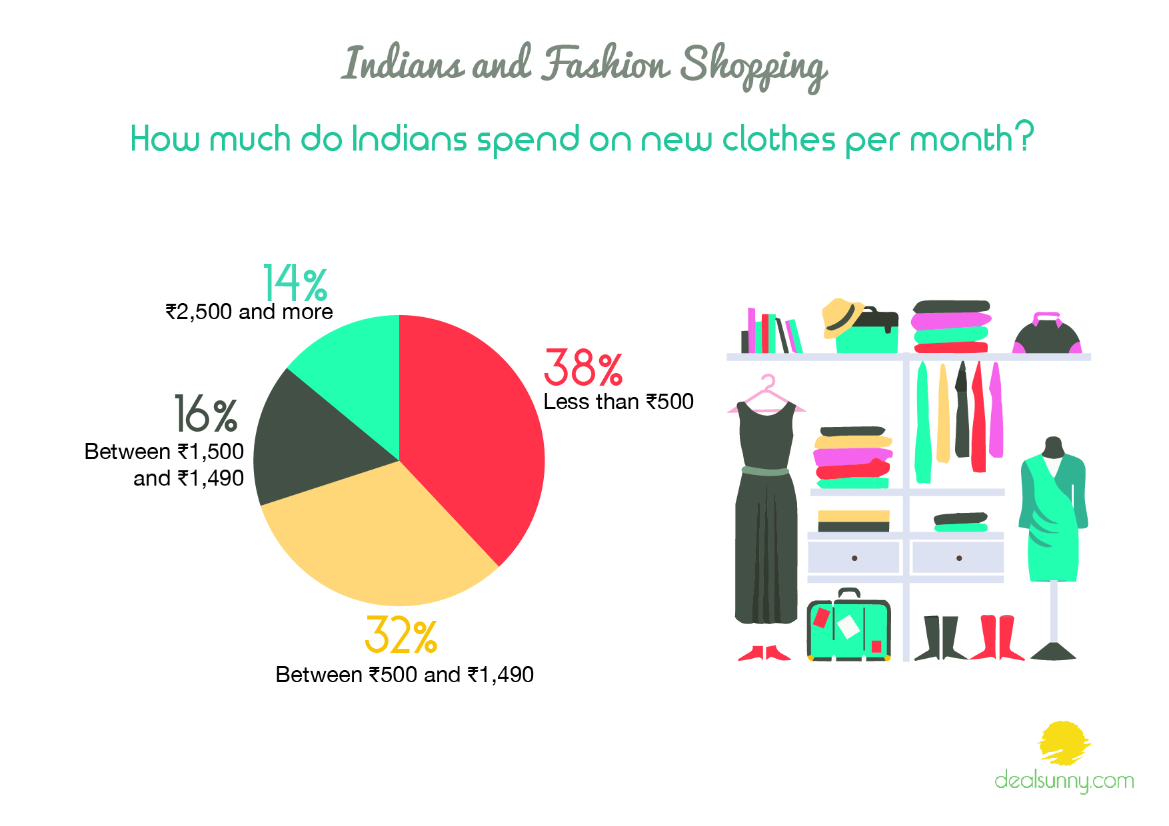
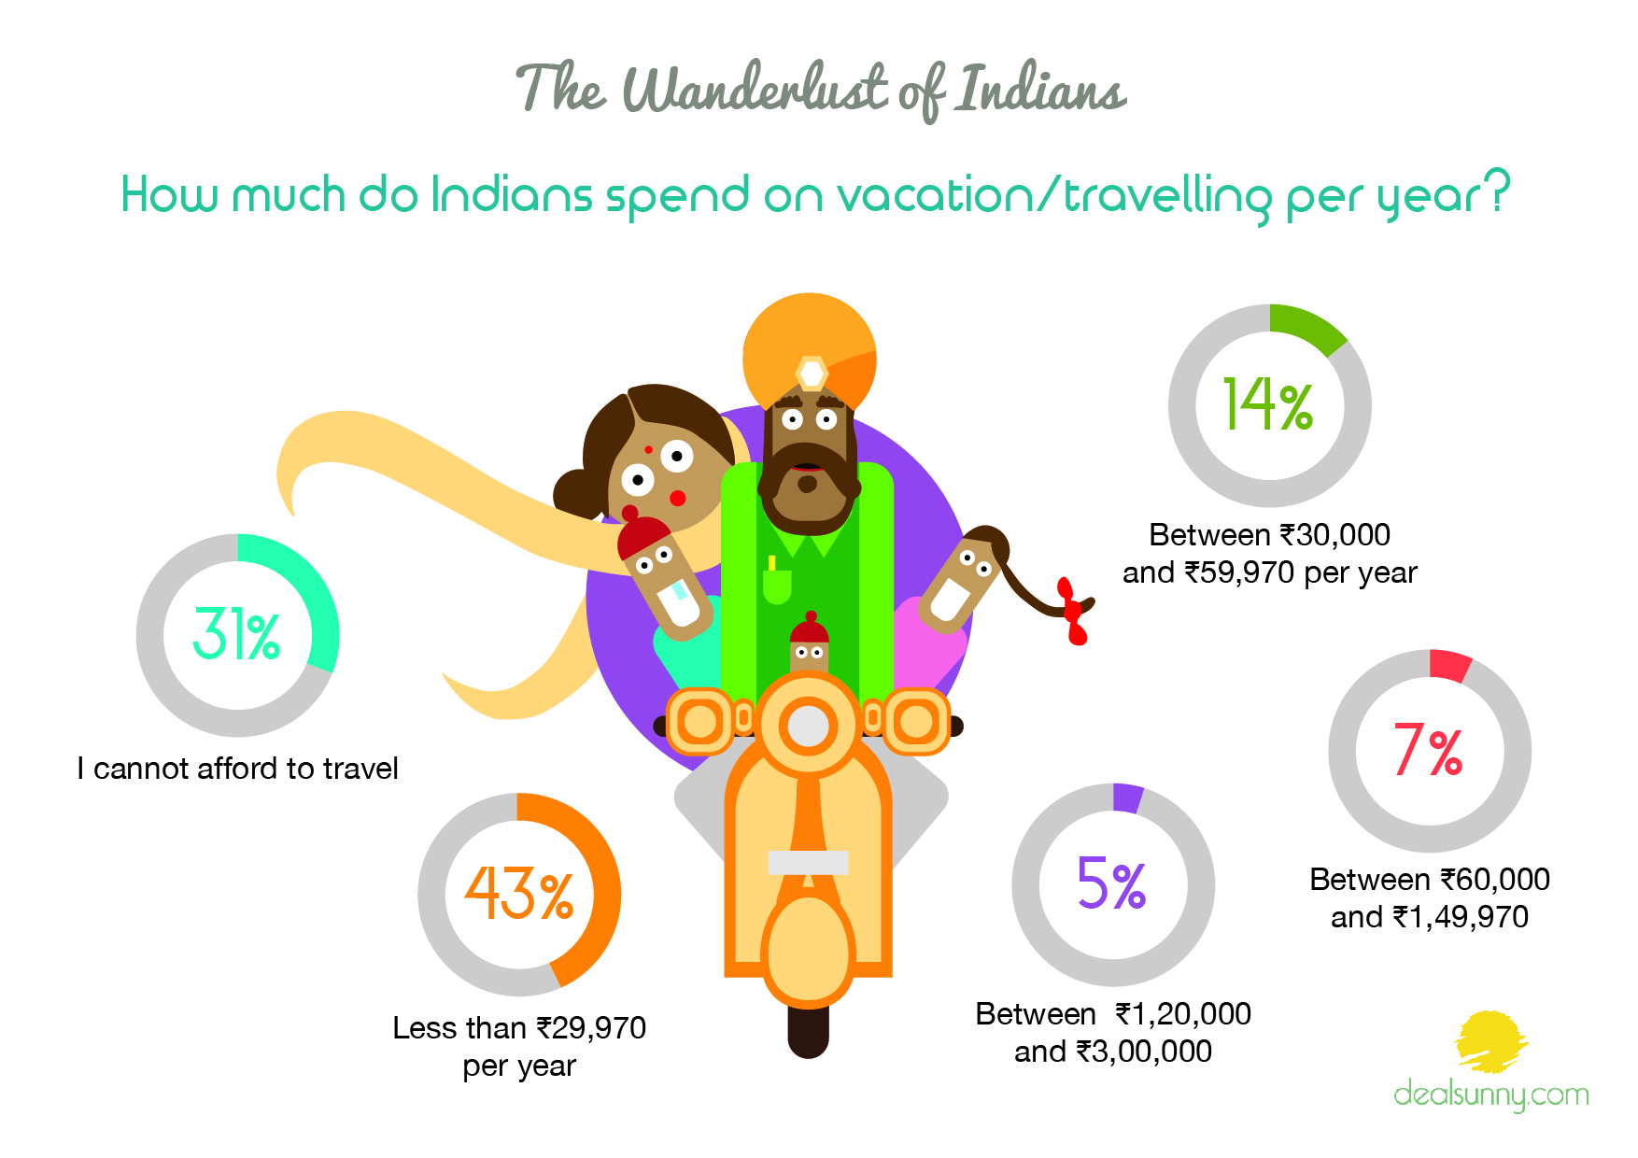
Data taken from a website indicating the range of expenditure on few domains for the Indian population.

Slide 13
Self-justification
Insight: People are concerned with justifying their expenditure choices to themselves and to others.
Need: Spending money with a sense of agency and reasoning without feeling guilty.

Slide 14
Special occasion
Insight: Birthdays, anniversaries, etc are occasions where people tend to spend money mindlessly.
Need: Creating better budgets for occasions like these and spending judiciously on them.

Slide 15
Aimless Spending
"I don’t feel a need to change the time I spend on tiktok because it doesn’t get in the way of other things I’d do." - Nuala, 13
“There’s nothing I can do about things being online, but it feels like my sister’s life has been put on hold for a year, and she’s spending 50 hours a week on her phone...Some of the stuff she sees on tiktok is crazy.” - Gaby, 21, Nuala’s sister
Insight: People,specially teenagers, spend on stuff without keeping track of their expenditure and thus, end up broke a lot of times.
Need: A log to keep track of when, where and on what, the amount was spent on.
Notes:
There’s a tension between younger generations who don’t feel like they’re missing out on anything by spending all their time online, and older family members who are worried about the amount of screentime and the type of content popular online.

Slide 16
Shopping Addiction
“I’ve tried to reach out [to friends] whenever something reminded me of someone, so that it would be organic.”
- Gaby, 21
“Eating meals with friends was important screen-free social time for me, but that’s hard now because of COVID.”
- Alwyn, 23
Insight: Compulsive shoppers who buy things they do not need and cannot afford.
Needs: Investing in things/products which have a positive long term effect rather than for momentary satisfaction.

Slide 17
Summary
Improved Justifications
Budget for Special Occasions
Maintaining log of expenses
Shopping only if required

Slide 18
Thank you!

