Slide 1



From:
Apoorva H M

Slide 2

In New York City, taxicabs come in two varieties: yellow and green; they are widely recognizable symbols of the city.
There are more than 13,000 taxis operating in the city, as well as more than 40,000 other for-hire vehicles. Taxicabs are operated by private companies and licensed by the Taxi and Limousine Commission (TLC), a New York City government agency.
Yellow cabs are concentrated in the borough of Manhattan, but can be hailed anywhere throughout the five boroughs of New York City and may be hailed with a raised hand or by standing at a taxi stand.

Slide 3

A cab's availability is indicated by the lights on the top of the car. When just the center light showing the medallion number is lit, the cab is empty and available. When the OFF DUTY inscriptions to either side of the medallion number are lit, the cab is off duty and not accepting passengers.
In 2015, the TLC recorded 7 million trips in the 541 wheelchair-accessible vehicles, up from 6 million in the previous year.

Slide 4

Trip Distance can’t be negative or zero.
Pickup longitude and latitude can’t be zero and can’t be outside New-York.
Drop-off longitude and latitude can’t be zero.
How much No. of trip having drop-up outside the New-York?
People in New-York prefer short distance or long distance trip (>30 miles) ?
Which is the Pickup and Drop-off Location preferred most?
Which pickup and drop-off location is mostly used for short distance trip?
Which pickup and drop-off location is mostly used for long distance trip?

Slide 5


Trip distance cannot be negative or zero.
This is considered as an error or an invalid entry.
Thus, out of 77080575 entries, 463178 trips are invalid.

Slide 6

Yellow trip has permission to pickup only in New York.
None of the region can have longitude or latitude zero.
In the data, we found 1326401 trip records having longitude and latitude zero or there are outside New-York.
New York longitude and latitude :
  min_lat = 40.5774 and max_lat = 40.9176
  min_long = -74.15 and max_long = -73.7004

Slide 7
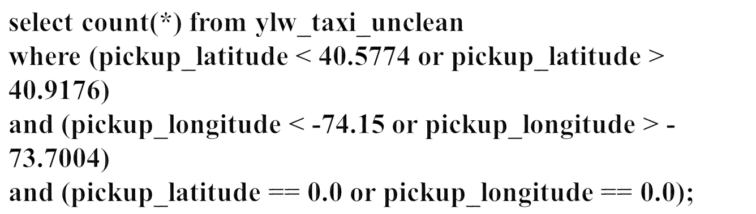
Query :

Slide 8

None of the regions can have longitude and latitude zero.
If the Drop-off longitude and latitude is having 0 value then that entry is considered as invalid.
In the data, we found 1285964 trip records having longitude and latitude zero.

Slide 9

Query :

Slide 10
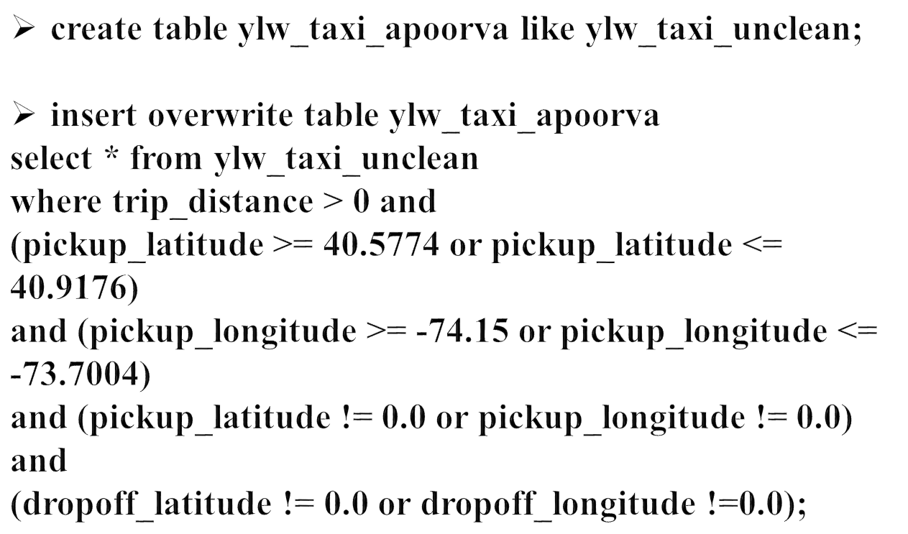
Query for Pre-Processing Data :

Slide 11

The longitude or latitude value is not in the range of New York, then it means trip’s drop is outside New York.
8363 trips have drop-off outside New York.
Range of New York is :
  min_lat = 40.5774 and max_lat = 40.9176
  min_long = -74.15 and max_long = -73.7004

Slide 12
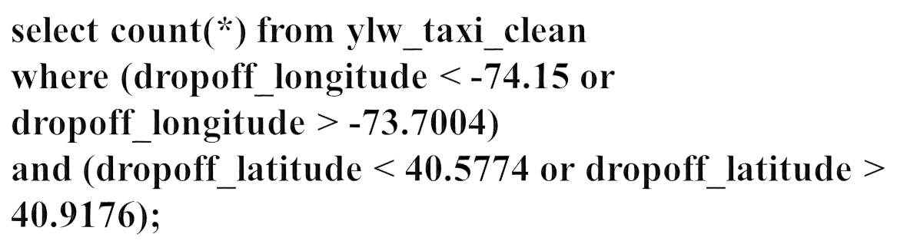
Query :

Slide 13

Here, we have binned the trip_distance columns into two categories as short and long distance trip.
Long distance trip means trip_distance columns having value greater than 30 miles.
From the data, we can say that most of people in new-York are preferring short distance trip.
76593117 trips are short distance trip and the rest, 24280 trips are long distance trip.

Slide 14
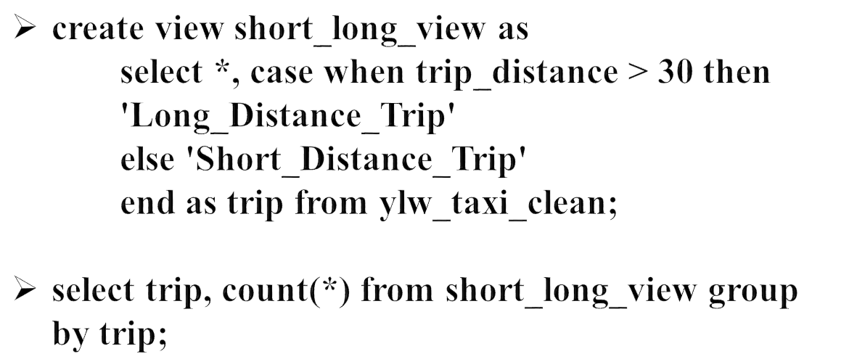
Query :

Slide 15
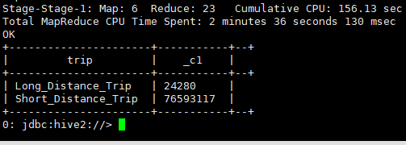
Output :

Slide 16

After analyzing the data, it is inferred that (-74.1863021850586, 40.69314193725586), (-73.94863891601562, 40.74489974975586), (-73.99268341064453, 40.72050094604492) locations are most preferable for pickups.
After analyzing the data, it is inferred that (-74.1863021850586, 40.69314193725586), (-73.94863891601562, 40.74489974975586), (-73.99268341064453, 40.72050094604492) locations are most preferable for drop-offs.

Slide 17




Query :

Slide 18
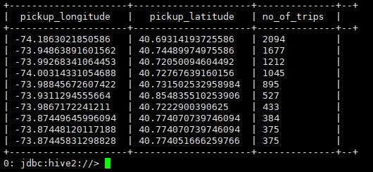
Output for Pickup :

Slide 19
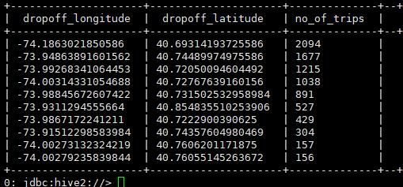
Output for Drop-off :

Slide 20

From the output, it is quiet evident that the most of the trips were within the New-York city range.
Therefore, the places from pickups and drop-offs are same.
As passengers tends to have round trips during weekdays.

Slide 21


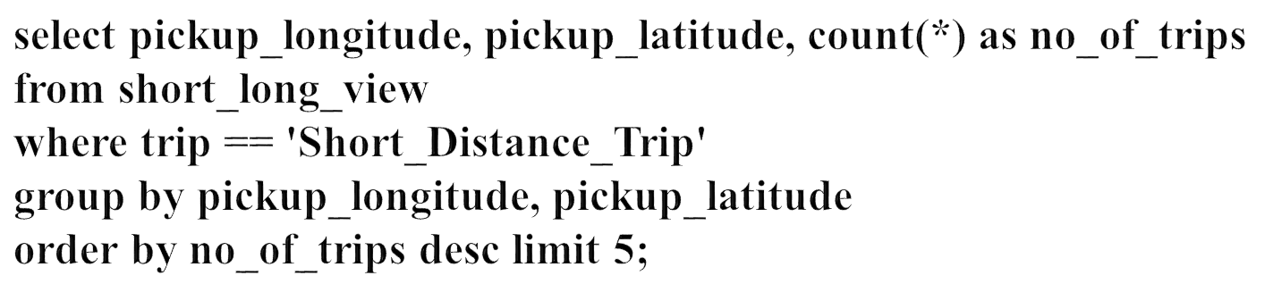

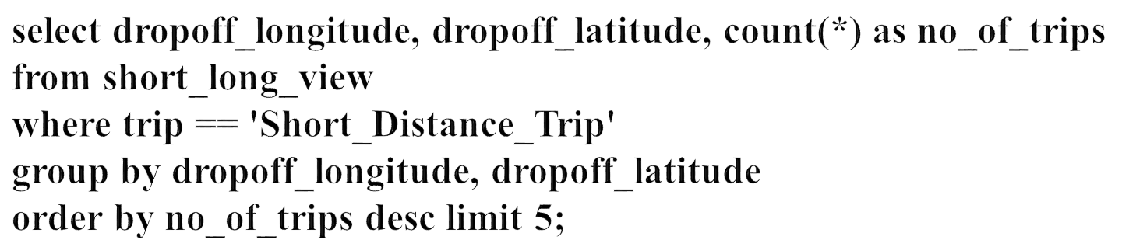

Slide 22
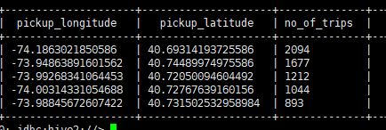

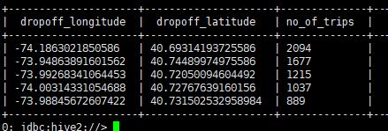

Output :

Slide 23

I can inferred from the output that, long trips are supposed to be weekend get a ways or some other official meeting which are outside the New-York.
It is possible that, long distance trip people are bound to go outside the city and trips are not round trips.

Slide 24


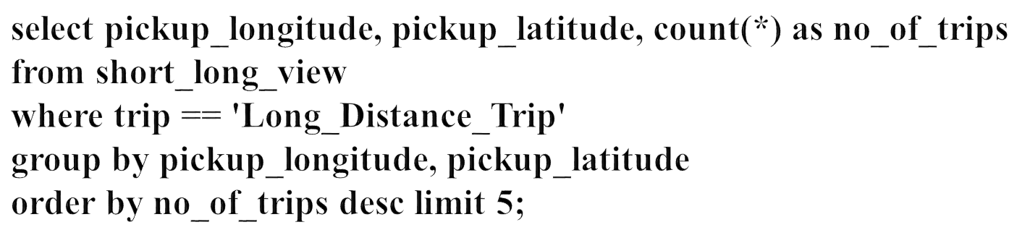

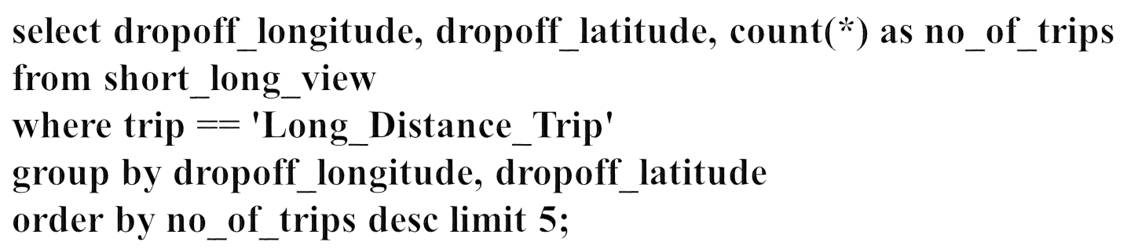

Slide 25

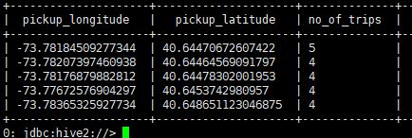

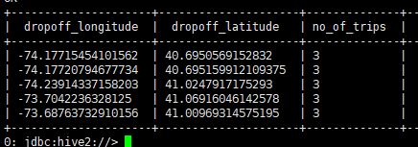


Slide 26

https://en.wikipedia.org/wiki/Taxicabs_of_New_York_City
https://www.yellowcabnyctaxi.com/
https://www.tripsavvy.com/dos-and-donts-of-nyc-cabs-443008
https://www.kaggle.com/kartikkannapur/nyc-taxi-trips-exploratory-data-analysis
https://www.appliedaicourse.com/wp-content/uploads/2017/09/NYCYellowTaxiPickupDensity.html
https://chih-ling-hsu.github.io/2018/05/14/NYC

Slide 27


