Slide 1

RESUME BUILDER APPLICATION
Submitted to: Submitted By :
Mr. Pankaj Dhadeech Aditi Gupta(12ESKCS006)
Apoorva Jain(12ESKCS019)
Kanika Bakshi(12ESKCS059)
Kratika Jain(12ESKCS061)
Department of Computer Science
Swami Keshavanand Institute of Technology,
Management & Gramothan,Jaipur

Slide 2
CONTENTS
Introduction
Java Server Pages
Java
MySQL
Apache server
Eclipse
Java Script
System requirments
Project description
Advantages
Snapshots

Slide 3
INTRODUCTION
This application is used for automating the process or resume writing. This would be facilitating the employees to make and print their resumes in a proper format. In addition , it will be facilitating the higher management to search the employees depending upon their skills sets and other attributes. The basic requirement is to have a centralized repository of all the skill holders in the organization so that an employee with a particular skill set can be immediately found in case of urgent requirement.

Slide 4
JSP(java server pages)
Java Server Pages (JSP) is a server-side programming technology that enables the creation of dynamic, platform-independent method for building Web-based applications.
The JSP pages are easier to maintain than servlet because we can separate designing and development.
A JSP container works with the Web server to provide the runtime environment and other services a JSP needs .Jsp allows java code and ertain predefined actions to be interleave with static web markup content,such as HTML with the resulting page being compiled and executed on the server t deliver a document. Jsps are usually used to eliver HTML and XML documents,but through the se of outputstream,they can deliver other types of data as well.

Slide 5
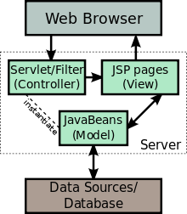

Slide 6
Java
Java is a general purpose, high-level programming language developed by Sun Microsystems
Java was originally called OAK, and was designed for handheld devices and set-top boxes. Java is a set of computer software and specifications developed by SUN micro system that provides a system for developing application software and deploying it in a cross platform computing environment .
The java platform is a suite of programs that facilitate developing and running programs written in java programming language. The platform is not specific to any one processor or operating system rather an execution engine and a compiler with a set of libraries are implemented for various hardware and operating systems

Slide 7
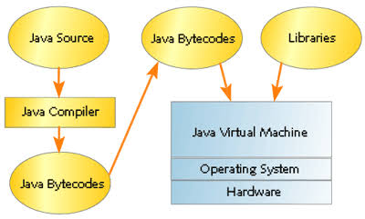

Slide 8
MySQL
MySQL handles a large subset of the functionality of the most expensive and powerful database packages.
Mysql is a popular choice of database for use in web applications and is a central component of widely used LAMP open source web application software stack
Free software open source projects that require a full featured database management system often use Mysql
On all platforms except windows, Mysql ships with no GUI tools to administer Mysql database or manage data contained within the databases

Slide 9
Apache Server
It is an open source web server developed by apache group
Apache is the servlet container that is used in implementation for the java servlet and java server pages technologies
Web servers like Apache tomcat support only web components
To develop a web application with jsp/servlet installs any web server like JRun, Tomcat etc. to run your application.
The apache HTTP server is the world’s most used web server software

Slide 10
Eclipse
Java Eclipse is an open source project that brings together programmers of many different languages
Via a Java plugin system, it allows programmers in various languages such as Java, C, C + +, Perl, Python, PHP to collaborate with the minimum of difficulty.
Eclipse is a powerful cross platform development tool based on Java.
Automate error reporting that allows eclipse users to report errors directly to eclipse projects

Slide 11
System Requirements
Hardware Requirements:
Intel i3 processor
1 GB RAM or higher
100 GB HDD or higher
Software Requirements:
Microsoft Windows-8/7
Database-MySQL
Backend-Apache Tomcat Server
Browser-Mozilla/Chrome

Slide 12
Project Description
It is an application that simplifies the task of creating a resume for individuals. The system is flexible to be used and reduces the need of thinking and designing an appropriate resume according to qualifications. The system is developed to provide an easy means for creating a professional looking resume. Individuals just have to fill up a form that specifies questions from all required fields such as personal questions, educational, qualities, interest, skills and so on. The answers provided by the users are stored and the system automatically generates a well structured resume. Users have option to create resume in any format and file.

Slide 13
ADVANTAGES
Provides instant resume to individuals.
There are choices available for resume format for users as per their qualification and requirements.
Reduces tedious work in thinking and creating resume and is convenient for users.
Provides quick access and is affordable.
The system saves time and reduces human efforts.
Sometime user wants customized resume that is not possible in the system.

Slide 14
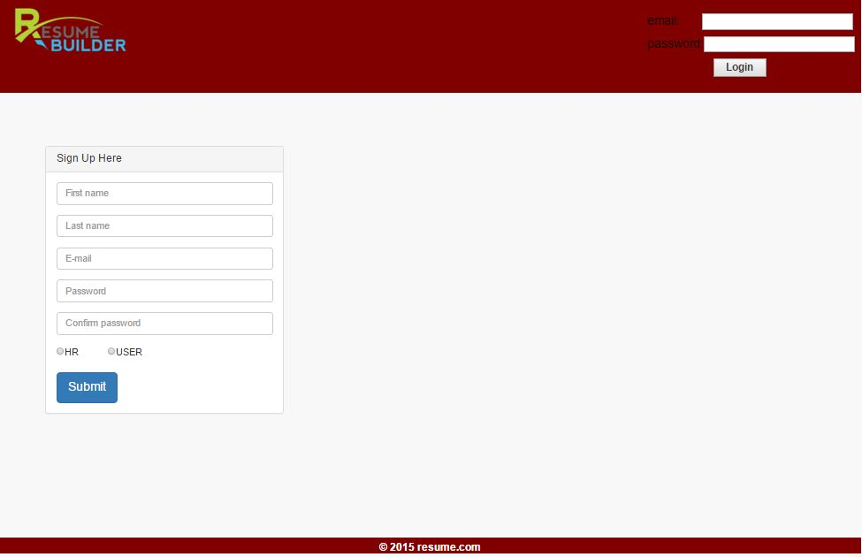
SNAPSHOTS

Slide 15
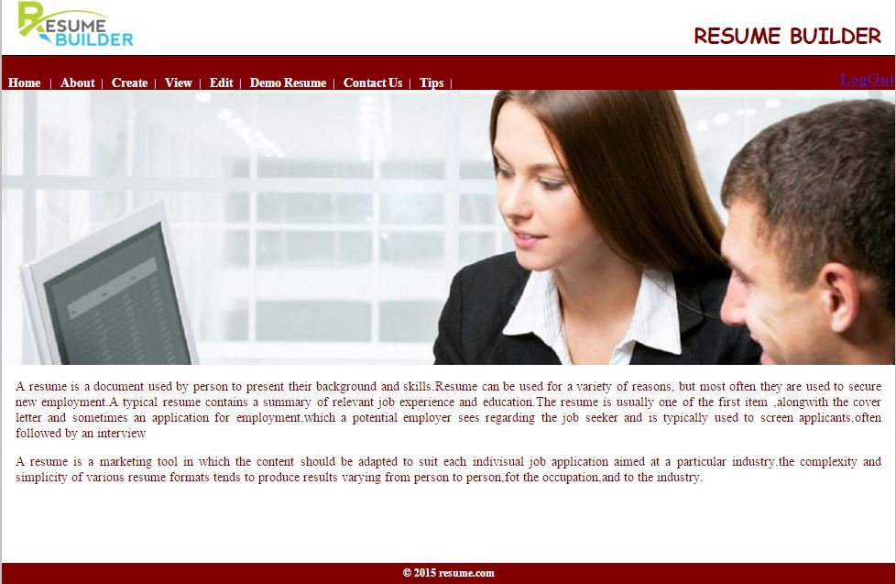

Slide 16
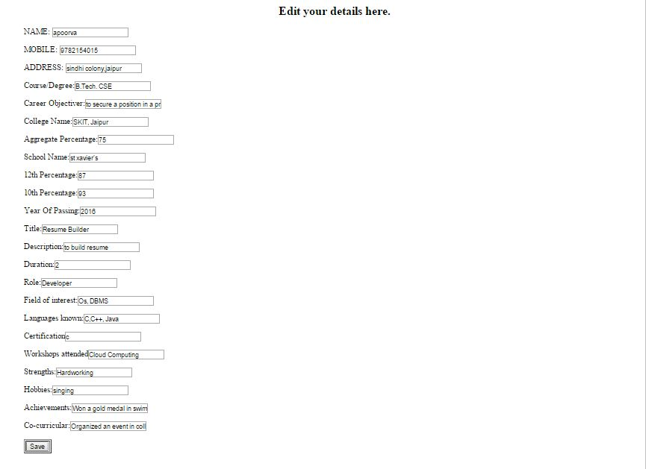

Slide 17
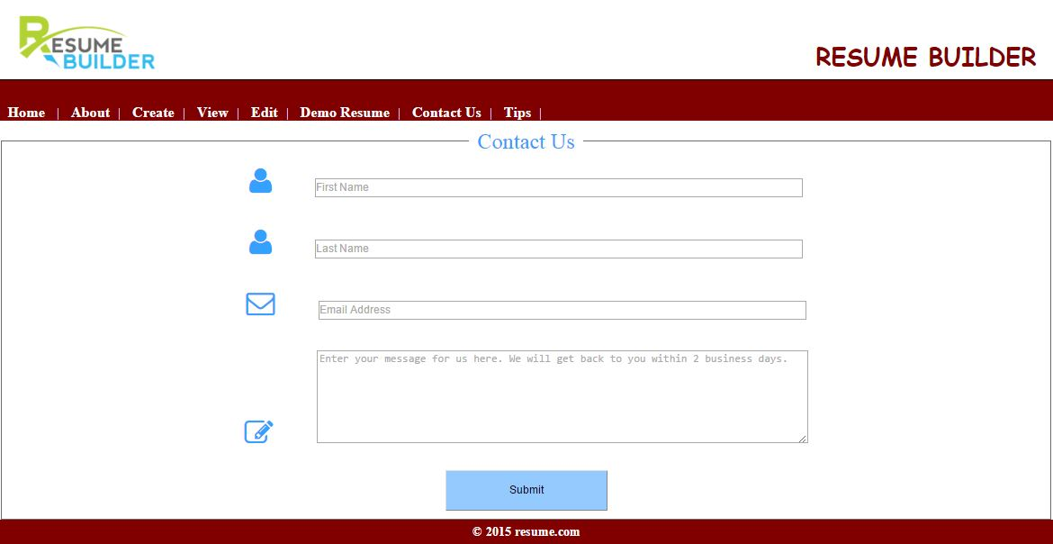

Slide 18
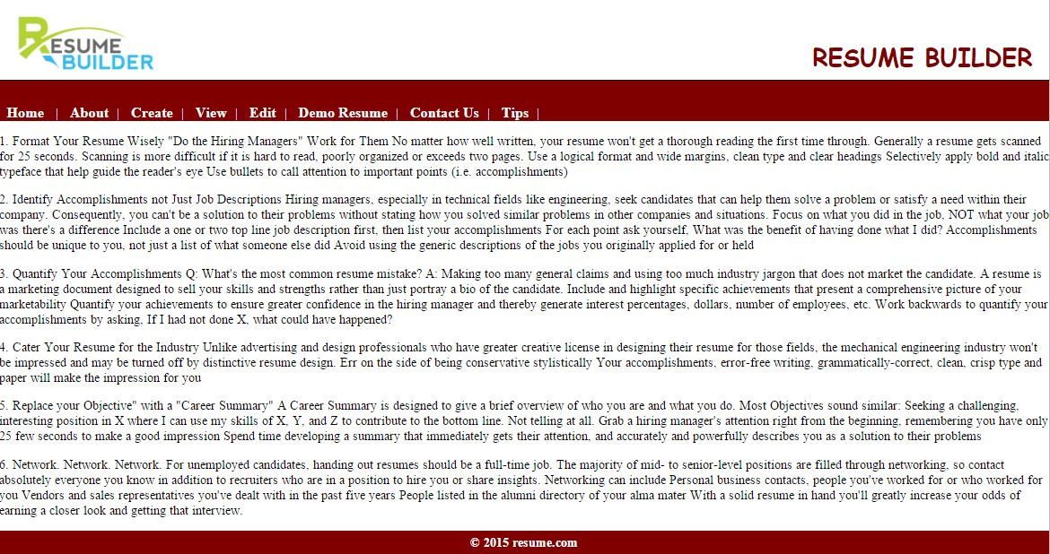

Slide 19


