Slide 1

Invoice2Go
Invoice and Billing Platform

Slide 2


Agenda
Problem Statement | 3
Proposed Solution | 4
Demo | 6
Technologies Used | 8
Feasibility | 9
Impact | 10
USP | 11

Slide 3
Problem Statement
Government universities need a reliable and efficient platform to manage financial transactions such as tuition fees, research grants, and vendor payments. The existing platform built on Ionic, while functional, faces limitations in performance, user experience, and scalability.

Slide 4




Proposed Solution
To address the challenge of porting the Invoice and Billing Platform for Government Universities from Ionic to React Native, our solution focuses on maintaining feature parity while enhancing performance, user experience, and maintainability. The proposed solution will have the following features:
Analyze Transition and Port Key Functionalities
The Ionic codebase will be carefully analyzed, and a modular architecture will be designed in React Native. This approach will ensure a clean separation of concerns, making the codebase more maintainable and scalable. Each UI component in Ionic will be mapped to its equivalent in React Native, leveraging React Native's component-based architecture to achieve a more native-like experience.
Responsive Mobile UI/UX
By leveraging React Native’s capabilities, the platform will offer a more responsive and intuitive user experience, with smoother animations and native-like performance across both iOS and Android devices.
Performance Optimization
Through careful optimization of assets and resources, we will significantly reduce load times, providing a faster and more responsive user experience. Any existing APIs will be optimized for faster response times and better handling of large data volumes.
Multi-Currency & Tax Compliance
The platform will be enhanced to support multi-currency invoicing and ensure compliance with local tax regulations, with automated updates to tax rates as required. We will incorporate localization features to handle different languages, currencies, and tax rules seamlessly.

Slide 5
Enhanced User Roles , Access Control and Security Enhancements
The existing Role-Based Access Control system will be ported to React Native with optimizations for better performance and scalability. This includes using React Native's state management libraries (e.g., Redux or Context API) to manage user roles and permissions efficiently. Advanced security protocols will be integrated to ensure secure authentication and authorization, complying with industry standards. A robust authentication system, including multi-factor authentication (MFA), will be integrated to safeguard user accounts.
Optimized Invoice Management
The invoice creation, tracking, and management features will be transitioned to React Native, focusing on enhancing user experience through smoother UI transitions and more intuitive interactions. By utilizing React Native’s native modules, we will optimize the handling of multiple line items, taxes, discounts, and notes to improve performance, particularly in processing large datasets.
Vendor Management System
The vendor management system will be migrated to React Native, with a focus on improving the vendor interface for easier submission of invoices and better management of contracts and payment terms. The system will be optimized for handling large volumes of vendor data efficiently.
ERP Integration
The integration with university ERP systems will be rebuilt in React Native, ensuring seamless synchronization of payment, budget, and expenditure data. We will leverage React Native’s native bridging capabilities to maintain robust and efficient communication with existing ERP systems.
Approval Workflows
The existing multi-tier approval workflows will be ported to React Native, ensuring that they align with university policies. We will enhance the workflow engine to provide more responsive and reliable approval processes. The approval process UI will be redesigned to offer a more intuitive and responsive experience for users on both iOS and Android.

Slide 6

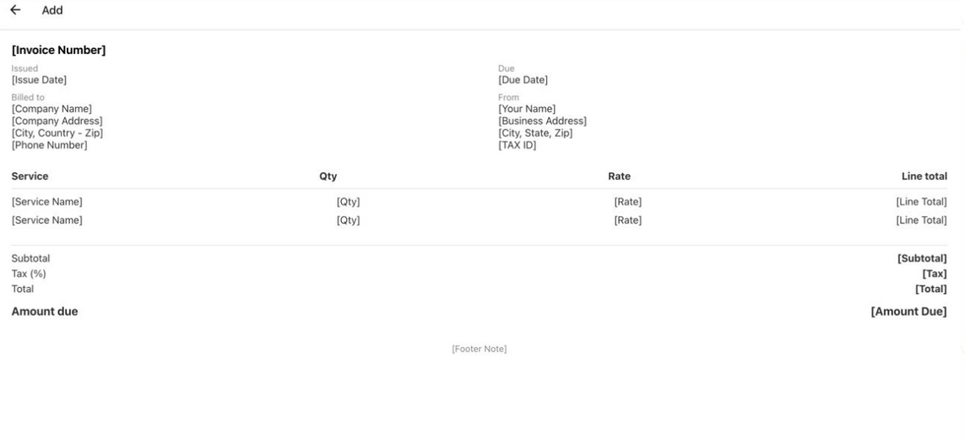
Demo

Slide 7
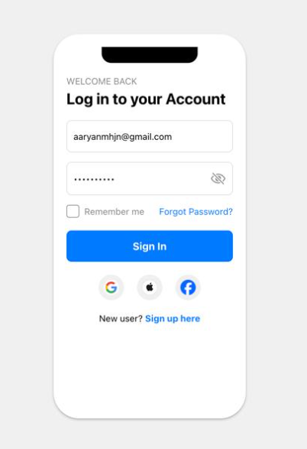
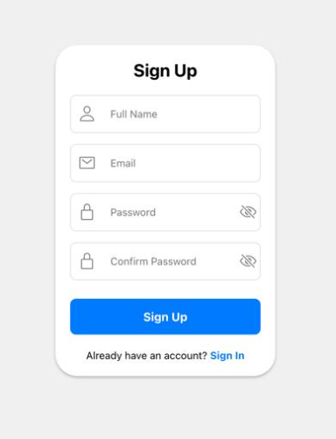
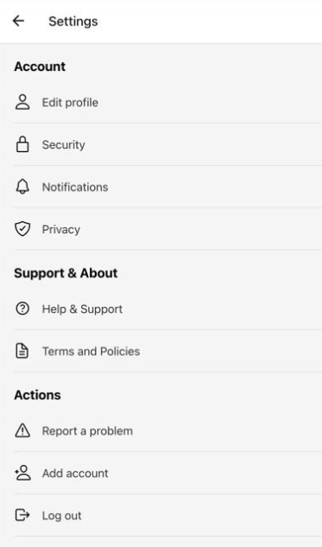

Slide 8

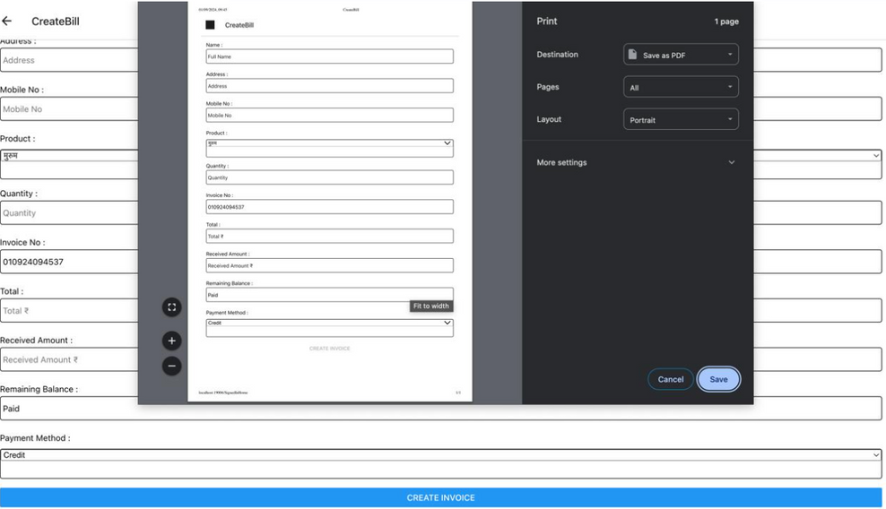
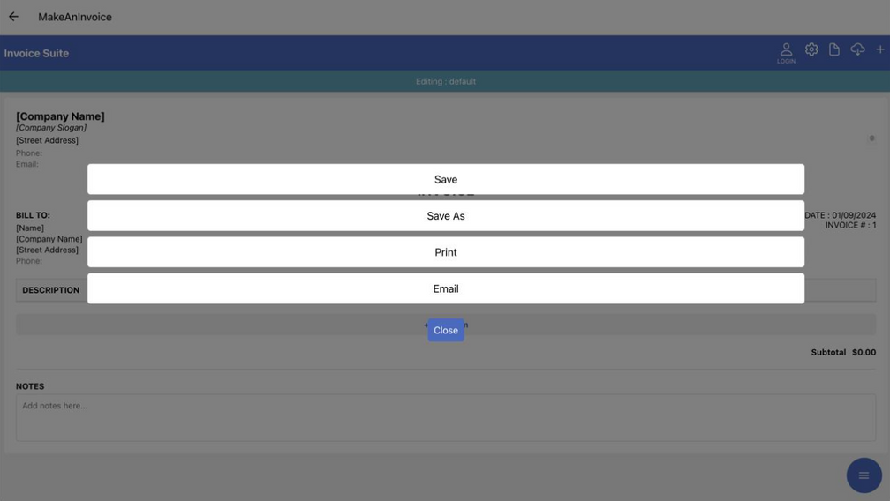
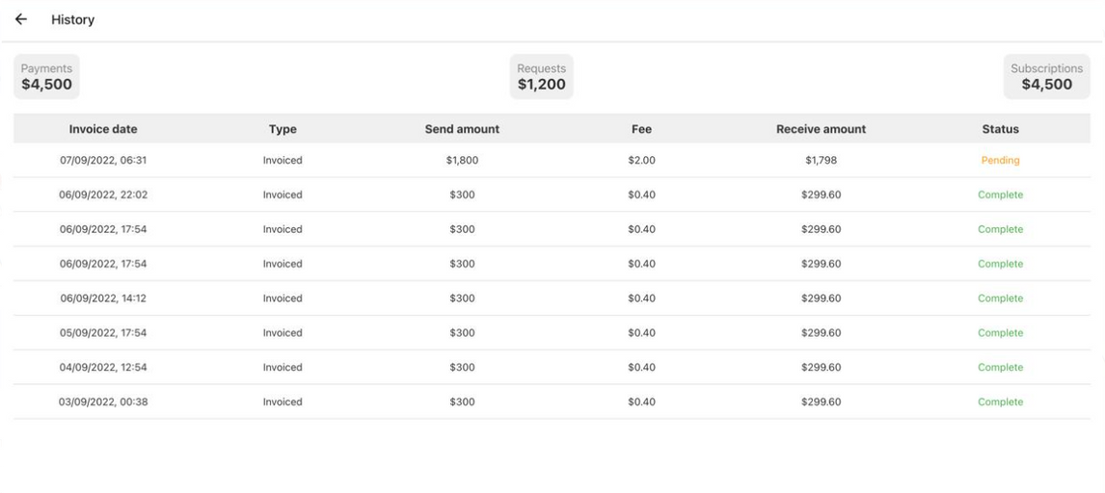

Slide 9







Technologies Used

Slide 10
FEASIBILITY
Technical Maturity
React Native is a mature and widely adopted framework with a vast ecosystem of libraries and tools, ensuring that all necessary features can be efficiently ported and maintained.
Resource Availability
Existing development resources familiar with JavaScript and React can transition to React Native with minimal upskilling, making the project highly feasible.
Cost Efficiency
React Native allows for a single codebase across both iOS and Android, reducing development time and cost compared to maintaining separate native applications.
Modular Codebase
React Native's component-based architecture aligns well with the modular design of the existing platform, making the transition smoother.

Slide 11
IMPACT
Enhanced User Experience
The transition to React Native will significantly improve the user interface and experience, leading to higher user satisfaction and engagement.
Performance Boost
React Native offers better performance than Ionic, especially in handling complex interactions and animations, leading to faster load times and smoother transitions.
Streamlined Operations
Better integration with ERP systems and offline functionality will streamline university operations, reducing administrative burdens and errors.
Future-Ready
The platform will be better equipped to integrate future technologies and features, keeping the university’s financial management systems up-to-date.

Slide 12
USP
Native Performance with Web Flexibility
The project uniquely combines the performance of native apps with the flexibility of web-based frameworks, offering the best of both worlds.
Cross-Platform Efficiency
A single codebase that runs efficiently across both iOS and Android without compromising on the native look and feel, unlike the current Ionic-based solution.
Comprehensive Security
Enhanced security features like data encryption and secure authentication cater specifically to the sensitive financial data managed by universities, making it a robust choice for educational institutions.
Customization and Flexibility
The modular nature of the React Native codebase allows for easy customization and expansion, making the platform adaptable to the specific needs of different universities.

Slide 13
THANK YOU

