Slide 1


SMART INDIA HACKATHON 2024
TITLE PAGE
Problem Statement ID – 1675
Problem Statement Title- Software solution to identify the end receiver of a cryptocurrency transaction
Theme-Blockchain & Cybersecurity
PS Category- Software
Team ID-
Team Name- Digital Defenders

Slide 2
Multi-Layer Blockchain De-Anonymization Platform
Digital Defenders
PROPOSED SOLUTION:
The Multi-Layer Blockchain De-Anonymization Platform (MLBDP) is a cutting-edge software solution designed to trace and identify the end receivers of cryptocurrency transactions, particularly in drug trafficking cases. It employs a multi-layered approach, integrating advanced graph analysis, AI-driven behavioral pattern recognition, and cross-ledger tracing to follow the flow of funds through anonymization techniques like tumblers, mixers, and bridges. The platform offers real-time monitoring, collaborative intelligence sharing, and hypothesis testing to enhance the accuracy and effectiveness of investigations.
KEY COMPONENTS AND FLOW:
1. Data Ingestion and Preprocessing Layer
Input: Wallet addresses, transaction hashes, public blockchain data, dark web intelligence.
Process: Ingest, clean, normalize, and index data from multiple blockchains (e.g., Bitcoin, Ethereum, Monero) and third-party sources.
Output: A unified, enriched dataset ready for analysis.
2. Blockchain Network Graph Construction
Input: Unified transaction dataset.
Process: Build a directed graph where nodes represent wallets and edges represent transactions, continuously updated in real-time.
Output: A dynamic graph showing the flow of funds between wallets.

Slide 3
Digital Defenders
3. Anonymization Service Detection
Input: Transaction graph and anonymization service database.
Process: Detect and flag transactions passing through known anonymization services (tumblers, mixers, bridges) using pattern recognition algorithms.
Output: Annotated graph highlighting transactions through anonymization services.
4. Behavioral Pattern Recognition and De-Anonymization
Input: Transaction patterns and historical data.
Process: Analyze transaction behaviors using AI/ML models to identify suspicious patterns and apply de-anonymization algorithms.
Output: Re-identified wallets with unique behavioral fingerprints and potential risk scores.
5. Cross-Ledger Tracing and Analysis
Input: Transactions across multiple blockchains.
Process: Trace funds moving between different cryptocurrencies and through bridges/mixers, analyzing cross-chain activities.
Output: Comprehensive cross-ledger trace, identifying potential end receivers.
6. Real-Time Monitoring and Alerts
Input: Live transaction data.
Process: Monitor wallets and transactions in real-time, updating the graph and triggering alerts based on risk indicators.
Output: Alerts and a real-time dashboard with visualizations and notifications.
7. Collaborative Intelligence and Reporting
Input: Collaborative data from multiple agencies.
Process: Share insights, generate detailed reports with visualizations and risk scores, and provide AI-driven investigative suggestions.
Output: Detailed reports and actionable insights for legal use.
8. Simulation and Hypothesis Testing
Input: Hypothetical transaction paths and scenarios.
Process: Simulate different transaction routes, test hypotheses, and assess probabilities.
Output: Likely scenarios with confidence levels for potential fund receivers.

Slide 4
Digital Defenders
Your Team Name
INNOVATION AND UNIQUENESS:
(1)Holistic and Dynamic Integration:
The MLBDP revolutionizes the tracing of cryptocurrency transactions by merging advanced techniques—such as graph analysis, AI-driven pattern recognition, and cross-ledger tracing—into a single, adaptive platform. This unified approach ensures that the platform evolves in real-time, remaining effective against ever-changing criminal tactics.
(2)Collaborative Intelligence and Predictive Analytics: The platform fosters unprecedented cooperation among law enforcement agencies, enabling secure, real-time data sharing and collaborative investigations. It goes beyond detection by leveraging AI to predict future transactions and offer prescriptive actions, allowing agencies to proactively disrupt criminal activities.
(3)User-Centric Design with Cross-Ledger Capabilities: The MLBDP is designed with investigators in mind, providing intuitive tools for simulating transaction pathways and testing hypotheses. Its ability to trace funds across multiple blockchains addresses a significant challenge in cryptocurrency investigations, making it a groundbreaking solution for tracking elusive transactions.

Slide 5
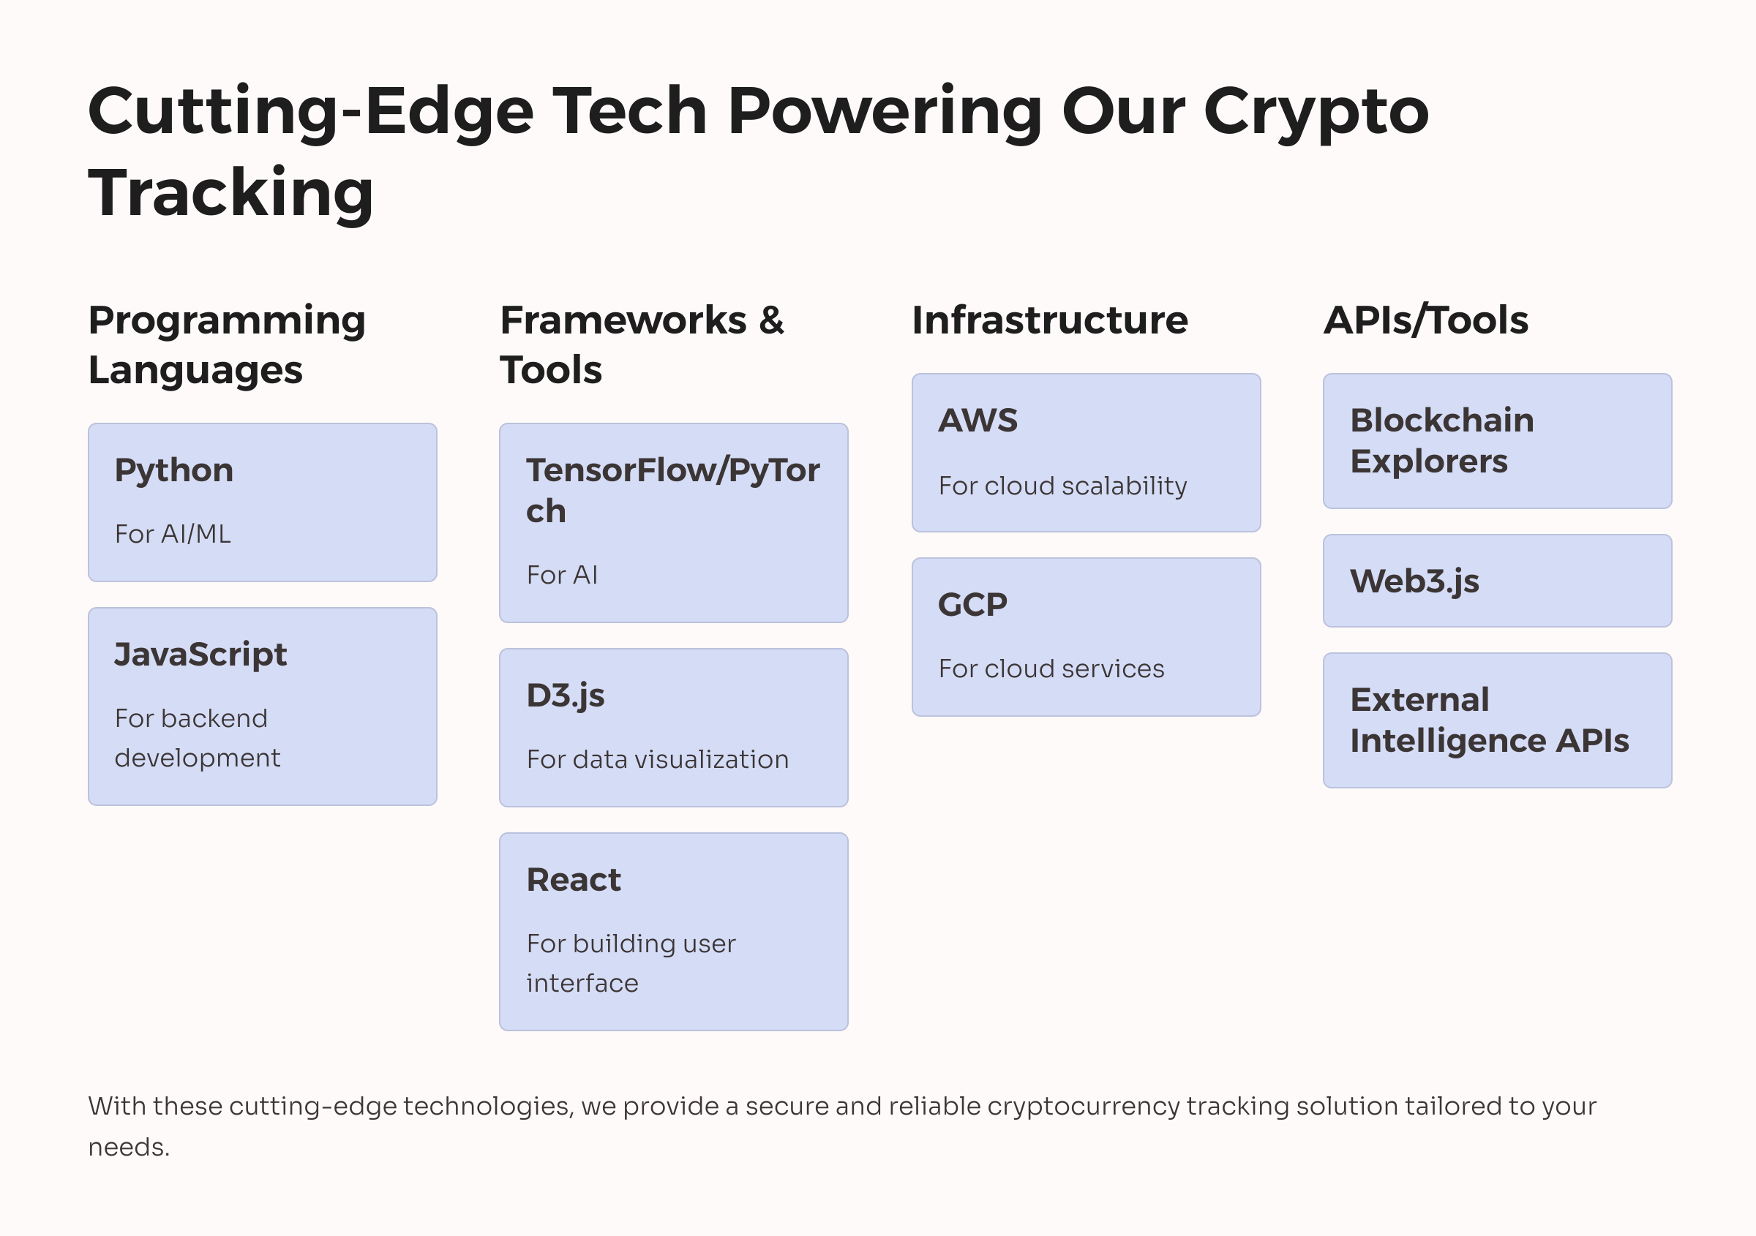
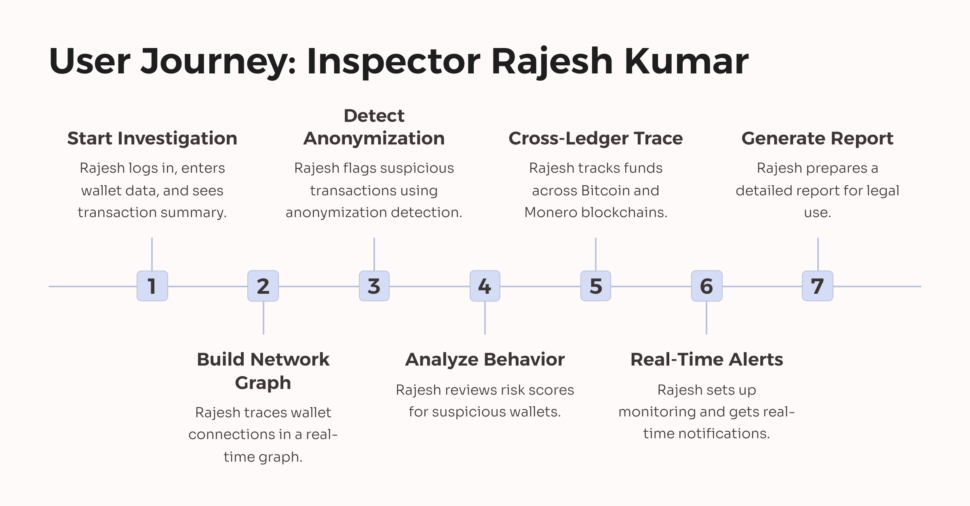
TECHNICAL APPROACH
Digital Defenders
@SIH Idea submission- Template
5

Slide 6
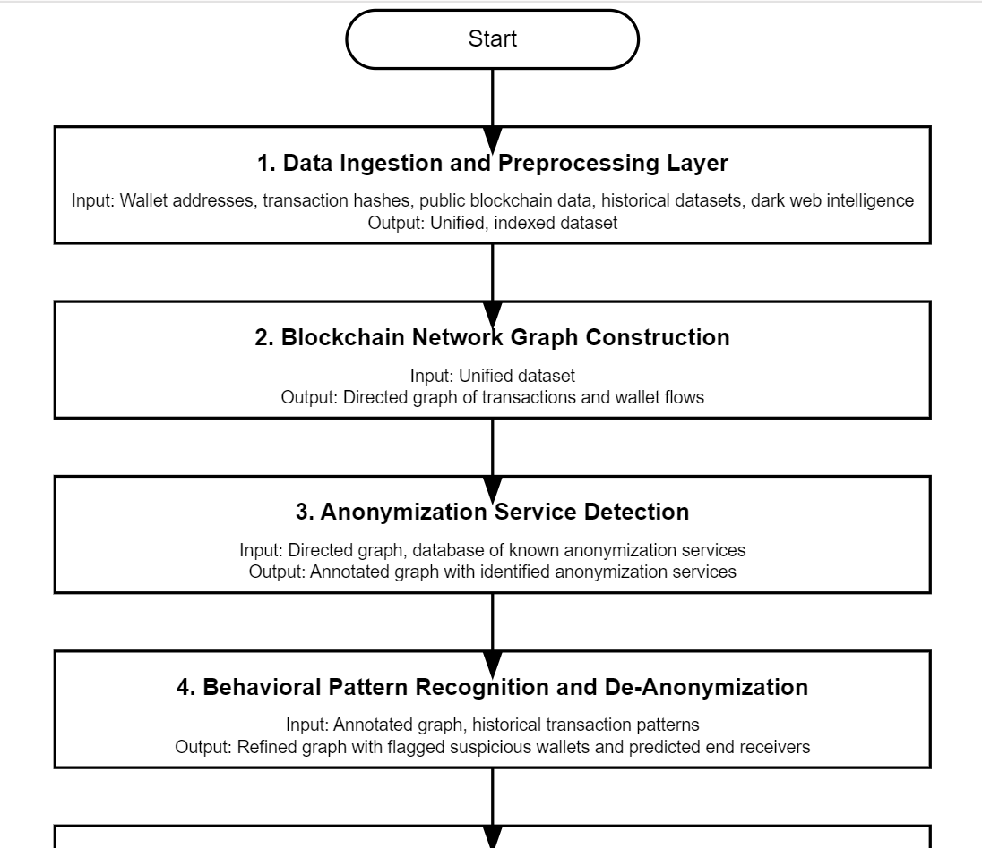
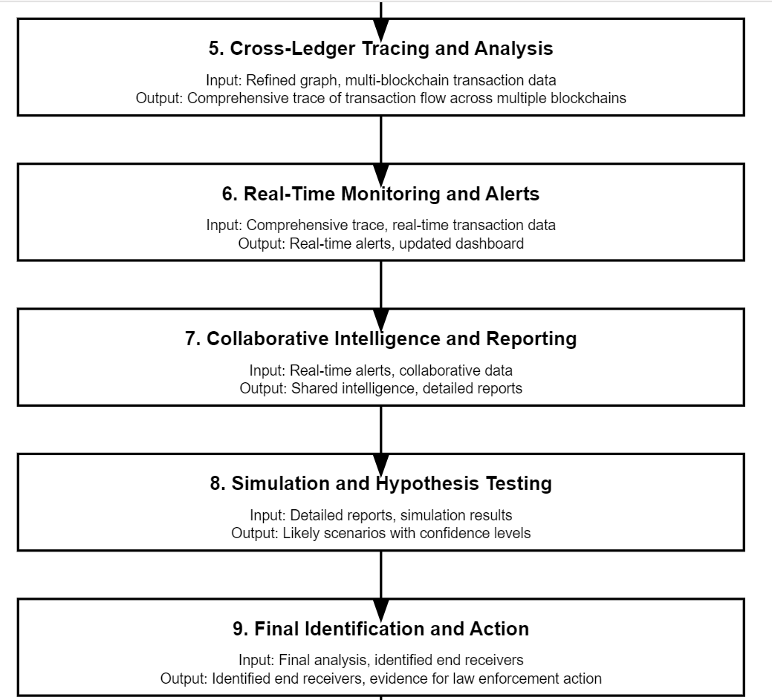
Multi-Layer Blockchain De-Anonymization Platform (MLBDP)
Digital Defenders
@SIH Idea submission- Template
6

Slide 7
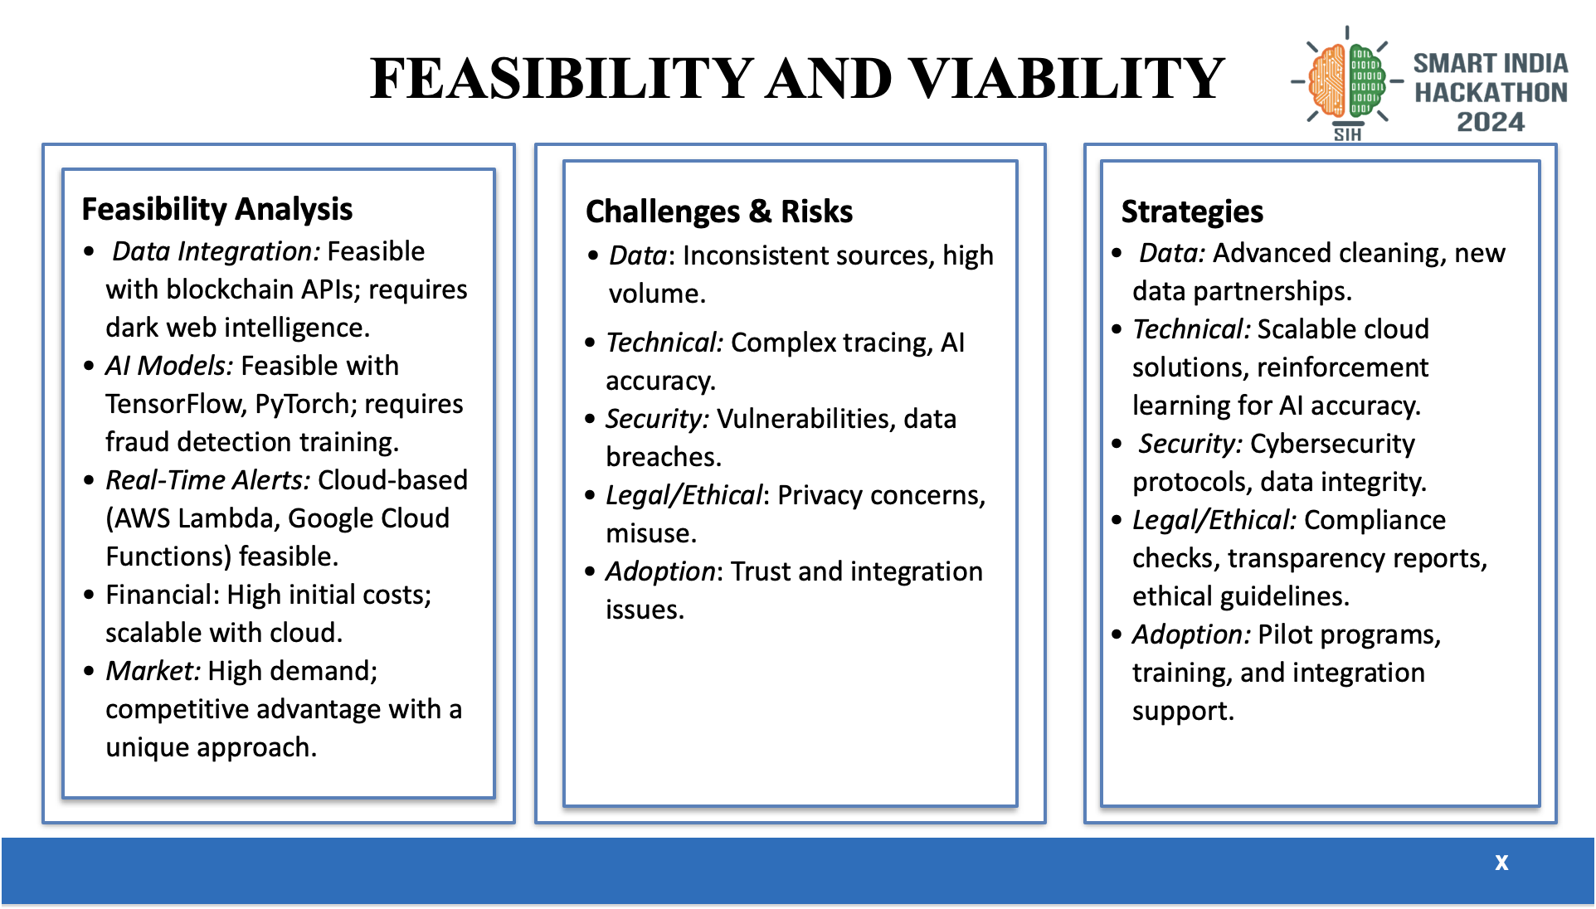

Slide 8




IMPACT AND BENEFITS
Digital Defenders
Potential Impact on target audience
Benefits of the solution
Increased Transparency: Provides clear visibility into the flow of cryptocurrency transactions, aiding in tracking and identifying end receivers.
Enhanced Security: Reduces the risk of fraud and illegal activities by enabling precise identification of transaction endpoints.
Higher Compliance: Helps meet regulatory requirements by ensuring all cryptocurrency transactions are traceable and verifiable.
Improved Trust: Builds trust among users and stakeholders by ensuring that all transactions are transparent and accountable.
Streamlined Investigations: Simplifies the process of tracking suspicious transactions, enabling quicker and more effective investigations.
Economic Benefits:
Cuts costs from fraud and compliance penalties.
Increases efficiency by automating the tracking of cryptocurrency transactions.
Social Benefits:
Enhances trust in cryptocurrency networks by ensuring secure and transparent transactions.
Supports law enforcement efforts by providing valuable tools for identifying illegal activities.
Environmental Benefits:
Reduces the need for manual transaction audits, saving time and resources.
Lower energy consumption with efficient mobile apps.
Technological Benefits:
Future-proofing with a modern, scalable framework ready for new technological advancements.
Protects financial data with enhanced security measures.

Slide 9
THANK YOU
Digital Defenders

