Slide 1
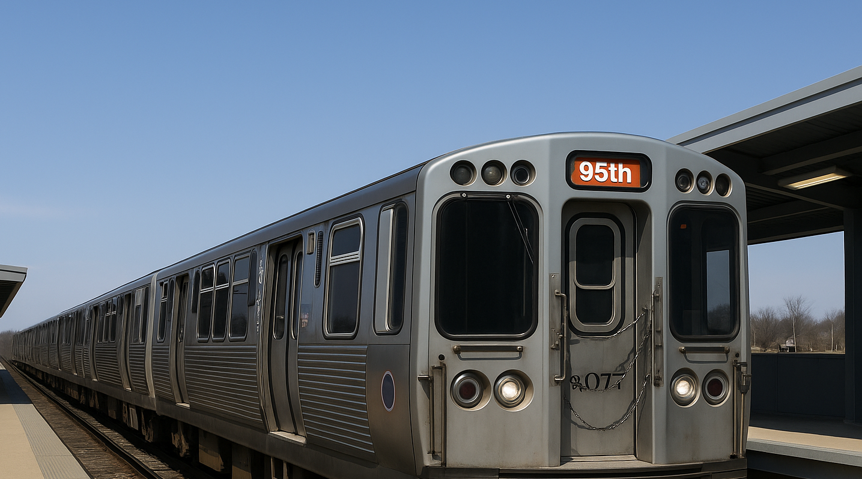
Elevating CTA Ridership:
A Safer Travel Option for UChicago Students
Transit Hacks 2025 Submission | April 26, 2025
Apoorva Gupta, Peyton Nash, Kyler Rosen, & Bradley Stoller
Notes:
Insert any pre-title text in the text box at the top (ie. “Presented by…”)
Insert the presentation title in the second text box with the largest text
Insert the speaker’s name and/or the month, day and year of the presentation.
Delete any text boxes you didn’t use.
You are welcome to use the image that is already included. For instructions on how to change the image, view slide 6. In order to keep the transparent look, change the picture’s transparency to 75% in the ”Picture format” pane that should pop up on the right side of the screen.

Slide 2




Our team brings diverse perspectives and a shared passion for Chicago transit!
Kyler Rosen
Bradley Stoller
Apoorva Gupta
Peyton Nash
Undergrad: Case Western University
Favorite CTA Line:
Brown Line
Undergrad: Cornell University
Favorite CTA Line:
Green Line
Undergrad: Purdue University
Favorite CTA Line:
Brown Line
Undergrad: Bard College
Favorite CTA Line:
Blue Line

Slide 3



UChicago students rely on the CTA, creating a need for safer, smarter transit options.
Digital Engagement By The Numbers:
140k+
70%
24/7
25%+
Daily CTA Red Line Riders
Proportion of Students Off-Campus
CTA Red Line Service Hours
Students Nationally Feel Unsafe at Night
Opportunity Areas:
Transit Matching
Exclusive UChicago Verification
Interest-Based Matching

Slide 4
Maroon Line offers a safer transit experience for UChicago students traveling alone.
Problem:
Problem:
Many UChicago students commute alone on the CTA. At later hours and on certain CTA lines, this presents a significant safety risk to all riders traveling alone.
However, current transit apps focus only on schedules, not rider safety.
Goal:
Goal:
We aim to build a secure platform that matches UChicago students traveling alone based on shared routes and social interests. By matching students along their travel journey, Maroon Line enhances safety, social connection, and the overall commuting experience for students.

Slide 5




We enable safer, shared rides by matching verified riders based on interests and routes.
Profile Creation
Student verifies UChicago email and creates profile
Smart Matching
We match similar students traveling on similar routes
Ride Together
Students ride together for safer (and more fun) trips

Slide 6





Our POC’s core features demonstrate security, smart matching, and ease of use.
Email Verification
Secure uchicago.edu verification using one-time tokens
Topic- Based Interest Matching
Students match based on shared hobbies and interests
Route Scheduling via Red Line Stations (CTA API)
Routes are scheduled using the CTA API for origin/destination pairings
Profile Creation & Storage
Interests and travel pattens are stored securely for matching
Route Matching Algorithm
Interests and routes are matched enabling fast and simple rideshares

Slide 7



A SQL database sends and receives information from the user interface, CTA API and matching algorithm
USER INTERFACE
CTA API
MATCHING ALGORITHM
DATABASE

Slide 8
Add transit options – Other train lines, Metra, UChicago transit
Alerting users about changes to the train schedule
Tools to identify to and confirm the identify of your match
Integrating games and news APIs to play or discuss on the ride
Photo verification

