Slide 1

Semantic Video Timestamp Retrieval Using Whisper, Sentence-BERT, FAISS and Clustering
Course: Natural Language Processing
Students: Apoorva Karnwal (22BCE0756),
Faculty: Prof. Arivoli A
Programme: B.Tech. in Computer Science & Engineering
Date: November 2025

Slide 2
Motivation & Problem Statement
Why this problem?
Long videos (lectures, podcasts) make topic search tedious.
Keyword search fails due to lack of semantic understanding.
Goal: Find exact timestamps in a video where a queried topic is discussed.
Motivation: To enable users to search videos by meaning, not just by words - and instantly jump to the relevant timestamp.

Slide 3
Research Objectives
Develop a semantic video retrieval system capable of mapping natural-language queries to video timestamps.
Combine speech recognition (Whisper), semantic embeddings (SBERT), and vector search (FAISS).
Compare two retrieval strategies:
Flat Index: exhaustive search for high accuracy
Clustered Index (KMeans): approximate search for high speed
Evaluate performance using Precision@k, Recall@k, and MRR.

Slide 4
System Architecture
The system consists of four interconnected modules forming an end-to-end pipeline:
Video Transcription (Whisper)
Text Segmentation & Preprocessing
Embedding Generation (SBERT)
Vector Indexing & Retrieval (FAISS + Clustering)

Slide 5
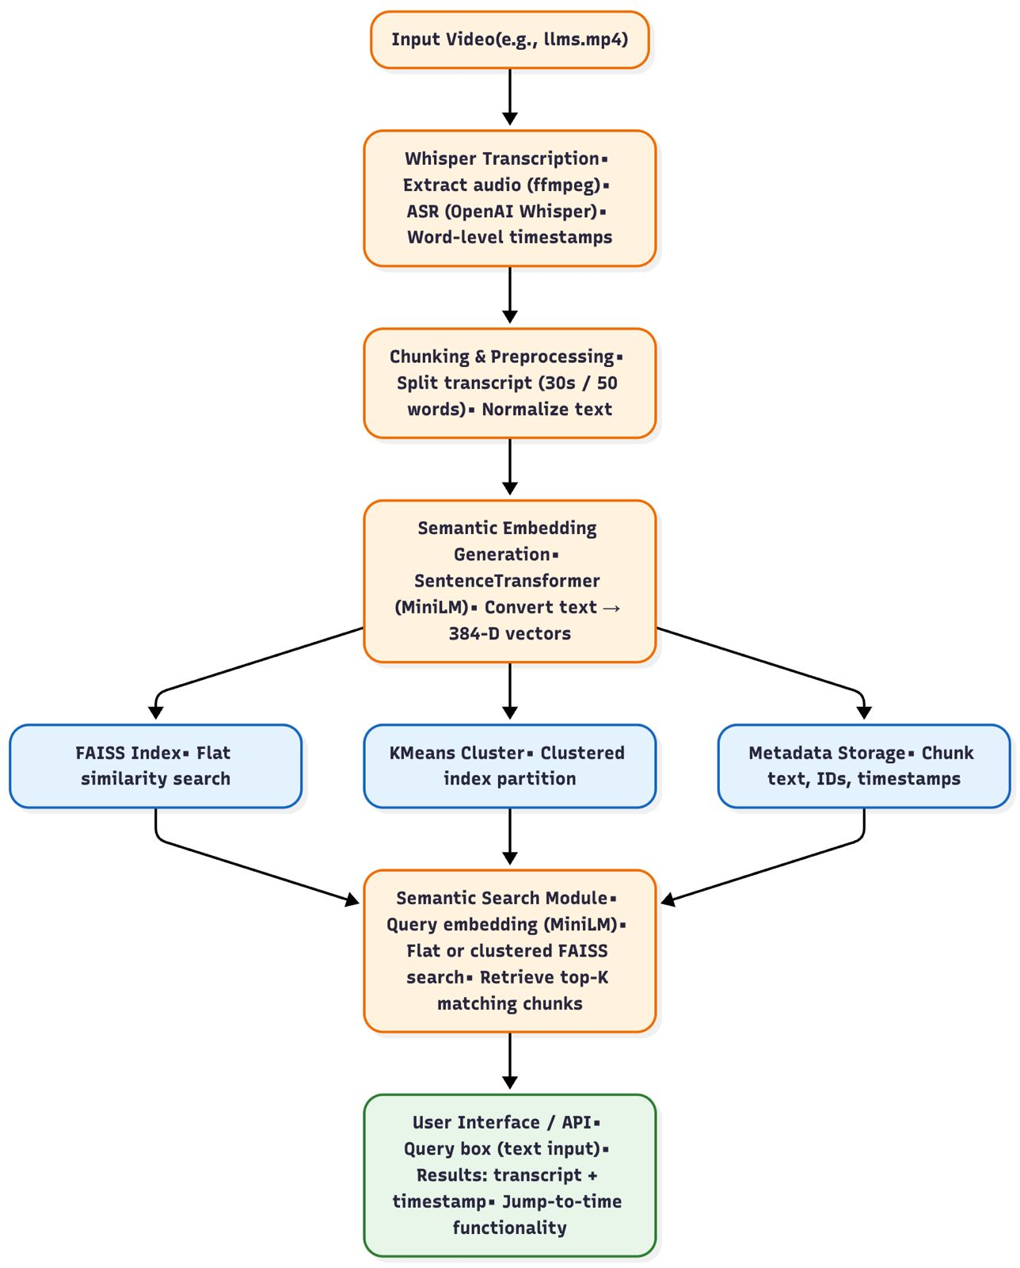

Slide 6
Video Transcription with Whisper
Model: OpenAI’s Whisper Base
Capabilities:
Multilingual and noise-resilient speech recognition
Outputs text with precise start–end timestamps
Outcome: Raw speech is transformed into accurate, time-aligned transcripts. Example:
“Solar panels convert sunlight into electricity.” → [00:01:45 – 00:01:58]

Slide 7
Semantic Embedding Generation
Model: Sentence-BERT (all-MiniLM-L6-v2)
Converts text segments (≈20–30 words each) into 384-dimensional semantic embeddings.
Embeddings represent meaning rather than literal words.
Example: “Machine learning algorithms” and “AI models” → similar embeddings in vector space.

Slide 8
Semantic Retrieval using FAISS
FAISS (Facebook AI Similarity Search) allows efficient retrieval among millions of embeddings.
Two indexing strategies:
Index Type | Search Mechanism | Accuracy | Speed
Flat Index | Performs exhaustive similarity search across all embeddings | High | Slower
Clustered Index (KMeans) | Uses approximate nearest neighbor search by grouping embeddings into clusters | Moderate | Fast

Slide 9
Conclusion
Conclusion:
The system successfully retrieves video timestamps semantically aligned with user queries.
Combines Whisper, SBERT, and FAISS into a unified, efficient pipeline.
Demonstrates strong performance with tunable trade-offs between accuracy and efficiency.

