Slide 1
Navigating Road Safety: Insights & Predictions on US Accidents (2016-2023)
Introduction to Data Science (DATS6101)
Guided By: Prof. Darcy Morris
Team Members:
Khush Shah
Devarsh Sheth
Apoorva Reddy
Bhoomika Nanjaraja

Slide 2
Content to Cover:
Introduction
Overview-
Smart Questions
About the Dataset
EDA
Hypothesis testing
Future Scope
Conclusion
References

Slide 3
Introduction
Brief context on road accidents in the US- Over 6 million passenger car accidents occur annually in the USA.
Importance of studying road accident data.- It helps analyze the factors involved in accidents and what can be done to reduce the casualty.
Overview of the project's objectives.- Focus on analyzing the impact of environmental and man-made parameters on the accident.

Slide 4
Overview
SMART Questions
Is there a statistically significant difference in the average number of accidents across different months of the year?
Is the occurrence of accidents statistically more frequent on weekdays compared to weekends?
Does the time of day (morning, afternoon, evening, night) have a measurable and statistically significant effect on the occurrence of fatal accidents within a specified geographic area over a defined time period?
Identifying the States or Regions with Consistently High Accident Rates in the U.S. and Exploring Geographic Patterns and Trends
What is the influence of different weather conditions, such as rain, snow, or fog, on the occurrence and severity of accidents, and are there associations between particular types of accidents and specific weather conditions?

Slide 5
Overview
b. Dataset Overview
This is a countrywide car accident dataset that covers 49 states of the USA.
This dataset was collected in real-time using multiple Traffic APIs.
The source dataset contains 46 attributes.
There are over 7.7 million instances recorded over numerous locations in USA.
It records multiple features like the location of the accident, the severity, presence of amenity in the proximity etc.
For the future scope of the project, additional features like response time of paramedics in the cities, severity proportion have been incorporated for the prediction of new location of the paramedic services.

Slide 6
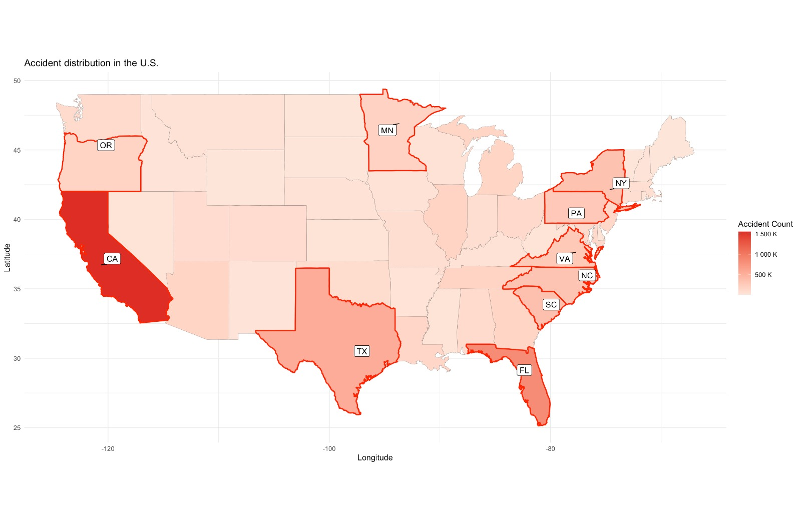
EDA
Accident
Count over
the US.

Slide 7
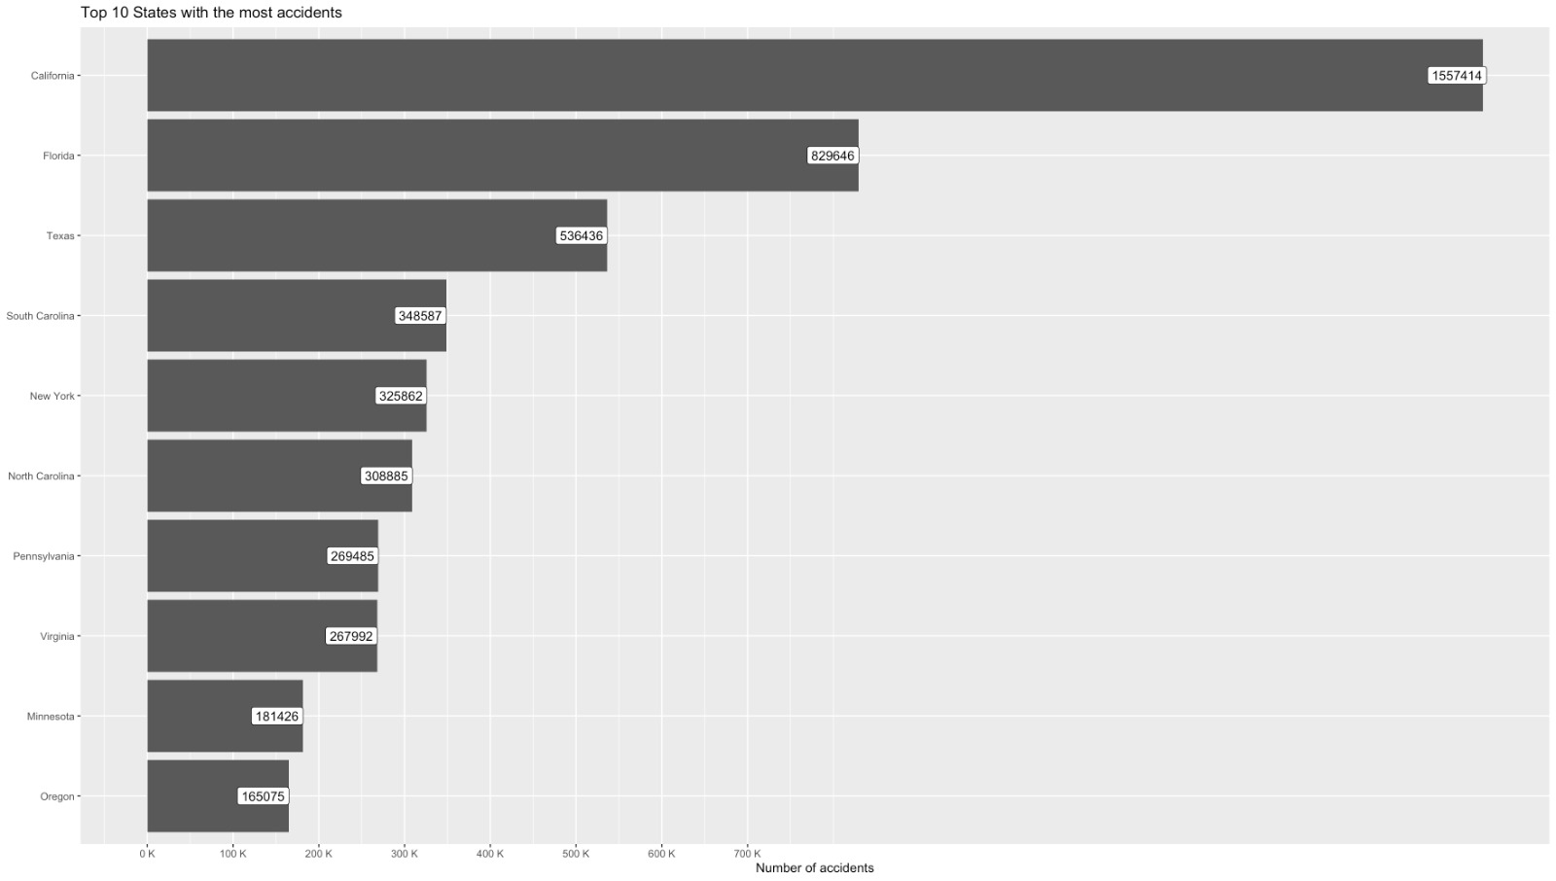
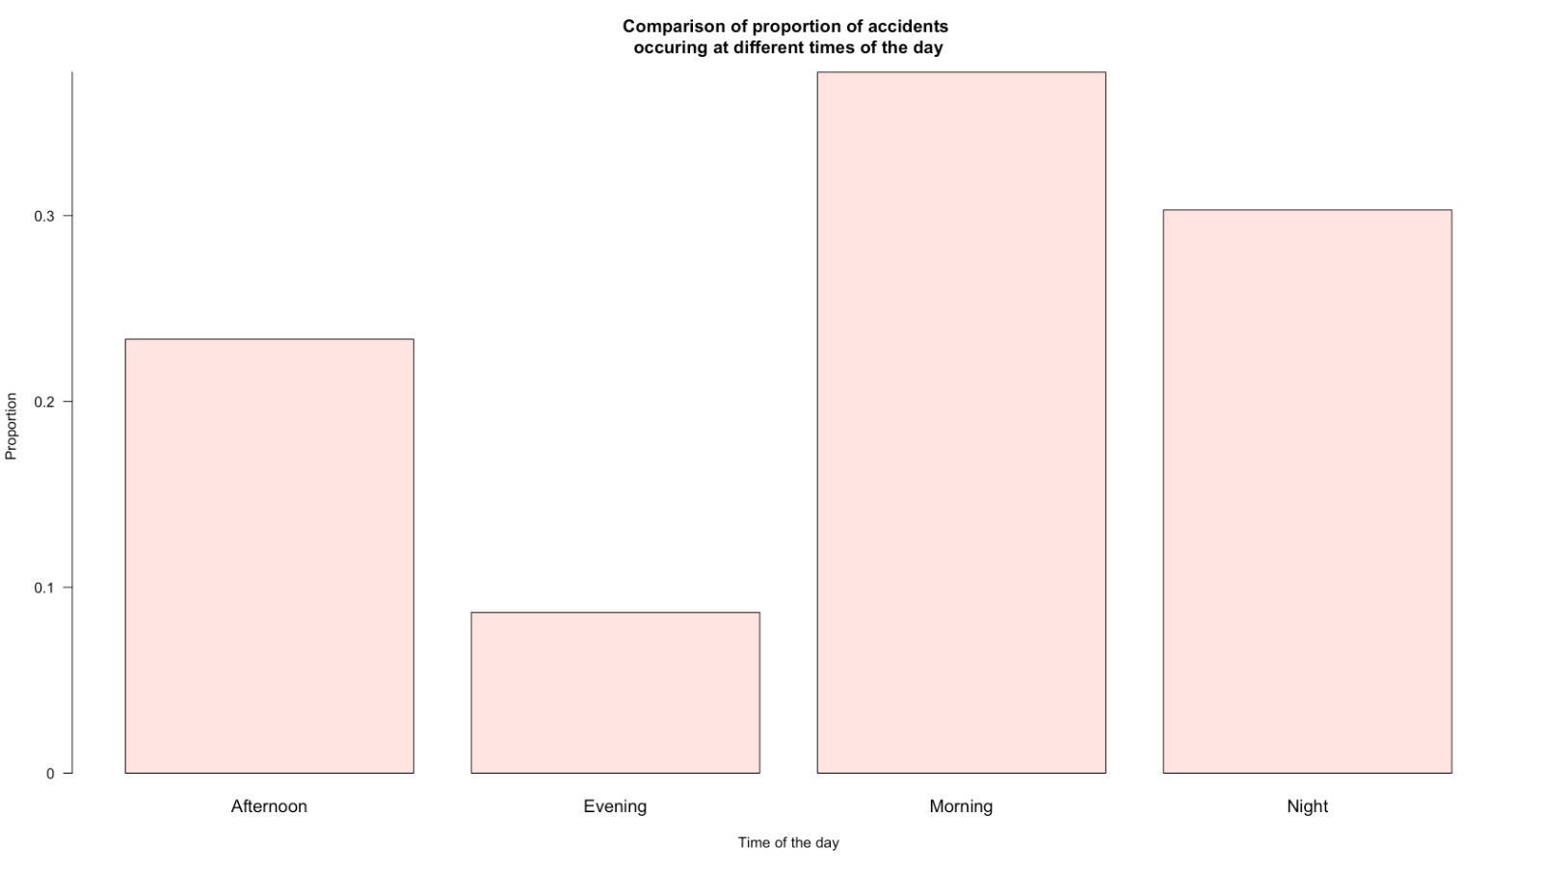
EDA
Top 10 States with Most Accidents: Accidents by Time of Day:

Slide 8
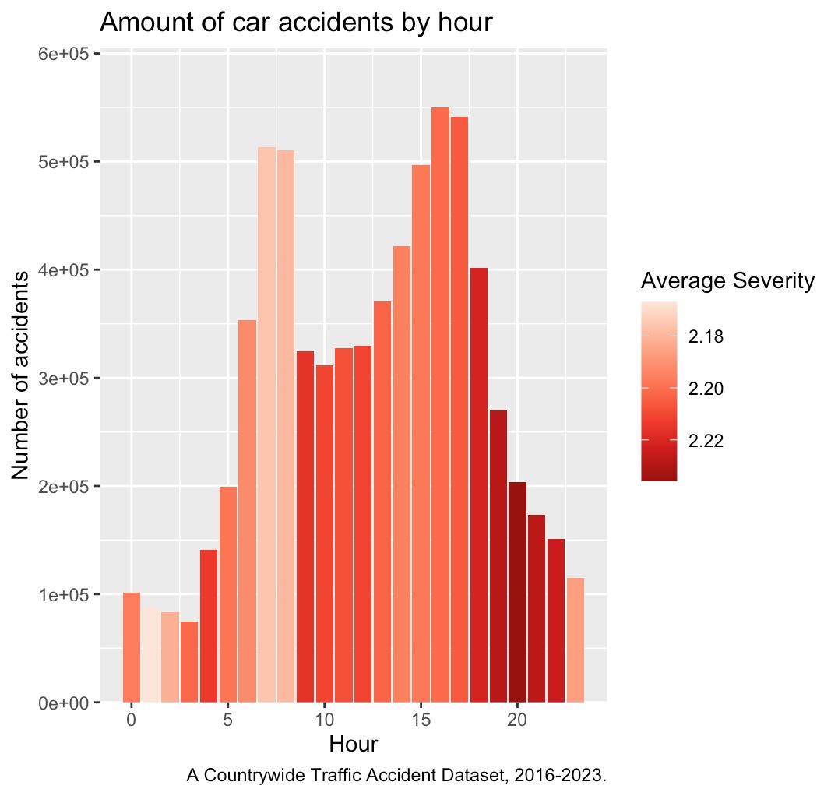
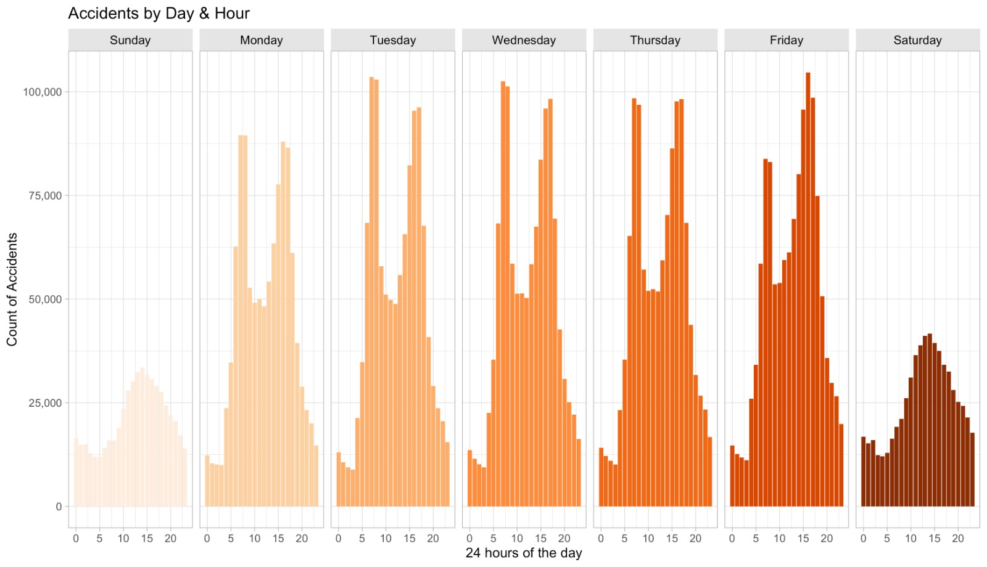
EDA
Car Accidents by Hour: Accidents by Day and Hour:

Slide 9
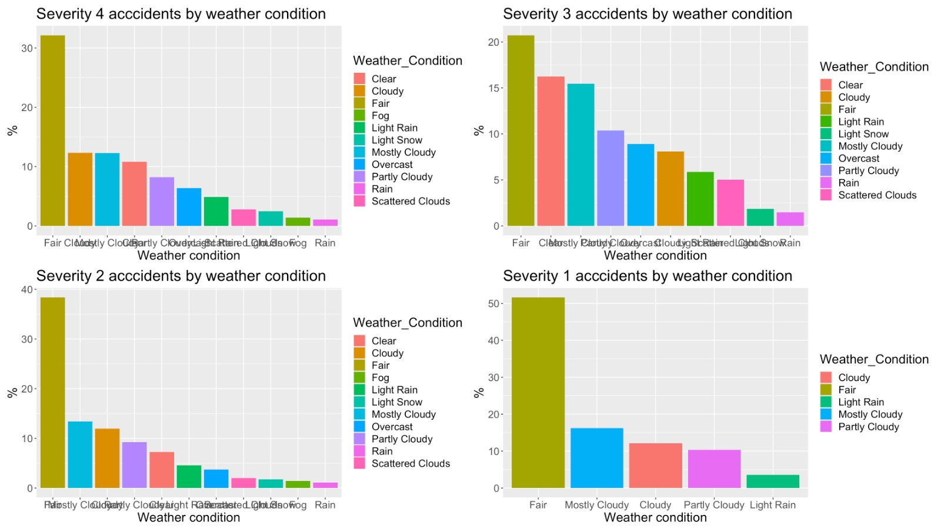
EDA
Severity of accidents mapped with the weather condition

Slide 10
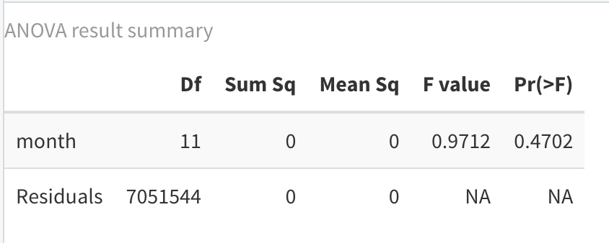
Hypothesis Testing
Is there a statistically significant difference in the average number of accidents across different months of the year?
Null Hypothesis (H0): The average number of accidents is the same for all months.
Alternative Hypothesis (H1): The average number of accidents varies by month.

Slide 11
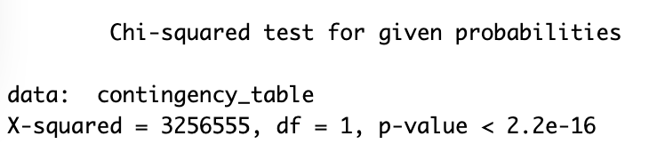
Hypothesis Testing
Is the occurrence of accidents statistically more frequent on weekdays compared to weekends?
Null Hypothesis (H0): The probability of an accident on weekends is the same as on weekdays.
Alternative Hypothesis (H1): The probability of an accident on weekdays is greater than on weekends.

Slide 12
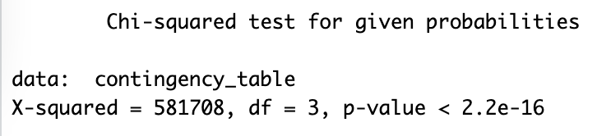
Hypothesis Testing
Does the time of day (morning, afternoon, evening, night) have a measurable and statistically significant effect on the occurrence of fatal accidents within a specified geographic area over a defined time period?
Null Hypothesis (H0): The time of day does not affect the occurrence of fatal accidents.
Alternative Hypothesis (H1): The time of day affects the occurrence of fatal accidents.

Slide 13
Future Scope
Smart Question:
Where can the new paramedical setup be developed for the quicker response time?
Target feature:
Amenity.
Predict the location for the setup of the new paramedical service.

Slide 14
Conclusion
The severity of the accident is not correlated with the environmental or man-made factors.
The average number of accidents occurring each month is similar.
The occurrence of accident is higher during office and school hours.
Almost no amenity presence found near accident sites.

Slide 15
References
Road accident dataset
Hypothesis testing
ANOVA test
Diez et al.(2015), OpenIntro to Statistics

Slide 16
Navigating Road Safety: Insights & Predictions on US Accidents (2016-2023)
THANK YOU

